Slide 1
Strangeness and ∆ resonance in compact stars with relativistic-mean-field models
arXiv: 1808.02207
Xia, Cheng-Jun (夏铖君)
Ningbo Institute of Technology,
Zhejiang University
Collaborators:
Ting-Ting Sun, Shi-Sheng Zhang, Qiu-Lan Zhang
Tsukuba-CCS workshop
Dec. 12, 2018

Slide 2
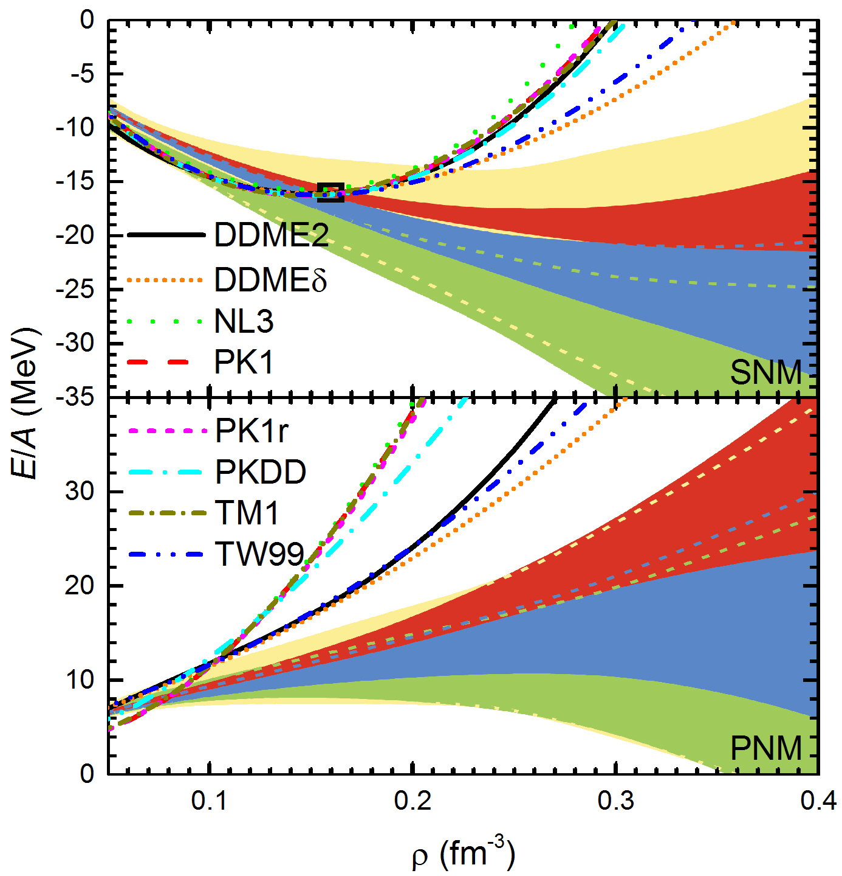
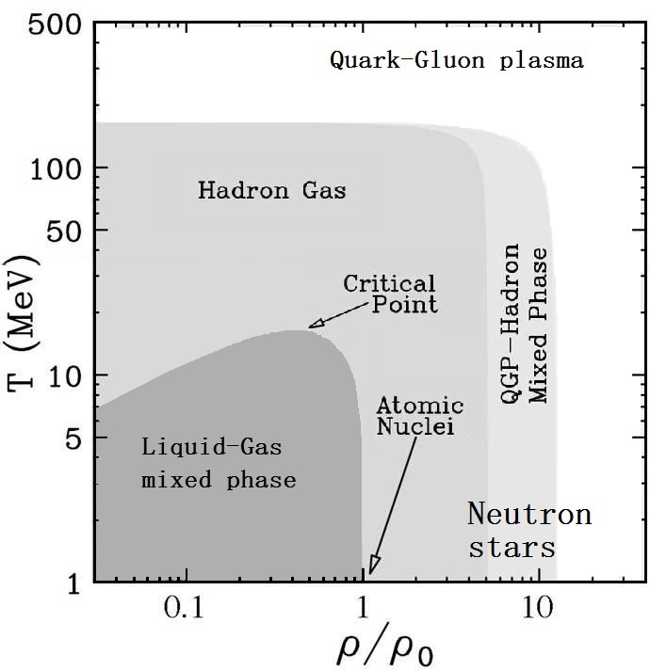
Nuclear matter phase diagram
Hu_Zhang_Epelbaum_Meissner_Meng2017_PRC96-034307

Slide 3
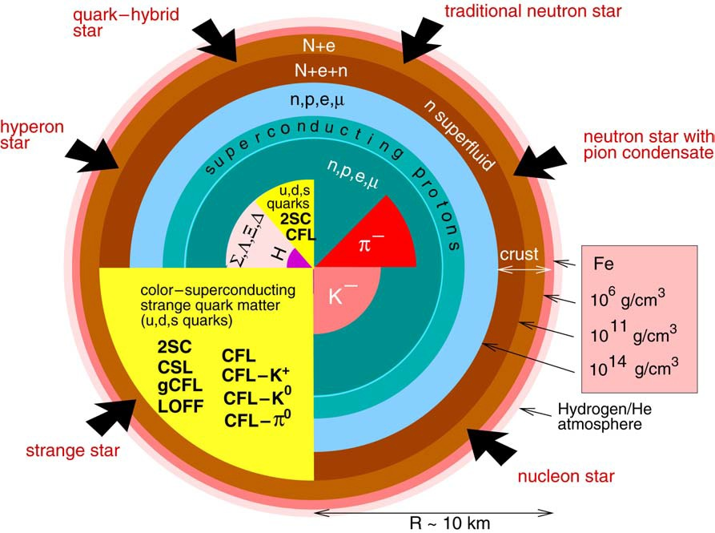
Compact star structures [Weber2005_PPNP54-193]

Slide 4


Experimental constraint: Pulsars
Observables:
barycentric period P and its time derivative:
spin-down driven by magnetic dipole radiation → surface magnetic field [Manchester_Hobbs_Teoh_Hobbs2005_AstronJ129-1993, …]
the cyclotron resonance features in the X-Ray spectrum of pulsars → surface magnetic field [Revnivtsev_Mereghetti2014_SpaceSciRev014-1]
photon spectrum of pulsars → surface temperature [Page2006_NPA777-497, Ho_Heinke 2009_Nature462-71] , mass-radius probability [Steiner_Lattimer _Brown2010_ApJ722-33, Guillot_Servillat _Webb_Rutledge2013_ApJ772-7, Ozel_Freire2016_AnnuRevAstro54-401…]
orbital motion of a binary system → precise mass measurement [Demorest et al.2010_Nature467-1081, Antoniadis et al.2013_Science340-6131, Linares et al.2018_ ApJ859-54…]
gravitational waves emitted from the merger of binary compact stars → Tidal deformability [LIGO_Virgo2017_PRL119-161101: GW170817, ...]

Slide 5
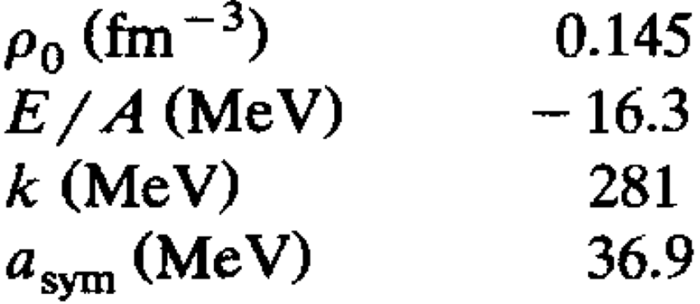
Baryonic matter
Shen EoS2&3: RMF model with the effective interaction TM1 and Λ-meson coupling determined by [Shen_Toki_Oyamatsu_Sumiyoshi2011_ApJ197-20]:
Sugahara_Toki1994_NPA579-557
1. the saturation density:
2. the energy:
3. the incompressibility:
4. the symmetry energy:
0.145
-16.3
281
36.9
VM EoS: Cluster variational method with the potential AV18 + UIX [Togashi_Hiyama_Yamamoto_Takano2016_PRC93-035808, Togashi_ Nakazato_Takehara_Yamamuro_Suzuki_Takano2017_NPA961-78]:
1. the saturation density:
2. the energy:
3. the incompressibility:
4. the symmetry energy:
0.160
-16.1
245
30.0

Slide 6
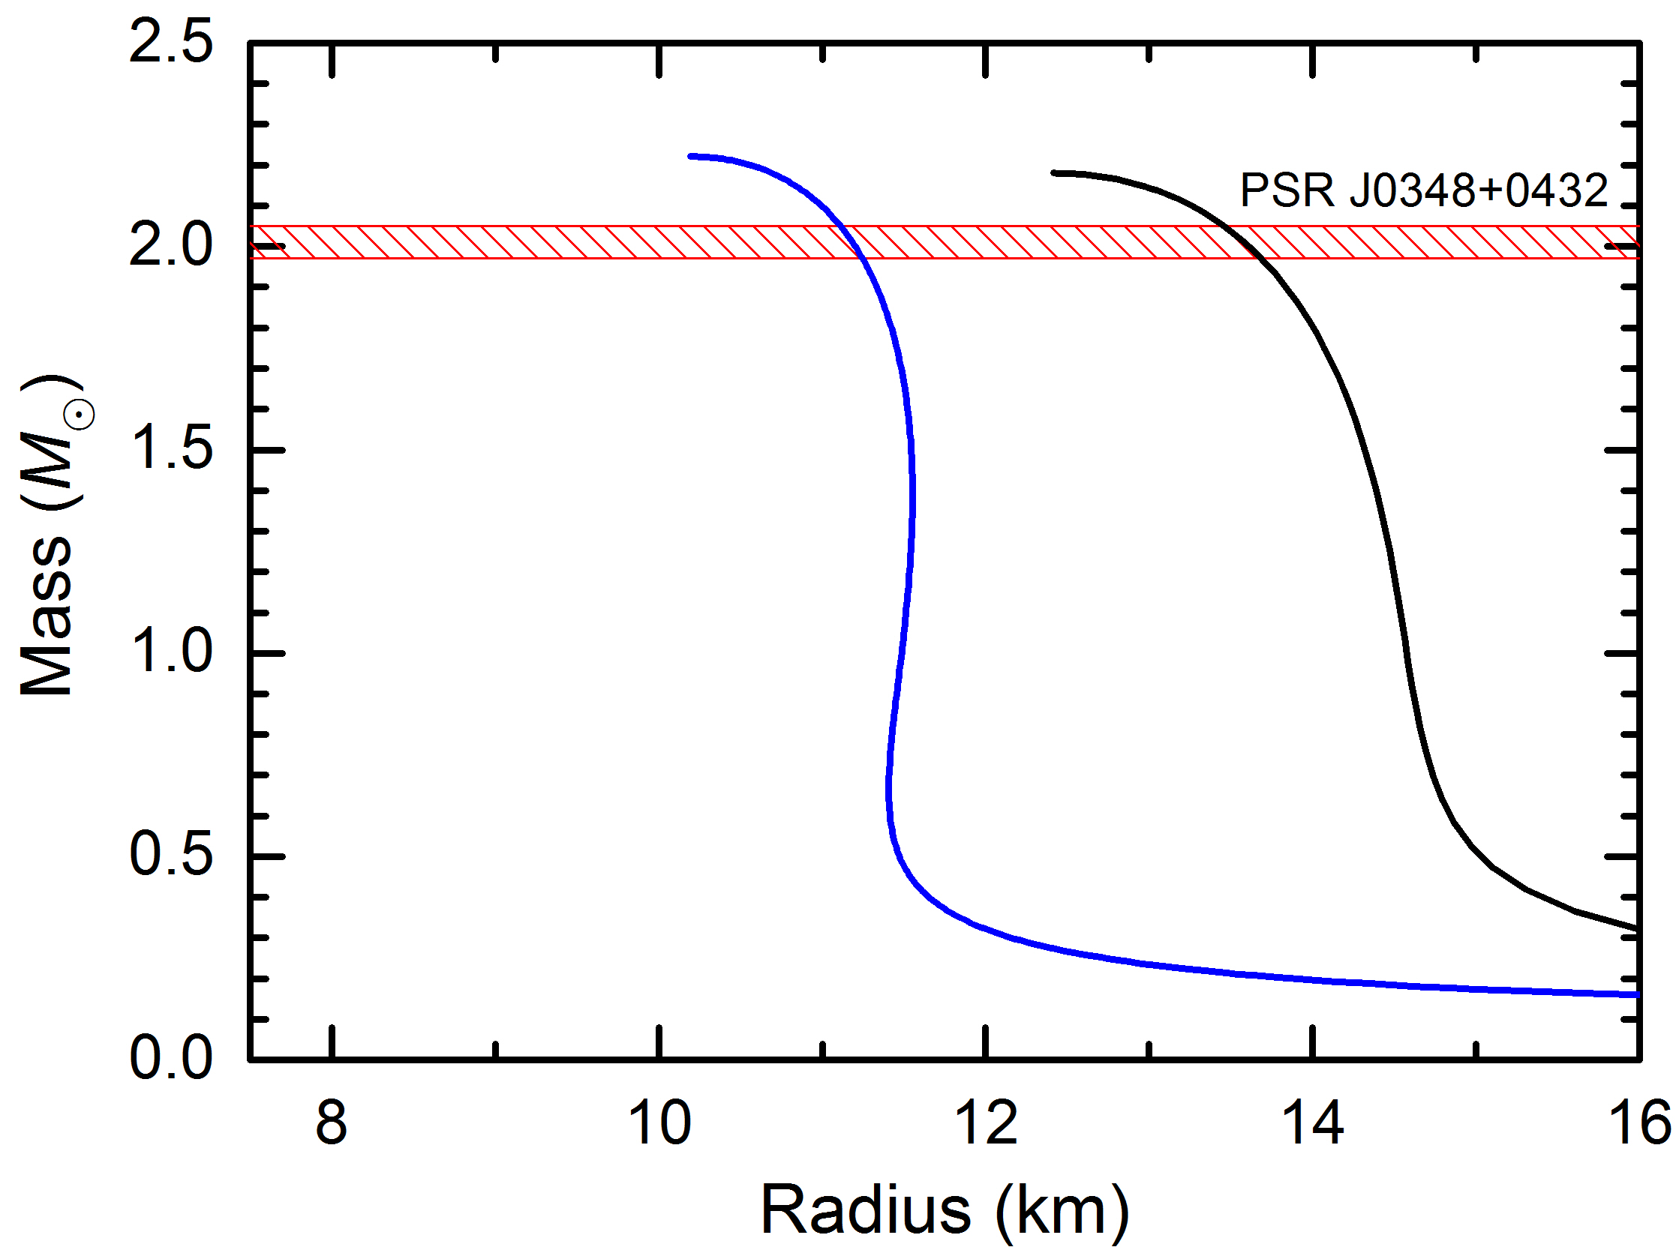
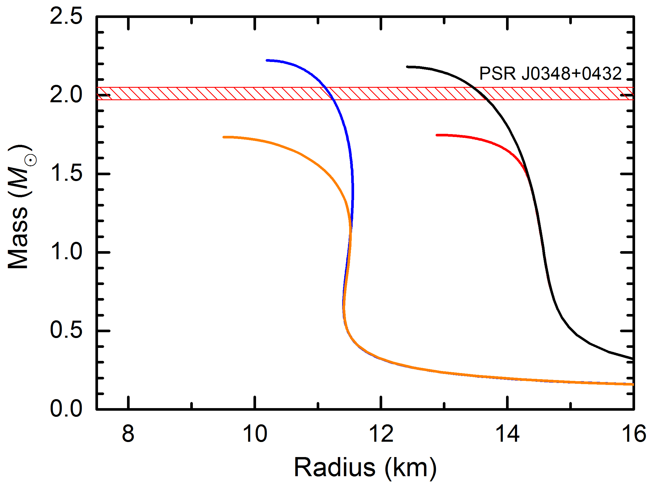
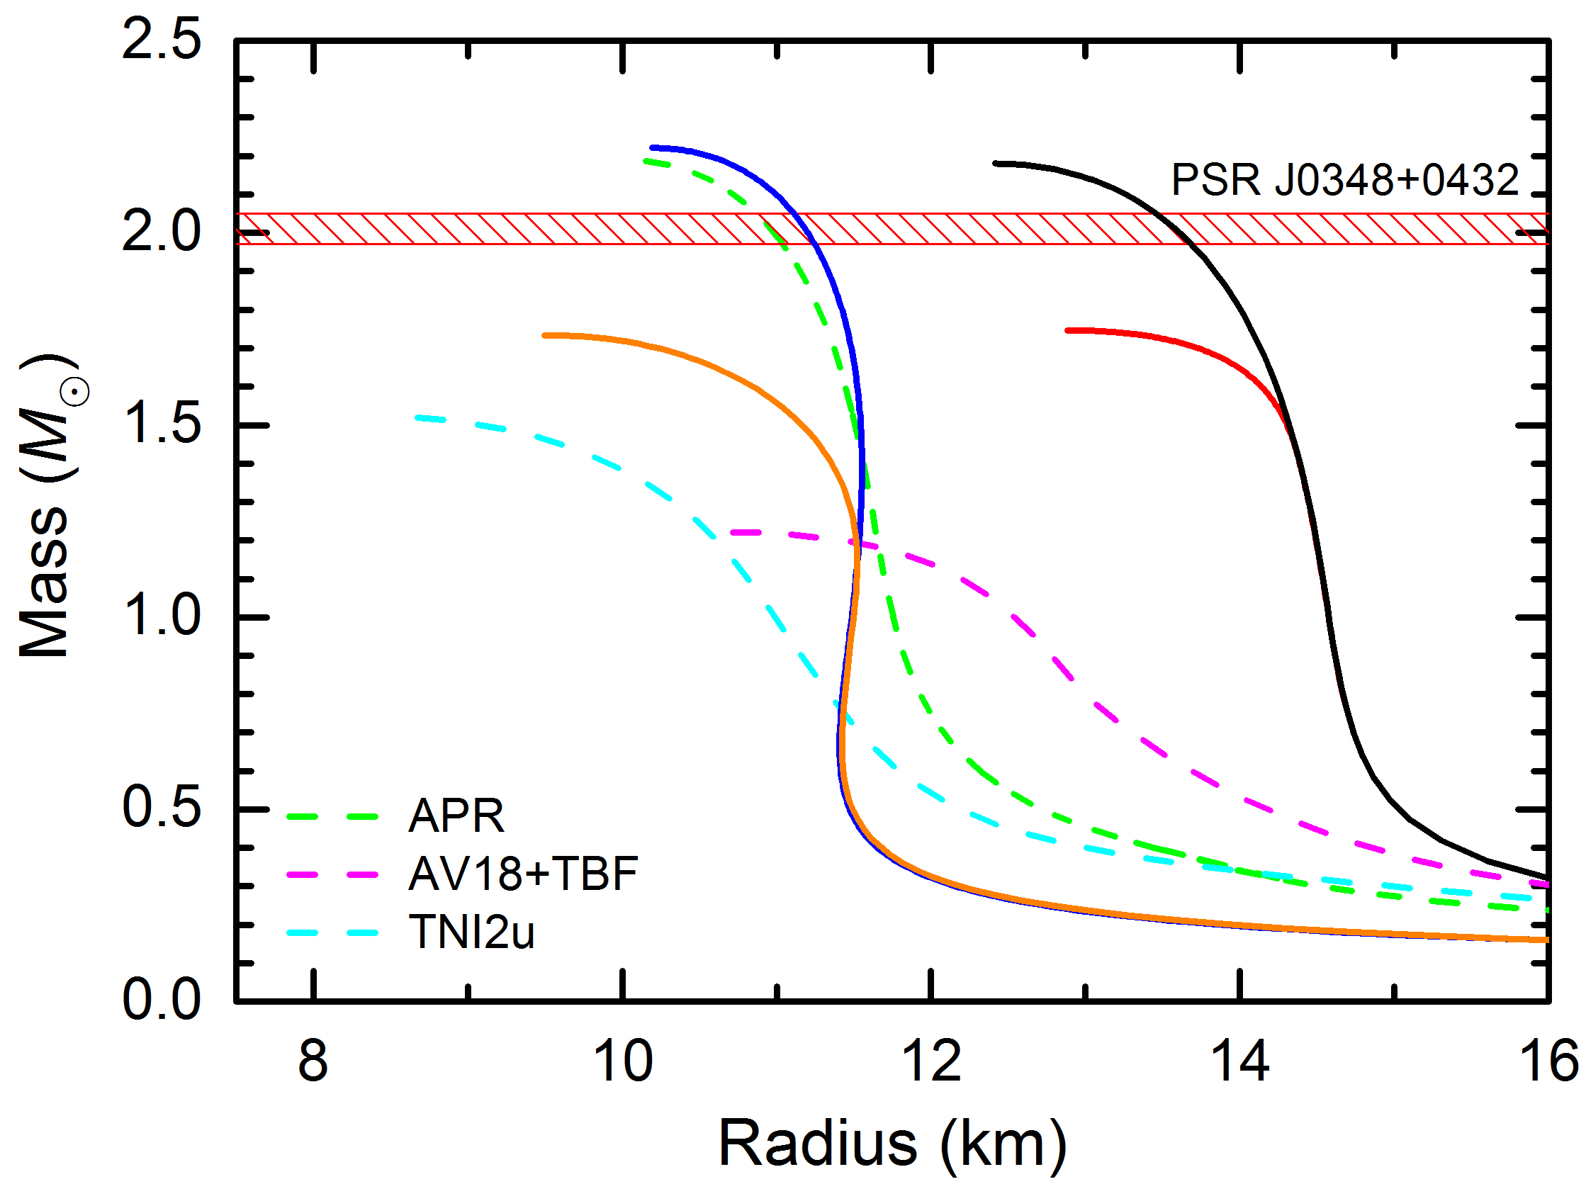
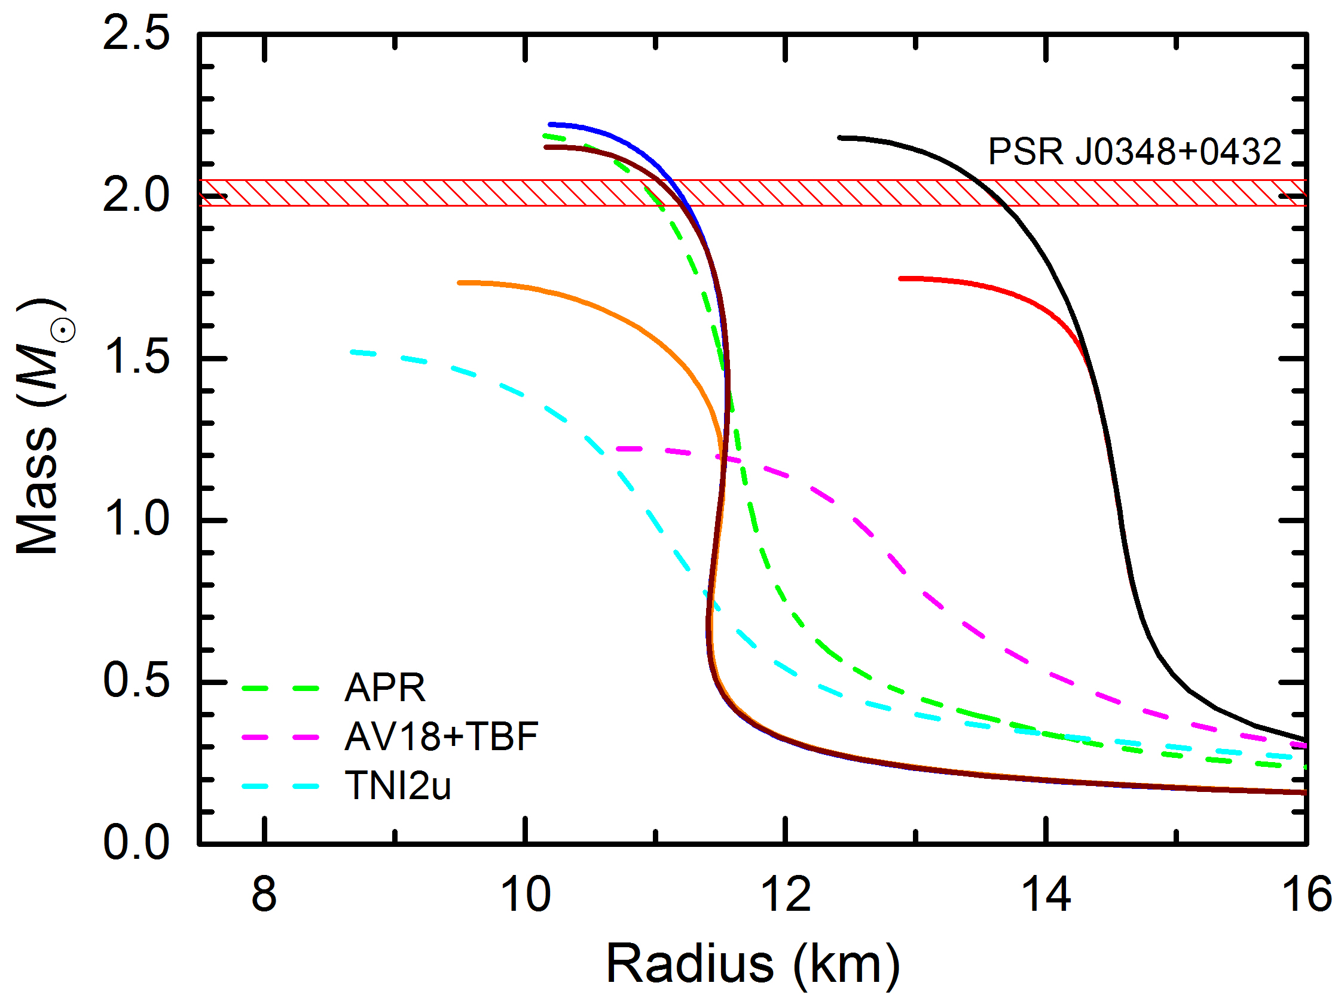
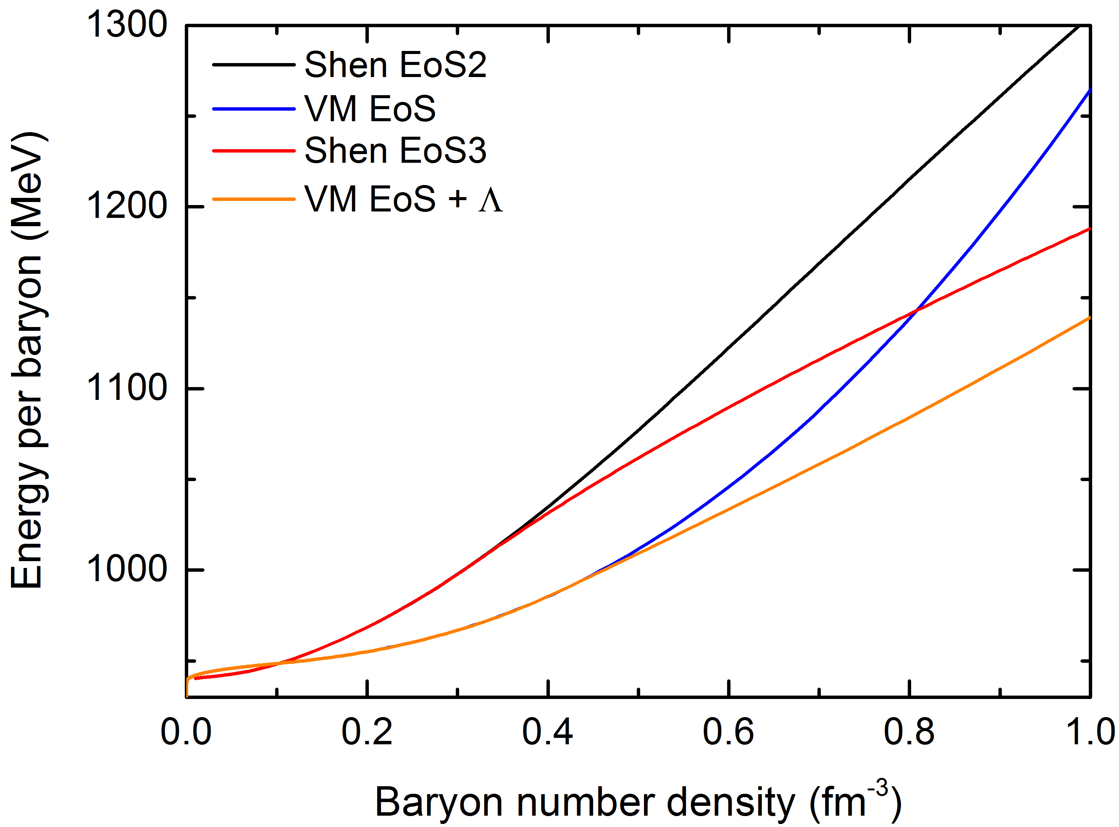
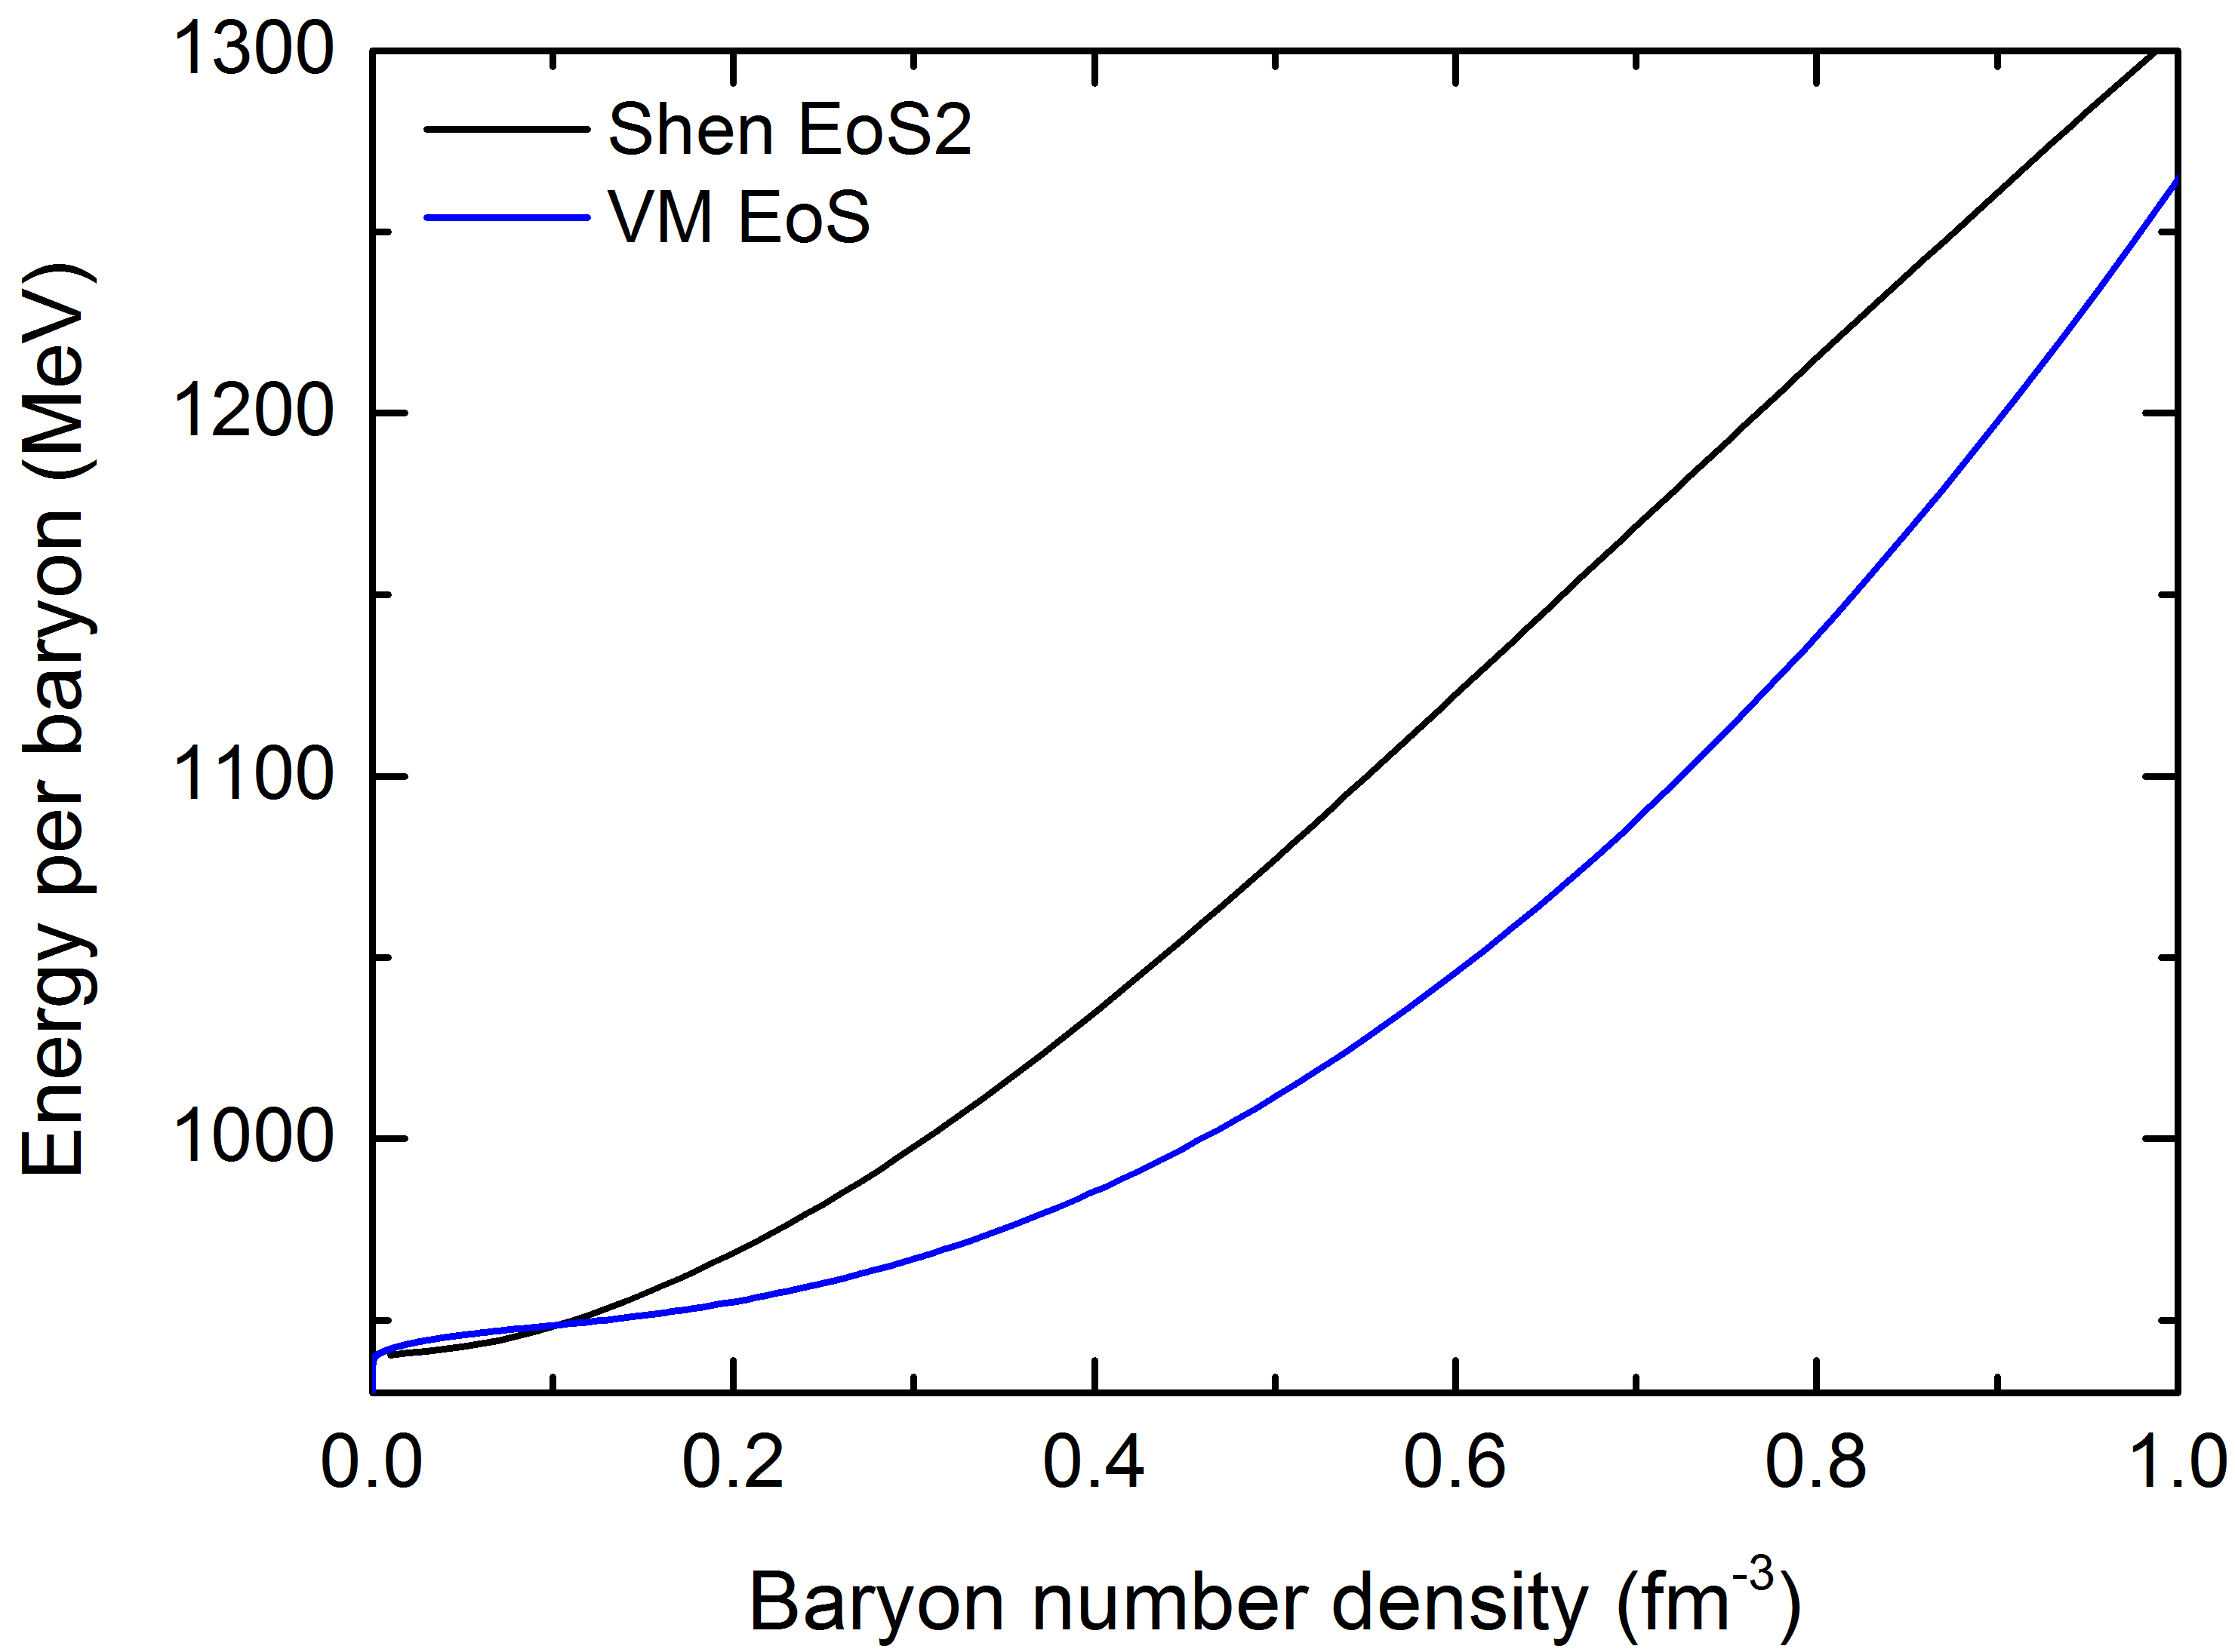
Hyperon puzzle
TOV equations:
TBF: YNN,YYN, and YYY
Dashed curves: The EoSs of nuclear matter are obtained based on the non-relativistic G-matrix approach.
APR: without hyperons [Akmal_Pandharipande_Ravenhall1998_PRC58-1804];
AV18+TBF: obtained with the realistic nucleon-nucleon interaction AV18, the Urbana three nucleon interaction and the Nijmegen softcore nucleon-hyperon potential [Baldo_Burgio_Schulze2000_PRC61-055801];
TNI2u: considering three hyperon interaction [Takatsuka_Nishizaki_Yamamoto_Tamagaki2006_PTP115-355];

Slide 7
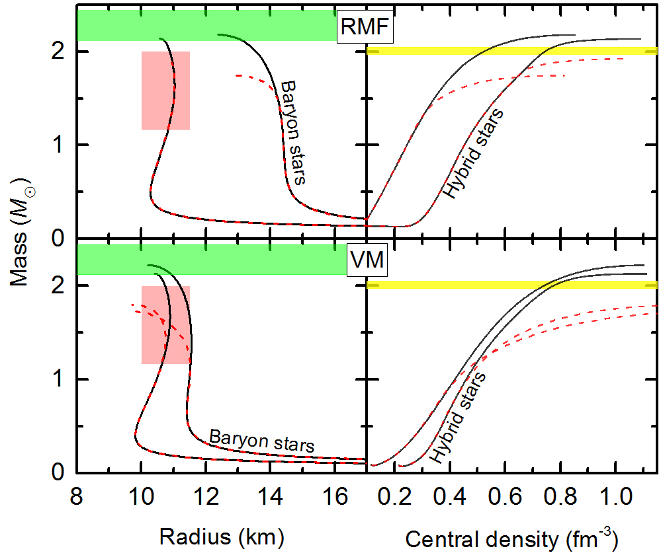
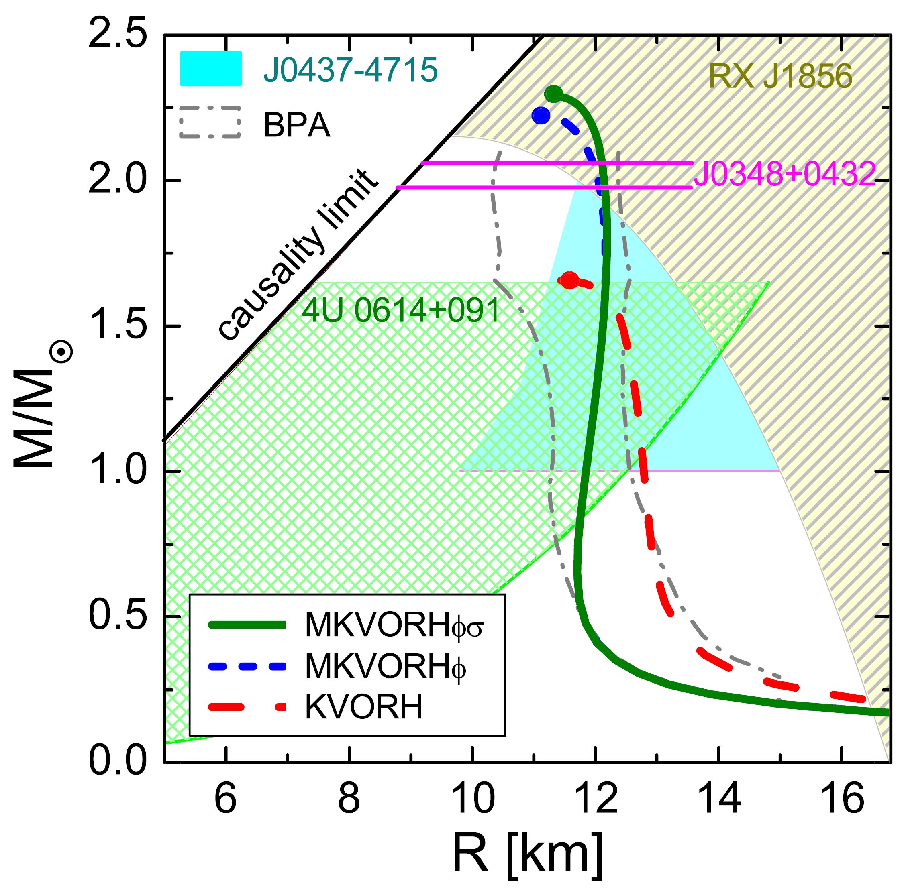
Hyperon puzzle (possible solutions)
Solutions:
Deconfinement phase transition prior to hyperons
Maslov_Kolomeitsev_Voskresensky2015_PLB748-369

Slide 8
Hyperon puzzle (our solution)
TM1:
0.145
-16.3
281
36.9
Sugahara_Toki1994_NPA579-557
PK1:
0.148
-16.3
283
37.6
Long_Meng_Giai_Zhou2004_
PRC69-034319
We vary the vector coupling constant
2/3 to 1.

Slide 9
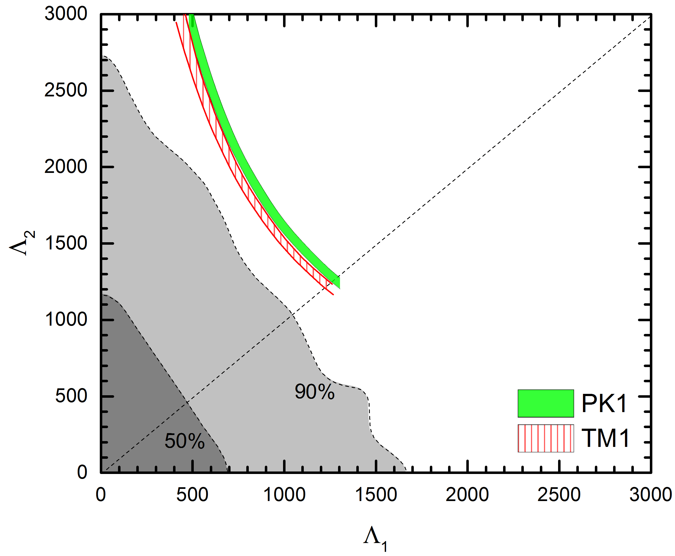
Tidal deformability
LIGO_Virgo2017_PRL119-161101
Chirp mass (GW170817):
Low-spin priors
Tidal deformability:

Slide 10
Strangeness and ∆ resonance in compact stars
Liu_Xia_Lu_Li_Hu_Sun2018_PRC98-024316
PKDD:
0.150
-16.3
262
36.8
Long_Meng_Giai_Zhou2004_
PRC69-034319
Breit-Wigner mass distribution
(π−, K+) reactions on medium-to-heavy nuclei [Noumi et al.2003_PRL90-049902, ...]
a ⁴_{Σ}He bound state in the (K−,π−) reaction [Nagae et al.1998_PRL80-1605]
Data analyses of photoabsorption, electron-nucleus, and pion-nucleus scattering [Drago et al.2014_PRC90-065809]
−30 MeV + V_{N} ≤ V_{Δ} ≤ V_{N}
V_{Δ} = V_{N}

Slide 11
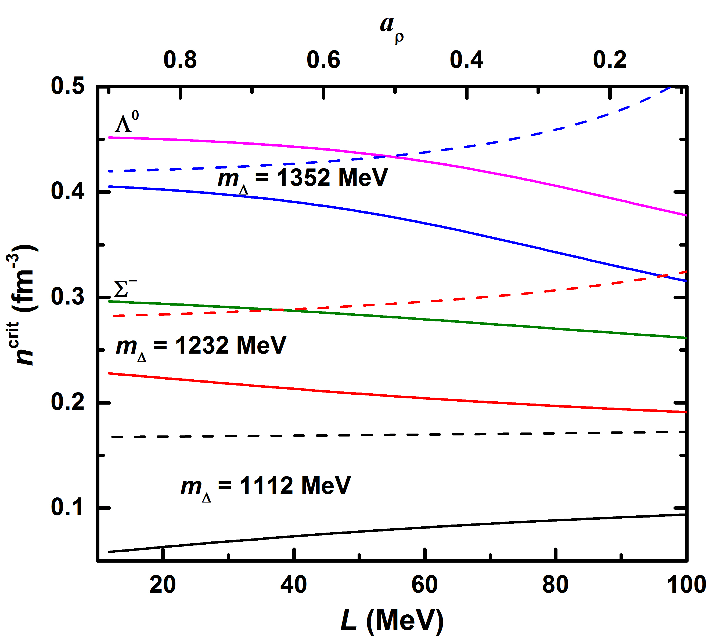
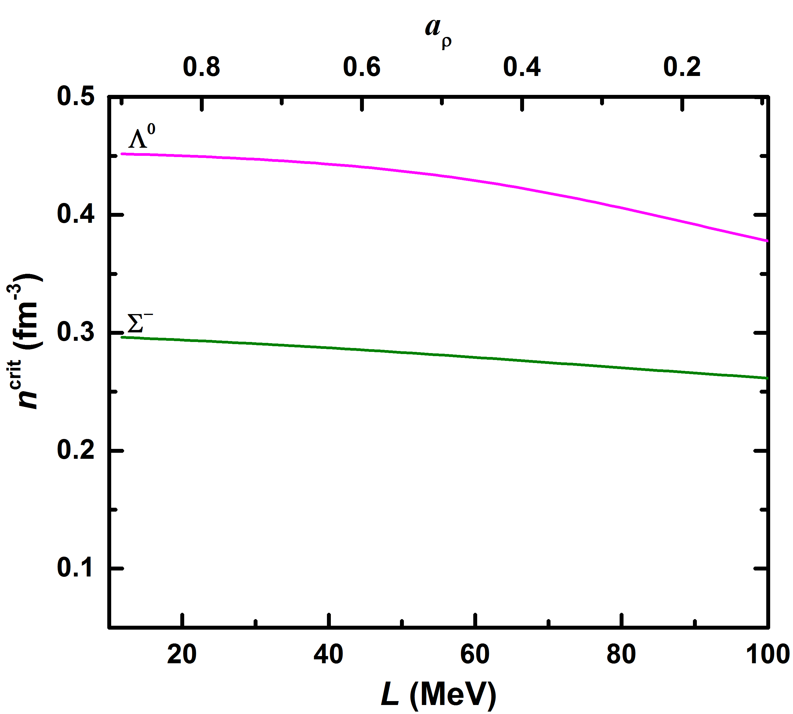
Onset densities
dashed g_{ρb} = g_{ρN}
solid g_{ρb} = 0

Slide 12
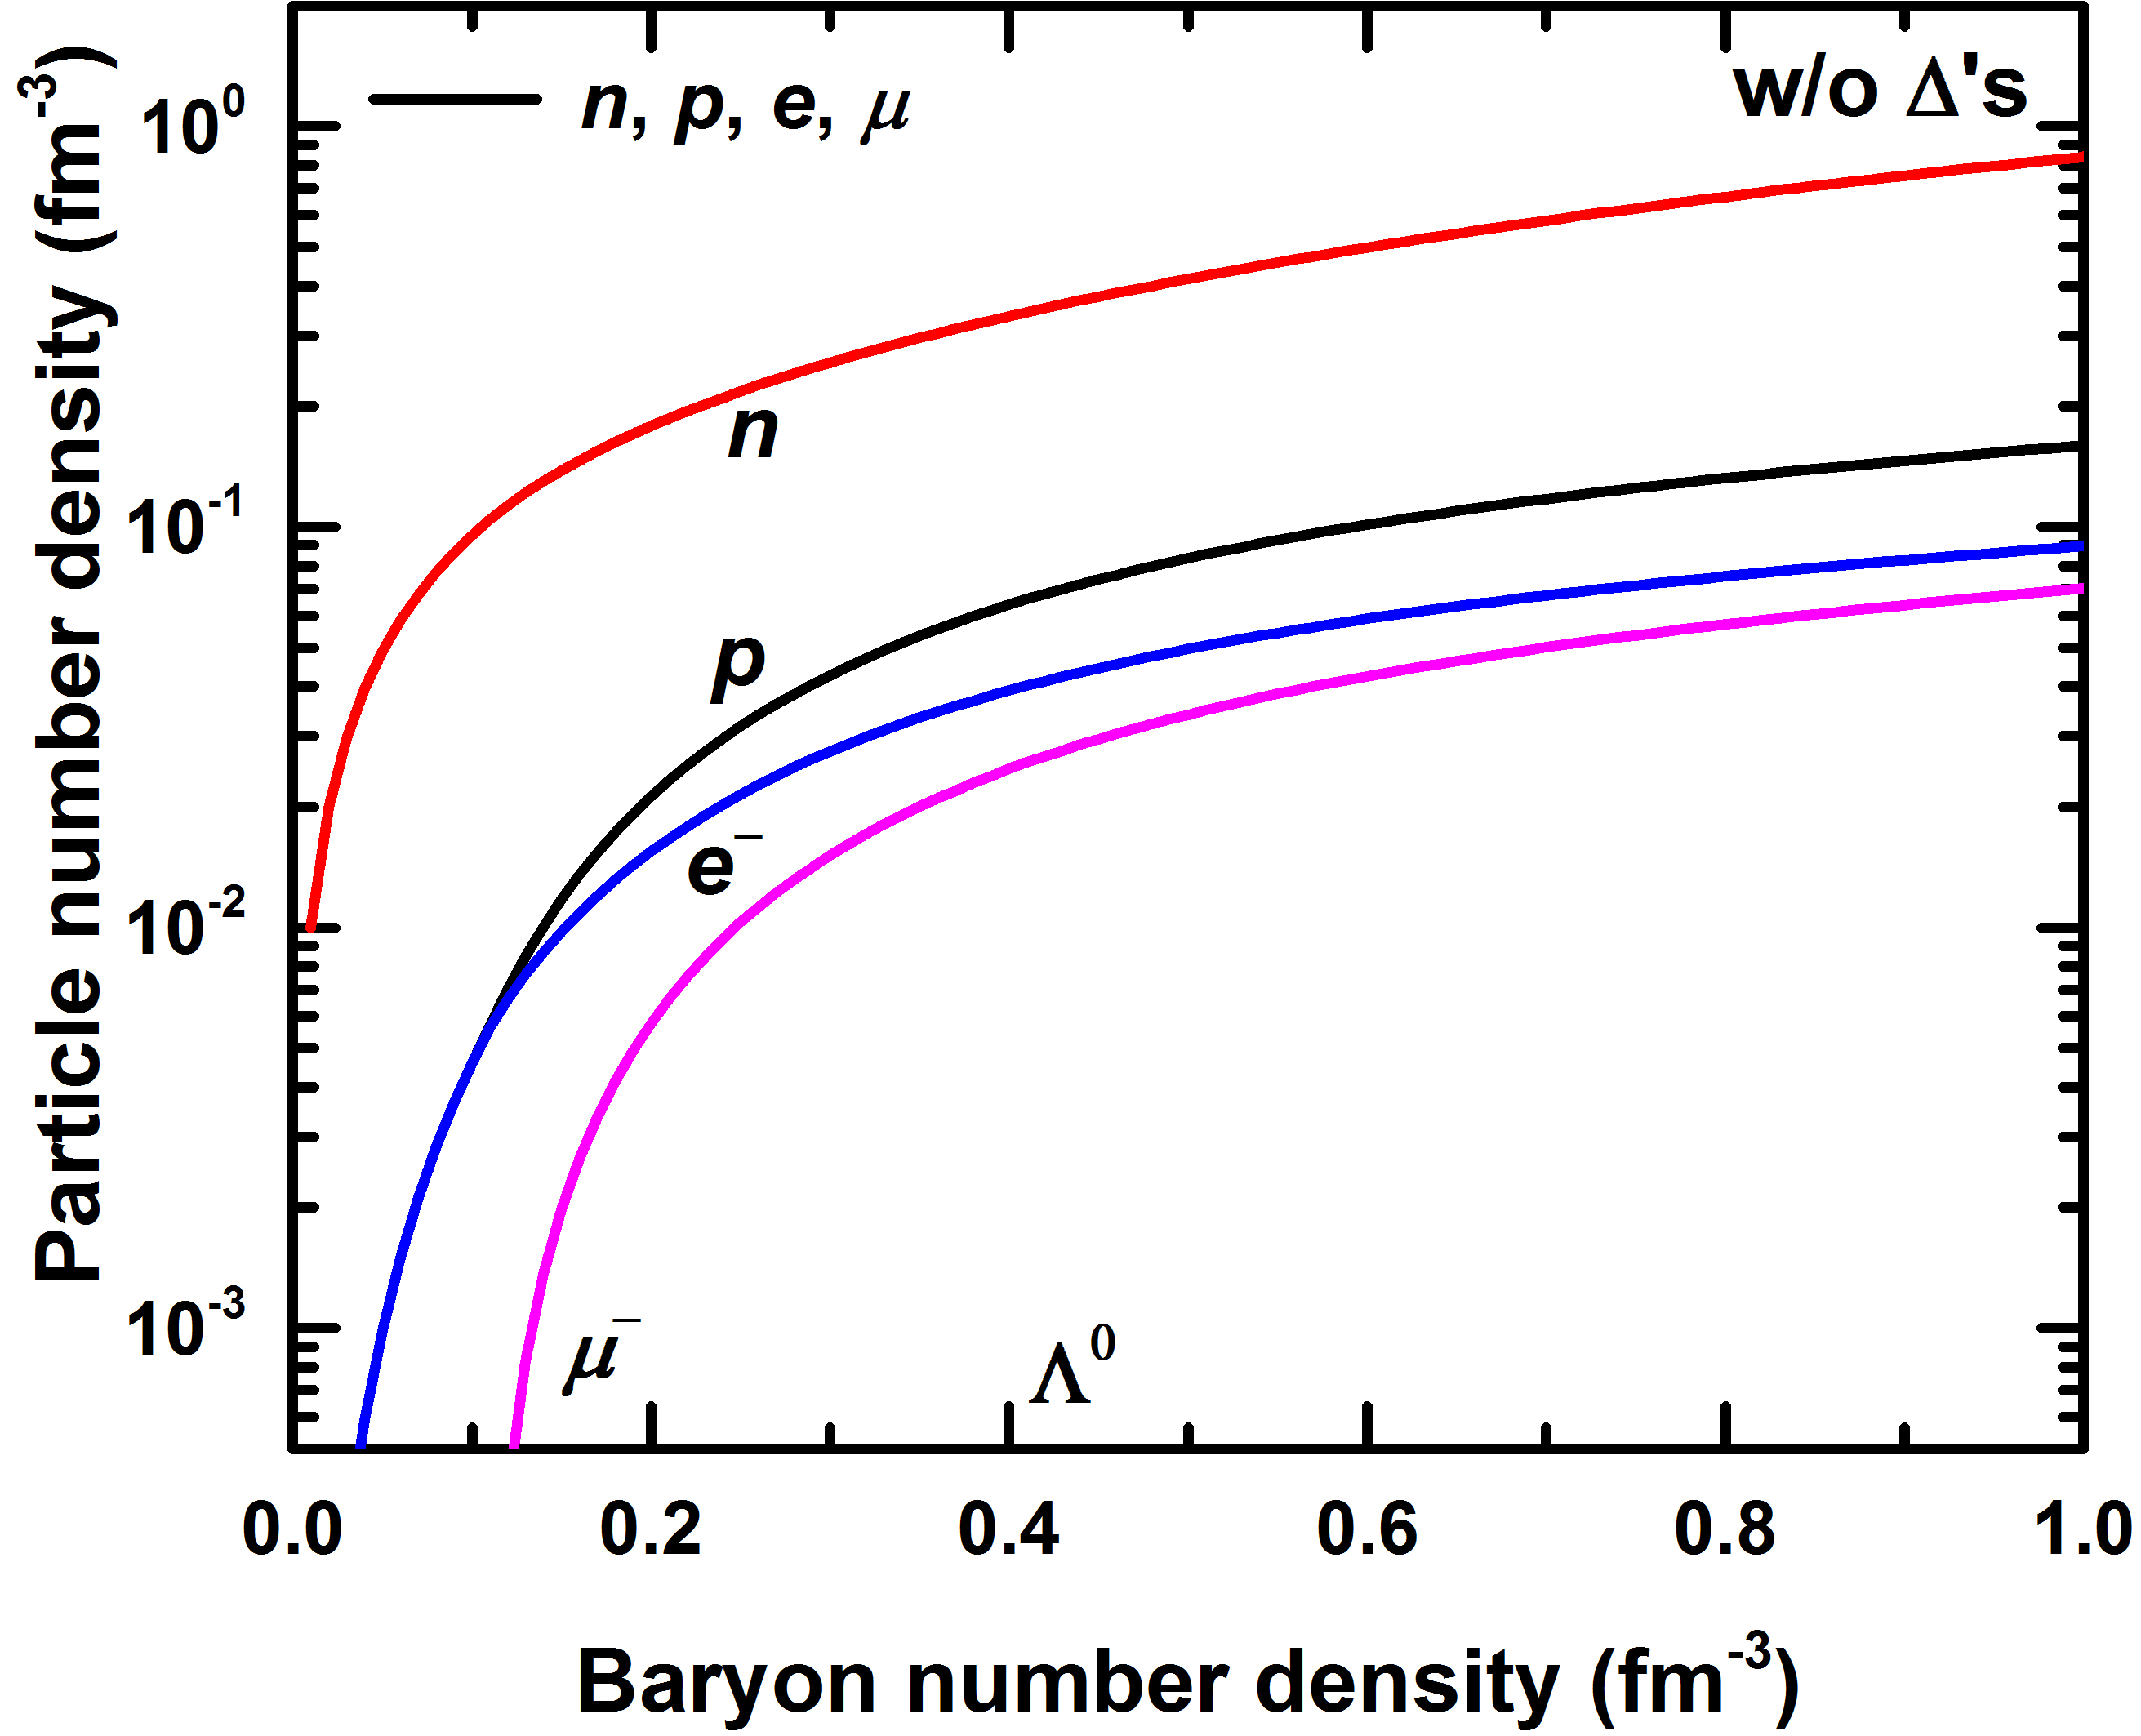
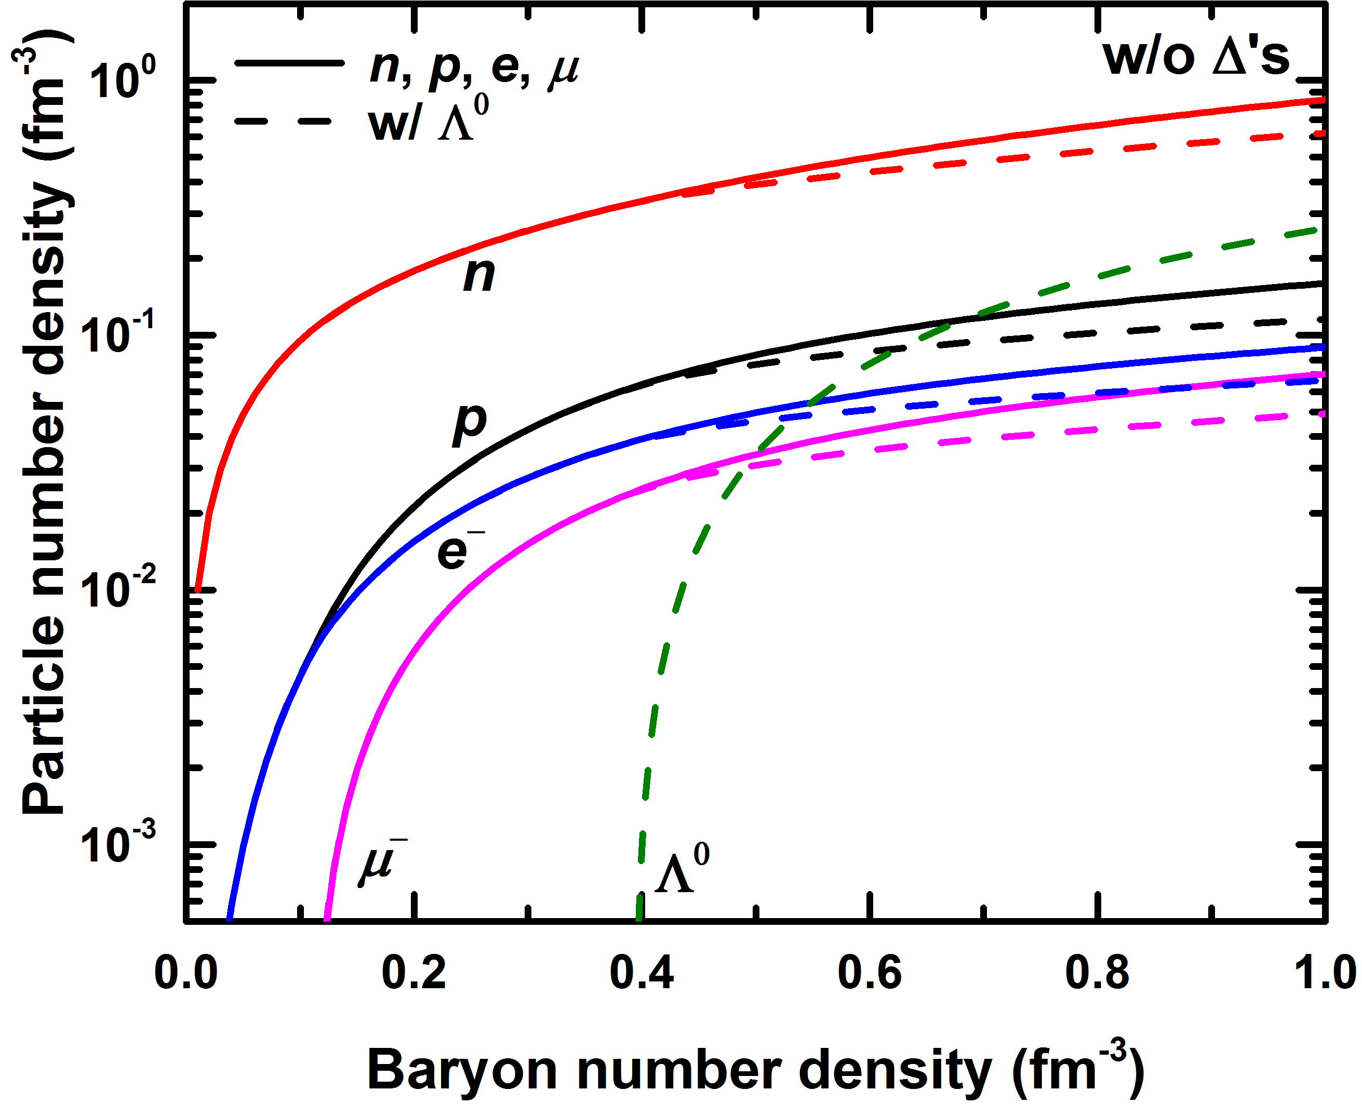
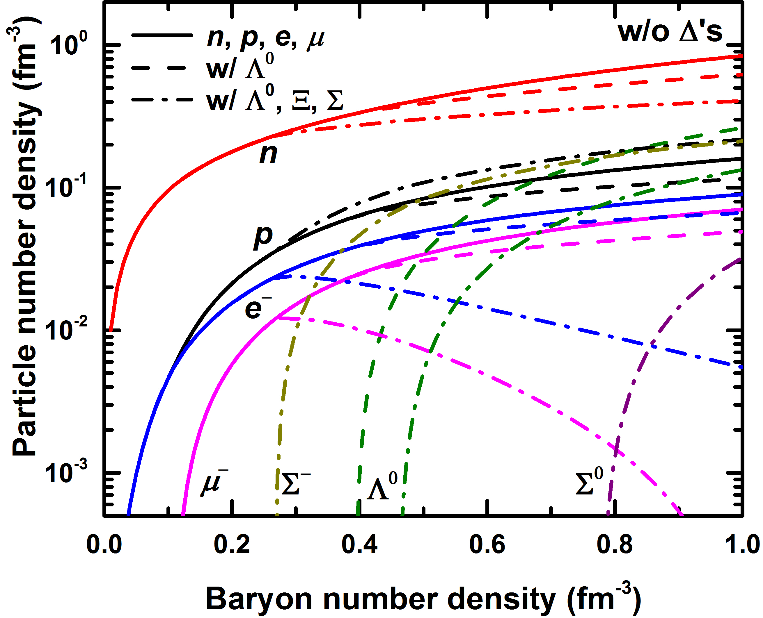
Particle number densities

Slide 13
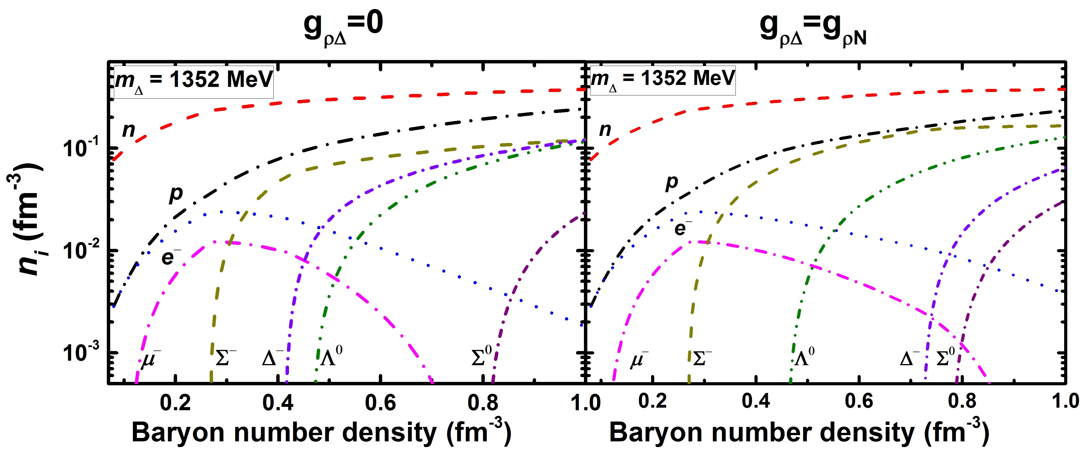
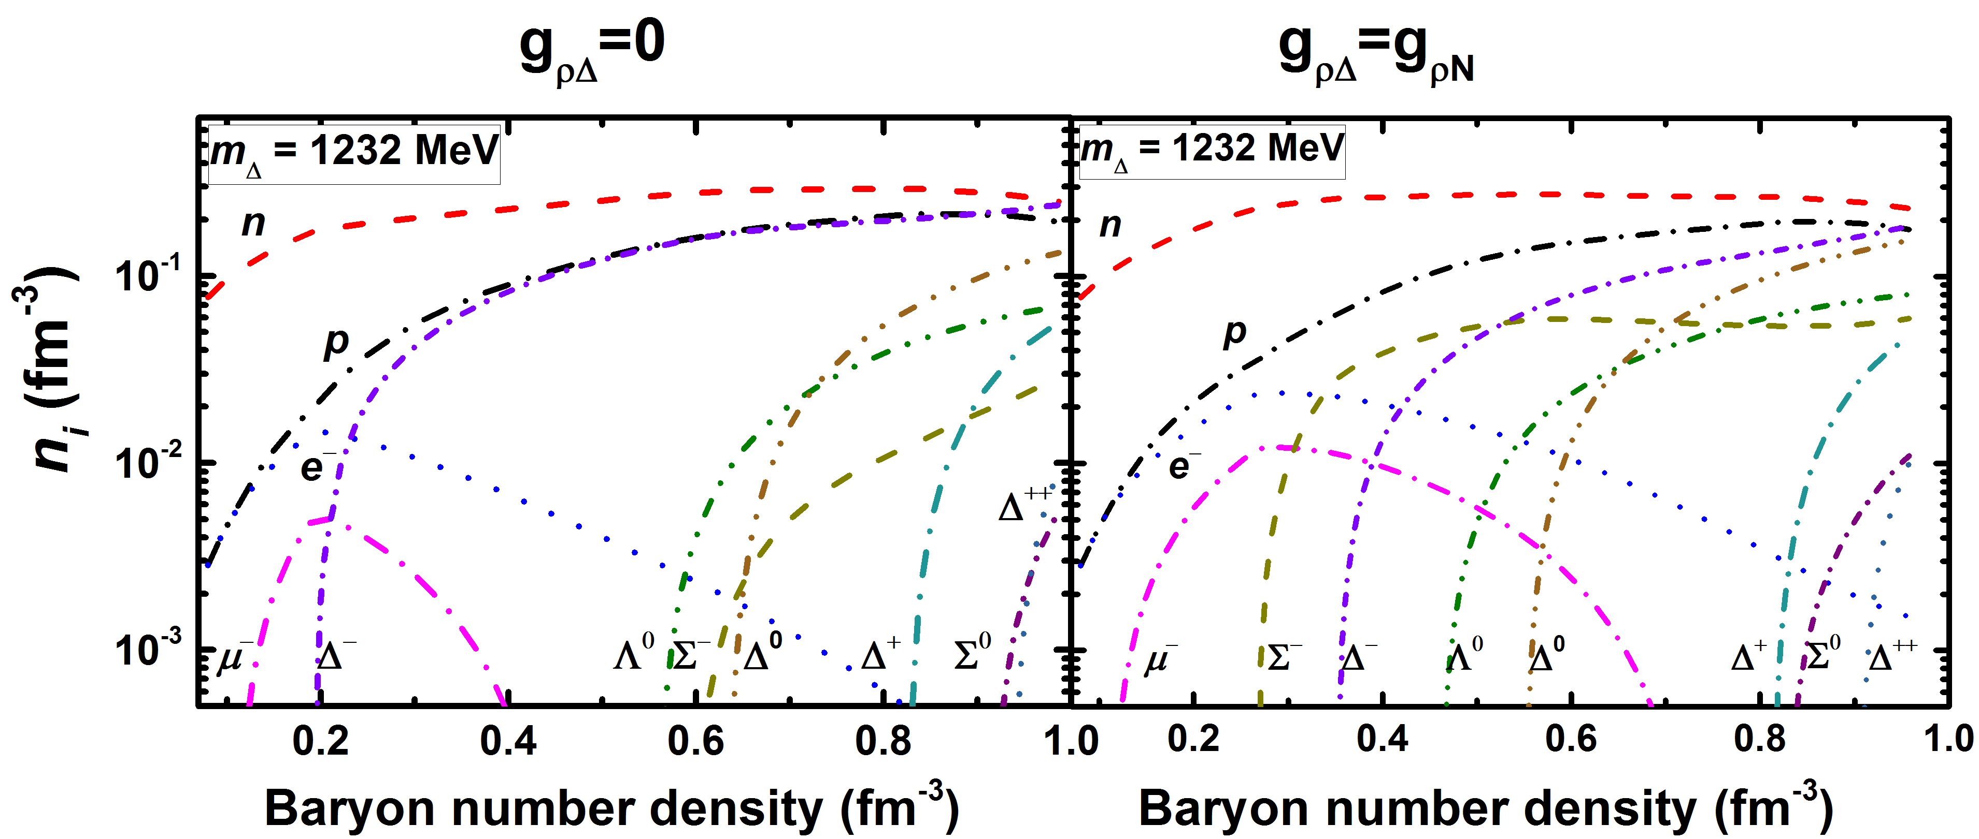
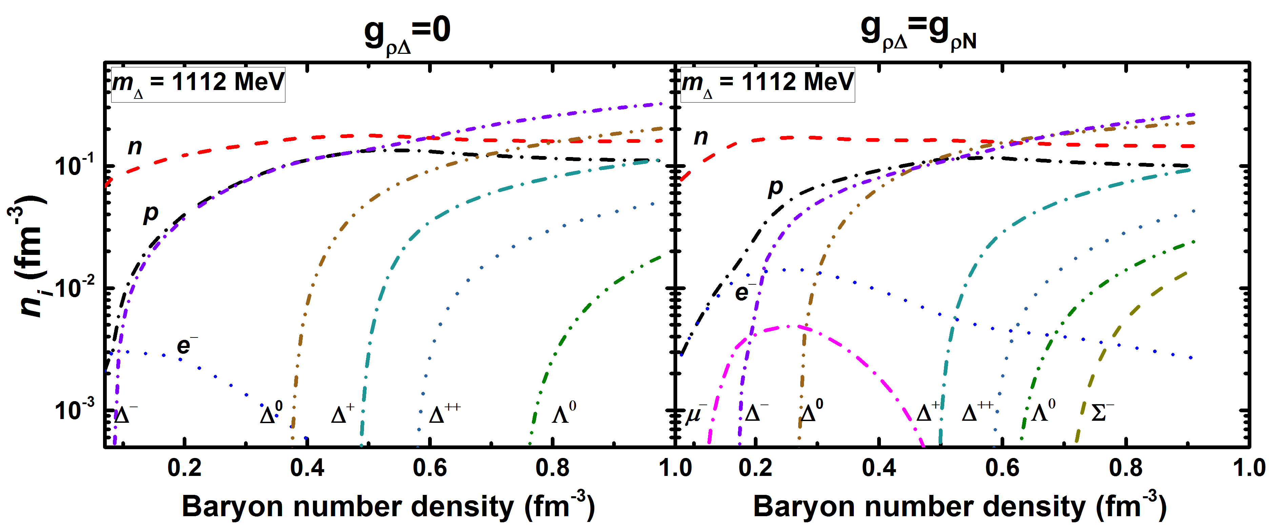
Particle number densities

Slide 14
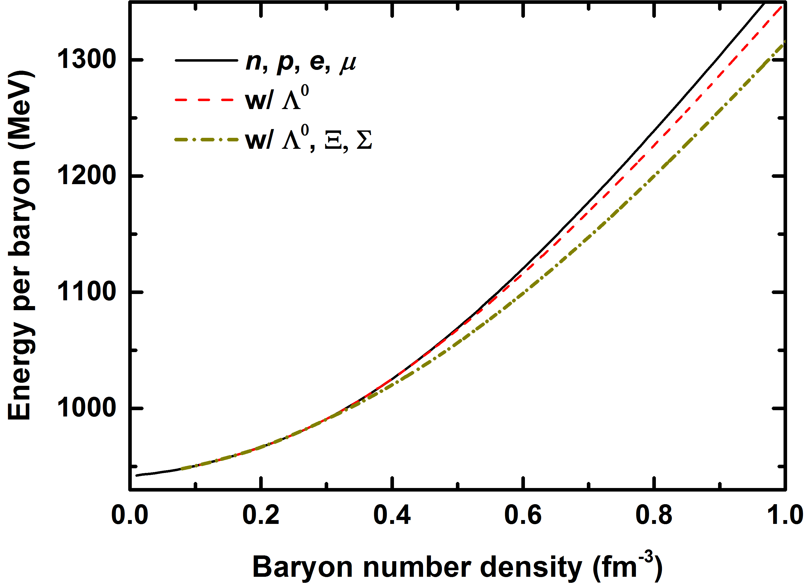
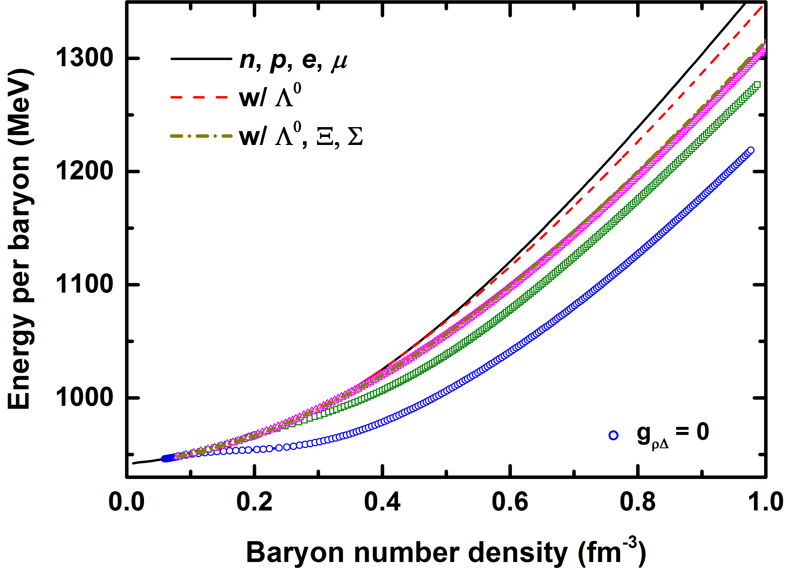
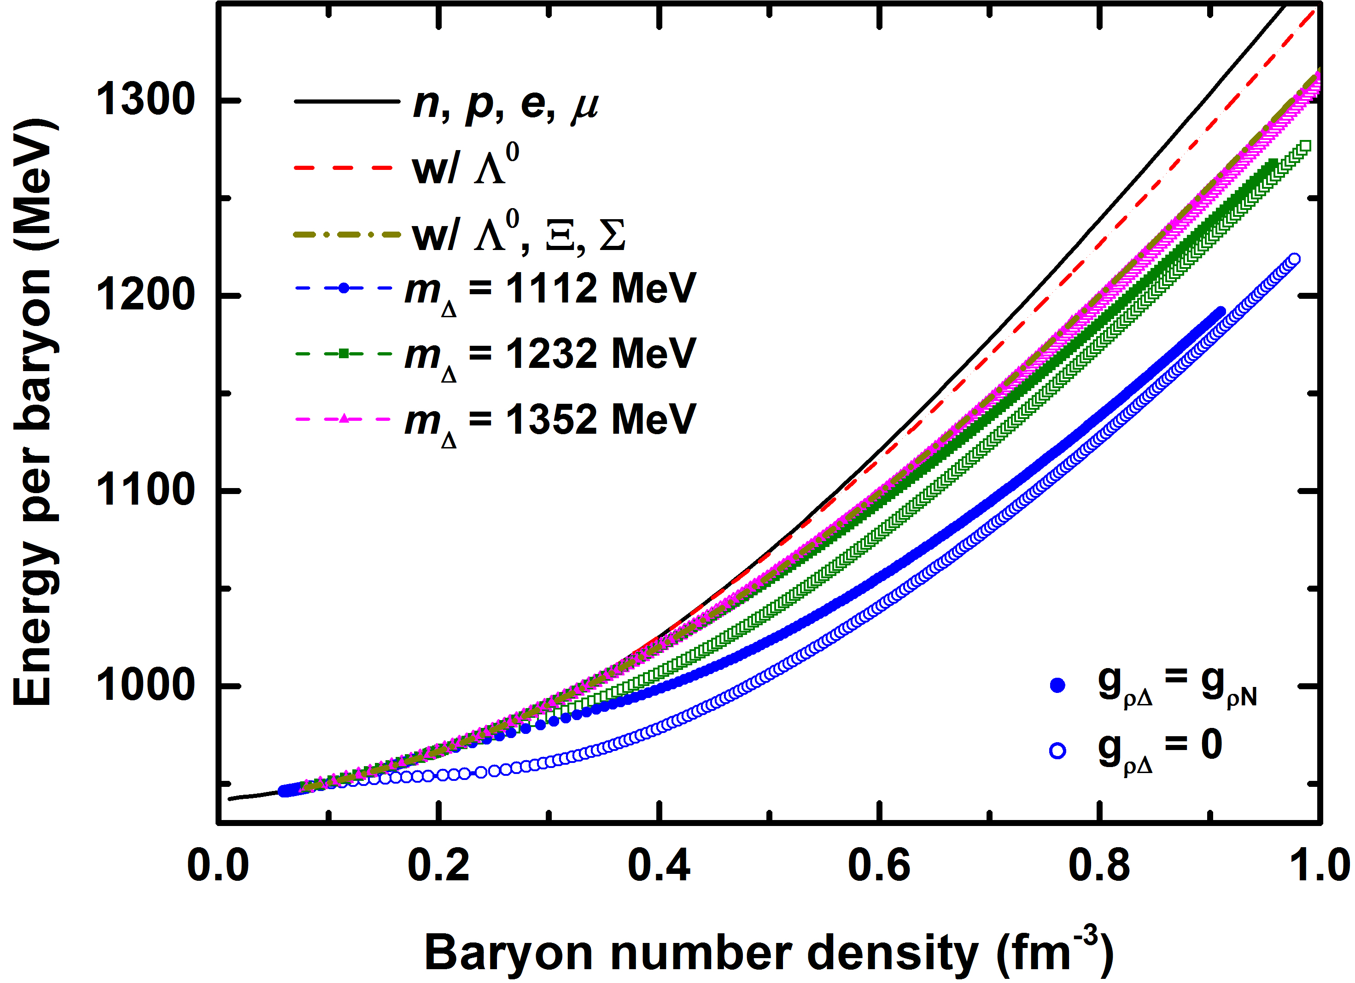
Energy per baryon

Slide 15
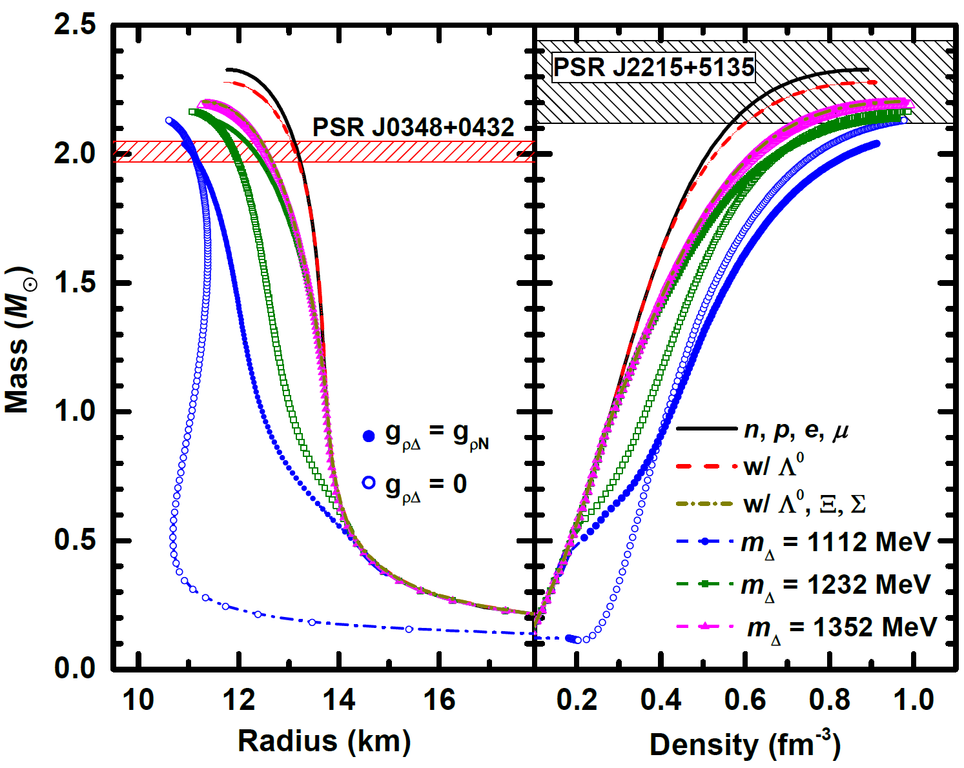
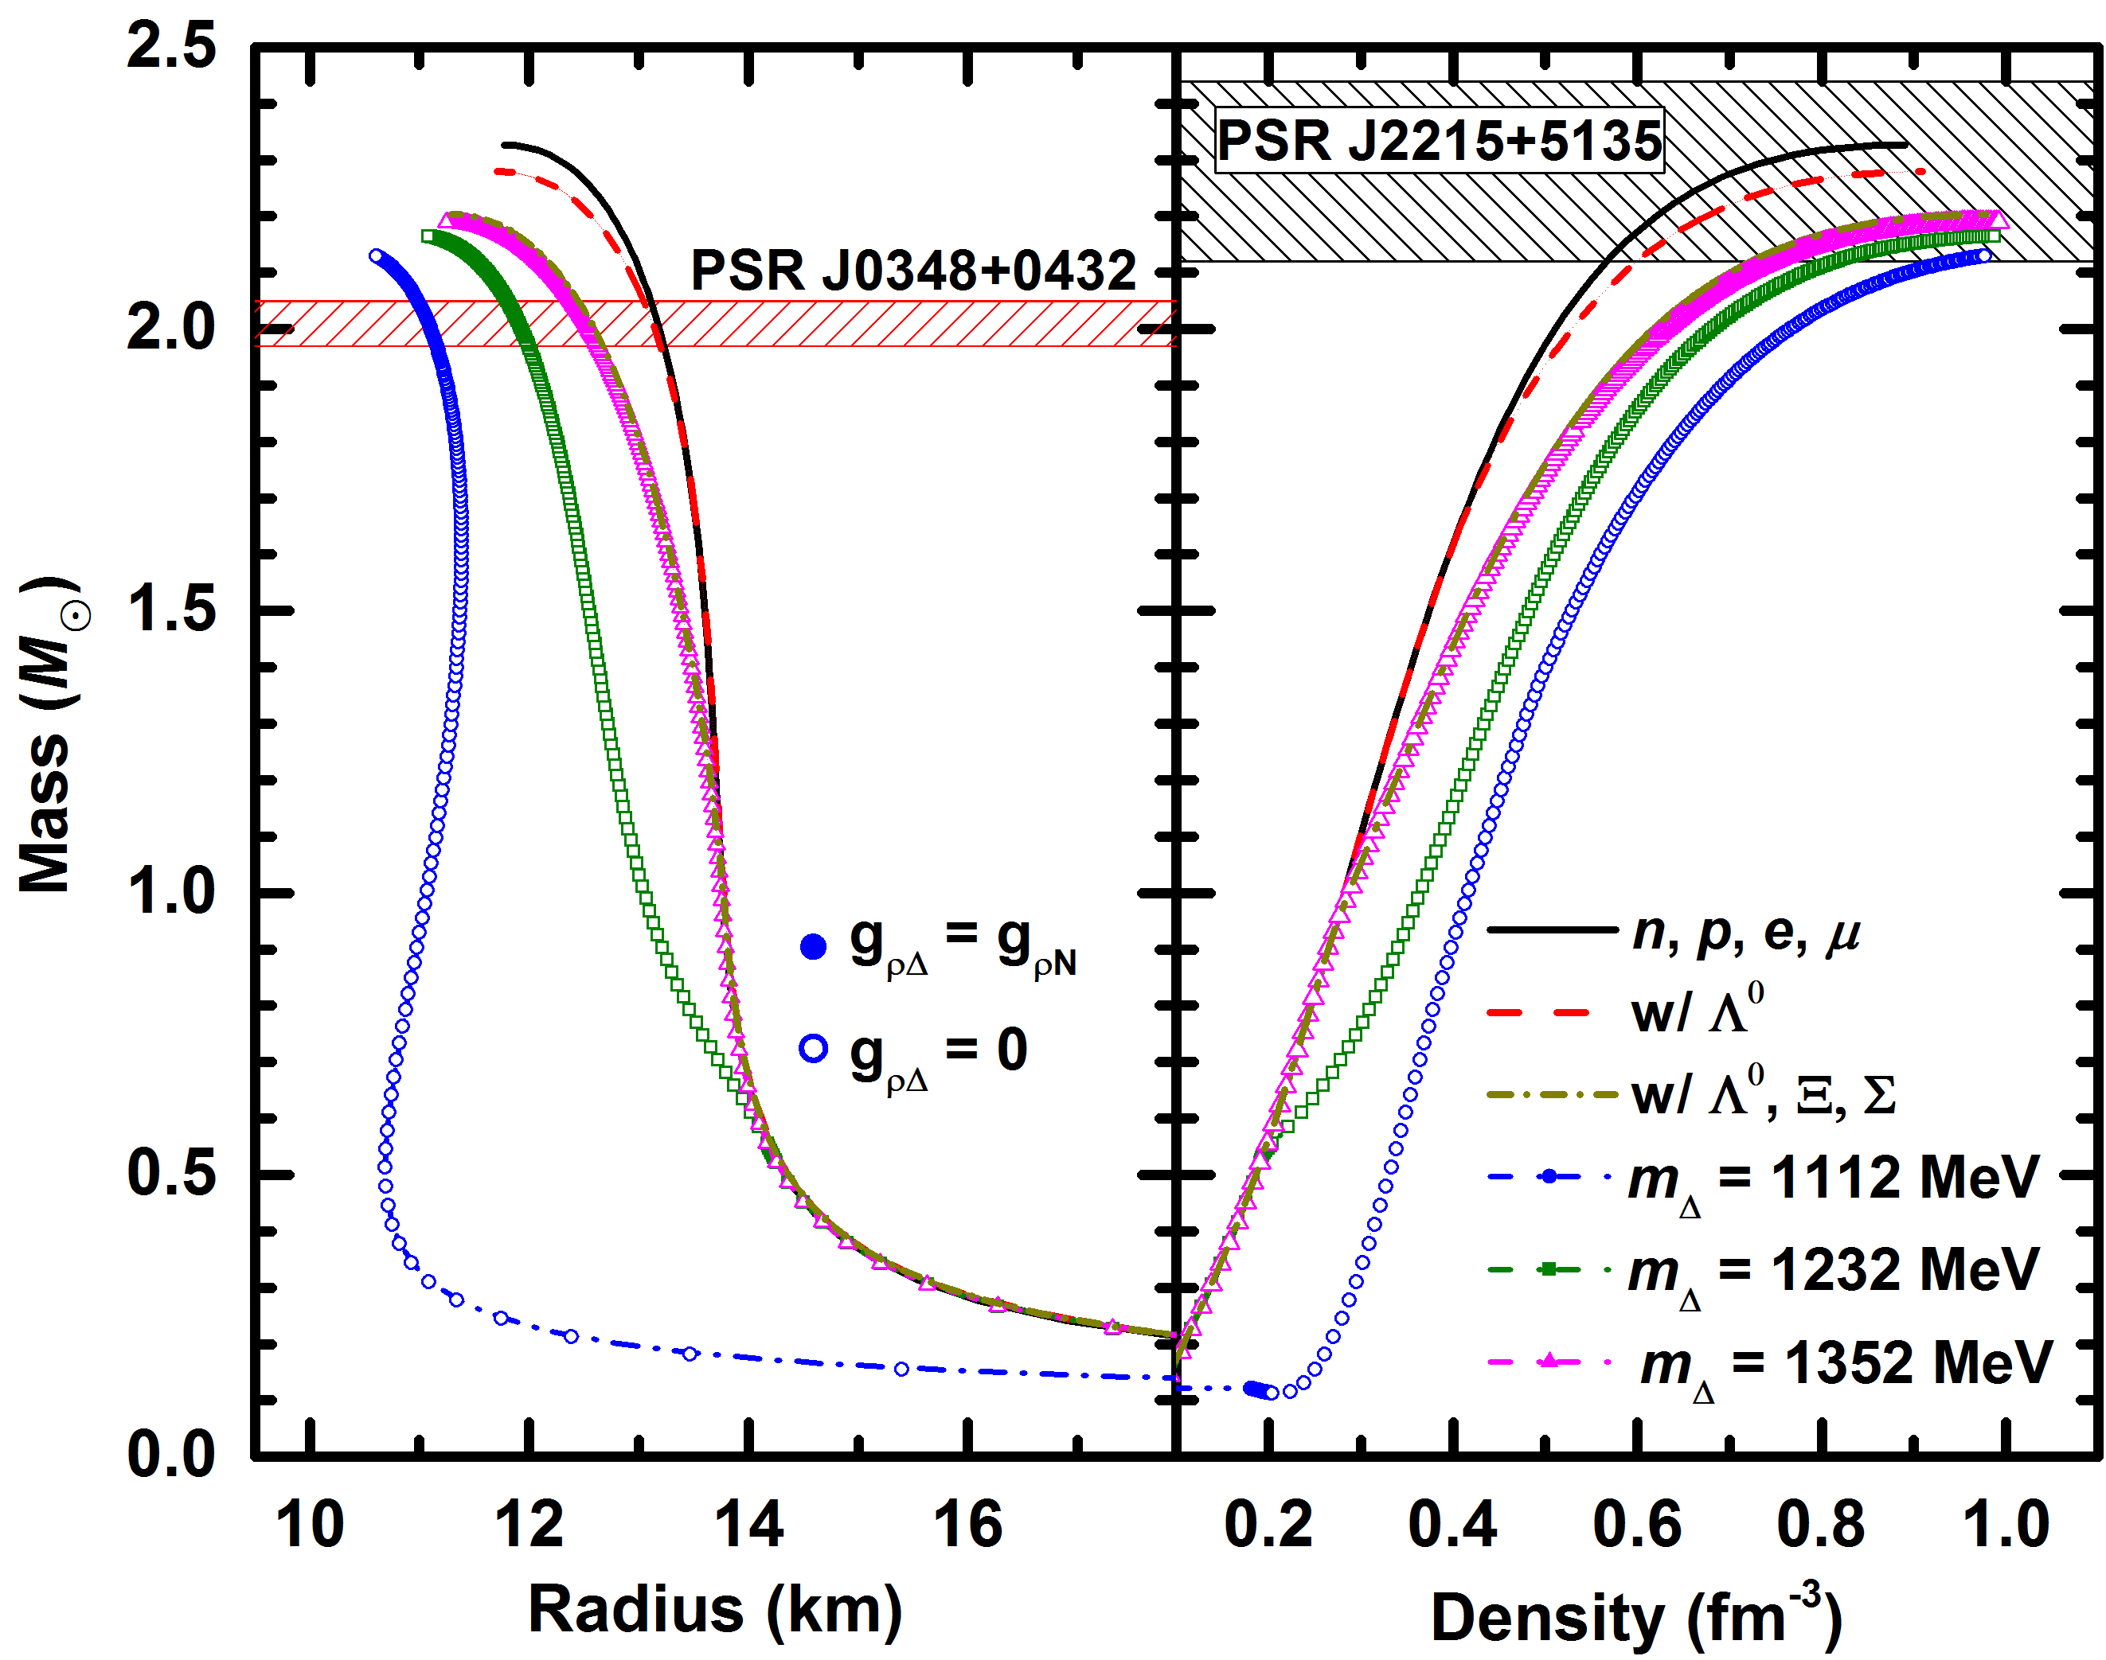
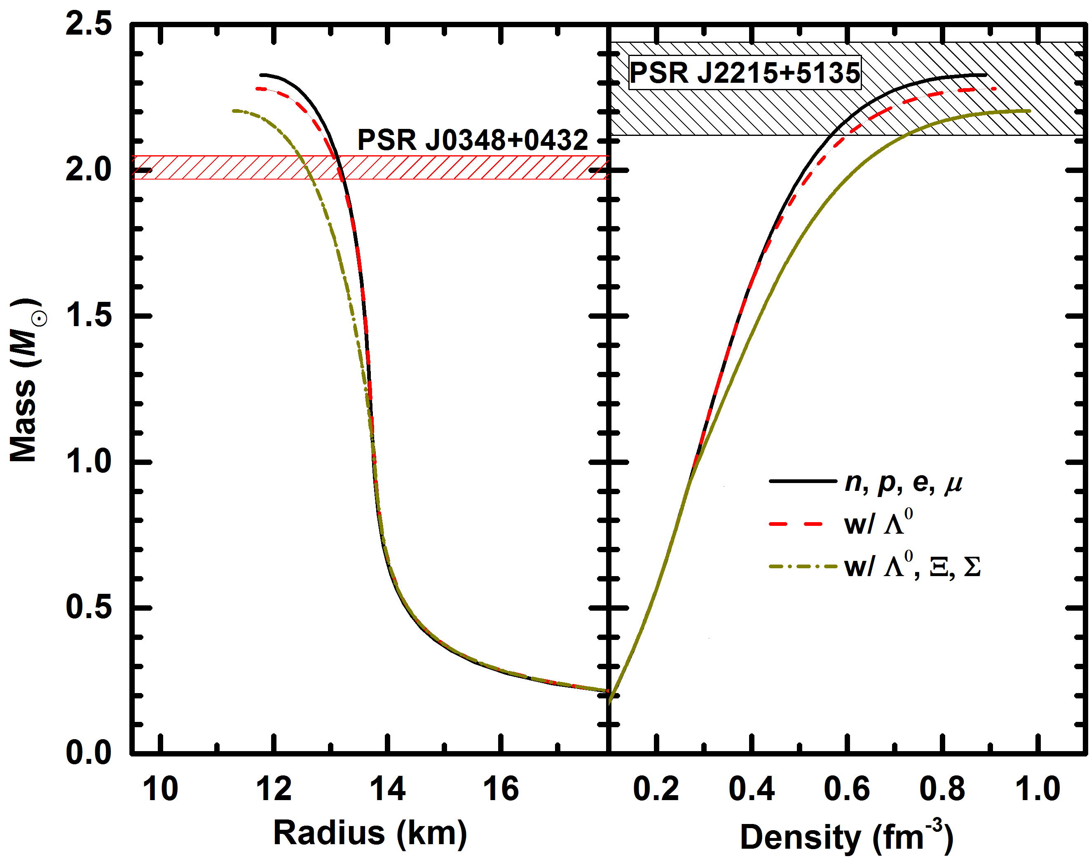
Mass, radius, and central density

Slide 16
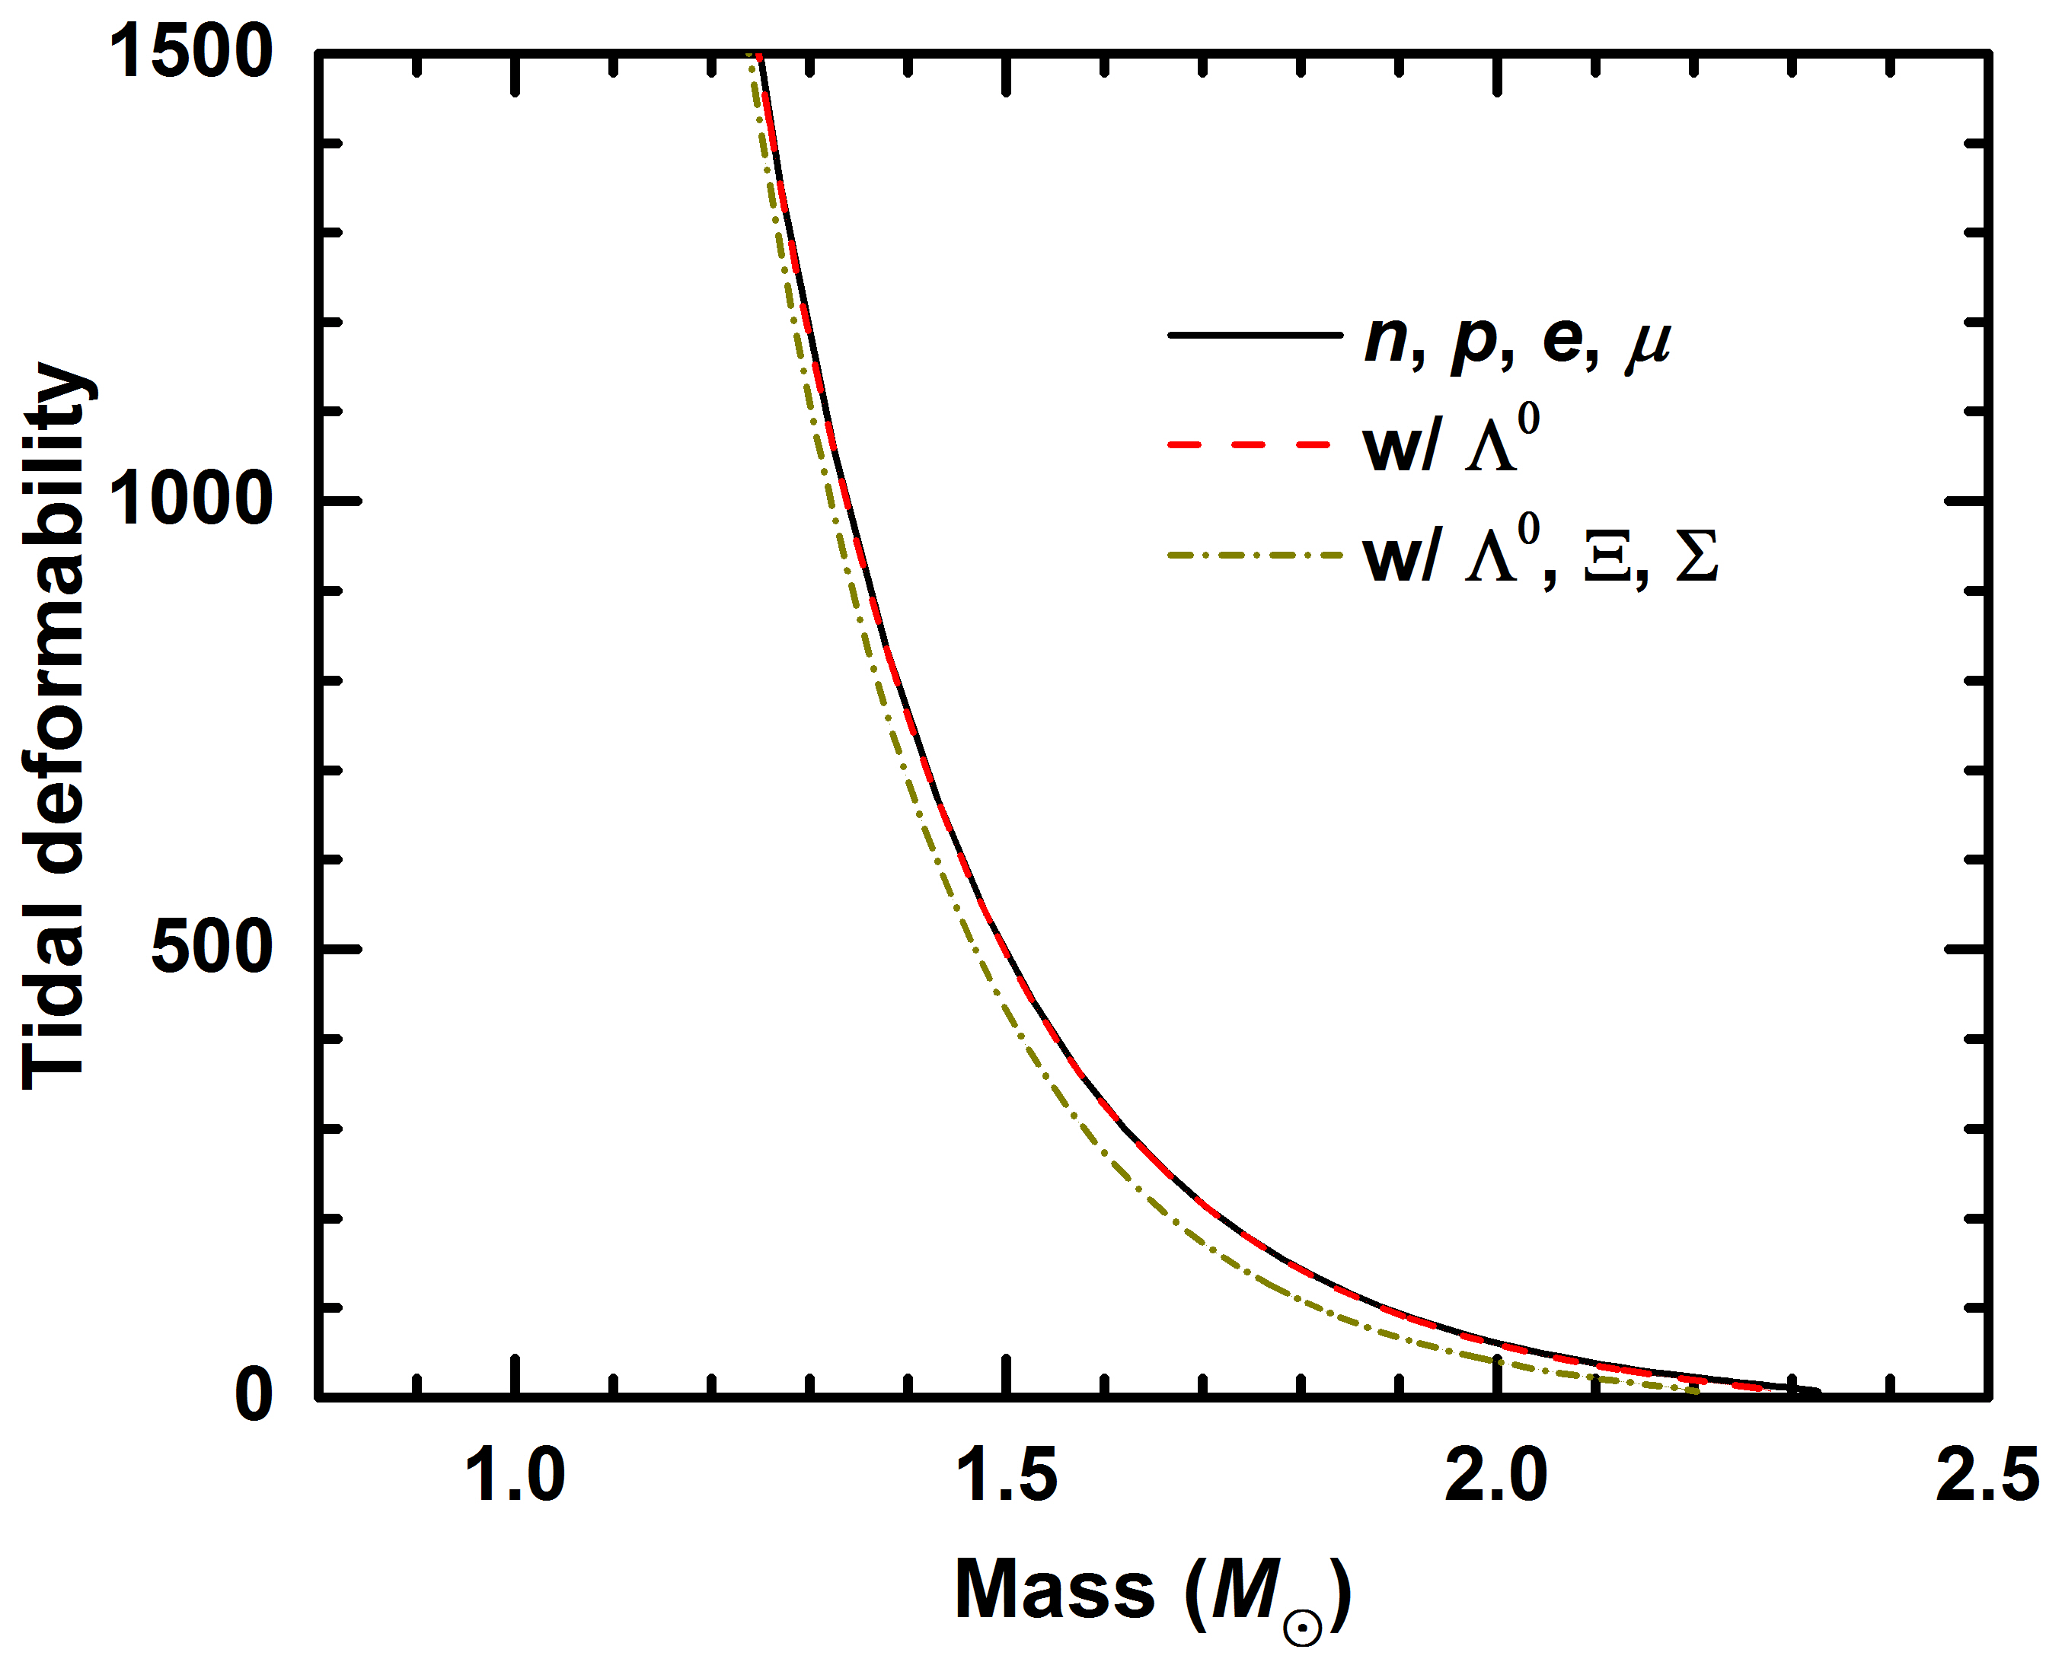
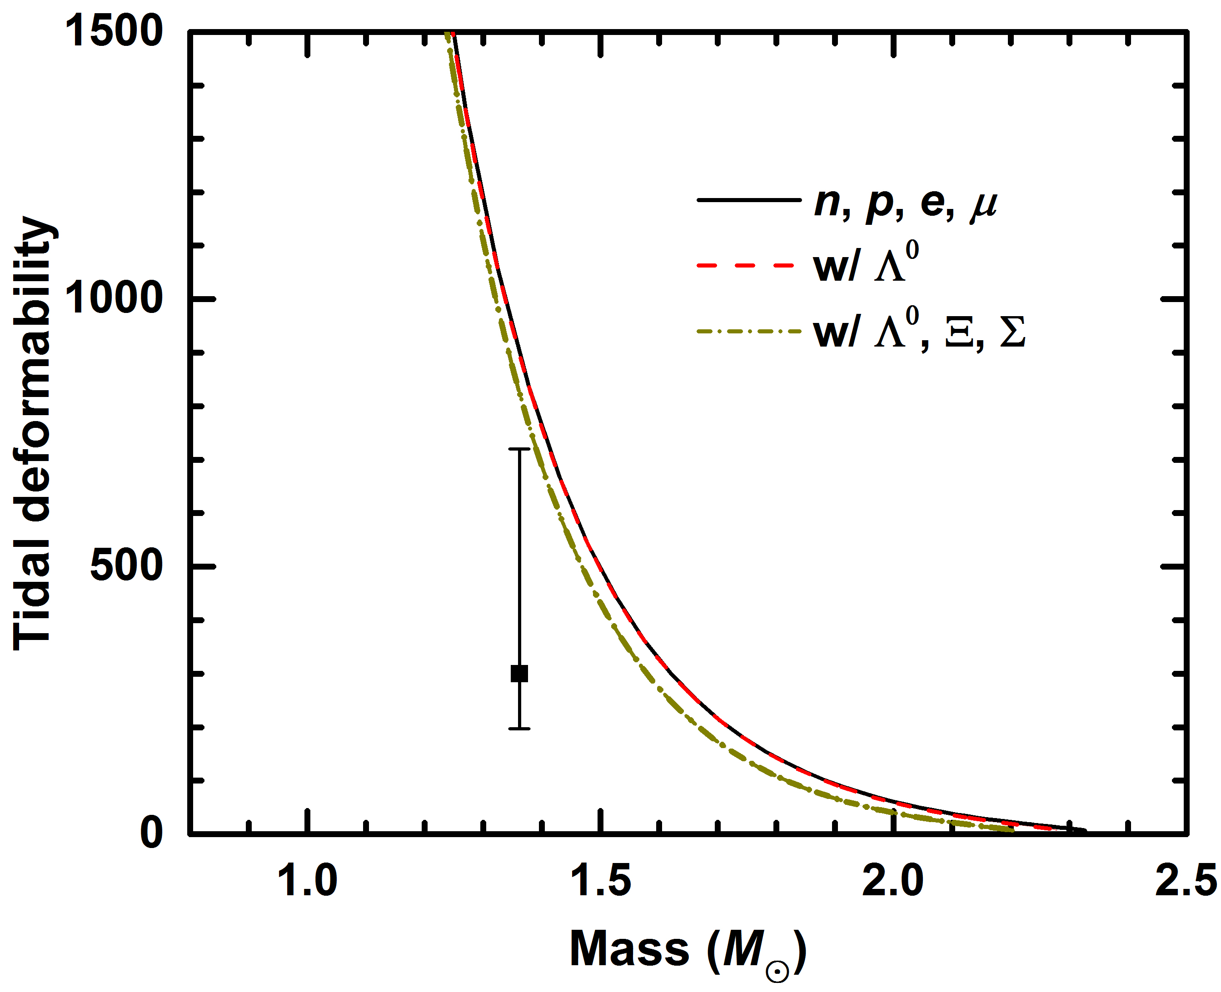
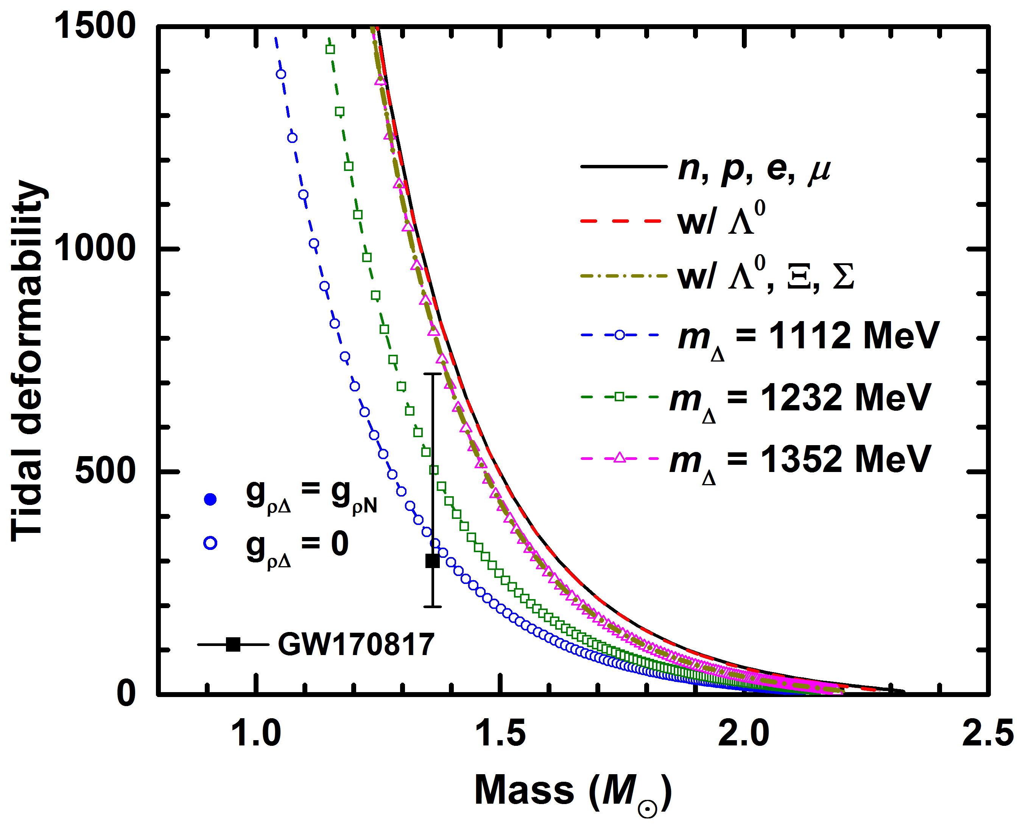
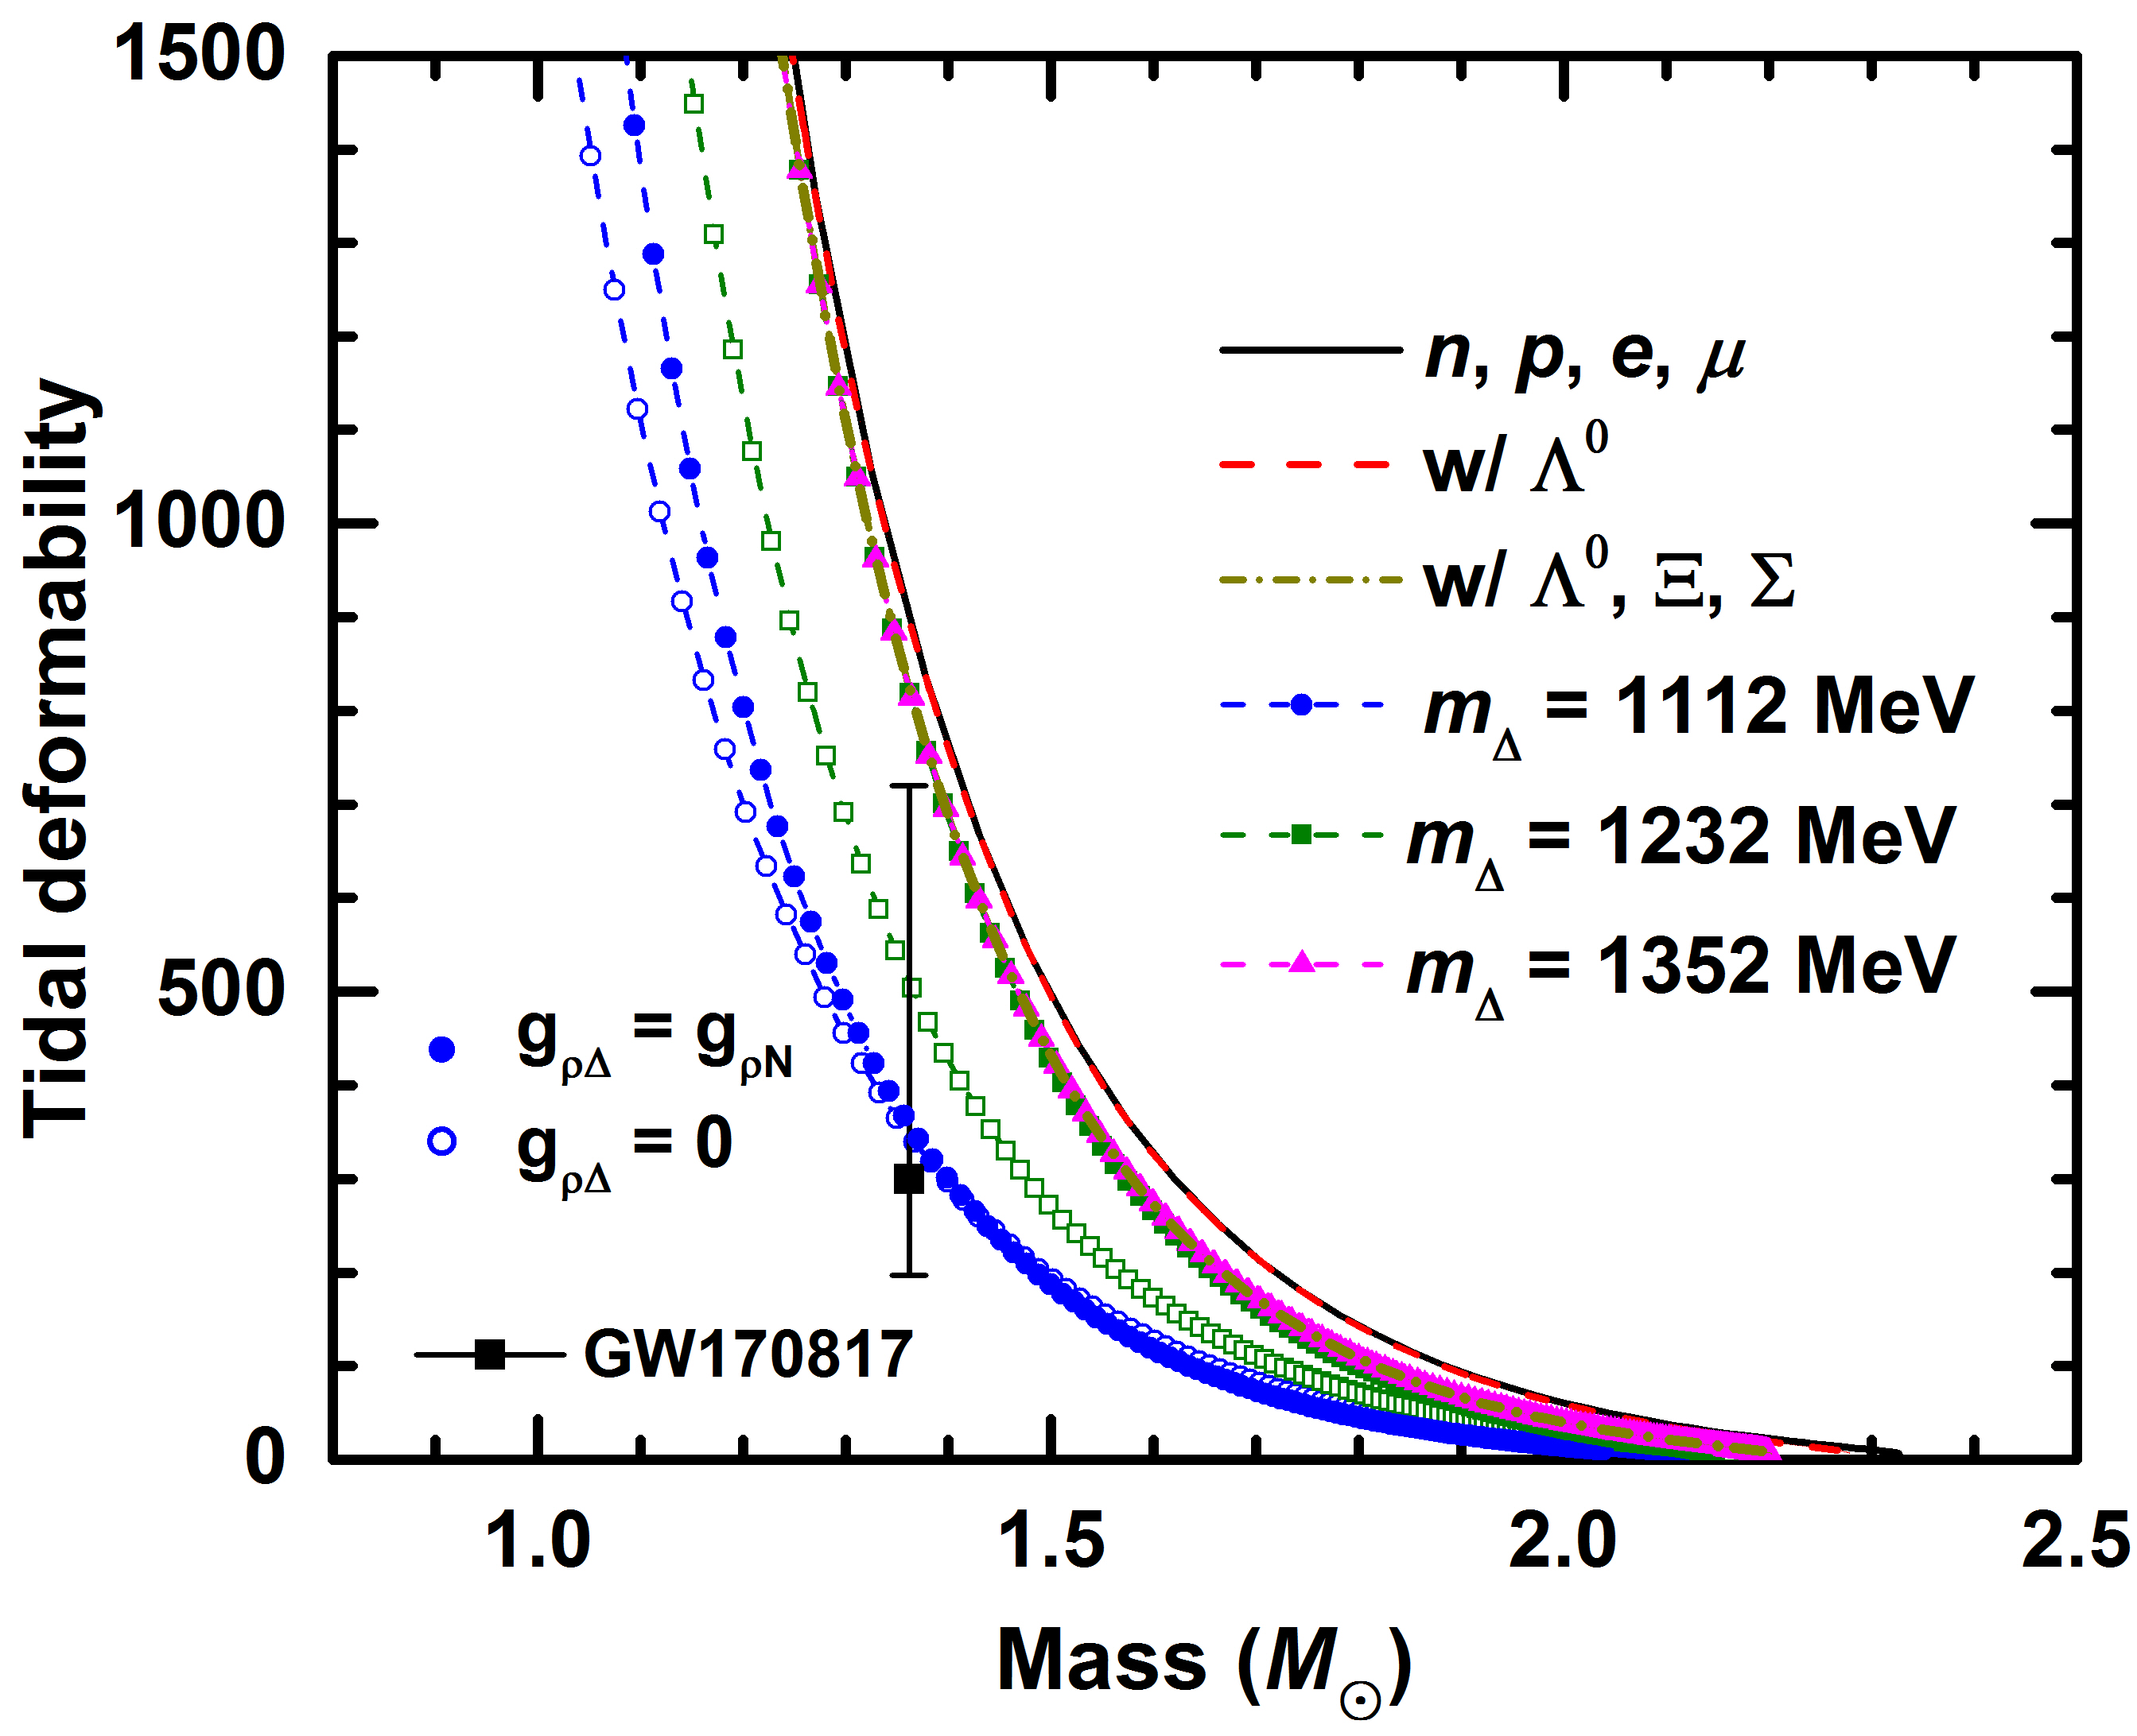
Tidal deformability
GW170817
LigoVirgo_
arXiv1805.11579:
≤ 720
Electromagnetic observations of the transient counterpart
AT2017gfo
Coughlin et al._
arXiv1805.09371:
≥ 197

Slide 17
Summary
The compact stars with possible existence of hyperons and ∆ resonance were investigated. It was found that:
The EoSs of neutron star matter become softer once we include new degrees of freedom;
There is no need to introduce Ф meson to resolve the hyperon puzzle;
The ∆ resonances will reduce the radii and tidal deformability of compact stars, which is more consistent with the recent observations [R = 10-11.5 km at M ≈ 1.17-2 M⊙, Ozel_Freire2016_AnnuRevAstro54-401; Λ ≤ 720 for low spin prior of GW170817, LigoVirgo_arXiv1805.11579]
－
Thank you!!!

