Slide 1
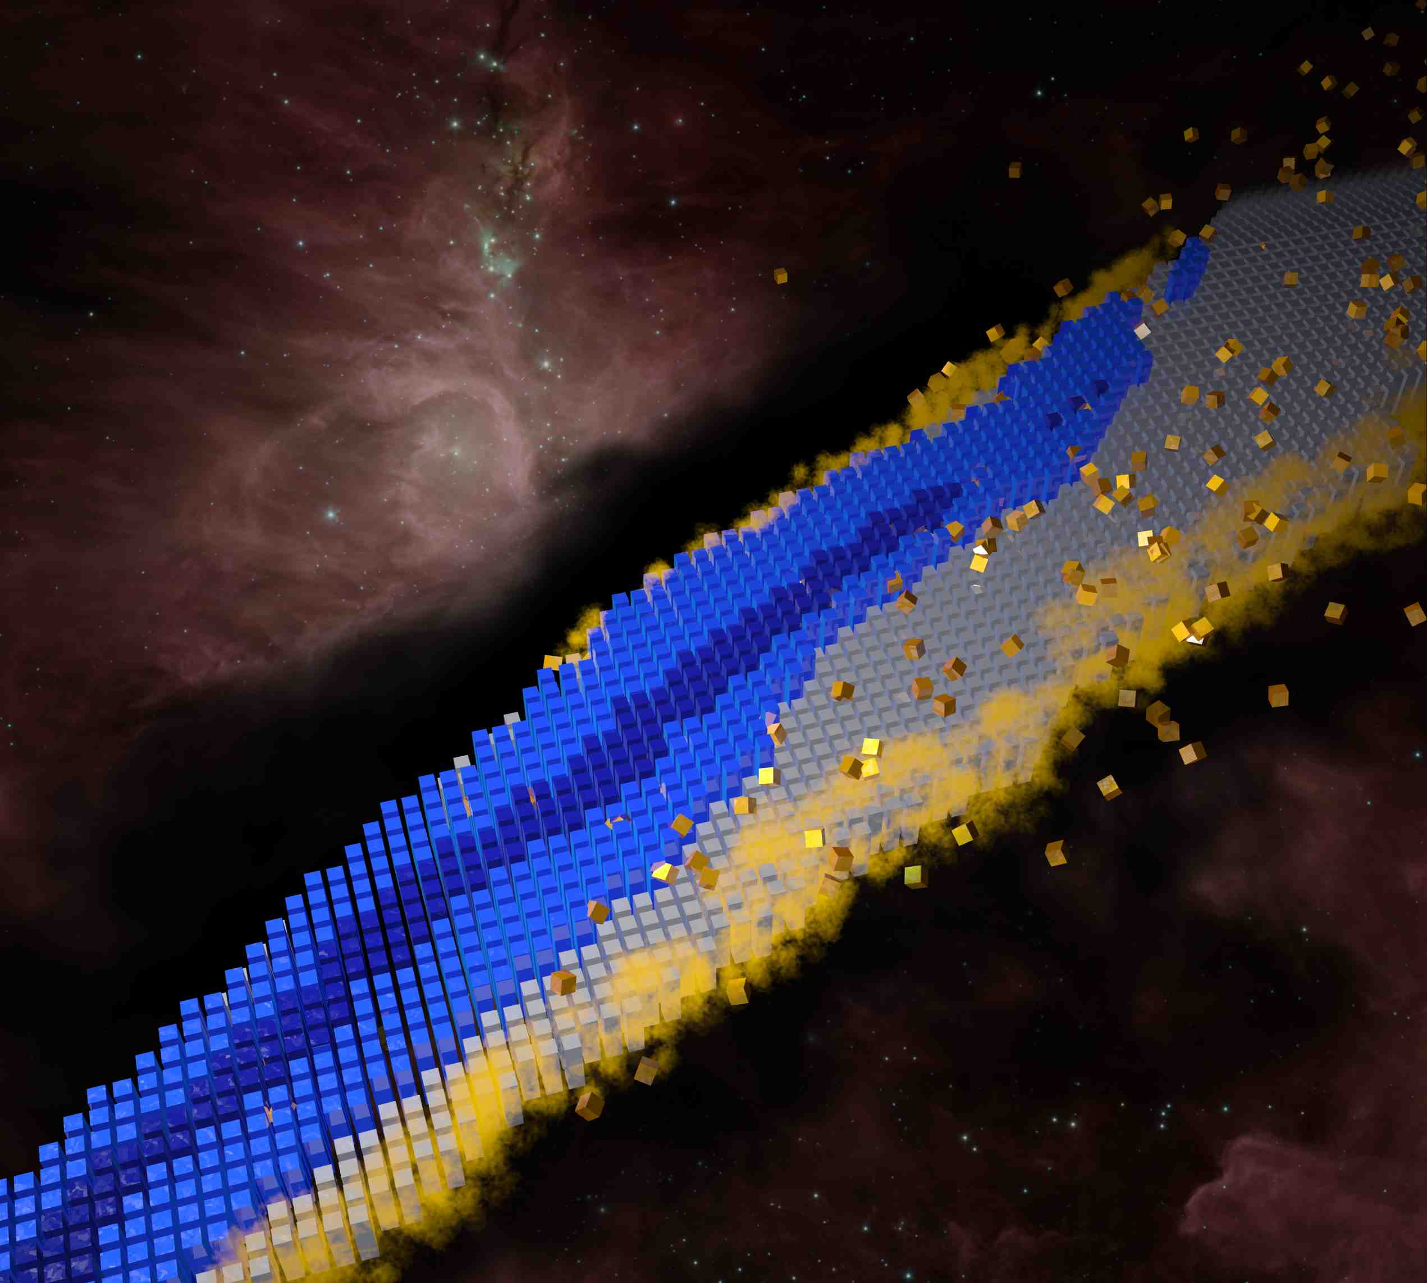
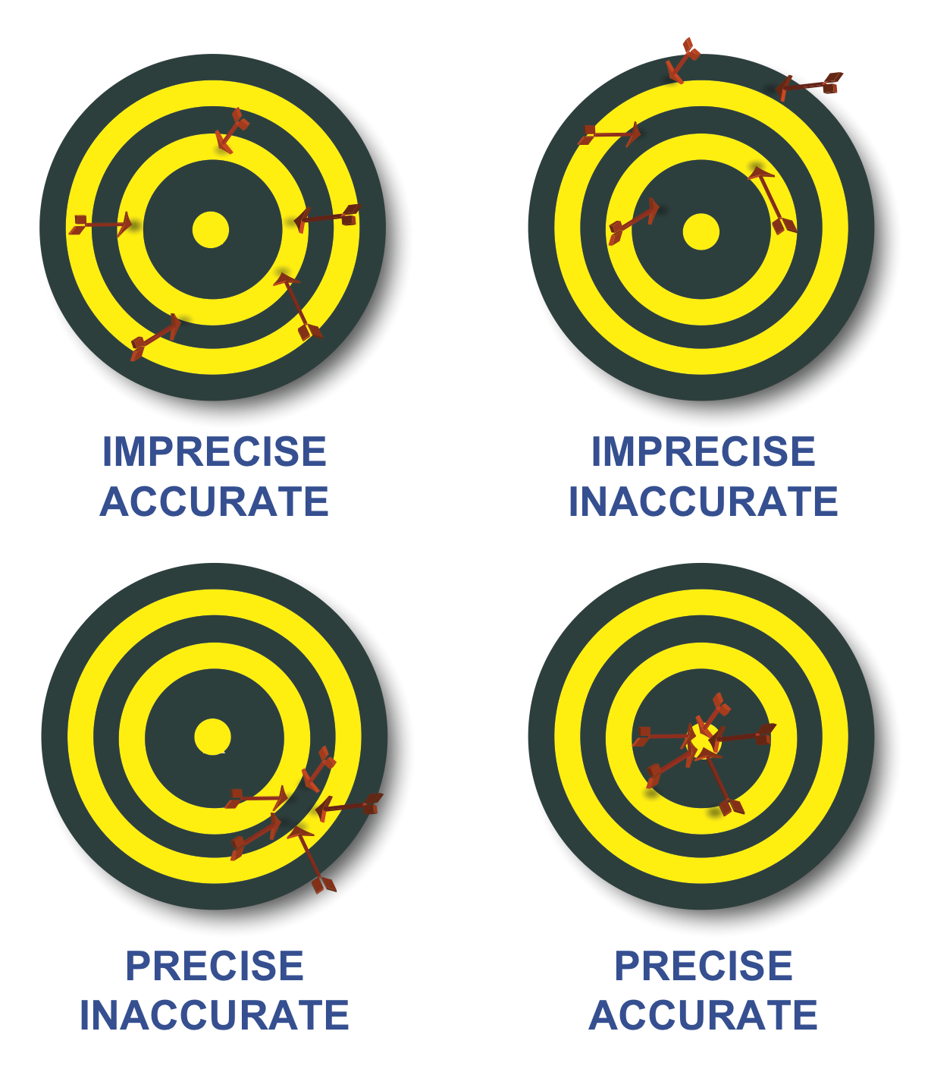
Neutron drip line in the Ca region from Bayesian machine learning
Witold Nazarewicz, Michigan State University/FRIB
Tsukuba-CCS workshop on “microscopic theories of nuclear structure and dynamics”
December 10-12, 2018
Menu
Introduction
Model extrapolations and machine learning
Model averaging
Conclusions

Slide 2
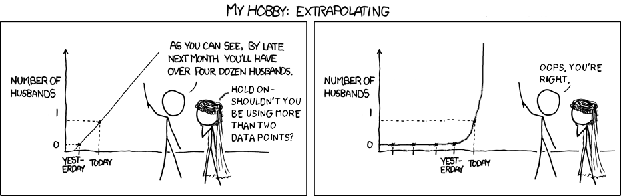
In many cases, nuclear input MUST involve massive extrapolations based on predicted quantities. And extrapolations are tough.

Slide 3
Some relevant references…
S. Athanassopoulos, E. Mavrommatis, K. Gernoth, and J. Clark, Nucl. Phys. A 743, 222 (2004).
R. Utama, J. Piekarewicz, and H. B. Prosper, Phys. Rev. C 93, 014311 (2016).
G. F. Bertsch and D. Bingham, Phys. Rev. Lett. 119, 252501 (2017).
H. F. Zhang et al.,J. Phys. G 44, 045110 (2017).
Z. Niu and H. Liang, Phys. Lett. B 778, 48 (2018).
R. Utama and J. Piekarewicz, Phys. Rev. C 97, 014306 (2018).

Slide 4
Separation energy residual:
emulator of residual

Slide 5
We consider 12 global nuclear mass models:
FRDM-2012, HFB-24: rms mass deviation ~0.6 MeV
SkM*, SkP, SLy4, SV-min, UNEDF0, UNEDF1: 1.5-6 MeV
NL3*, DD-ME2, DD-PC1, DDMEδ: 2-3 MeV
The emulators of S_{2n} residuals and confidence intervals defining theoretical error bars are constructed using Bayesian Gaussian processes and Bayesian neural networks.
By establishing statistical methodology and parameters, we carried out extrapolations towards the 2n dripline.

Slide 6
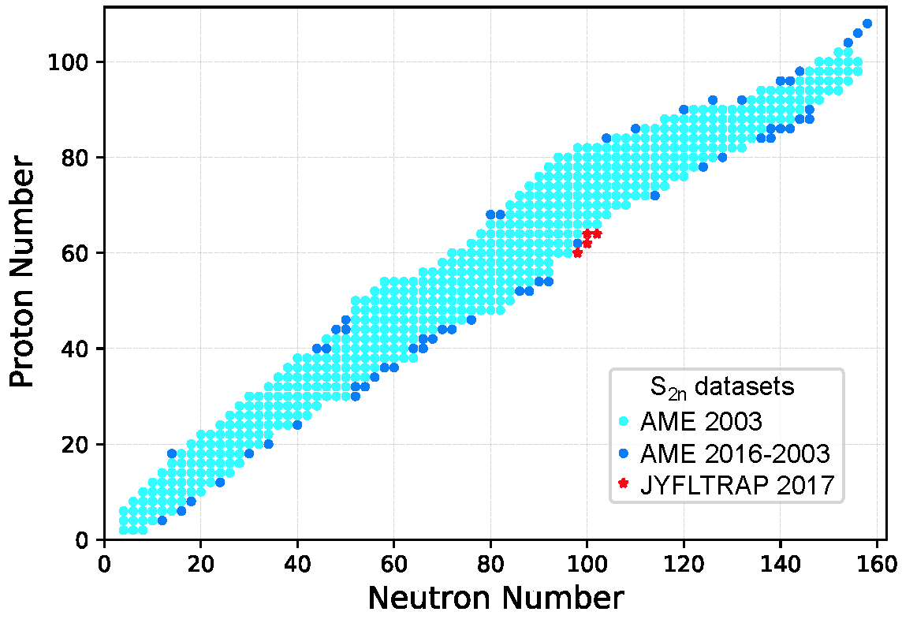
Our objective: extrapolations
We consider a large training dataset pertaining to nuclei whose masses were measured before 2003. For the testing datasets, we considered those exotic nuclei whose masses have been determined after 2003.
Training set:
537 points
Testing sets:
55+4 points

Slide 7
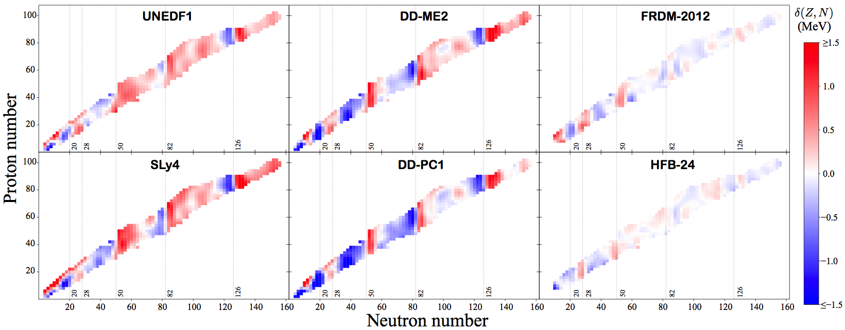
Residuals exhibit local trends
This information can be used to our advantage to improve model-based predictions!
It can also be used to improve models themselves

Slide 8
Bayesian approach
residual
(Z,N)_{i}
Bayes’ theorem
Prediction of unknown observable y* given known data y
Two statistical models used:
Gaussian process (3 parameters)
Bayesian neural network with sigmoid function (30 neurons, 1 layer; 181 parameters)
100,000 iterations of an ergodic Markov chain produced by the Metropolis-Hastings algorithm
Some refinements added based on our knowledge of trends

Slide 9
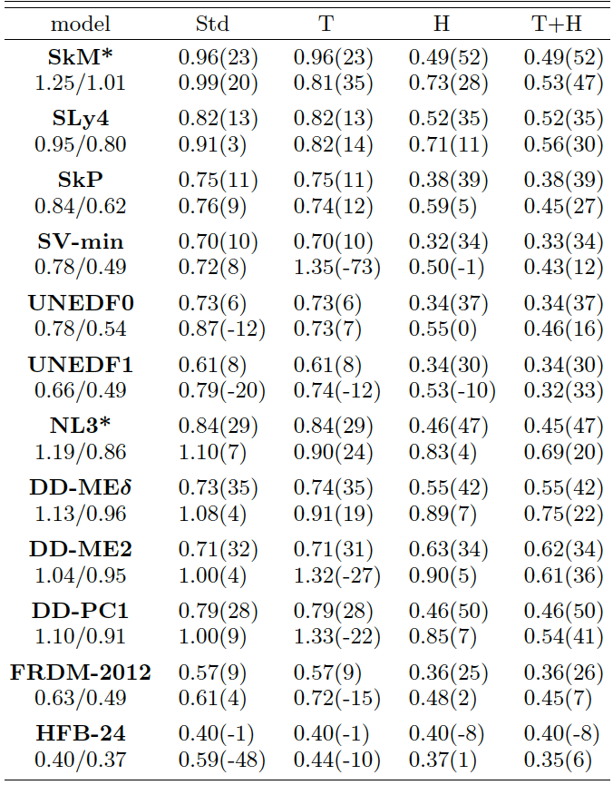
GP
BNN
training dataset: AME2003
testing dataset: AME2016-AME2003
Overall, for the testing dataset AME2016-2003, the rms deviation from experimental S_{2n} values is 400-500 keV in the GP variant for all theoretical models employed in our study, which suggests that our statistical methods capture most of the residual structure.
BUT the predicted mean value is certainly not the whole story!

Slide 10
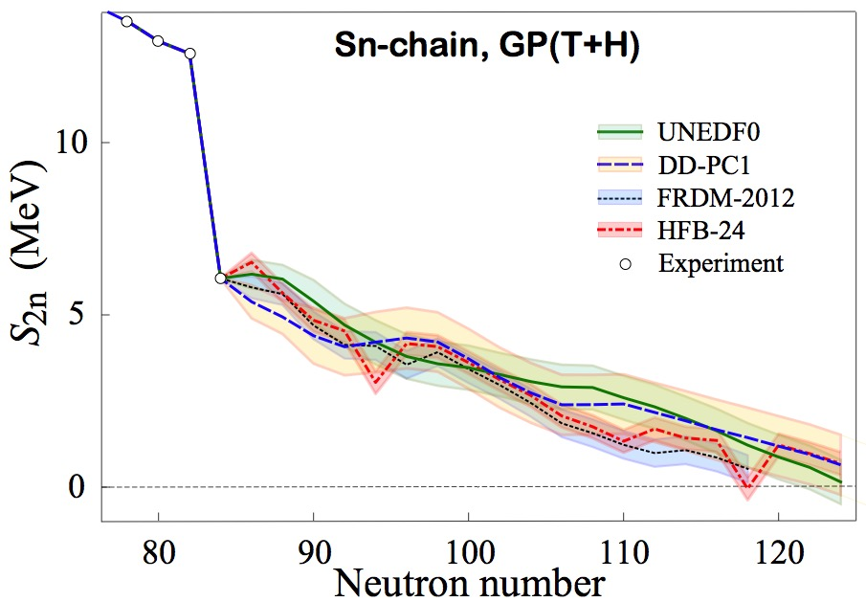

Slide 11
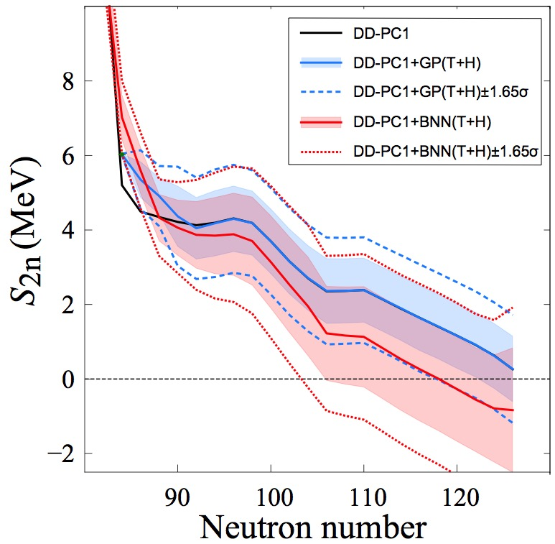
model: N*=126
model+GP: N*=126 (N*=122 at 1σ and N*=118 at 1.65σ one-sided/credibility 95%)
model+BNN: N*=118 (N*=104 at 1σ and N*=102 at 1.65σ)
Can one say: “DD-PC1 predicts the 2n dripline at N=126” ?

Slide 12
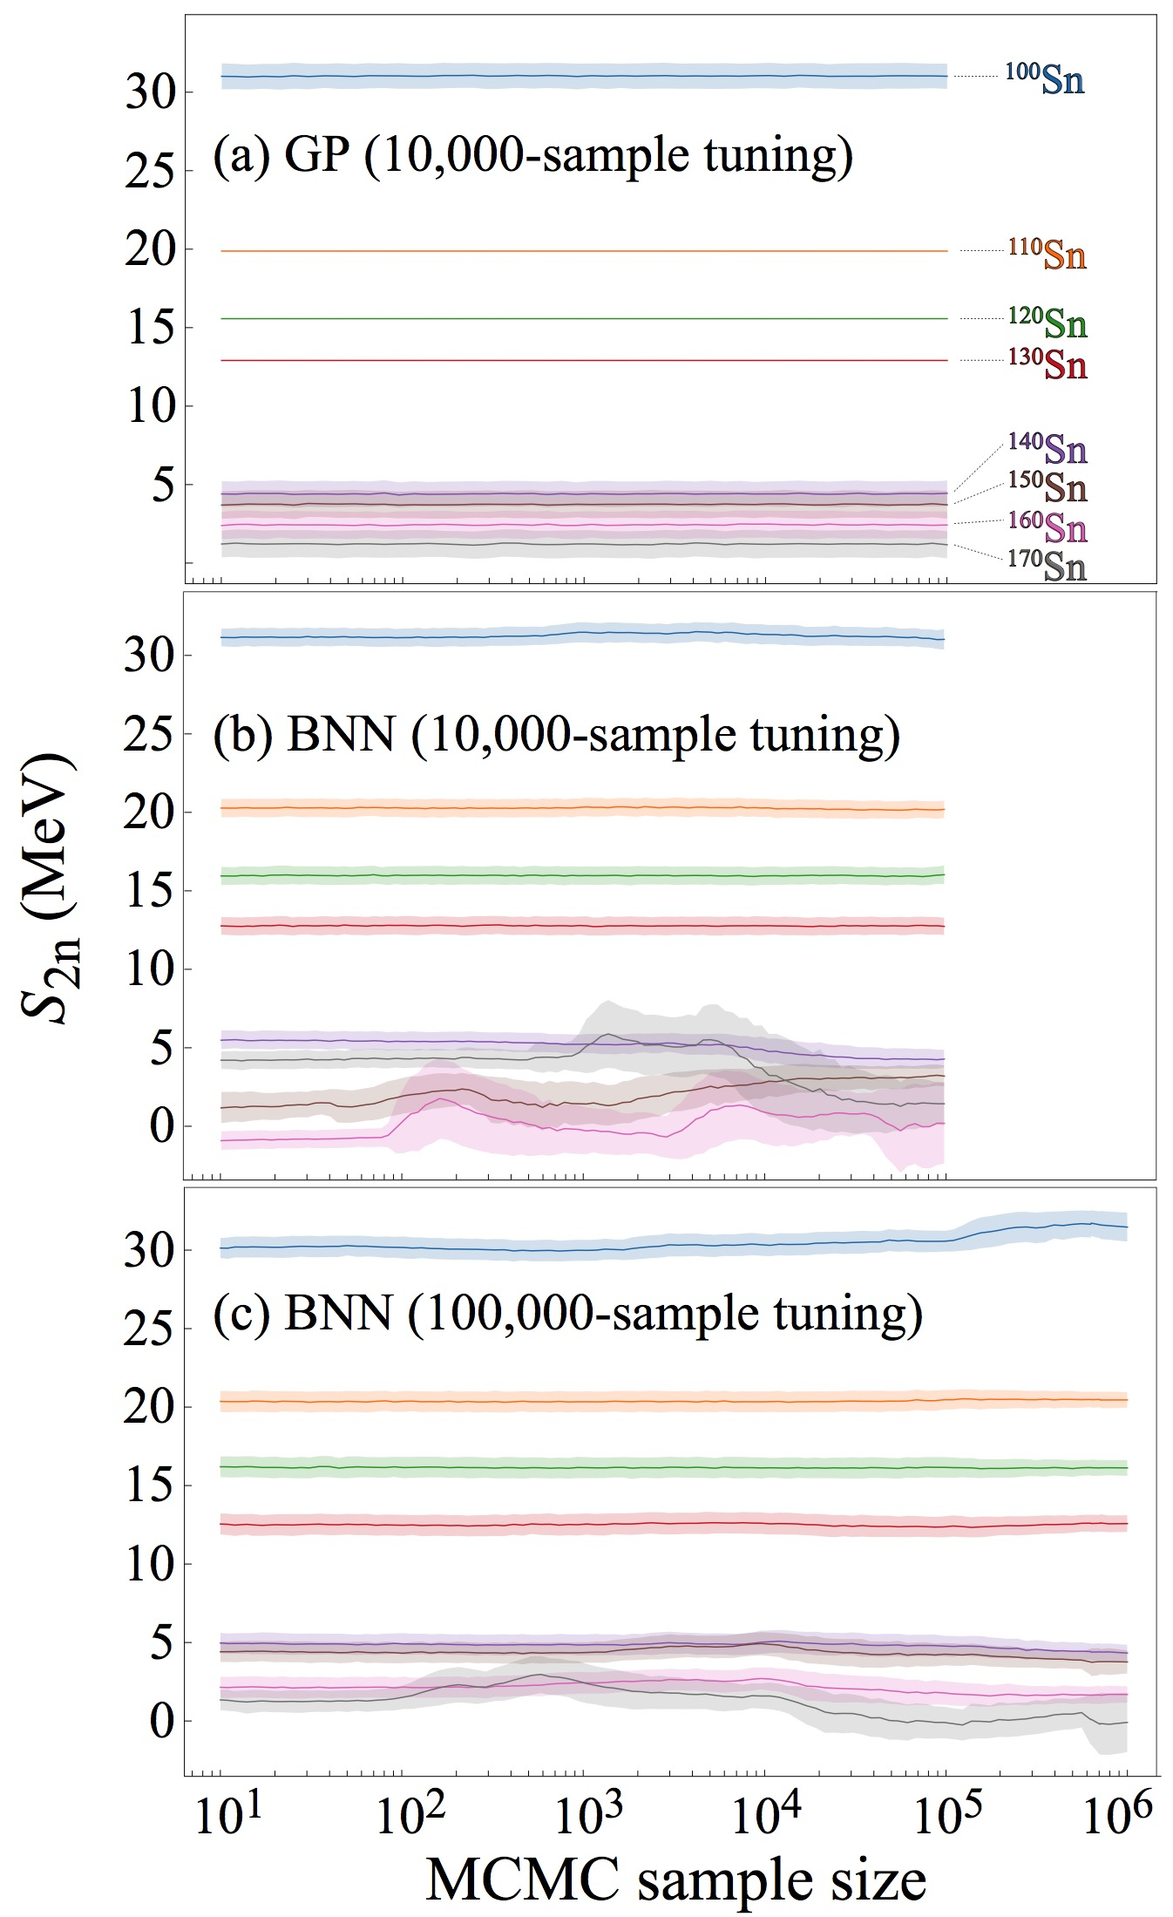
Massive MCMC runs: BNN shows convergence issues!

Slide 13
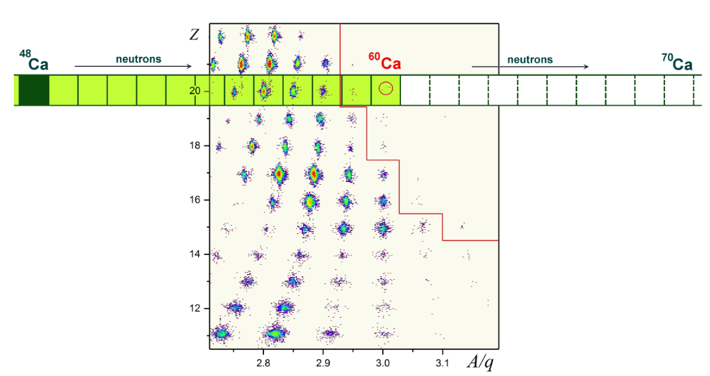
Discovery of ⁶⁰Ca
O.B. Tarasov et al. Phys. Rev. Lett. 121, 022501 (2018)
⁵⁹K ?
The eight new neutron-rich nuclei discovered, ⁴⁷P, ⁴⁹S, ⁵²Cl, ⁵⁴Ar, ⁵⁷K, ^{59,60}Ca, and ⁶²Sc, are the most neutron-rich isotopes of the respective elements. In addition, one event consistent with ⁵⁹K was registered.

Slide 14
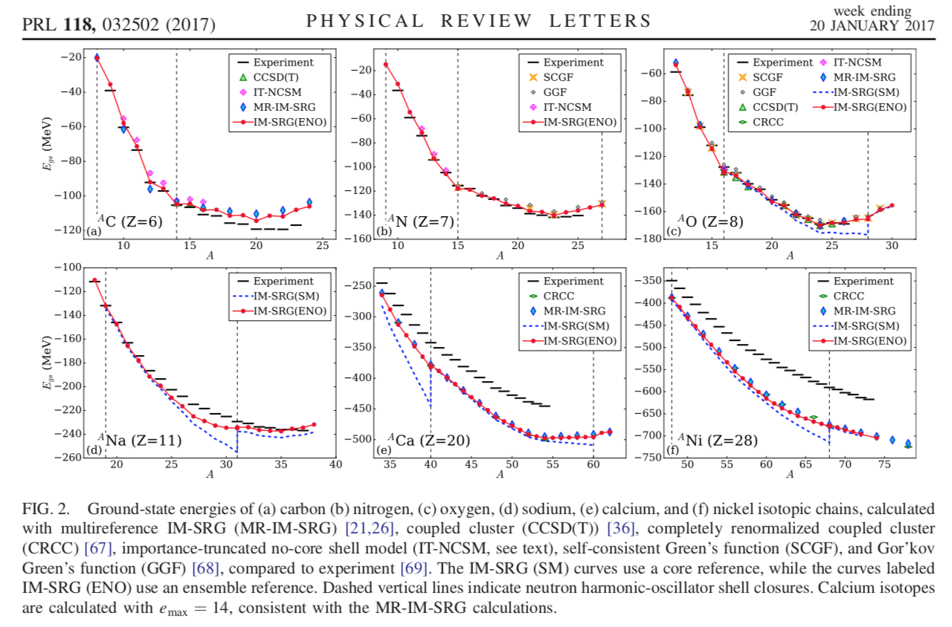
S. R. Stroberg et al.

Slide 15
Phys. Scripta 2013, 014022 (2013)

Slide 16
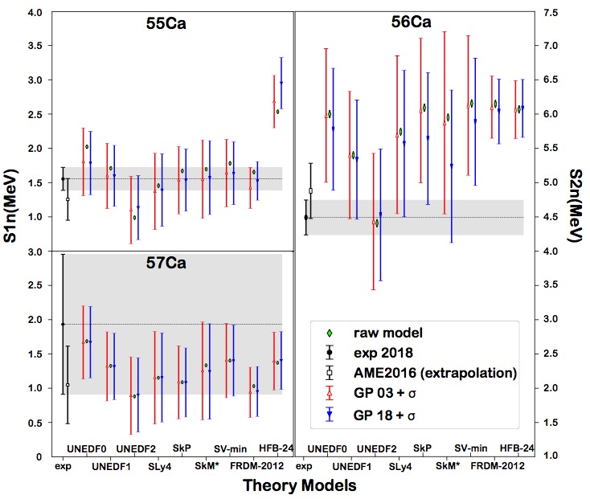
Validation: new masses of ⁵⁵⁻⁵⁷Ca
S. Michimasa, et al., Phys. Rev. Lett. 121, 022506 (2018)

Slide 17
Probability of existence
Neufcourt, Cao, Nazarewicz, Olsen, to be published
We introduce the posterior probability p_{ex}(Z,N) of the predicted separation energy S_{1n/2n}(Z,N) being positive:
*

Slide 18
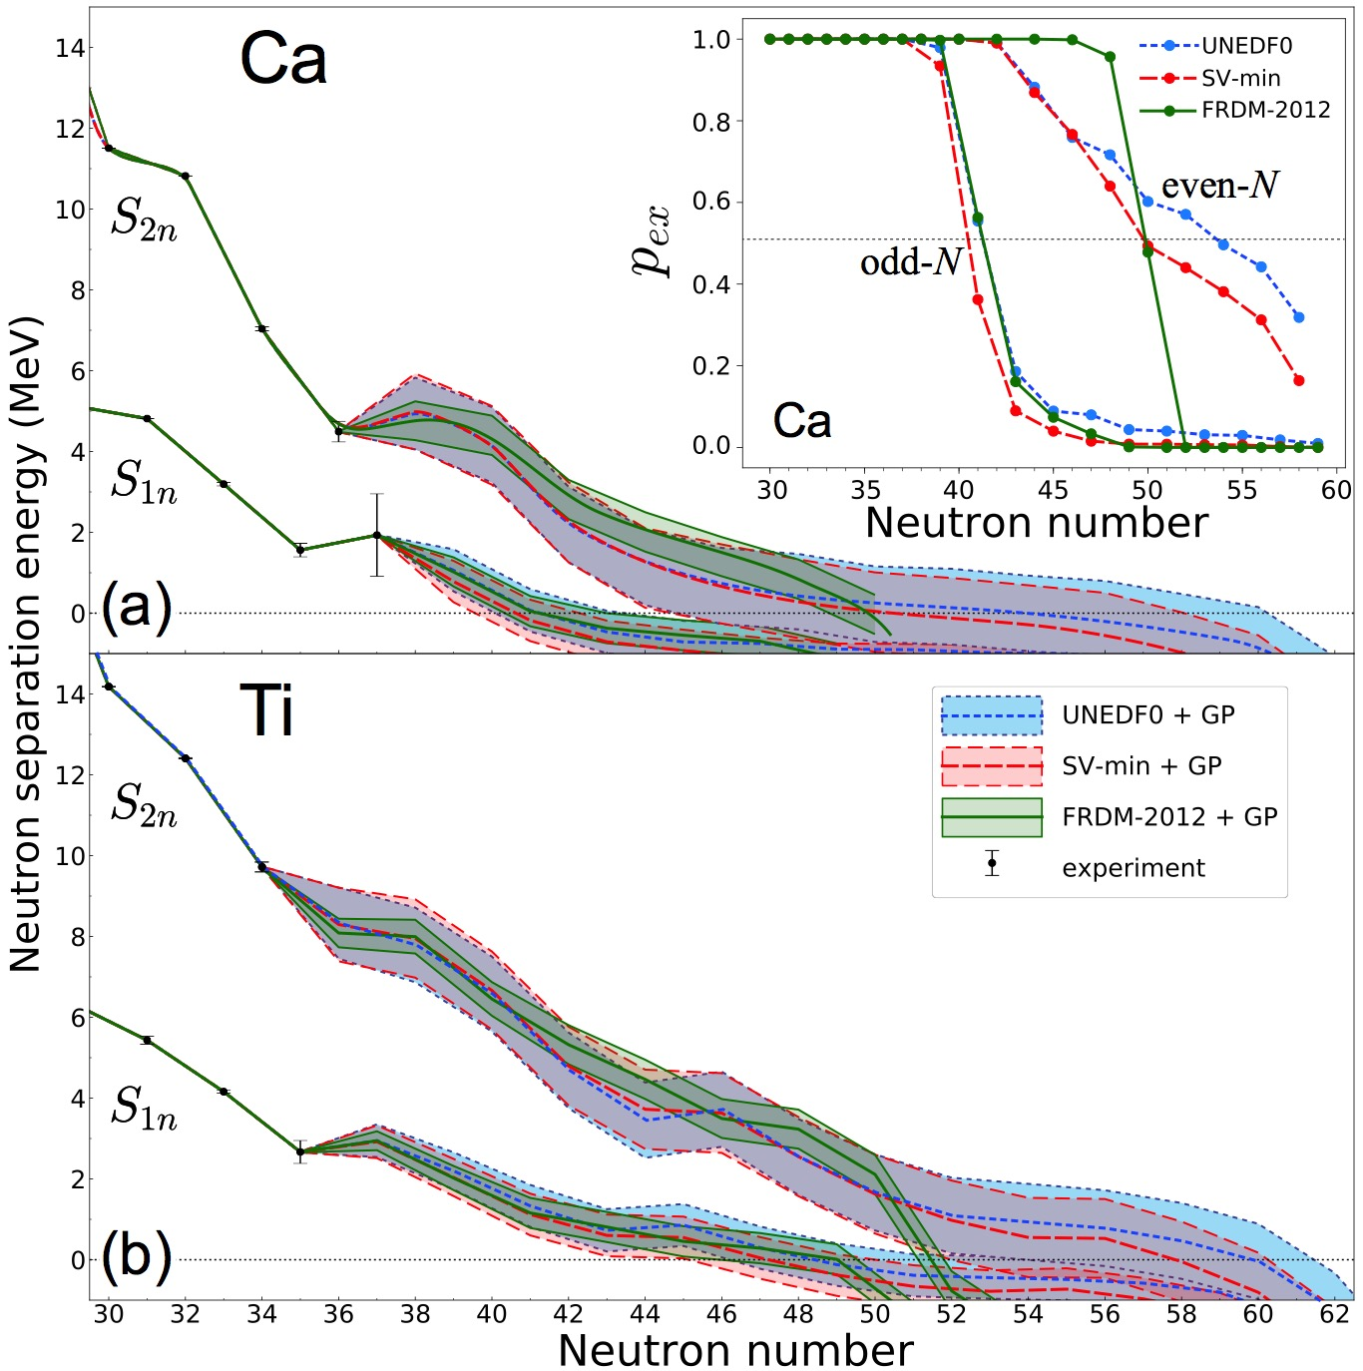
Neutron drip line in the Ca region from Bayesian machine learning and Bayesian model averaging

Slide 20
Naïve nuclear theorist’s approach to a systematic (model) error estimate:
Take a set of reasonable global models M_{i}, hopefully based on different assumptions/formalism, that satisfy basic theoretical requirements (here comes the expert belief thing)
Make predictions: E(y;M_{i})=y_{i}
Compute average and variation within this set
Compute rms deviation from existing experimental data.
Can we do better? Yes!

Slide 21
Bayesian model mixing
Our model mixing calculations were done by averaging posteriors obtained with individual models. In the first averaging variant, we assumed model-independent prior weights. In the second posterior averaging variant, the weights were obtained as the Bayesian posterior probabilities that a model M_{k} predicts the existence of the key nuclei ⁵²Cl, ⁵³Ar, and ⁴⁹S, namely:

Slide 23
Summary
While both Gaussian processes and Bayesian neural networks reduce the rms deviation from experiment significantly, GP offers a better and more stable performance. The increase in the predictive power of DFT models aided by the statistical treatment is quite astonishing: the resulting rms deviations from experiment on the testing dataset are similar to those of well-fitted mass models.
The estimated confidence intervals on predictions make it possible to evaluate predictive power of individual models, and also use groups of models to make quantified predictions.
We quantified the neutron-stability of the nucleus in terms of its existence probability p_{ex}. Our results are fairly consistent with recent experimental findings: ⁶⁰Ca is expected to be well bound with S_{2n}~ 5 MeV while ⁴⁹S, ⁵²Cl, and ⁵³Ar are predicted to be marginally-bound threshold systems. One event consistent with ⁵⁹K was registered. According to our calculations, this nucleus is expected to be firmly neutron-bound.

Slide 24
Thank you!

Slide 25
What is required?
Common dataset Y (as large as possible) needs to be defined
Statistical analysis for individual models needs to be carried out (parameter posteriors determined)
Individual model predictions carried out, including statistical uncertainties
Decision should be made on the prior model probability p(M_{k})
The posterior mean and variance of y are:
M₁
M₁₂₇₁
M₂
Y
M₃
Y ⊂Y_{α} ⊂Y_{tot}
M_{α}
Y_{α}
set of observables Y_{tot}

Slide 26
Bayesian Model Averaging (BMA)
models considered
posterior distribution given data
Posterior distribution of y under each model
quantity of interest
observables
(data)
posterior probability of a model
The posterior probability for the model M_{k}
prior probability that the model M_{k} is true (!!!)
marginal density of the data; integrated likelihood of model M_{k}
likelihood
prior distribution of parameters

Slide 27
Model selection and Bayes Factor (BF)
BF an be used to decide which of two models is more likely given a result y.
The outcome
The posterior mean and variance of y are:

Slide 28
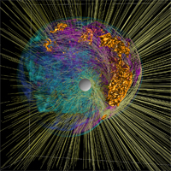
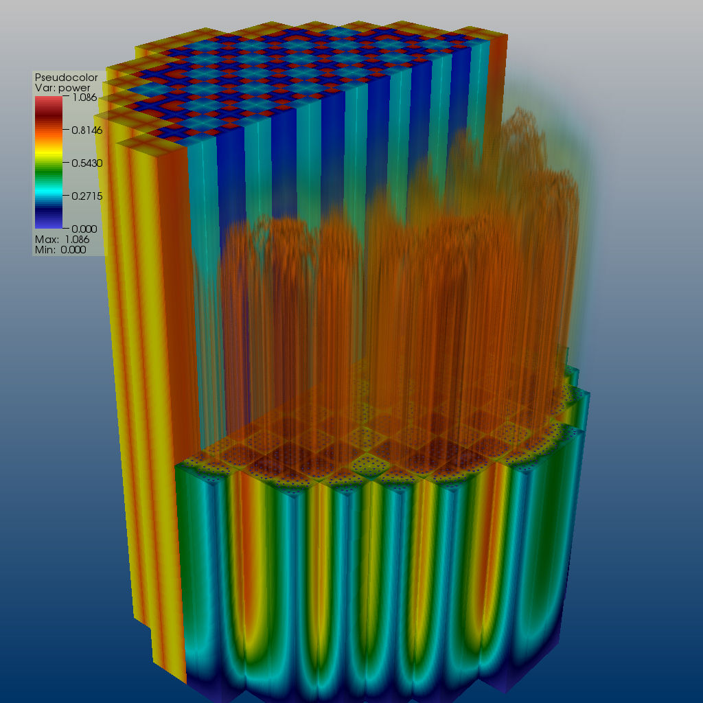
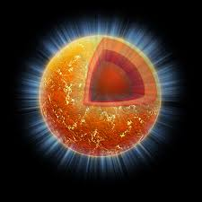

Bayesian inference & RNB science
Beam time and compute cycles are difficult to get and expensive
  What is the information content of measured observables?
  Are estimated errors of measured observables meaningful?
  What experimental data are crucial for better constraining current nuclear models?
New technologies are essential for providing predictive capability, to estimate uncertainties, and to assess extrapolations
  Theoretical models are often applied to entirely new nuclear systems and conditions that are not accessible to experiment
Statistical tools can help us revealing the structure of our models
  Parameter reduction
  Uncertainty quantification

Slide 29
From Hoeting and Wasserman:
When faced with several candidate models, the analyst can either choose one model or average over the models. Bayesian methods provide a set of tools for these problems. Bayesian methods also give us a numerical measure of the relative evidence in favor of competing theories.
Model selection refers to the problem of using the data to select one model from the list of candidate models. Model averaging refers to the process of estimating some quantity under each model and then averaging the estimates according to how likely each model is.
Bayesian model selection and model averaging is a conceptually simple, unified approach. An intrinsic Bayes factor might also be a useful approach.
There is no need to choose one model. It is possible to average the predictions from several models.
Simulation methods make it feasible to compute posterior probabilities in many problems.
It should be emphasized that BMA should not be used as an excuse for poor science... BMA is useful after careful scientific analysis of the problem at hand. Indeed, BMA offers one more tool in the toolbox of applied statisticians for improved data analysis and interpretation.

