Slide 1
A method to measure the transition energy of the isochronously tuned storage ring
RuiJiu Chen
Institute of Modern Physics, Chinese Academy of Sciences
Notes:
Good Afternoon, everyone. My name is Chen Ruijiu. I am from institute of modern physics, Chinese academy of sciences. First I would like to thank organizer to give me this opportunity to attend this conference. Today I will give a talk on “a method to measure the transition energy of the isochronously tuned storage ring”.

Slide 2
Outline
Introduction
Principle
Applications
Summary
Acknowledgement

Slide 3
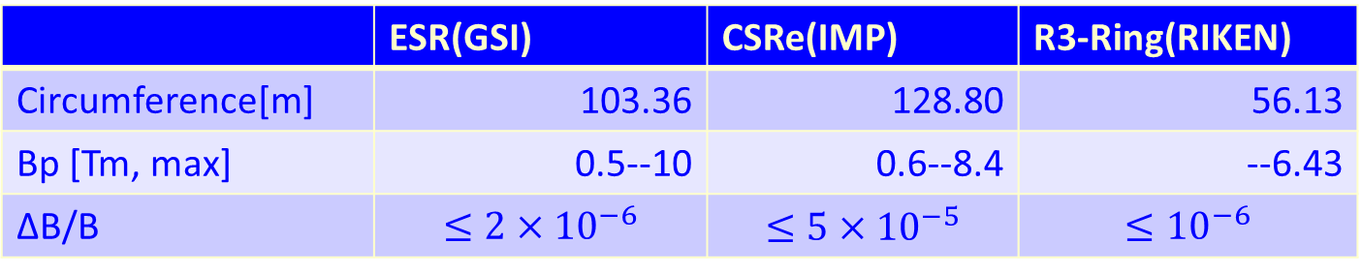
1.1 Introduction
ESR
GSI
German
CSRe
IMP
China
R3-Ring
RIKEN
Japan
 | ESR(GSI) | CSRe(IMP) | R3-Ring(RIKEN)
Circumference[m] | 103.36 | 128.80 | 56.13
Bp [Tm, max] | 0.5--10 | 0.6--8.4 | --6.43
ΔB/B | $$≤2×{10}^{−6}$$ | $$≤5×{10}^{−5}$$ | $$≤{10}^{−6}$$
Notes:
Masses are basic nuclear properties.
The Isochronous Mass Spectrometry (IMS) is an important tools used to obtain accurate masses of nuclei located far away from the valley of beta stability.
Until now, there are three isochronous mass spectrometries. These are the experimental storage ring ESR at GSI in German, at the experimental cooler-storage ring CSRe at the IMP in China, and at the R3-ring at the RIKEN in Japan.

Slide 4
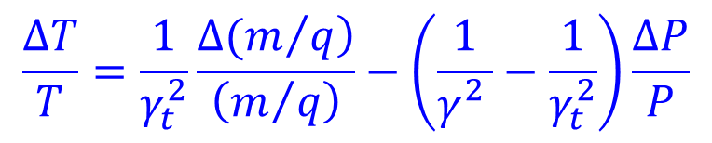
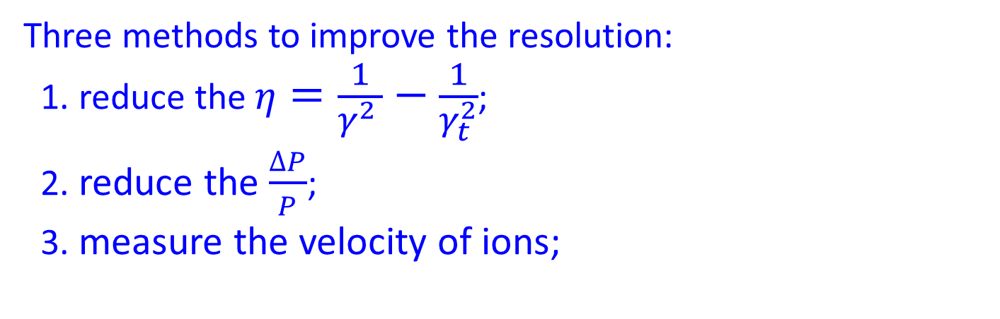
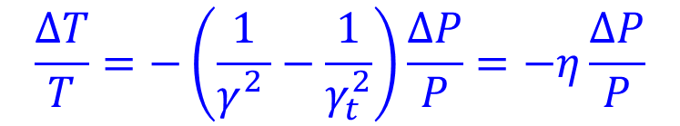
1.1 Introduction
Principle of IMS:
$$\frac{∆T}{T}=\frac{1}{γ_{t}^{2}}\frac{\left.∆(m/q\right)}{\left(m/q\right)}−\left(\frac{1}{γ_{}^{2}}−\frac{1}{γ_{t}^{2}}\right)\frac{∆P}{P}$$
For the ions of the same species:
$$\frac{∆T}{T}=−\left(\frac{1}{γ_{}^{2}}−\frac{1}{γ_{t}^{2}}\right)\frac{∆P}{P}=−η\frac{∆P}{P}$$
Three methods to improve the resolution:
1. reduce the $η=\frac{1}{γ_{}^{2}}−\frac{1}{γ_{t}^{2}}$;
2. reduce the $\frac{∆P}{P}$;
3. measure the velocity of ions;
We need to know the γ_{t} for all three methods!
Notes:
The principle of the IMS is expressed by the this equation. Here T is revolution time of stored ions. m/q is mass-to-charge ratios of stored ions. g is the relativistic Lorentz factor of stored ions and dp/p is the momentum acceptance of the storage ring. gtr is the transition energy of the storage ring.
For the same species of ions, the above formula can be simplified to this formula. This formula determines the mass resolving power of isochronous mass spectrometry.
There are various methods to reduce dT/T. One method is to reduce the yita by adjusting the gt of storage ring. The limitation of this method is that it can only improve resolution for one specific isotope.
Another method is to reduce dP/P by using a mechanical slit. The disadvantage of this method is that it will loss valuable statistics.
The third method is to measure the velocity of ions by using two timing detector. We call it as double TOF isochronous mass spectrometry. In principle, we can improve the resolution without losing stastiscs.
For all three methods, we need to know the transition energy gt of storage ring.

Slide 5
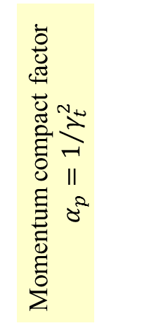
1.2 Existing methods to measure the γ_{t}
1. Measure the γ_{t} of IMS by using electron cooling in SMS.
Advantage: the dependence of the γ_{t} on the orbital length can be measured
Limitation: electron cooling is needed.
X. L. Yan, et al., Physica Scripta T166 (2015) 014045.
Momentum compact factor
$$α_{p}=1/{γ_{t}^{2}}$$
Notes:
Since transition energy gt plays a very important role in the IMS experiments, it is necessary to measure it. However, it is difficult to measure the gt of storage ring.
Until now, there are some existing methods to measure the gammat of a storage ring.
At the ESR, people uses the electron cooling and primary beam to measure the gammat. The storage ring acceptance is scanned by changing the ion velocity and the corresponding revolution frequencies are used to extract the gt.
The advantage of this method is that it can determine the gt of each orbital precisely. However, because the electron cooler can not be used during experiments, this method can be not used for online monitoring of gt.

Slide 6
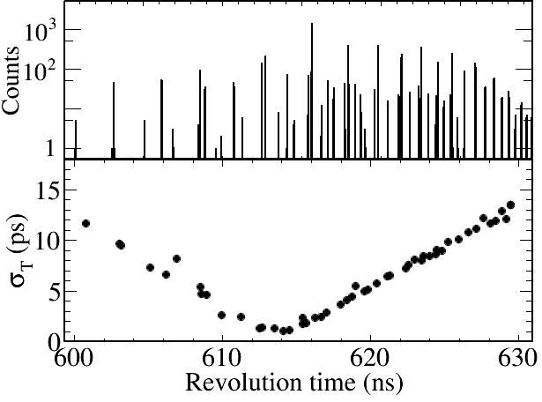
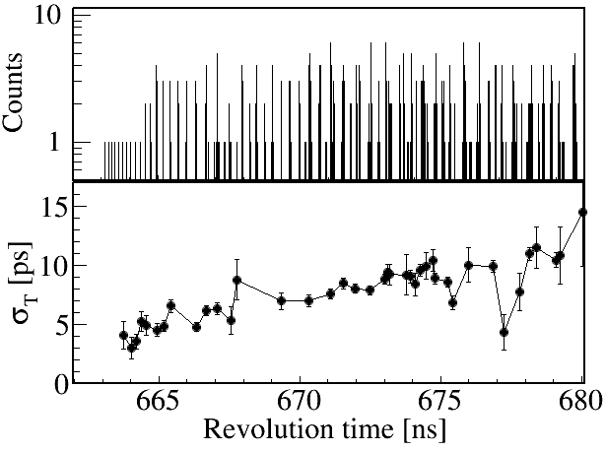

1.2 Existing methods to measure the γ_{t}
2. Measure the γ_{t} of IMS by revolution time spectrum.
Advantage:
can be used as a real-time monitor of the γ_{t}
Limitation: affected by the instability of magnetic field and isochronous setting.
⁵⁸Ni@2011 Exp.
¹¹²Sn@2015 Exp.
Notes:
In IMP, because the electron cooler doesn’t work, we determine the gammat from revolution time spectrum. For example, this is a typical revolution time spectrum. Each point represent one isotope. The x-axis of each point represent the mean revolution time of this isotope. The y-axis represent the width of this isotope. The width is small when the gamma is closed to gammat and becomes larger and larger when the gamma is far away from gammat. Therefore, we can determine the gt roughly from the revolution time spectrum.
The advantage of this method is that it can be used as a real-time monitor of the gammat. The disadvantage is that it is largely affected by the instabilities of magnetic fields of ring magnets and isochronous settings. For example, if the result is like this, then it is difficult to determine the gammat.

Slide 7
1.3 Existing methods to measure the γ_{t}
3. Other methods. …
Notes:
It has been a challenge to measure the gammat of isochronous mass spectrometry. Therefore, we try to develop a new technique to determine the gammat online.

Slide 8
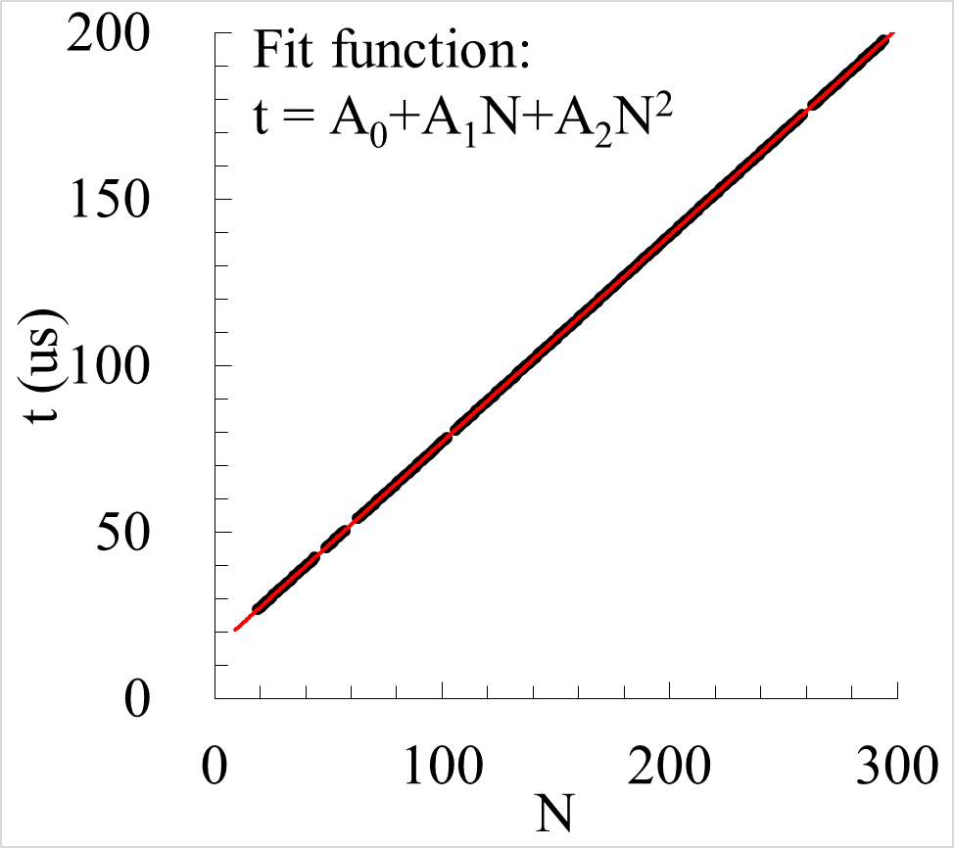

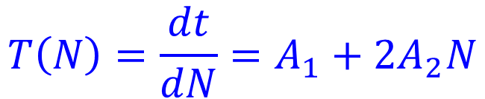
2.1Principle
The time of signals of each ion are fitted by second order polynomial function as follow
$$t=A_{0}+A_{1}N+A_{2}N^{2}$$
（1）
The revolution time is determined by:
$$T\left(N\right)=\frac{dt}{dN}=A_{1}+{2A}_{2}N$$
（2）
The difference of revolution time of each ion between two turns:
$$δT=T\left(N+1\right)−T\left(N\right)=2A_{2}$$
（3）
Notes:
Let me briefly introduce the principle. For example, we stored one ion inside storage ring. The ion will circulate 300 turns inside storage ring. We use a timing detector to measure it. We will get a sequence of timing signals. We fit the time of signals by a polynomial function and determine its revolution time.
In principle, if the revolution time is a constant value, we only need a linear function. However, in our data analysis, we found that we have to use a second order polynomial function to fit it. Then the revolution time of this ion is calculated by this formula. We can see that the revolution time is dependent on turn number. The difference of revolution time between two turns amounts to 2A2. This means that the revolution time is changed turn by turn.
At beginning, we cannot understand this phenomena. Finally, we realized that this is the second order term is caused by the energy loss inside carbon foil.

Slide 9
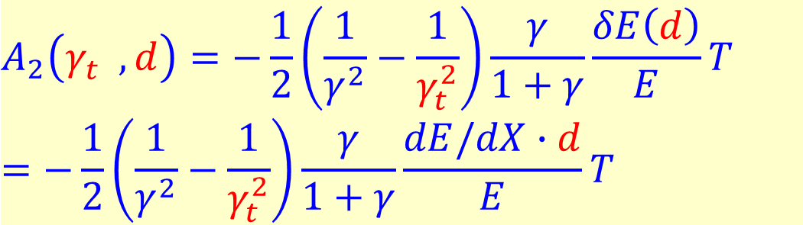
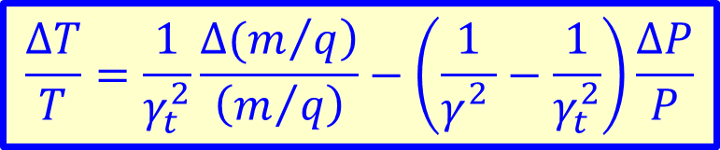
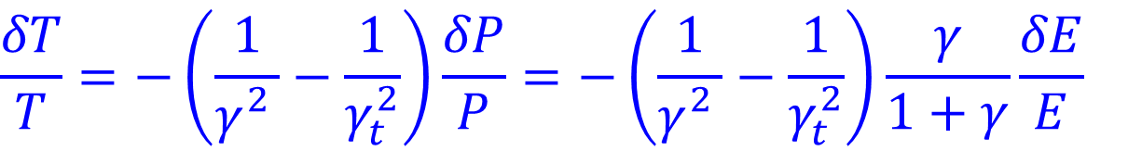
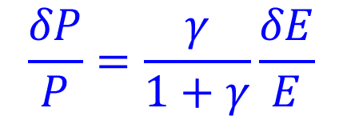
2.2Principle
$$\frac{∆T}{T}=\frac{1}{γ_{t}^{2}}\frac{\left.∆(m/q\right)}{\left(m/q\right)}−\left(\frac{1}{γ_{}^{2}}−\frac{1}{γ_{t}^{2}}\right)\frac{∆P}{P}$$
The difference of revolution time between two turns caused by energy loss of carbon foil:
$$\frac{δT}{T}=−\left(\frac{1}{γ_{}^{2}}−\frac{1}{γ_{t}^{2}}\right)\frac{δP}{P}=−\left(\frac{1}{γ_{}^{2}}−\frac{1}{γ_{t}^{2}}\right)\frac{γ}{1+γ}\frac{δE}{E}$$
（4）
$$\frac{δP}{P}=\frac{γ}{1+γ}\frac{δE}{E}$$
（5）
Submitting (3) into (4)：
$$A_{2}\left(γ_{t}^{},d\right)=−\frac{1}{2}\left(\frac{1}{γ^{2}}−\frac{1}{γ_{t}^{2}}\right)\frac{γ}{1+γ}\frac{δE\left(d\right)}{E}T$$
$$=−\frac{1}{2}\left(\frac{1}{γ^{2}}−\frac{1}{γ_{t}^{2}}\right)\frac{γ}{1+γ}\frac{dE/dX∙d}{E}T$$
（6）
Notes:
For the same species of ions, the relative difference of revolution time dT/T which is caused by energy loss of carbon foil is given by this formula. Here dE represent energy loss of carbon foil. Gamma is Lorenz factor. Then submit the previous equation (3) into (4), we can deduce this formula.

Slide 10
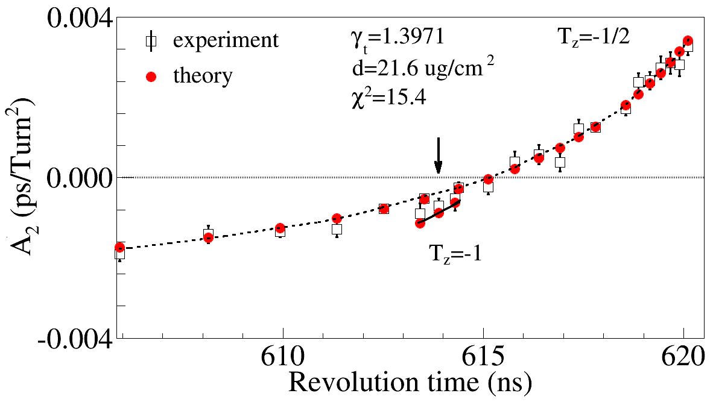
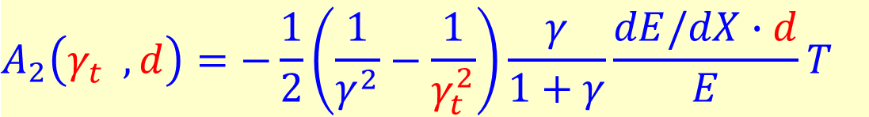
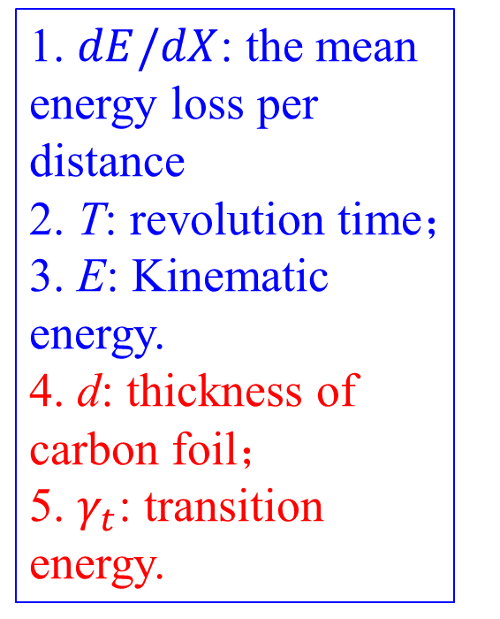
2.2Principle
$$A_{2}\left(γ_{t}^{},d\right)=−\frac{1}{2}\left(\frac{1}{γ^{2}}−\frac{1}{γ_{t}^{2}}\right)\frac{γ}{1+γ}\frac{dE/dX∙d}{E}T$$
（6）
1. $dE/dX$: the mean energy loss per distance
2. T: revolution time；
3. E: Kinematic energy.
4. d: thickness of carbon foil；
5. $γ_{t}$: transition energy.
Notes:
From this formula, we can see that the A2 is determined by energy loss of carbon foil, the revolution time, the kinematic energy and gammat.
We compare this formula with experimental data. Here is a result. We take one hour experimental data for comparison. The black point is the experimental data. Each point represent one isotope. The x-axix means its mean revolution time. The y-axis means its mean A2 value. The red point is the theoretical result calculated by this formula. We assume that the gammat = 1.3971 and d=21.6 in this theoretical calculation.
We can see that experimental A2 parameters can be descripted by this formular very well.

Slide 11
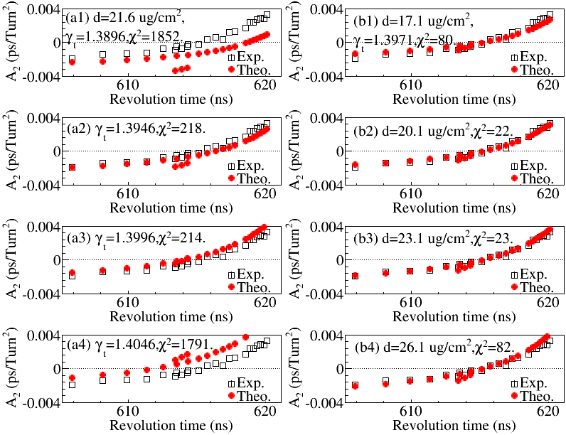
2.3.2
Notes:
We try to change the d and gammat parameters. We calculate the chi2 value for each set of parameter. These are results. First we fixed the d parameters and only change gammat. The results are shown at left pictures. Second, we fixed the gammat value and change the d parameters. The results are shown at right pictures. We can clear see that the chi2 is very sensitive to the d and gammat parameters.

Slide 12
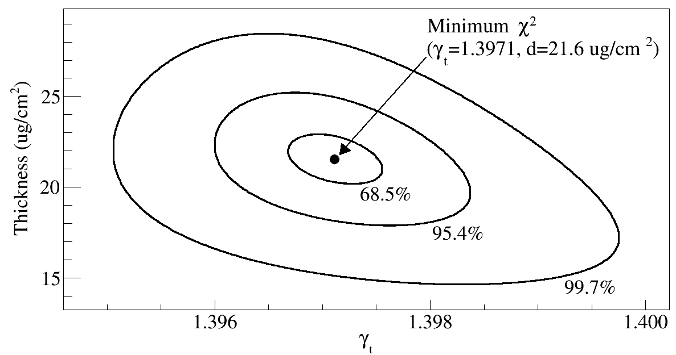
2.3 Evaluate the optimized thickness of carbon foil and γ_{t}
The optimized thickness of carbon foil is 21.6+/-1.4 ug/cm² and γ_{t} is 1.3971+/-0.0005.
The γ_{t} could be changed over time. Therefore, the calculated γ_{t} here represents the average γ_{t} during one hour.
Notes:
Therefore, we try to calculate the optimized d and gammat value by minimizing the chi2 value. Here is the result. The optimized d value is 21.6+/-1.4 ug, gammat =1.3971+/-0.0005. Here we take one hour of experimental data in this analysis. Because the gammat could be changed over time. Therefore, the gammat value represent the average value during this one hour. This give us a opportunity to determine the gamma and d value from experimental data.

Slide 13
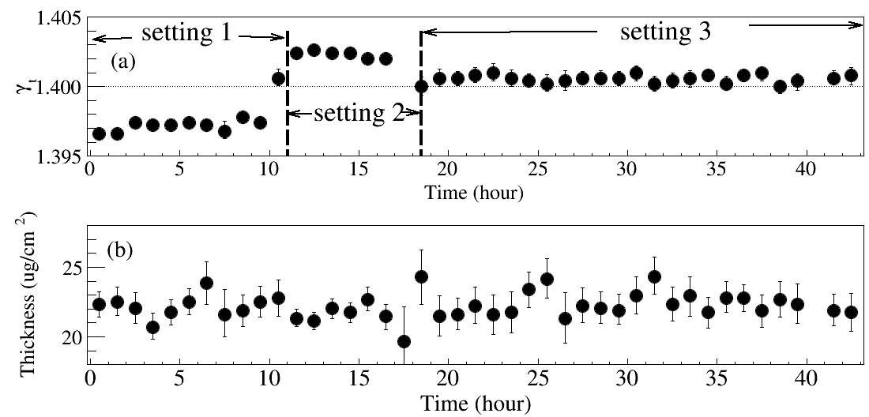
3.1 Evaluate the thickness of carbon foil and γ_{t} by minimizing χ2 value
adjust the quadrupole of CSRe.
a slit was used.
⁵⁸Ni@2014
Optmised thickness：22.3±1.3 ug/cm²
Designed value：20 ug/cm²
Notes:
We use this method to analyze 48 hours experimental data. Here is the results. The x-axis represent the time. The up panel represents the variation of gammat over time. The bottom panel represents the variation of thickness over time.
In this experiments, we did two adjustments: 1) we change the quadrupole of CSRe. 2) we use a slit to reduce the momentum acceptance of CSRe. We can see that the gammat value is changed when we adjusted the experimental setting. However, the thickness is almost not changed all the time. The designed thickness of carbon foil is 20 ug/cm2. It is shown as this line. The thickness calculated by our methods is 22.3+/- 1.3 ug/cm2. It is closed to designed value.

Slide 14
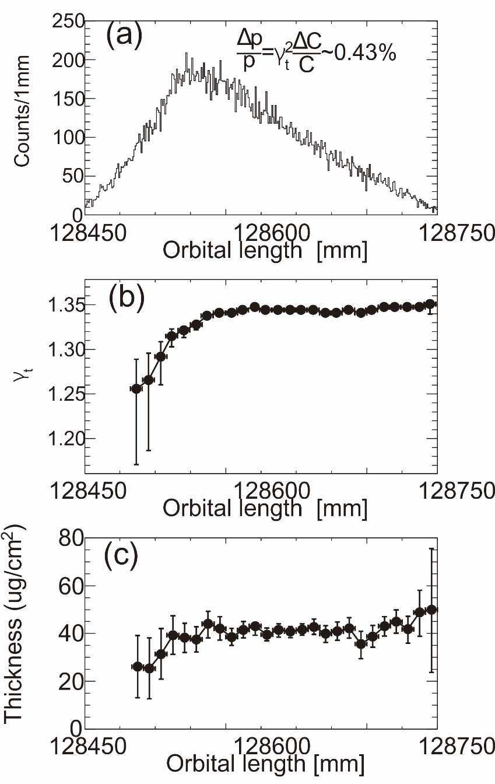
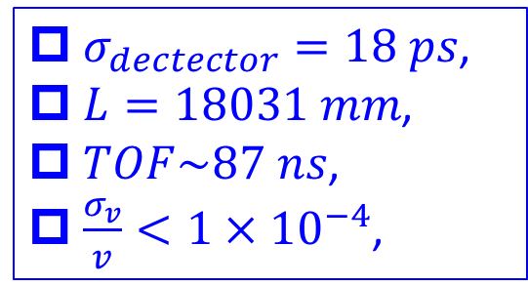

3.2Determination of the γ_{t} as a function of orbital length C
L
示波器
$σ_{dectector}=18 ps$,
$L=18031 mm$,
$TOF\sim 87 ns$,
$\frac{σ_{v}}{v}<1×{10}^{−4}$,
Optmised thickness：
39.2±6 ug/cm²
$$C=vT$$
Designed value：
40 ug/cm²
Notes:
We use this method the calculate the gammat as a function of orbital length C in our recent double-TOF IMS experiments. In this experiments, we installed two timing detectors to measure the velocities of ions. The time resolution of time detector is 18ps. The length between two detector is about 18 meters, corresponding to time-of-flight 87 ns. The precision of velocity measurement is less than 10-4.
The orbital length C is calculated by this formula. V means the velocity. T means the revolution time.
This figure shown the orbital length distribution of ions measured in one hour.
We divides the data into many groups and analyze each group of data and calculate the gammat and d for each group of data.
This figure shows the gammat as a function of C. We can see that the gammat is nearly constant in this part however, changed rapidly at this side.
This figure shows the thickness of carbon foil as a function of orbital length C. The optimized value is estimated to be 39.26 μg/cm2.
Since two detectors are installed, total designed thickness is expected to be 40 ug/cm². The designed value agrees with well our optimized value.

Slide 15
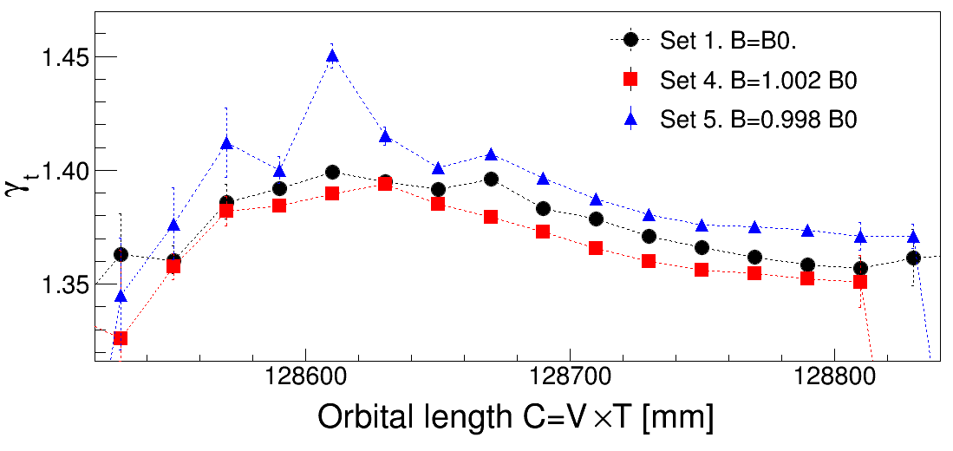
3.3.1 Change gammat curve by dipole.

Slide 16
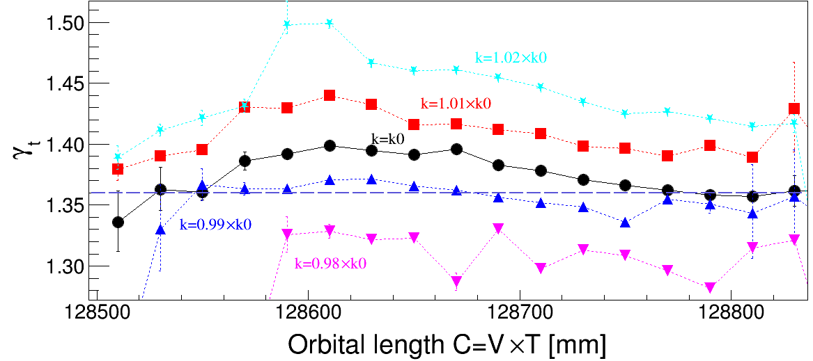
3.3.2 Change gammat curve by quadrupole

Slide 17
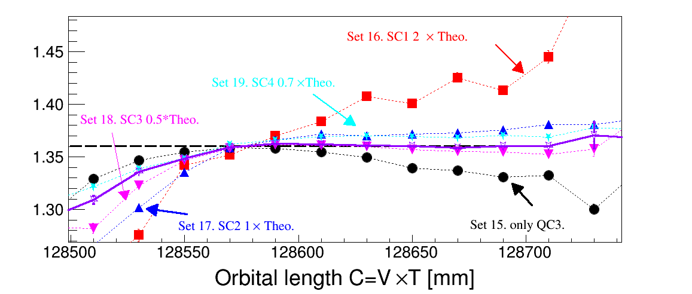
3.3.3 Change gammat curve by sextupole

Slide 18
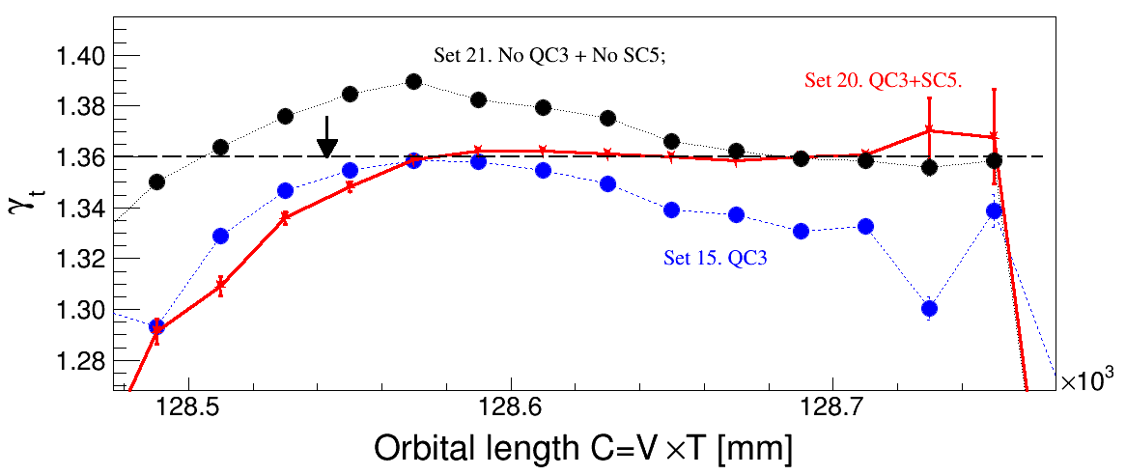
3.3.4 Adjust gammat curve by quadrupole corrections and sextupole corrections.
Black line: No quadrupole correction and sextupole correction.
Blue line. With only quadrupole corrections.
Red line. With both quadrupole corrections and sextupole corrections.

Slide 19
4. Conclusion
I introduce a method which can be used to measure the γt and the thickness of target during the IMS experiments by using experimental data.
Combining with the velocity measurement in IMS with two time-of-flight detectors, the γt as a function of orbital length can be determined by using this method.
The method is used as an online monitor of the γt in IMS experiments.
This method could be used to measure the thickness of solid target for internal target experiment in future.

Slide 20
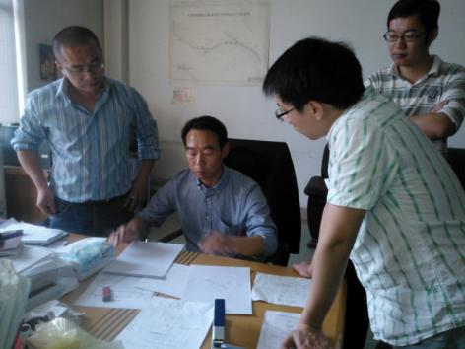
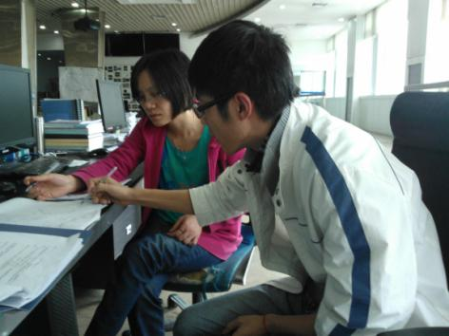
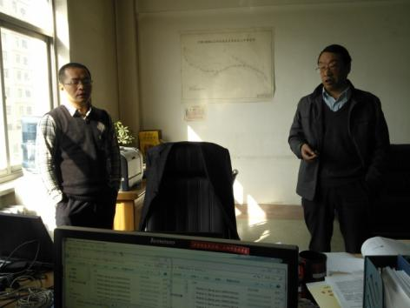
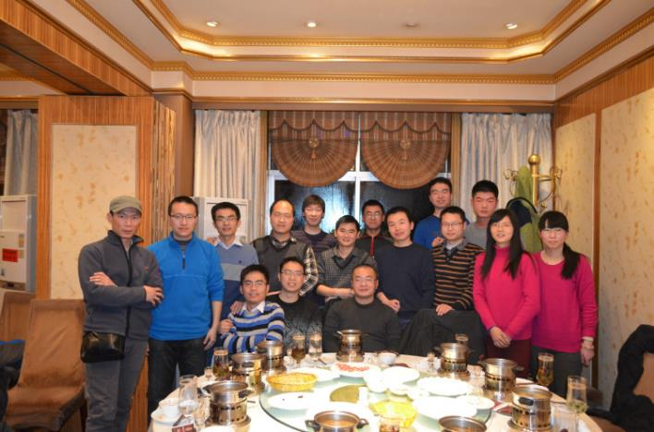
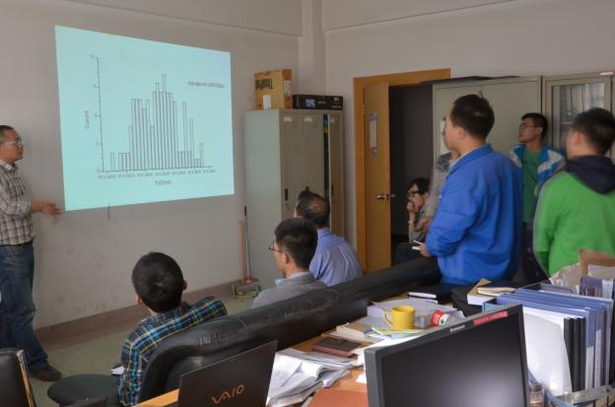
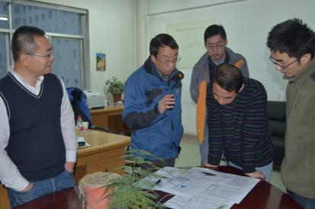
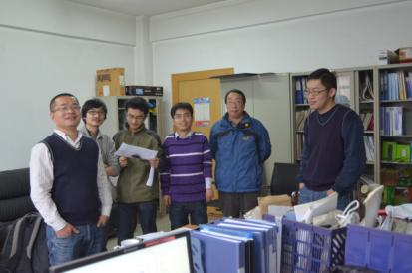
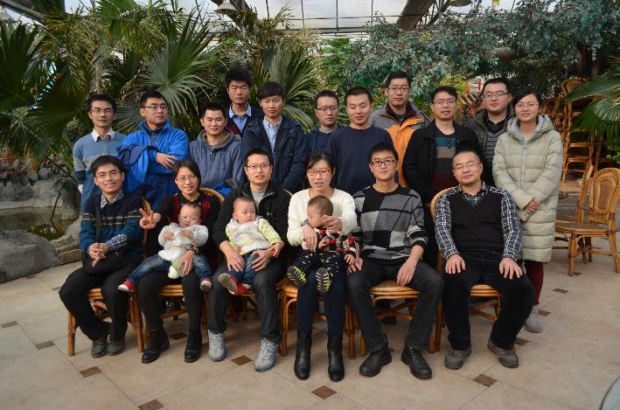

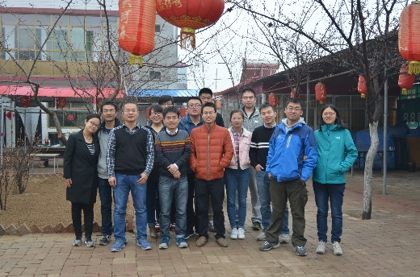

Acknowledgement:

Slide 21
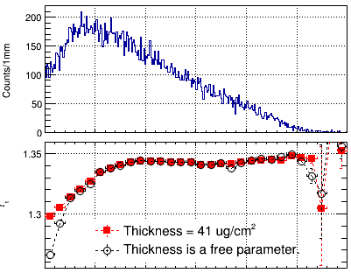
Appendix-1: fixed and not fixed d parameters

