Slide 1


High-precision Q_EC values of superallowed 0⁺ –> 0⁺ β-emitters
⁴⁶Cr, ⁵⁰Fe, and ⁵⁴Ni
P.Zhang
CSR fine nuclear spectroscopy group

Slide 2
Outline
1.Background
2.Experiment
3.Discussion
4.Conclusion

Slide 3
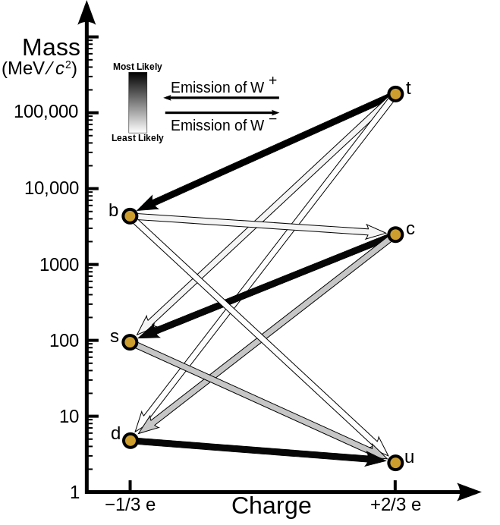
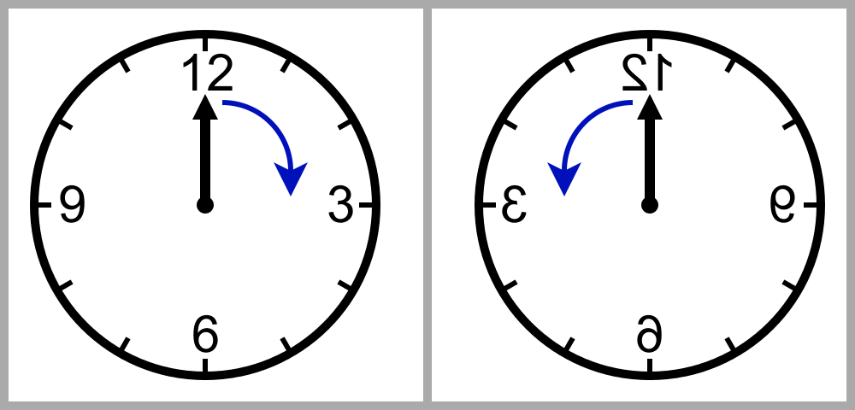
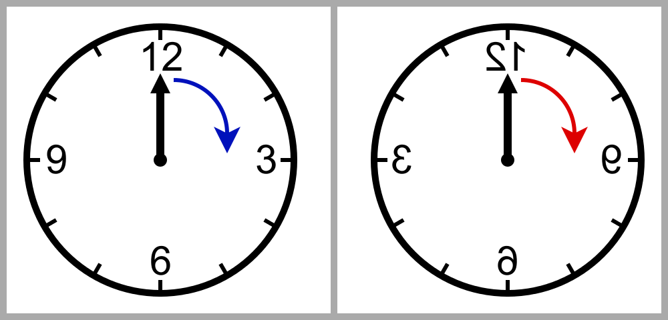
Background
strong interaction
weak interaction
gravitational interaction
electromagnetic interaction
low
symmetry：
space reflection
time reversal
isospin
strangeness
Conserved Vector Current

Slide 4
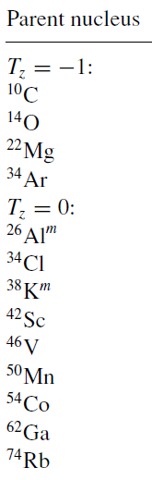
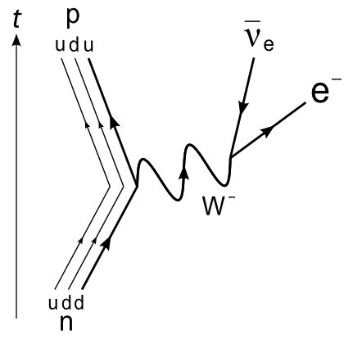
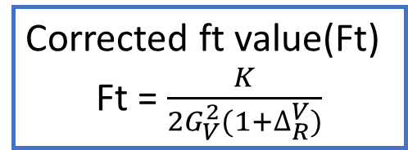
Background
CVC
vector coupling constant(Gv)
constant
1958 - 2017
Superallowed β-decay
0⁺ → 0⁺
β decay
Ft(⁴⁶Cr → ⁴⁶V)
Ft(⁵⁰Fe → ⁵⁰Mn)
Ft(⁵⁴Ni → ⁵⁴Co)
Corrected ft value(Ft)
Ft = $\frac{K}{2G_{V}^{2}(1+∆_{R}^{V})}$

Slide 5

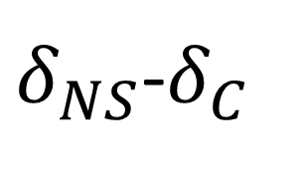
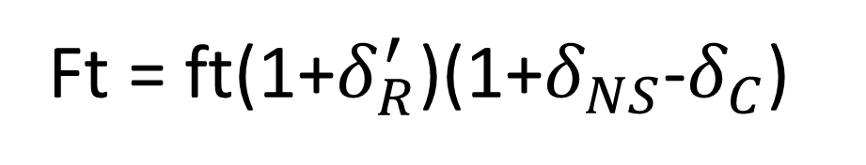
Background
f
Q_{EC}
ME_{mother nuclide}
$$δ_{R}^{′}$$
Ft
T_{1/2}
ME_{daughter nuclide}
t
$δ_{NS}$-$δ_{C}$
BR
ME(⁴⁶Cr)
ME(⁵⁰Fe)
ME(⁵⁴Ni)
Ft = ft(1+$δ_{R}^{′}$)(1+$δ_{NS}$-$δ_{C}$)

Slide 6
Experiment
TOF

Slide 7
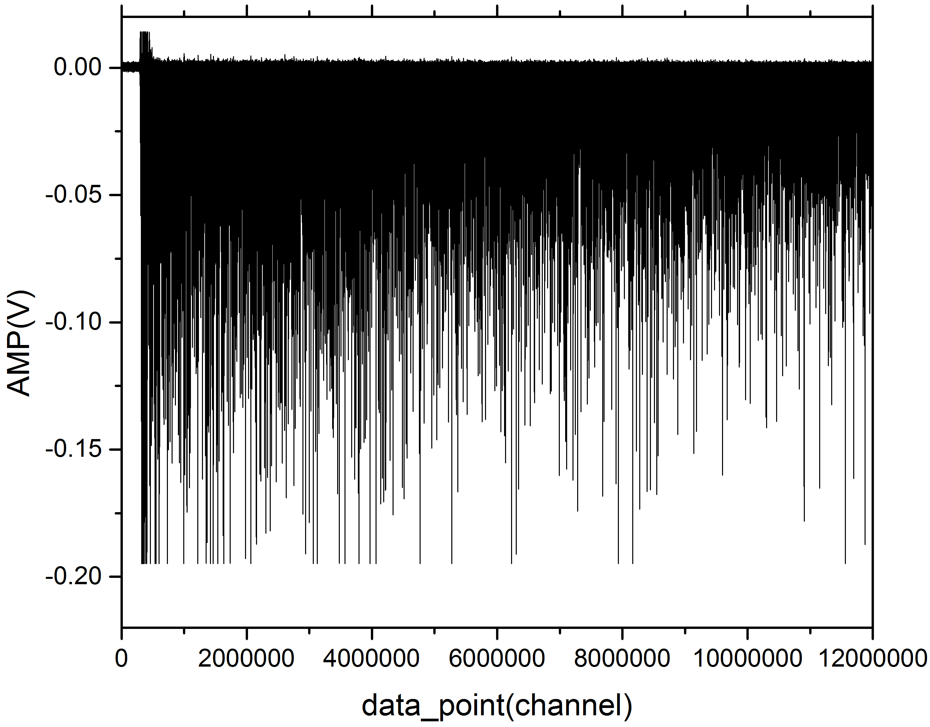
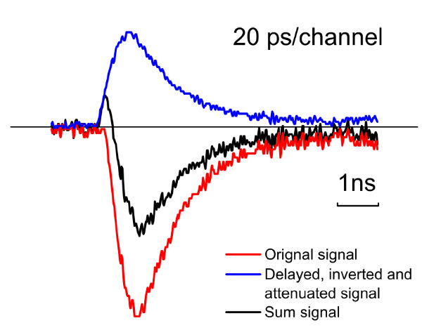
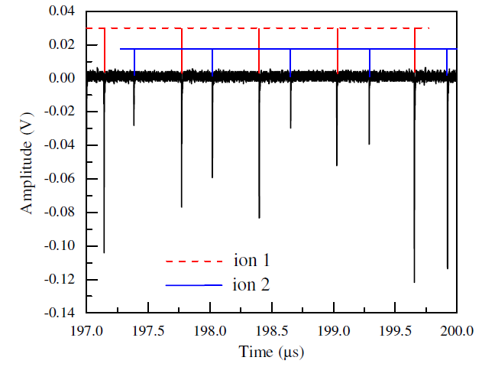
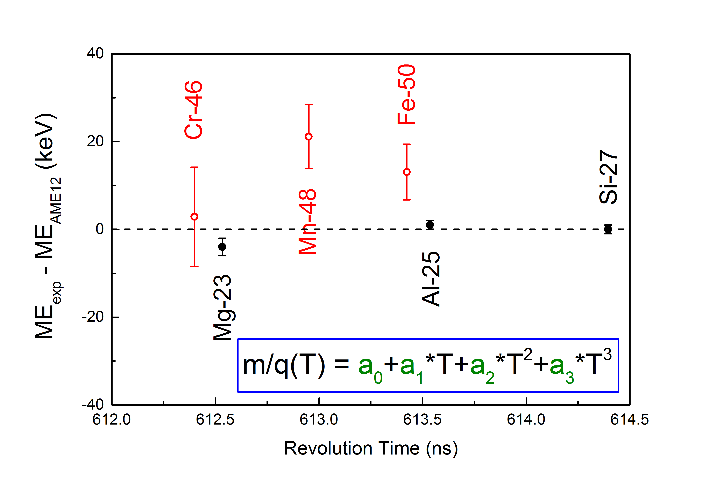
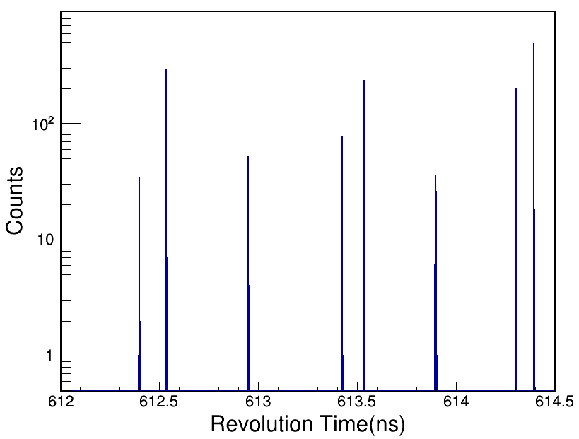
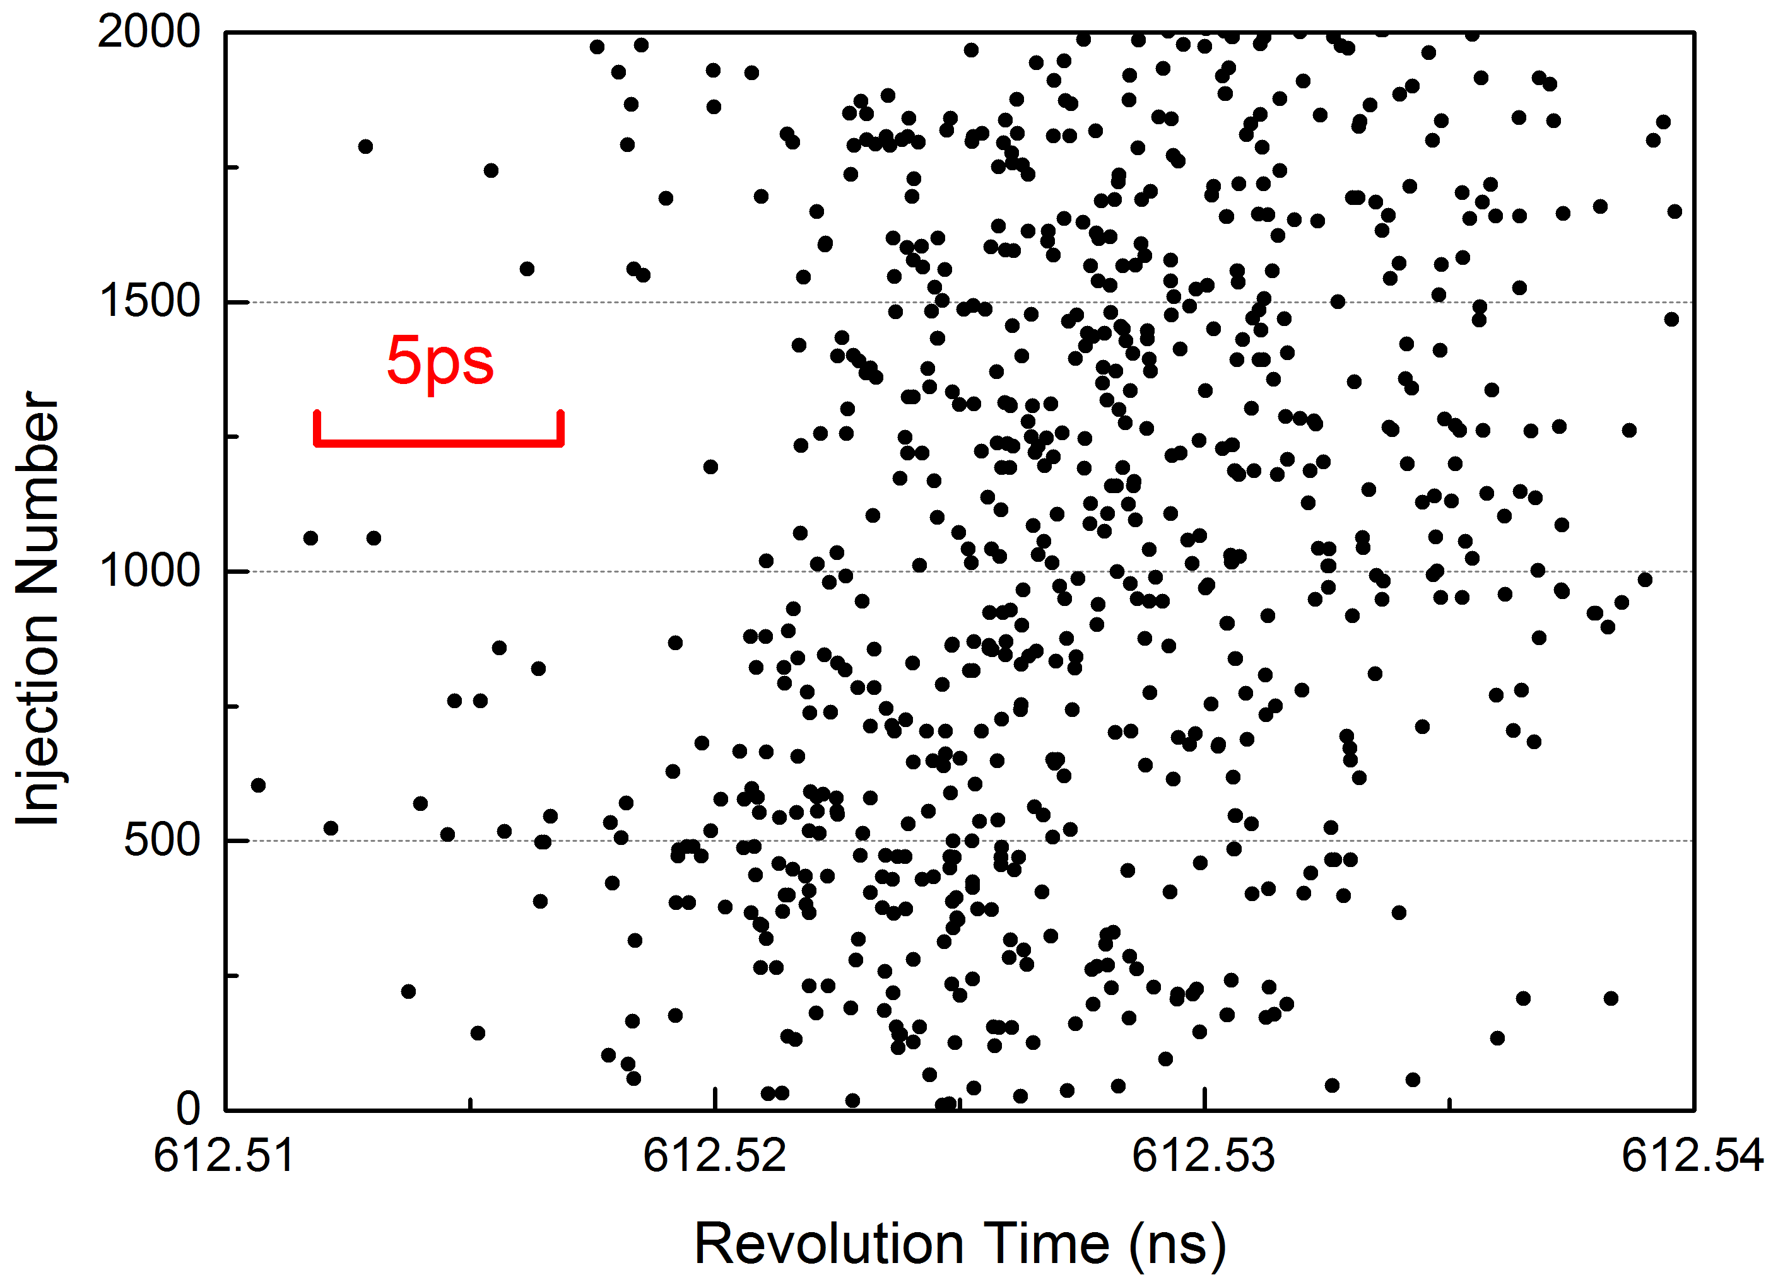
Data analysis
original signal
constant fraction timing
ion’s signals
mass calibration
revolution time correction
unstable of magnetic field

Slide 8

Result

Slide 9
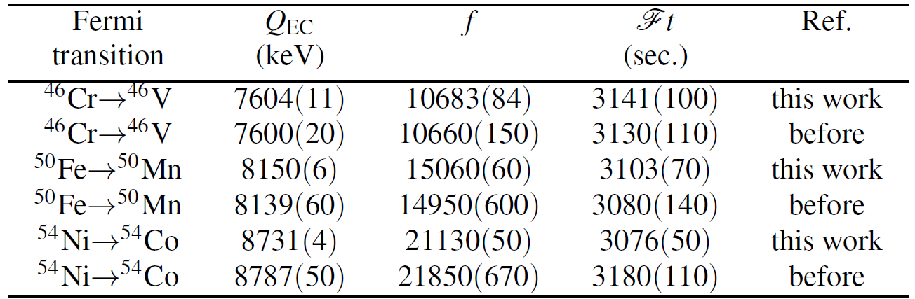
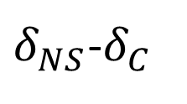

Discussion
f
Q_{EC}
ME_{mother nuclide}
$$δ_{R}^{′}$$
Ft
T_{1/2}
ME_{daughter nuclide}
t
$δ_{NS}$-$δ_{C}$
BR

Slide 10
Discussion

Slide 11
Summary
The ME accuracy of ⁵⁰Fe and ⁵⁴Ni is about ten times higher than previous data.
The error of the new Ft value is still too large, and the conserved vector current can’t be tested by new data.
the greatest contribution to the error of Ft value is the branching ratio, and the next step should try to reduce the error of the branching ratio.

Slide 12
Thank you

