Slide 1
Nuclear mass predictions from Weizsaecker-Skyrme model and statistical uncertainties in parameters
Ning Wang
Guangxi Normal University, Guilin, China
China-Japan collaboration workshop,
on “Nuclear mass and life for unravelling mysteries of r-process”
Tsukuba, Japan, June 25 - 28, 2017

Slide 2
Outline
Introduction
Nuclear mass models
Characteristics of the WS model
Tests and applications of the WS model
Statistical errors in parameters and masses
Summary and discussions

Slide 3
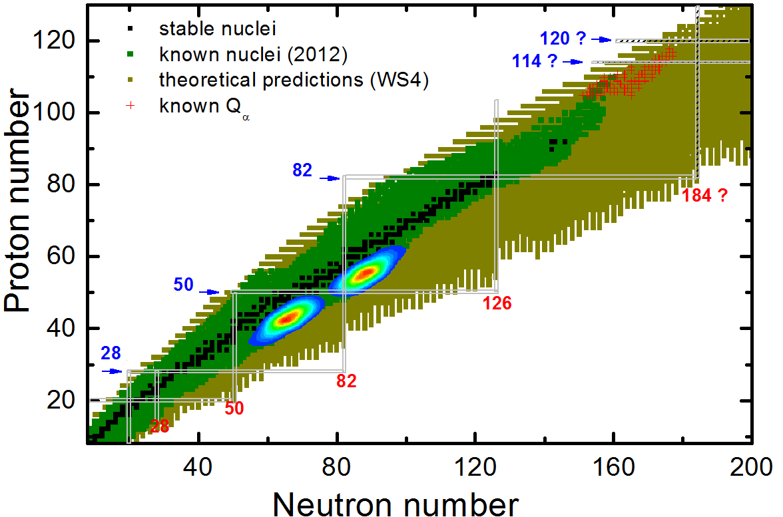


~ 3000 measured masses
~ 4000 unknown masses
…
裂变
核天体
rms error of 200 ~ 1000 keV
对称能
超重
质量

Slide 4
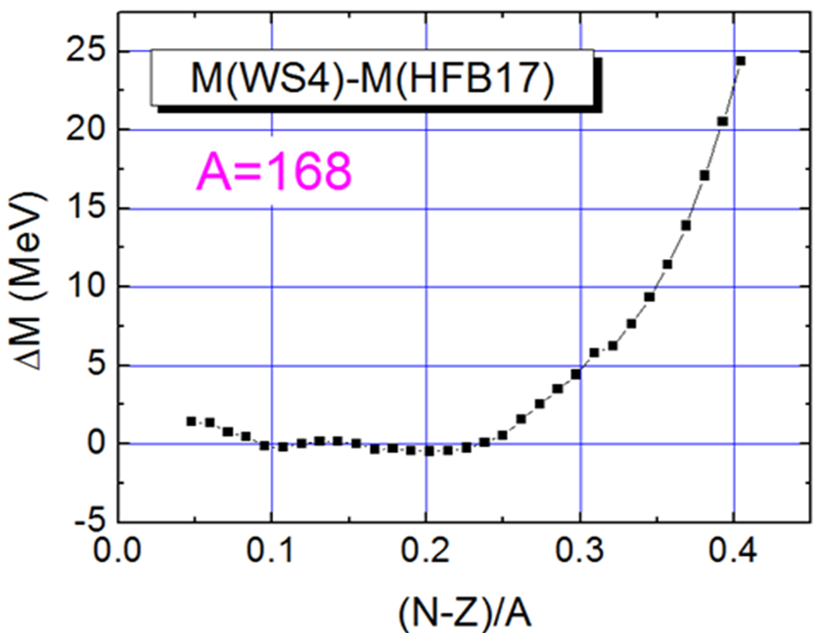
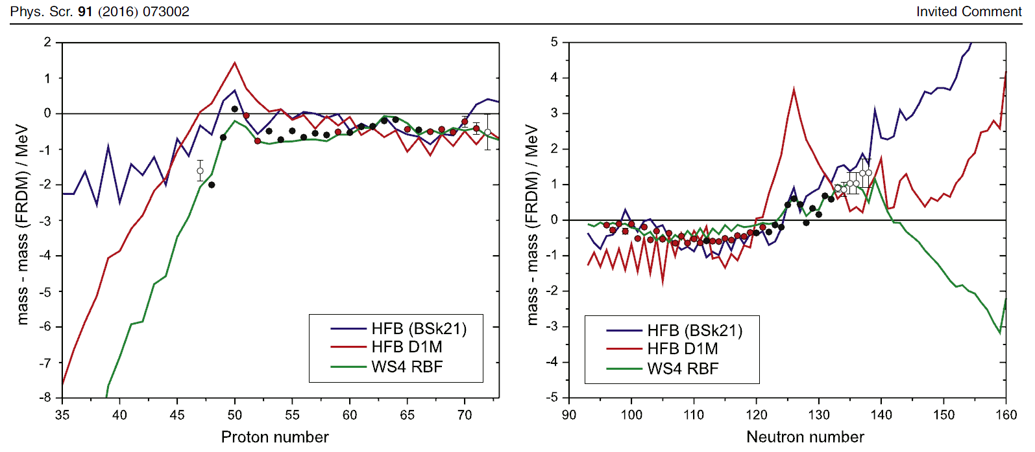
Discrepancies increase evidently approaching neutron drip line
What is the reason?
How large is the model error?
Y.-H. Zhang, Yu. A. Litvinov, T. Uesaka and H.-S. Xu
N=82
Z=82

Slide 5

Nuclear mass models
Global
Local
Systematics
Garvey-Kelson
n-p residual
ab initio
Shell model
… ~200keV
Microscopic
Macro-Micro
Duflo-Zuker
… ~300-600keV
AME
CLEAN
RBF
… ~200keV

Slide 6
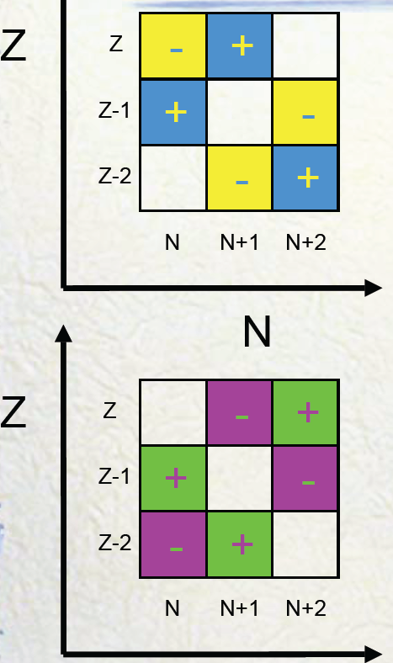

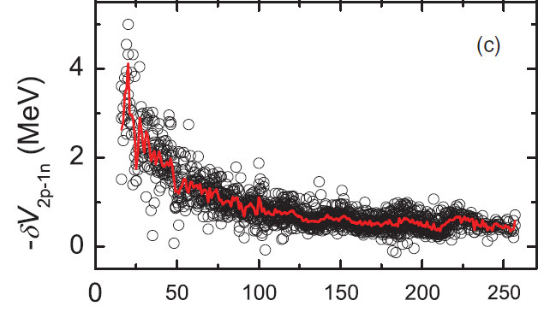
Local mass models
Garvey-Kelson
n-p residual interaction
Isobaric Multiplet Mass Equation
……
IMP-CAS, Lanzhou
PRL 109 (2012) 102501
PLB 735 (2014) 327
…
Garvey, Gerace, Jaffe, Talmi, Kelson, Rev. Mod. Phys. 41 (1969) S1
Barea, Frank, Hirsch, Isacker, et al, Phys. Rev. C 77 (2008) 041304(R)
Y. M. Zhao, et al.,
Phys. Rev. C82-054317;
Phys. Rev. C84-034311;
Phys. Rev. C85-054303;
…
Z
N

Slide 7
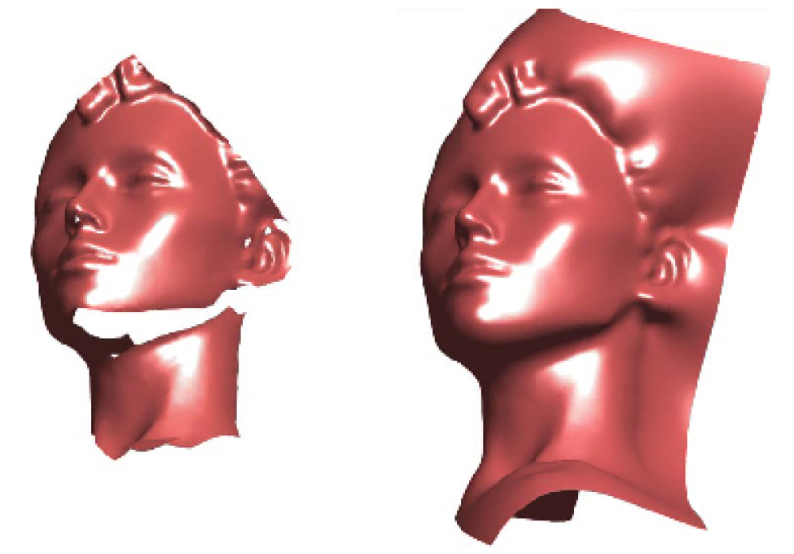
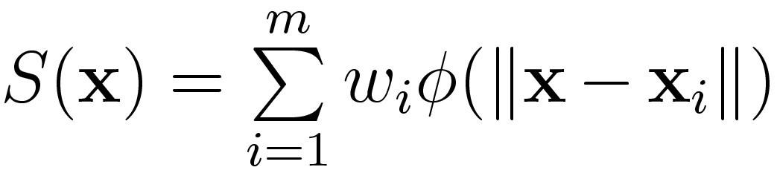

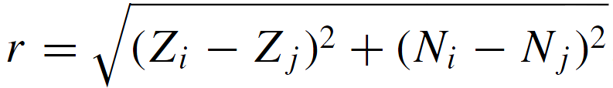
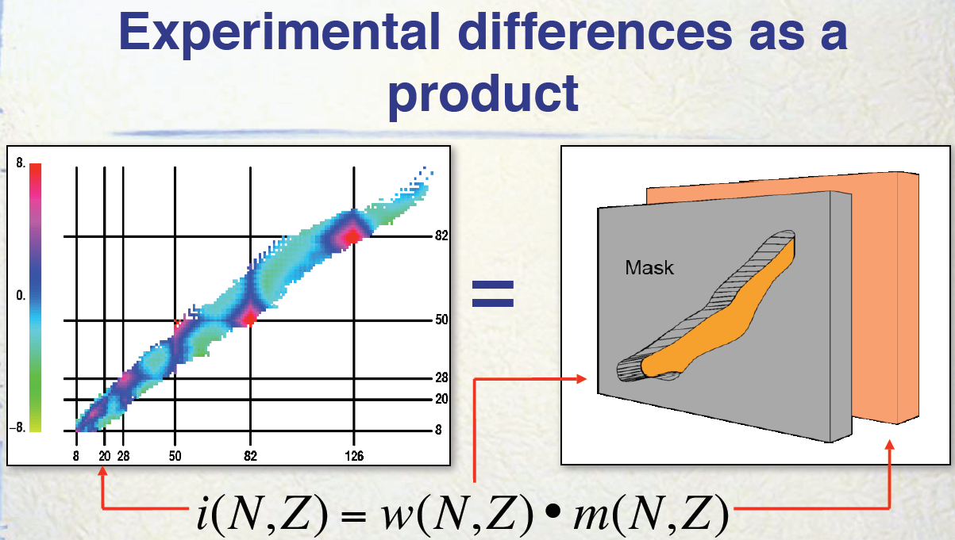
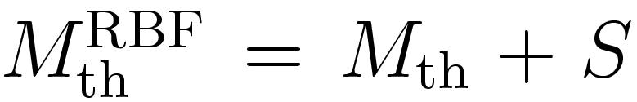
Radial Basis Function correction
image reconstruction
Morales, Isacker, Velazquez, Barea,
et al., Phys. Rev. C 81 (2010) 024304
Revised masses
Wang & Liu, PRC84 (2011) 051303(R)
ZM Niu, et al, PRC88 (2013) 024325

Slide 8

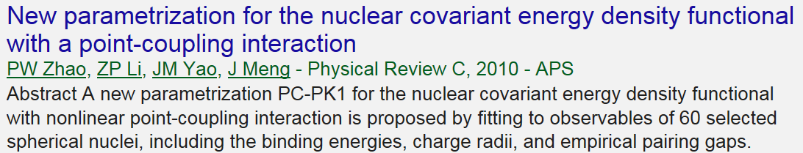
Microscopic models (global)
# Relativistic energy density functional
# Non-relativistic energy density functional
1. Skyrme: HFB1…HFB32; … UNEDF …
2. Gogny: Goriely…PRL102 (2009) 242501
3. Fayans: Fayans...NPA676 (2000) 49 (m*=m)
…
P. Ring, J. Meng, S.-G. Zhou, W.-H. Long …

Slide 9
Macroscopic-microscopic mass models
Strutinsky type: (shell corrections)
FRDM: Moller…1995, 2012, [M, β, B_{f},…]
Extended Thomas-Fermi+SI (ETFSI): [M, EOS, β, B_{f},…]
Lublin-Strasbourg Drop (LSD) model: [M, β, B_{f},…]
Weizsäcker-Skyrme (WS) model: [M, β, R_{ch},…]
… …
Others :
E_{sh} from valence-nucleons: Kirson, NPA798 (2008) 29
Dieperink & Isacker, EPJA 42 (2009) 269
Wigner-Kirkwood method: Centelles, Schuck, Vinas, Anna.
Phys. 322 (2007) 363; Bhagwat, et al.,PRC81_044321
KUTY model: Koura, Uno, Tachibana, Yamada, NPA674(2000)47

Slide 10
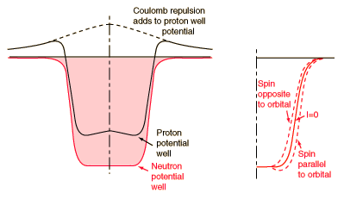
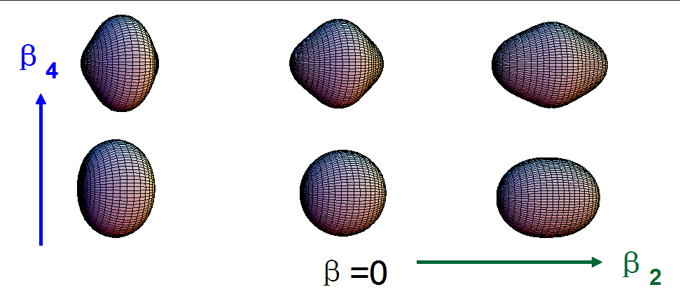

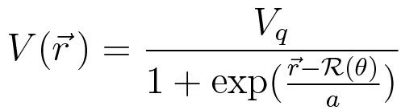

Strutinsky shell correction
Woods-Saxon potential
WSBETA: Cwoik, Dudek, et al., Comput. Phys. Commun. 46 (1987) 379

Slide 11
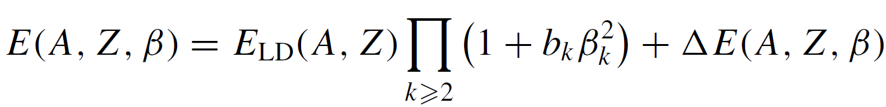
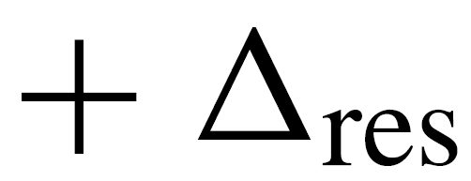
Characteristics of
Weizsäcker-Skyrme mass model
Liquid drop
Deformation
Shell
Residual
Residual：Mirror 、pairing 、Wigner corrections...
Macro-micro concept & Skyrme energy density functional
N. Wang, M. Liu, et al., PRC81-044322；PRC82-044304；PRC84-014333

Slide 12
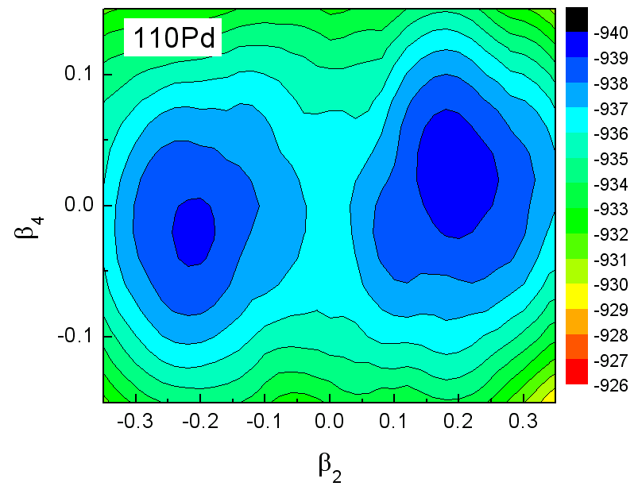
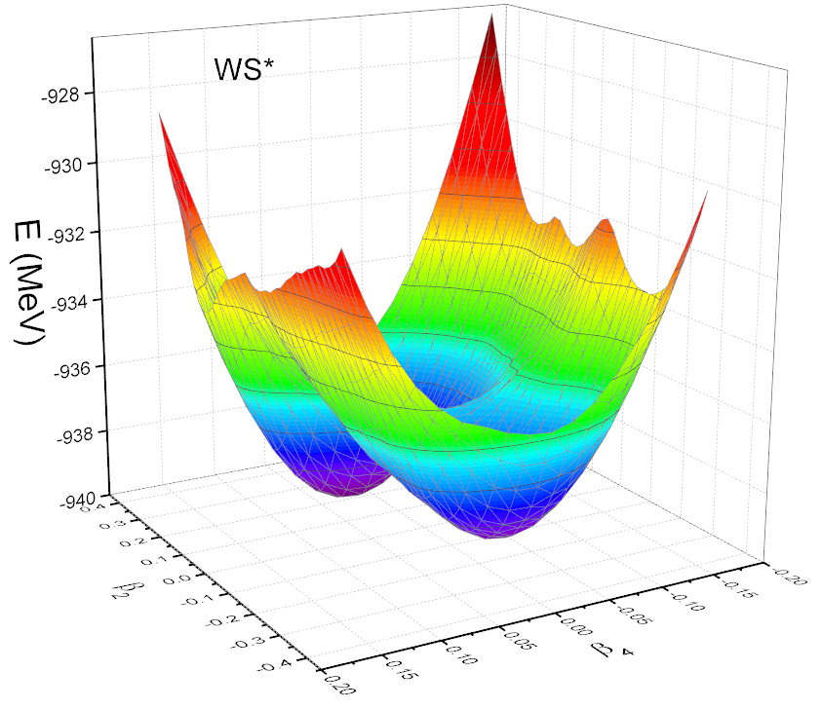


Potential energy surface around ground state deformations
WS
To obtain g.s. energy, one needs to find the minimum on the PES
are considered

Slide 13
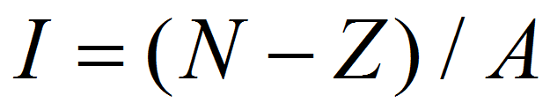
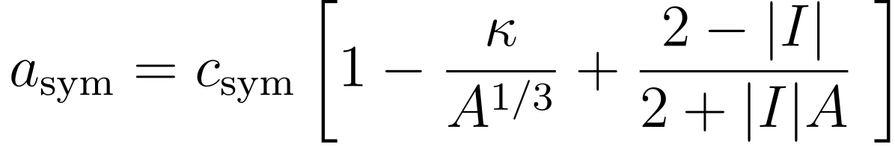


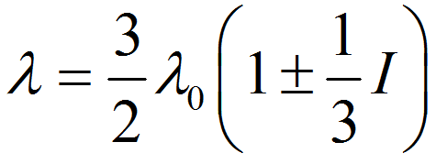
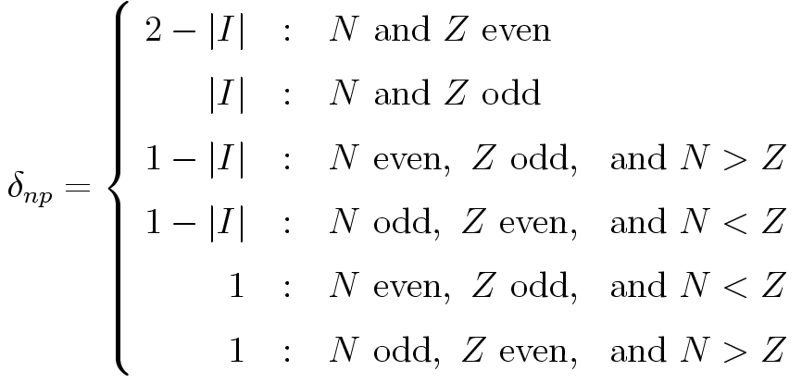
Isospin dependence of model parameters
Symmetry energy coefficient
Symmetry potential
Strength of spin-orbit potential
Pairing corr. term
symmetry potential
WS*：Phys. Rev. C 82 (2010) 044304

Slide 14
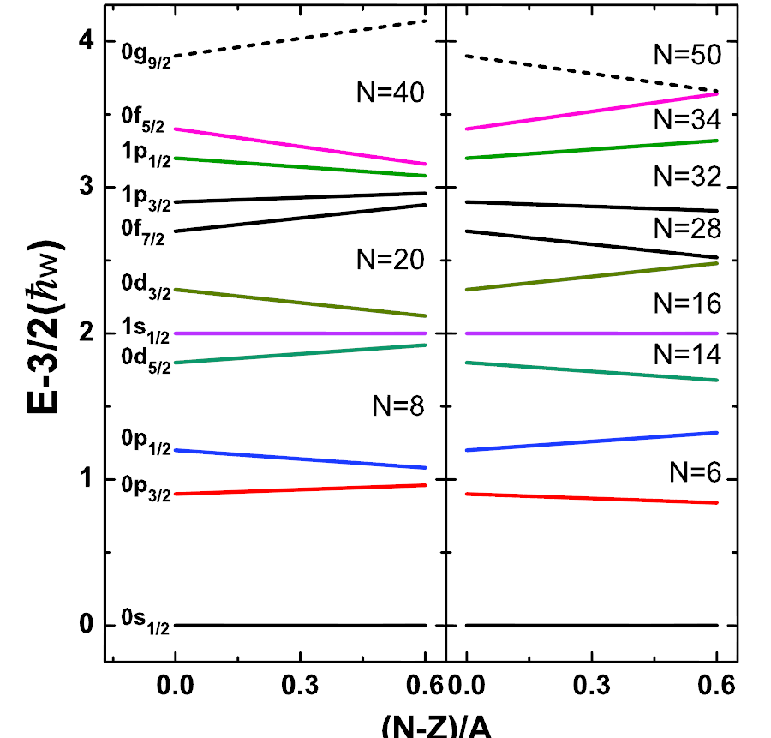
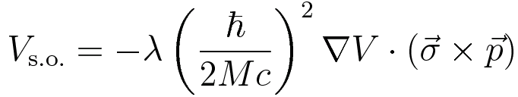

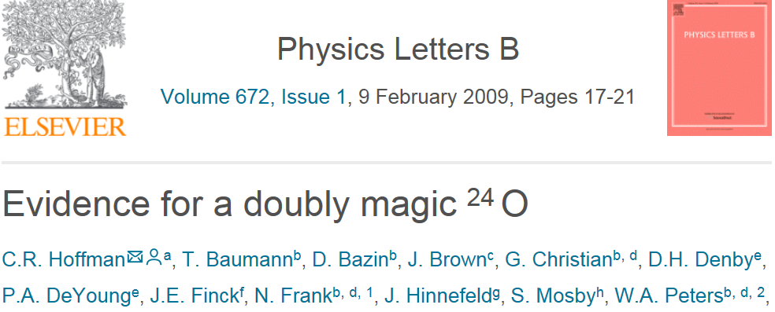
Xu and Qi, Phys. Lett. B724 (2013) 247
K_{SO} = -1
K_{SO} = 1

Slide 15
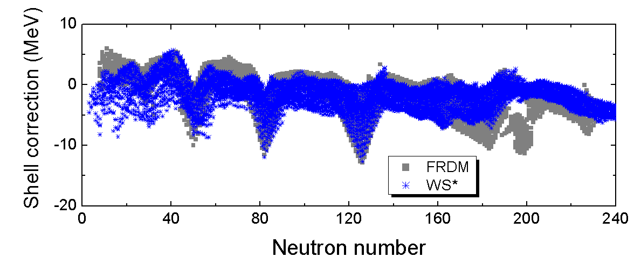
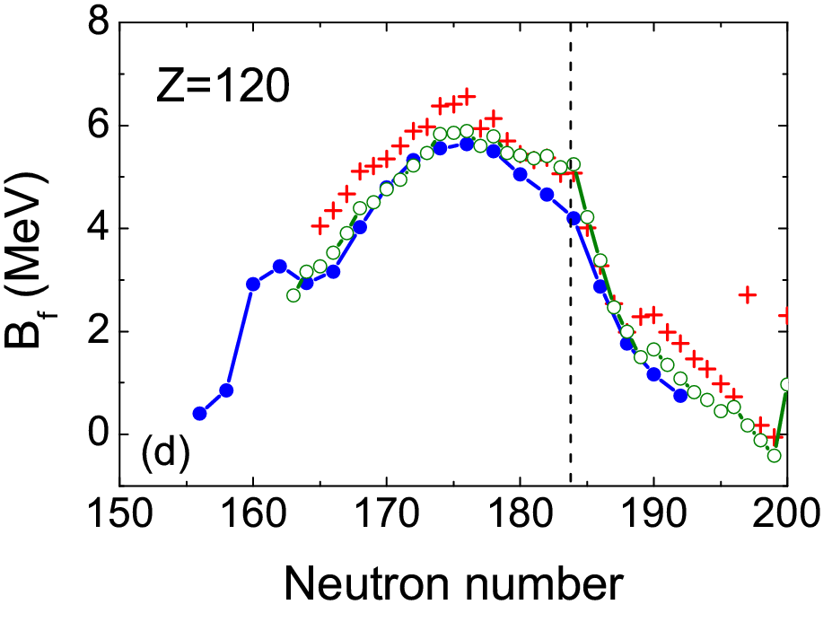
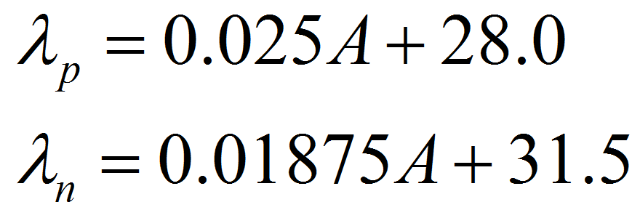

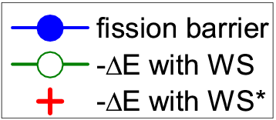
WS*
N=16
N=184
FRDM
Nishio, el at., ^{40,48}Ca+²³⁸U
PRC86, 034608 (2012)
B_{f} : Kowal, Jachimowicz, and Sobiczewski, Phys. Rev. C 82 (2010) 014303

Slide 16
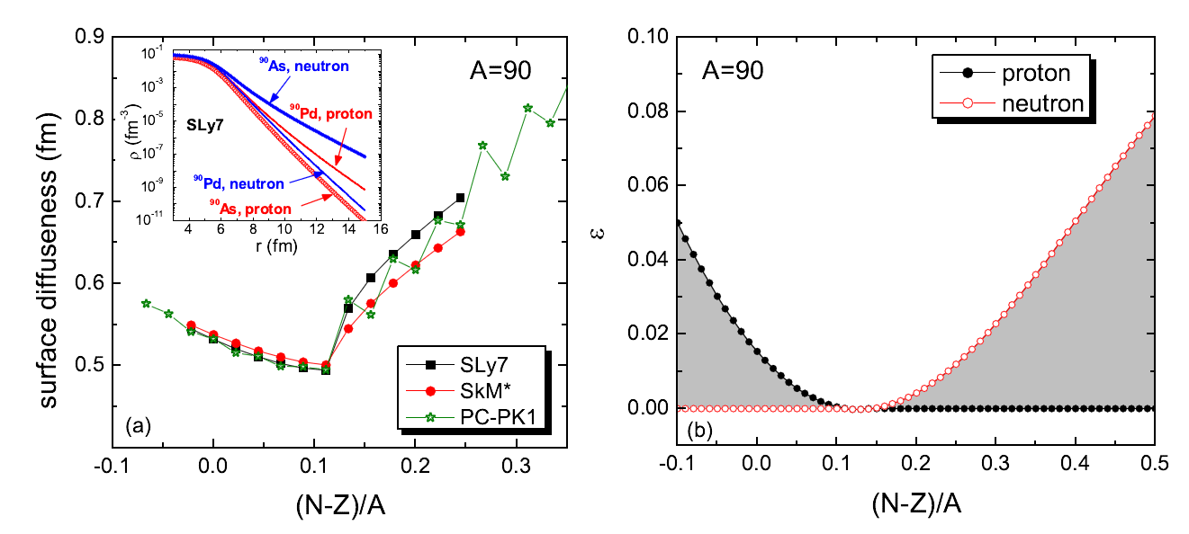
5. Isospin dependence of surface diffuseness
Neutron-rich
N. Wang, M. Liu, X. Z. Wu, and J. Meng, Phys. Lett. B 734 (2014) 215

Slide 17

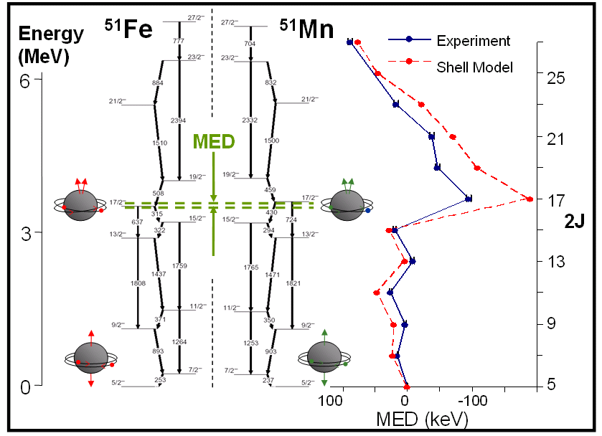

Considering symmetries/correlations
26
25
From S. Lenzi
D.D. Warner et al., Nature Physics 2 (2006) 311
Isospin Symmetry: 1932 Heisenberg SU(2)

Slide 18
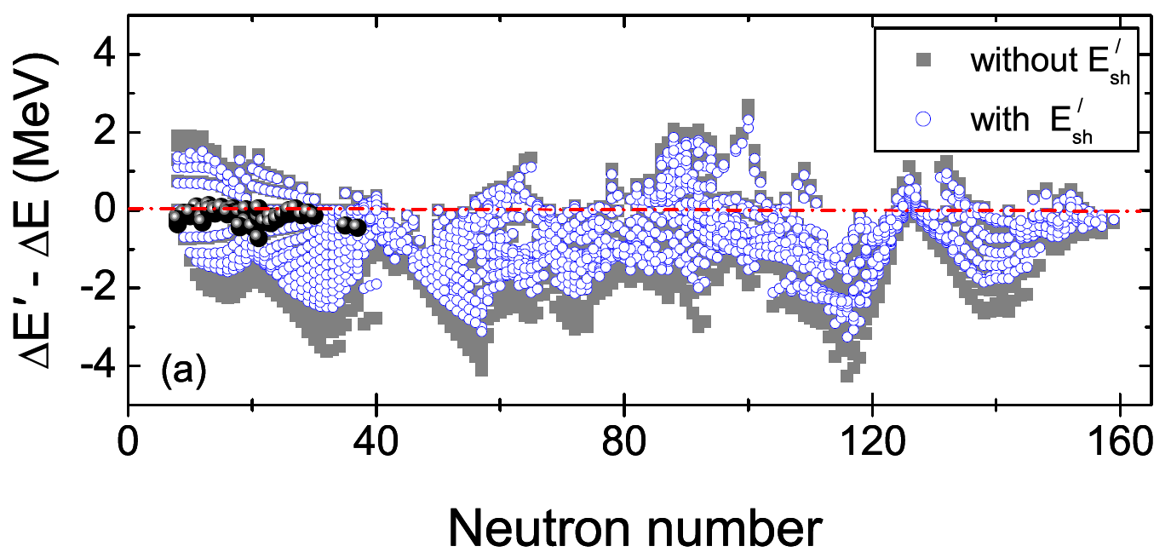



Constraint from mirror nuclei
charge-symmetry / independence of nuclear force
reduces rms error by ~10%

Slide 19
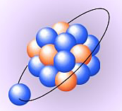

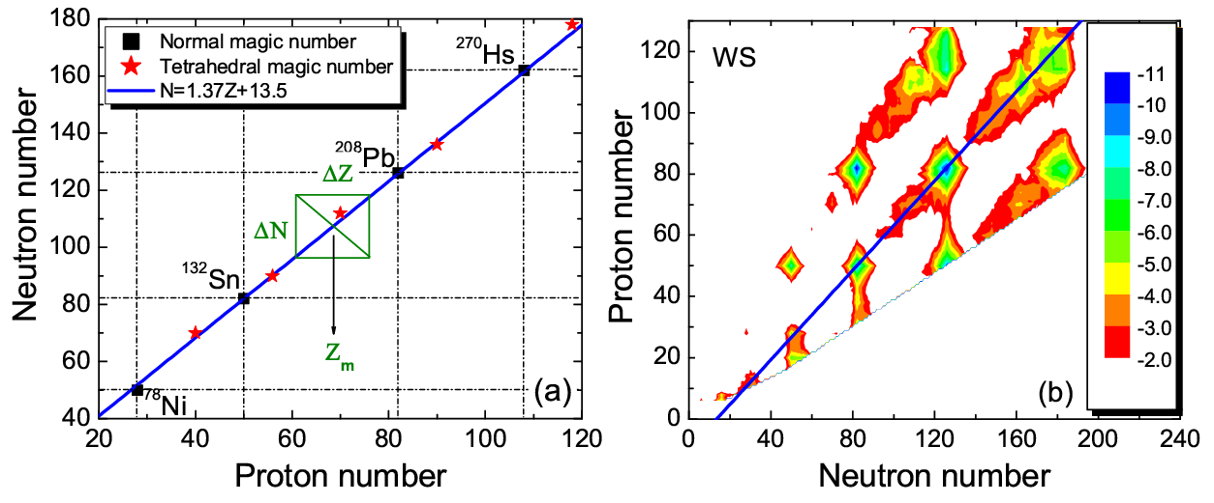



Wigner effect of heavy nuclei
Isospin symmetry of valence nucleons
(N,Z)
N=Z
K. Mazurek, J. Dudek，et al., J. Phys. Conf. Seri. 205 (2010) 012034

Slide 20
Tests and Applications
Alpha decay energies of super-heavy nuclei
Nuclear charge radii and magic numbers
Nuclear symmetry energy

Slide 21
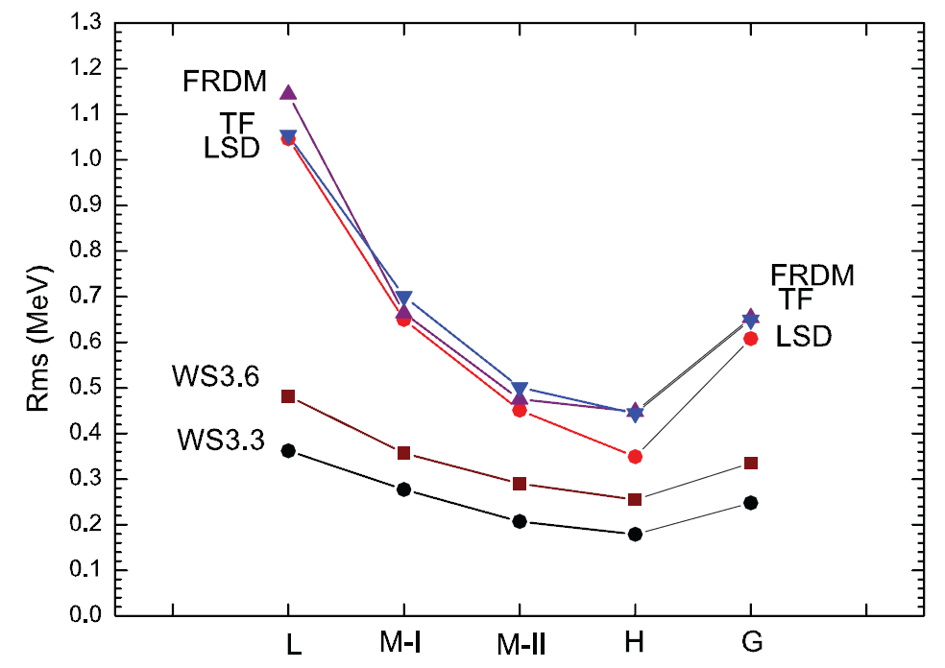
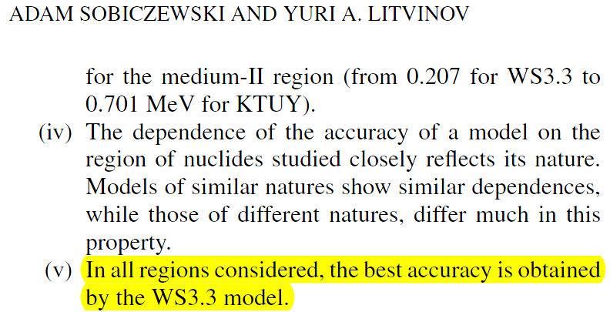
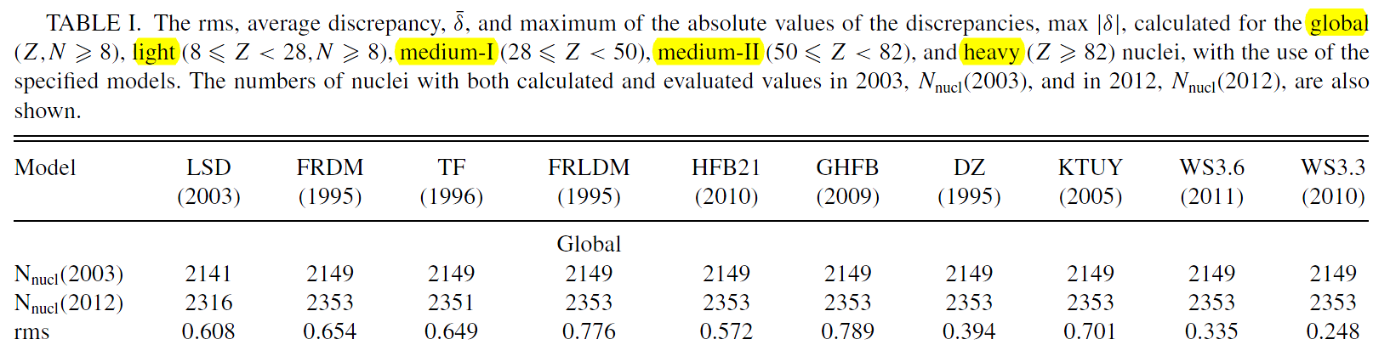
Sobiczewski, Litvinov, Phys. Rev. C 89, 024311 (2014)
WS*+RBF

Slide 22
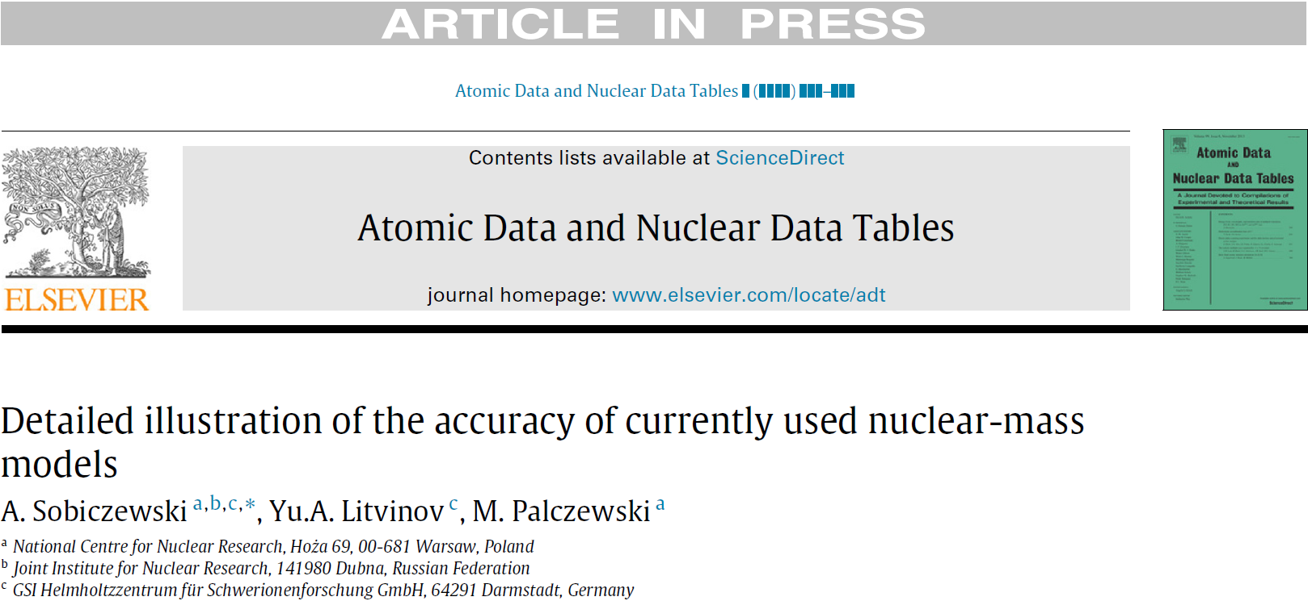
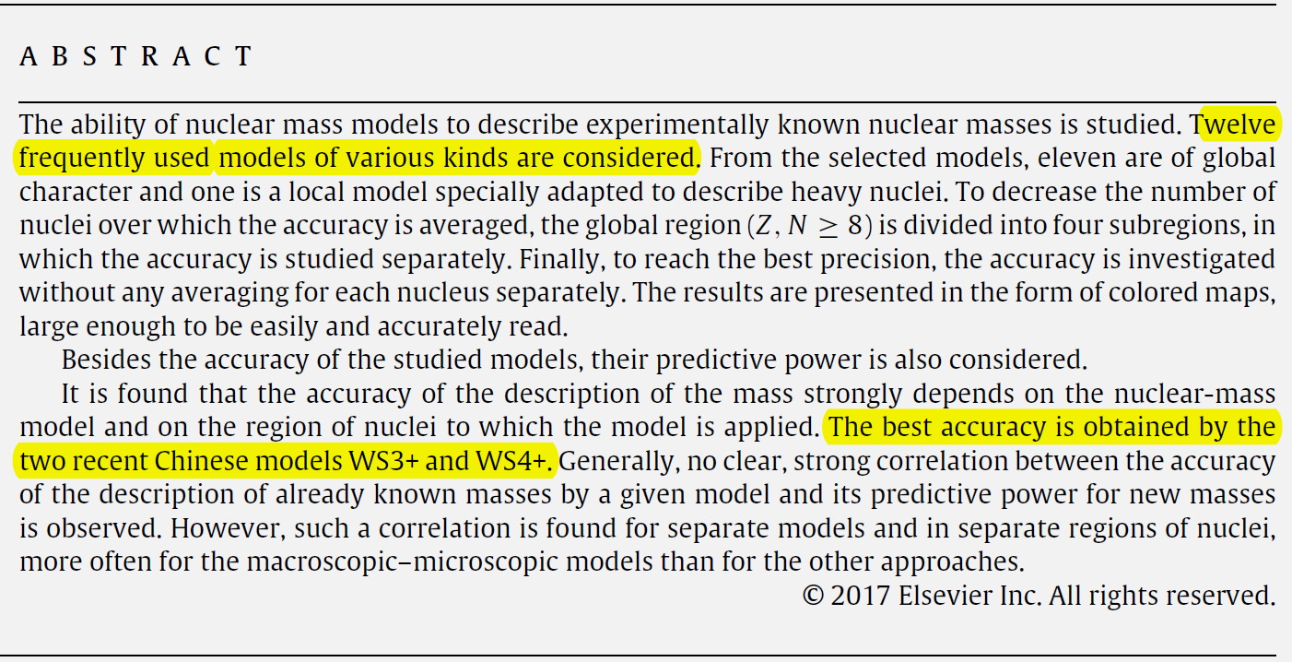
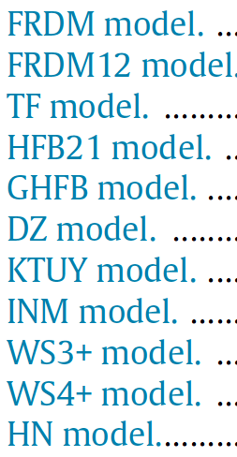
LSD model …

Slide 23
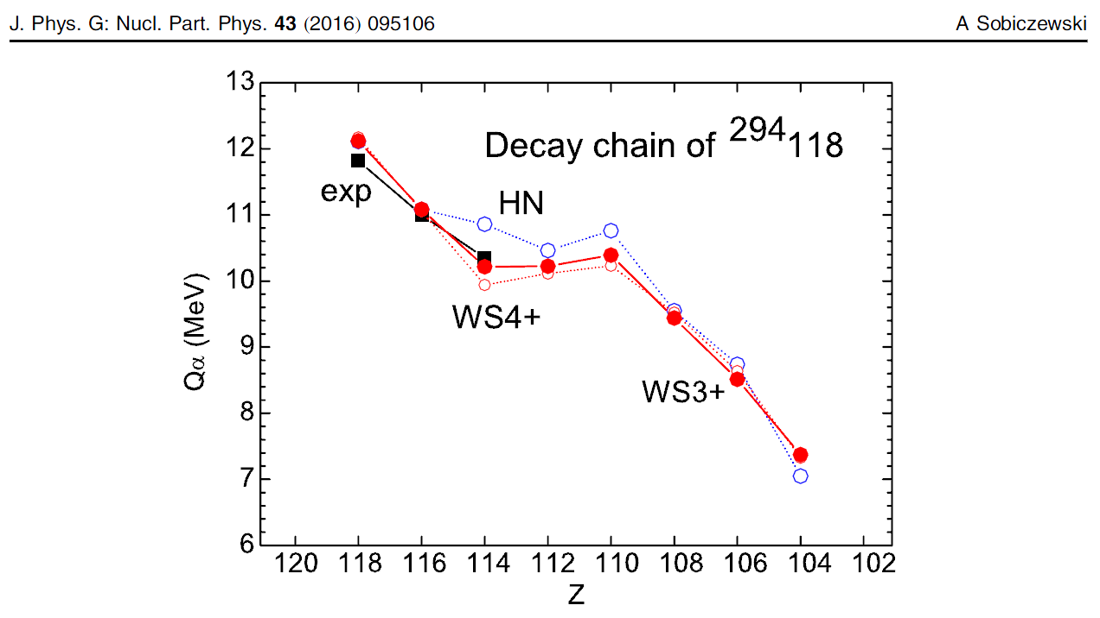
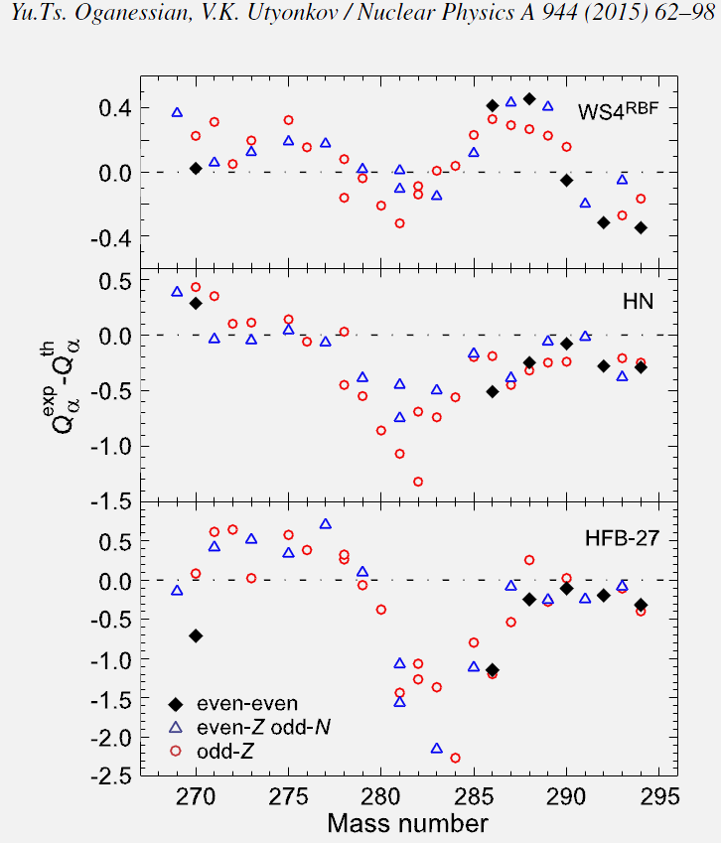
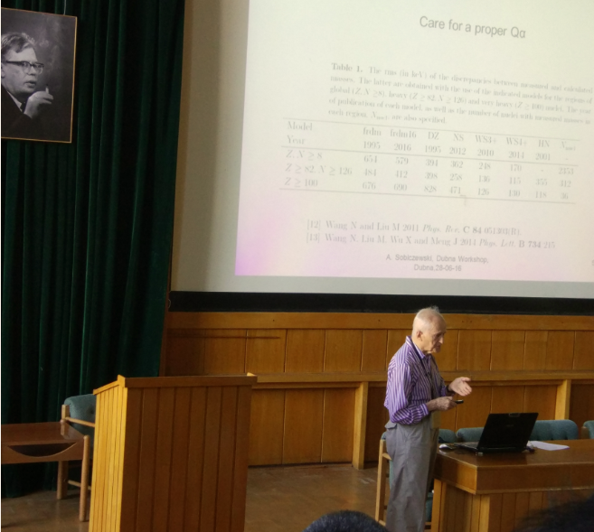
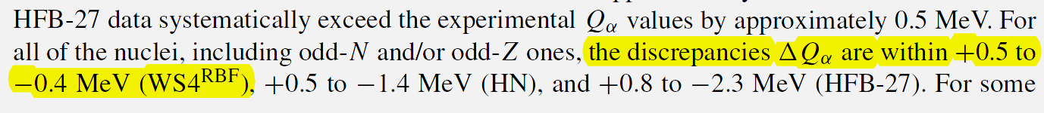
alpha-decay energies of SHN

Slide 24
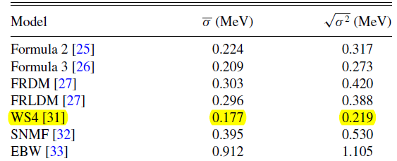
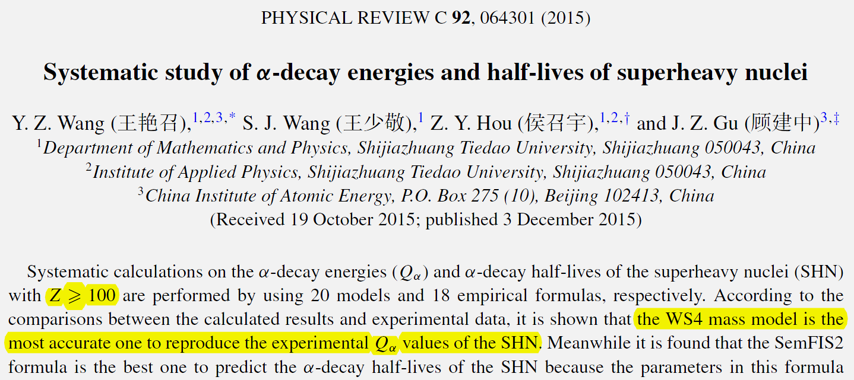
121个超重核alpha衰变能rms偏差
alpha-decay energies
YZ Wang, et al., Phys. Rev. C92,064301(2015)

Slide 25
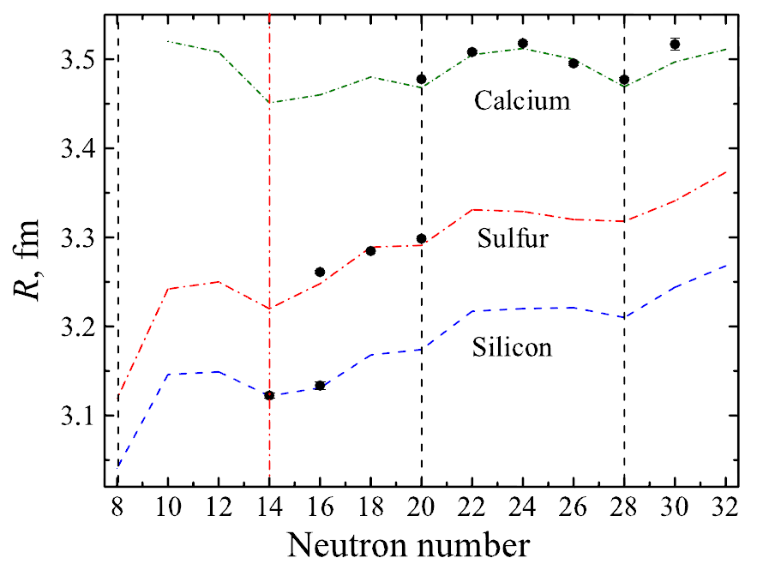
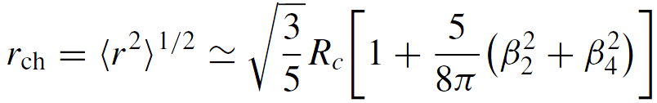
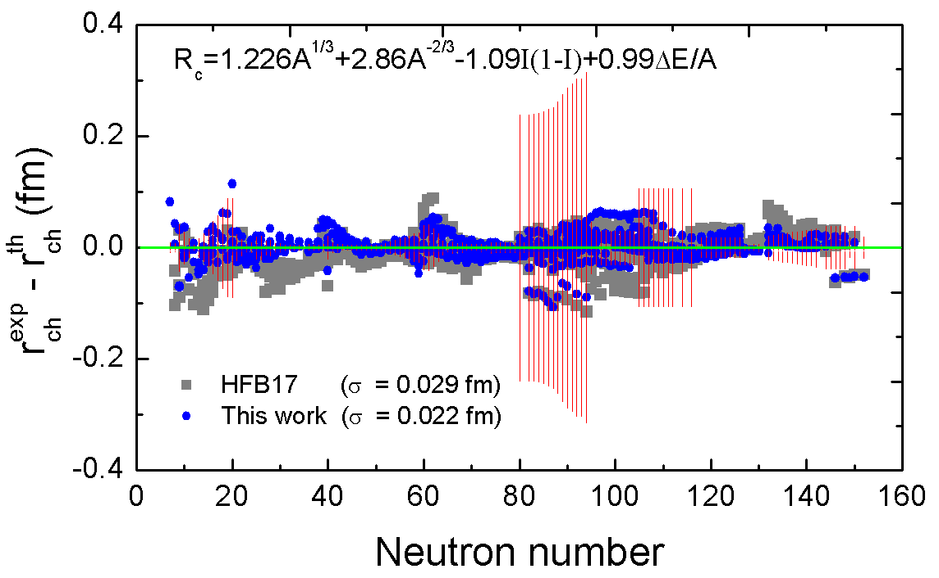
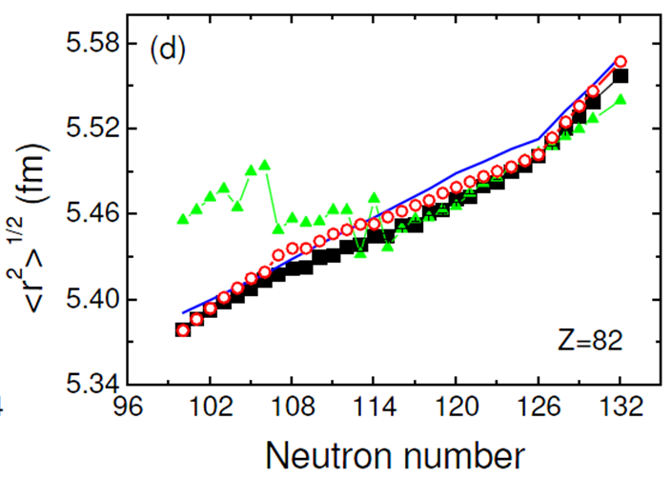

Nuclear charge radii
Angeli, Marinova, JPG42 (2015) 055108
N. Wang, T. Li, PRC88, 011301(R) (2013)
Shell corrections and deformations from WS*

Slide 26



Magic numbers in unknown region
WS4
New magic number N=32
N. Wang, M. Liu, Chin. Sci. Bull. 60, 1145 (2015)
N. Wang, M. Liu, X. Z. Wu and J. Meng, Phys. Rev. C 93, 014302 (2016)

Slide 27



Matching macro-micro model and Skyrme EDF

Slide 28

4th-order symmetry energy coefficient
N. Wang, M. Liu, H. Jiang, J. L. Tian and Y. M. Zhao, Phys. Rev. C 91, 044308 (2015)

Slide 29





(keV)
Statistical errors
rms(2003)
Predictive power from masses of 270 ”new” nuclei in AME2016
Estimate of model errors from rms error to known masses
W. J. Huang, G. Audi, Meng Wang, et al., Chin. Phys. C 41, 030002 (2017).
rms(2003)
RBF correction
N. Wang and M. Liu, J. Phys: Conf. Seri. 420 (2013) 012057
YZ Wang, et al., Phys. Rev. C92,064301(2015)
M Liu, et al., Phys. Rev. C 84, 014333 (2011)

Slide 30

Estimate of model errors with data in different region
Model errors for different region
Model parameters:
FRDM : ~30
DZ28 : ~28
HFB17 : ~24
HFB24 : ~30
WS3 : ~16
WS* : ~13

Slide 31

Statistical errors based on variation of fit data (WS*)
considering the weak correlations between parameters of macro part and those of micro part

Slide 32


Slide 33


Slide 34





Liu et al., PRC82, 064306 (2010)

Slide 35

Correlations between model parameters in WS*

Slide 36
Summary and discussions
The rms deviations of mass models with respect to known masses fall to about 200 keV (local) and 300-600 keV (global) .
Isospin dependence of model parameters and isospin symmetry improve the accuracy of the WS mass model.
For super-heavy nuclei and neutron drip line nuclei, the statistical errors increase evidently. The symmetry energy term plays a key role to the mass predictions of nuclei approaching to neutron drip line.
The large discrepancy between WS4 and HFB17 for the masses of neutron drip line nuclei could be due to the uncertainty of 4th-order symmetry energy coefficient.

Slide 37


Thank you for your attention
Codes & Nuclear mass tables：www.ImQMD.com/mass
Guilin, China

Slide 38
谢 谢
Zhu-Xia Li (CIAE, Beijing)
Xi-Zhen Wu (CIAE, Beijing)
Ying-Xun Zhang (CIAE, Beijing)
Kai Zhao (CIAE, Beijing)
Min Liu (GXNU, Guilin)
Jie Meng (Peking U, Beijing)
Hui Jiang (SHMTU, Shanghai)
Lu Guo (UCAS, Beijing)
Yu-Min Zhao (SJTU, Shanghai)
Li Ou (GXNU, Guilin)
Jun-Long Tian (AYNU, Anyang)
Zhi-Gang Xiao (Tsinghua U., Beijing)
Shan-Gui Zhou (ITP-CAS, Beijing)

