Slide 1
Recent progress of the KISS project at KEK-WNSC
20170626-28 J-C collab. kick off
H. Miyatake , WNSC, IPNS, KEK
• Physics motivation of the KISS project
• Recent activities at KISS stage I and MRTOF
-> Lifetime and hyperfine structure measurements
-> Mass measurements
• Perspectives of the project
-> Future plan
• Summary

Slide 2
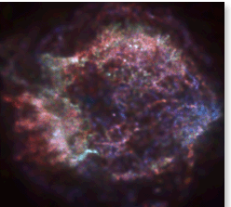

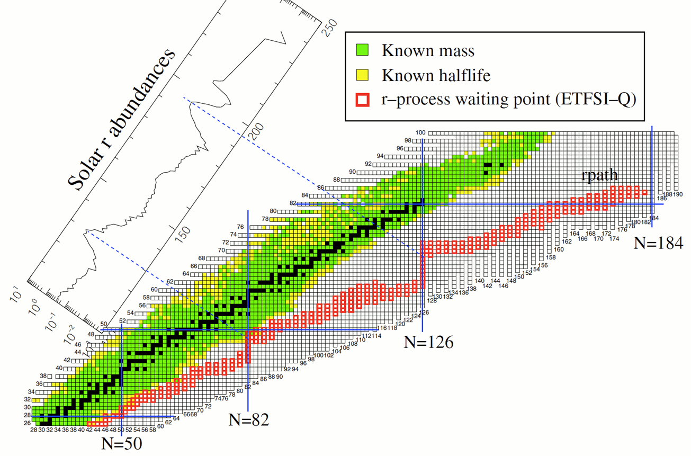
What is KISS ?
- How are the gold and platinum synthesized ? -
Type II Supernova (CC-SNe)
Neutron star merger (NS-NS)
H. Grawe et al., Rep. Prog. Phys. 70 (2007), 1525-1582.
A
3rd peak (A∼195)
Solar r-process abundance
2nd peak
Waiting point for
the 3rd peak
（Blank spot）
Atomic number
rapid neutron capture (r-) process
The third peak of the abundance pattern
Unclear estimations with various nuclear models
→ Most important region to pin down the astrophysical origin of the r-process
Neutron number

Slide 3
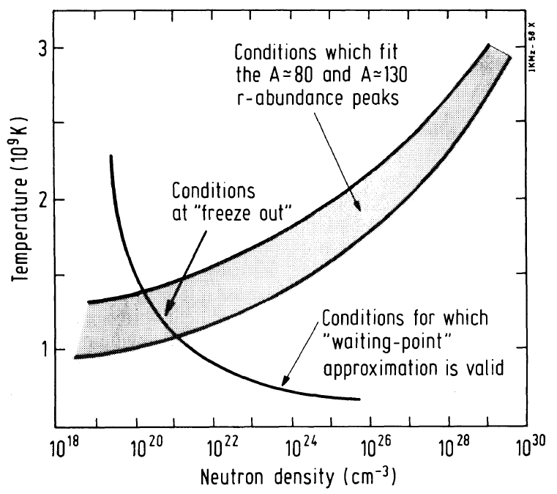

Physics goal
ー Lifetime and mass measurements ー
Directly
• (n, γ)-(γ, n) equilibrium:
r-process path
• lifetimes of waiting nuclei
duration time to form the third peak
• steady flow approx.:
correlation between T and N_{n}
from K. –L. Kratz, et al., Ap. J. 403(‘93)216.
Second peak(A~130)
First peak(A~80)
Temperature (10⁹ K）
Unique circumstance for r-process？
Indirectly
• neutron fraction (1-Y_{e})
• production rates of fissile isotopes
• nuclear properties in waiting region
•
Third peak
(A~195)???
Neutron number density (n/cm³)
Clarifying the proposed astrophysical sites (CC-SNe, NS-NS, ..)

Slide 4
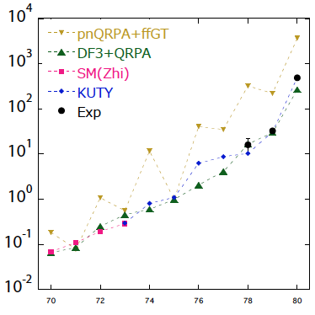
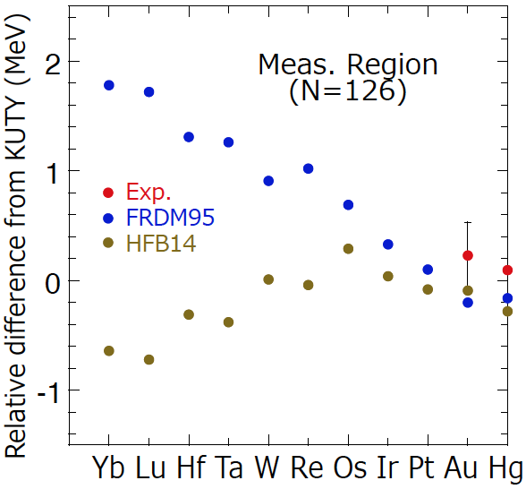
Uncertainty of lifetime & mass predictions in N=126 isotones
Stage I (~2020, ¹³⁶Xe, 250 pnA) to Stage II (2021~, ²³⁸U, up to 10 pμA)
Waiting
region
δｍ~100 keV
β-decay half-life (sec)
Waiting
region
ΔT_{1/2}/T_{1/2} < 10%
Stage II
Stage I
Stage II
Stage I
Yb Lu Hf Ta W Re Os Ir Pt Au Hg
Isotone (N=126)
Isotone (N=126)
Notes:
4

Slide 5
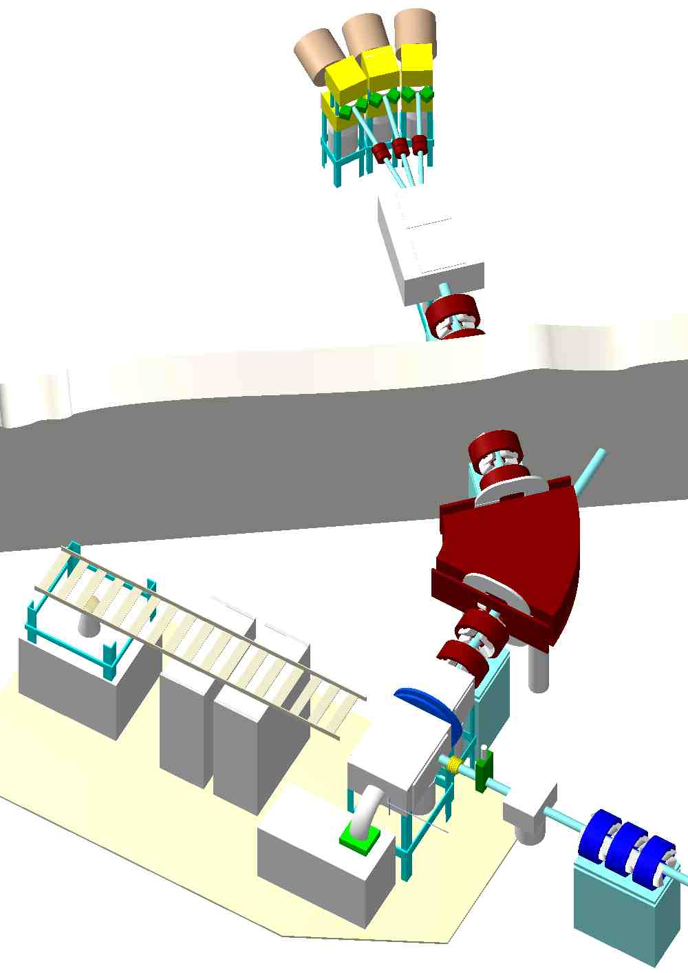
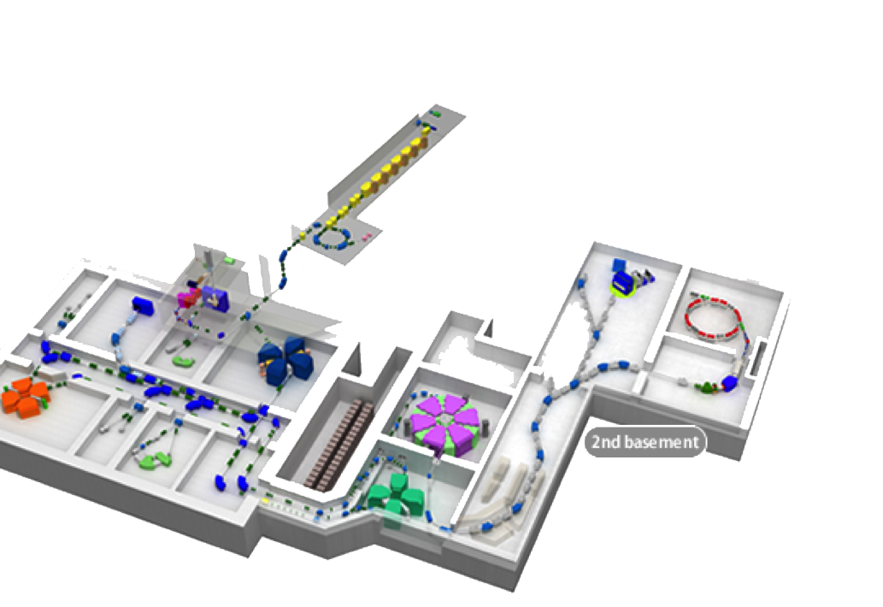
KISS: KEK Isotope Separation System
- New research method for waiting nuclei of A=195 peak -
Decay measurement
station
(1) Multi-nucleon transfer reactions
n-rich beams (~10 MeV/u)
i.e. ⁽¹³⁶⁻¹⁴⁴⁾Xe+¹⁹⁸Pt
(2) In-gas laser ionization
Neutralization of RI by argon gas
+ Laser resonance ionization (Z)
+ mass separation (A)
+ Det. system at low-background
E3-room
E2-room
Laser light
Gas
cell
J3-room
Beam
2011~2012：installation
2013-2014: R&D’s
Y. Hirayama, EPJ 66(’14)11017.
Y.X. Watanabe, P.R.L. 115(’15)172503.
High purity
Argon gas
Radioactive Isotope Beam Factory (RIBF)

Slide 6
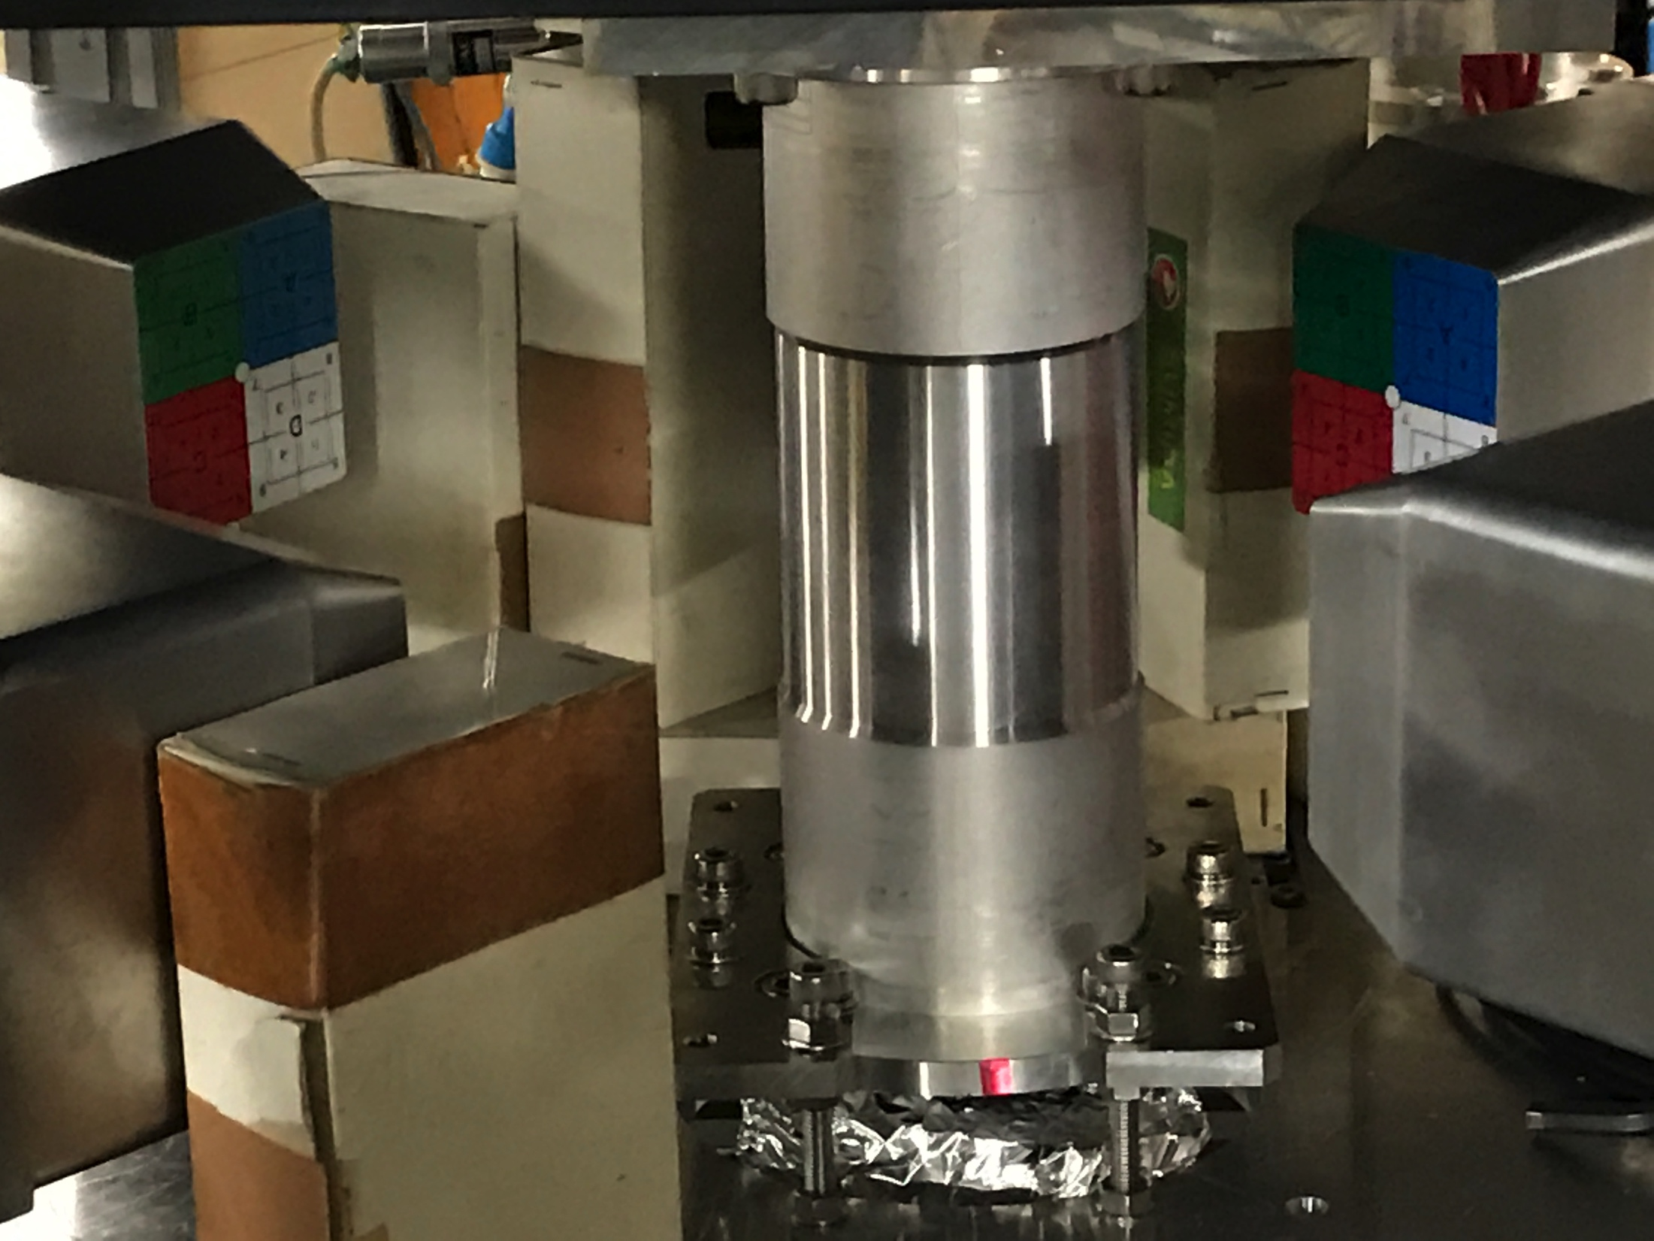
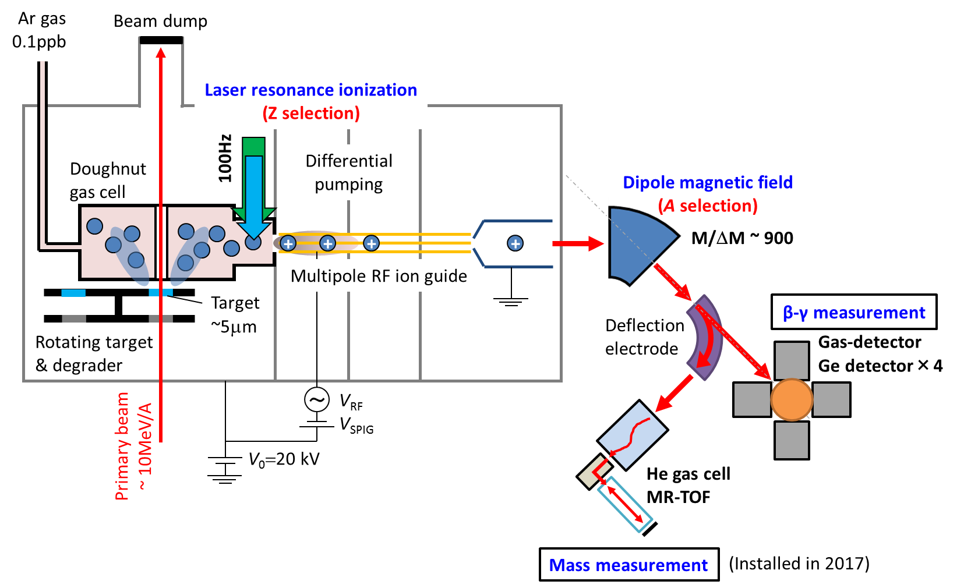

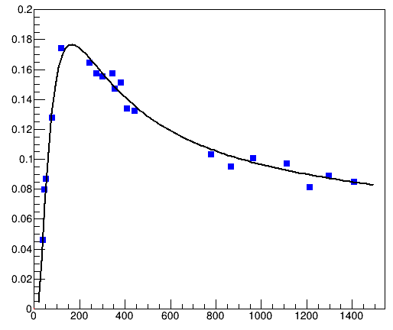

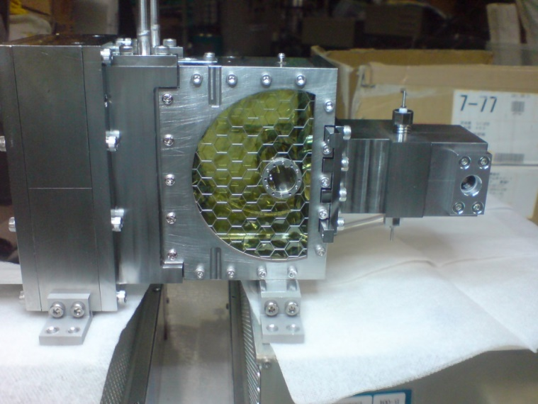
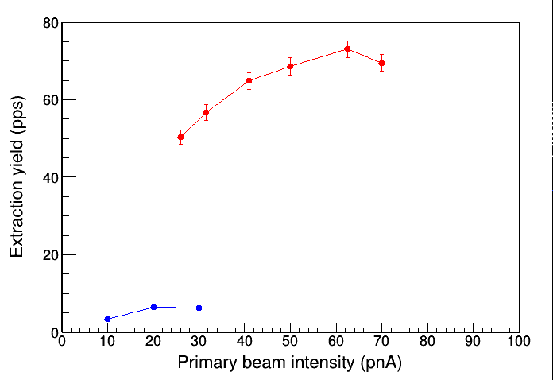
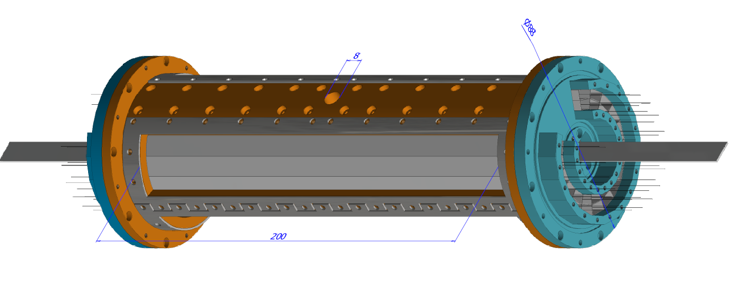
KISS (KEK Isotope Separation System)
20
16
12
8
4
4 x SC-Ge det’s
collab. with IBS
Efficiency (%)
0 400 800 1200 1600
Eγ (keV)
High-pressure ion cooler
Multi-trap ion buncher
MRTOF-MS
Tape
β
SUS
RI’s
¹⁹⁹Pt
KISS beam
BG
200 mm
ε_{ext} x 5
->I_{ext}x 10
2 layers ×16 segmented
proportional gas counters
laser
KISS beam
¹³⁶Xe-beams
fixed target
@Mar. 2016
ΔΩ = 79% (4π)
E_{thr.} ~ 200 eV
Doughnut-shape gas cell
Mesh
&
Myler foil

Slide 7
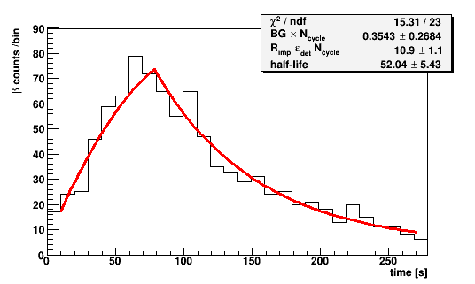
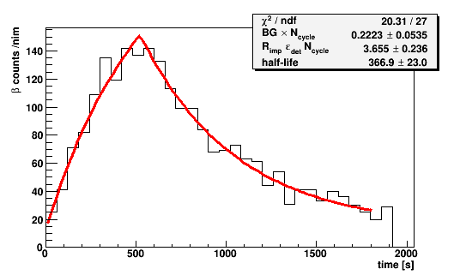
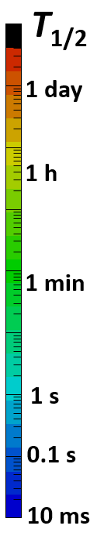
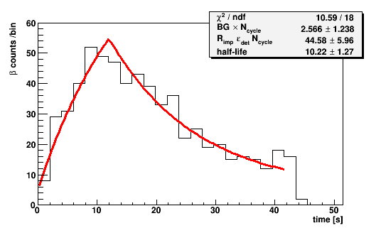
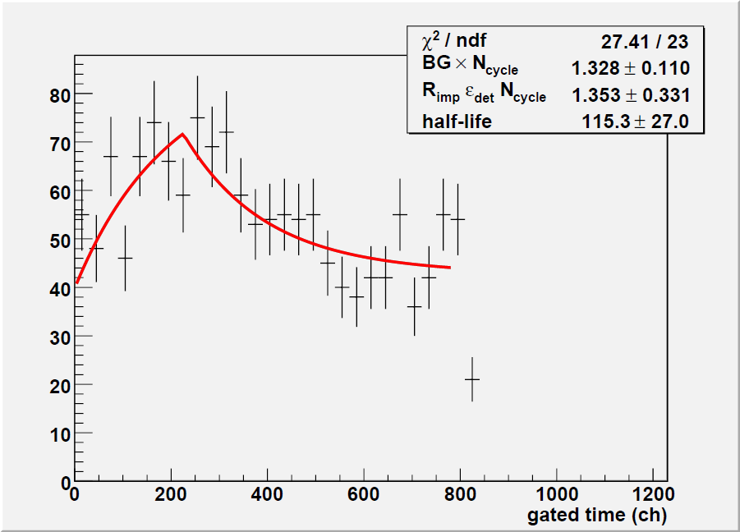
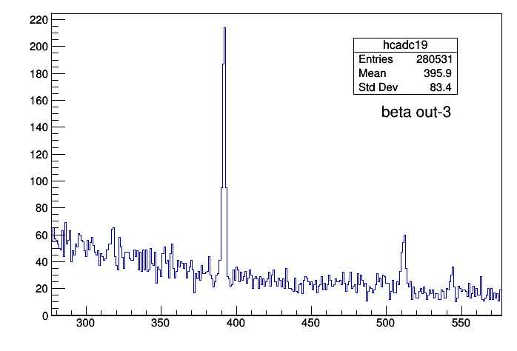
Lifetime confirmation in decay spectroscopy
• Y. Hirayama, NP1512-RRC41: “Lifetime measurement of nuclei
around N=126 using KISS” (2016~)
Confirmation of the reported lifetimes
¹⁹⁶Ir
t_{1/2}=52(1)s
52(5)s
¹⁹⁷Ir
t_{1/2}=5.8(5)m
6.1(4)min
KUTY : H. Koura, et al., http://wwwndc.jaea.go.jp/CN14/index.html
Expected ：T_{1/2}
Au
measured region
Pt
¹⁹⁸Pt
T_{meas.}~20 min
T_{meas.}~60 min
Ir
²⁰³Ir
1 h
Os
²⁰²Os
1 h
¹⁹⁸Ir t_{1/2}=8(1)s
10(1)s
²⁰¹Pt
t_{1/2}=2.5(1)min.
1.9(5) min.
¹³⁶Xe : I=20pnA
Re
unknown region 1
(Stage I)
²⁰¹Re
¹³⁶Xe : I=250pnA
W
²⁰⁰W
¹⁹⁹Ta
T_{meas.}~35 min
T_{meas.}~60 min
Ta
unknown region 2
(Stage II / present RIBF)
²³⁸U :
I=500pnA
Hf
1 s
Waiting
region
1 s
Lu
unknown region 3
(Stage II / RIBF upgrade)
¹⁹⁹Pt
392 keV:
isomer(13⁺/2, 13.6 sec)
to 1st ex.(7⁻/2)
²³⁸U :
I=10pμA
Yb
120
121
122
123
124
125
126
127
Y_{gs} : Y_{isomer} = 1 : 0.4
Νευτρον νυμβερ
542 keV
¹⁹⁹Pt_{gs} to ¹⁹⁹Au
• Lifetimes of 5 n-rich isotopes around ¹⁹⁸Pt have been
confirmed within measuring time of several tenth minutes
• The population probability of isomeric state in MNT reactions
suggest the feasibility of isomer spectroscopy
• Further measurements are soon (Sept., 2017)
E (keV)

Slide 8
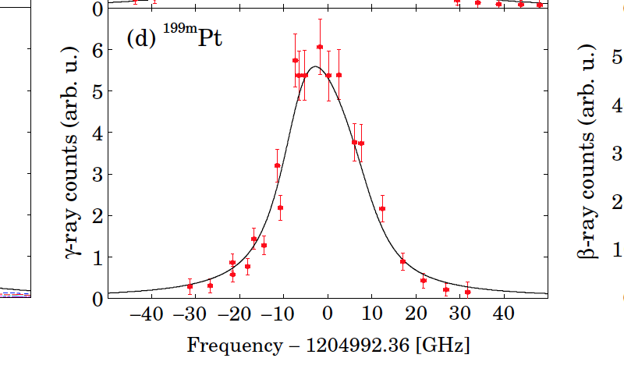
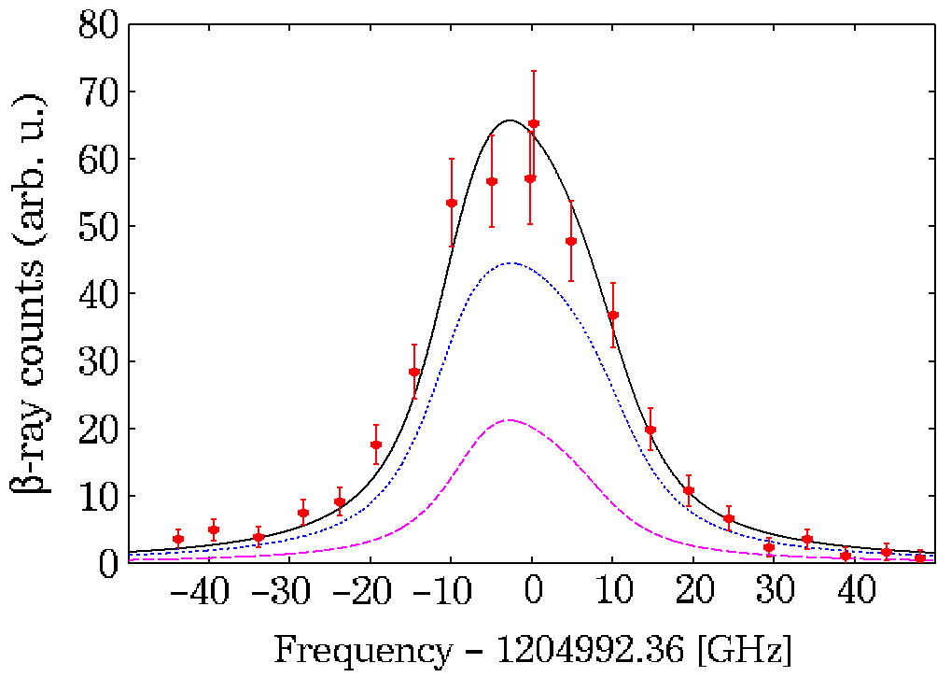
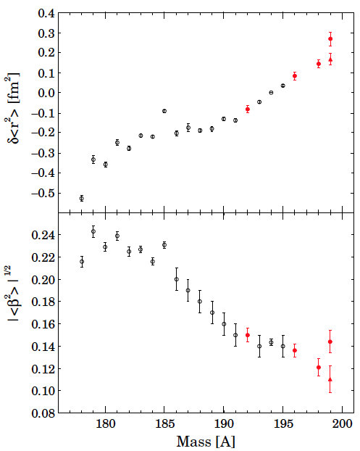
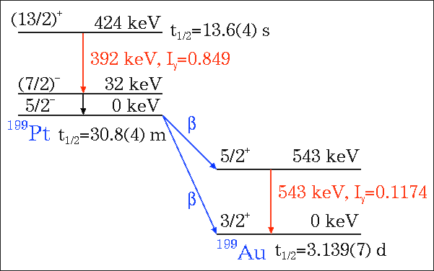
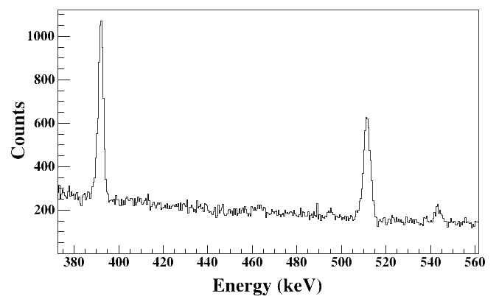
Laser spectroscopy probing nuclear structure
around N=126 isotones
^{199m}Pt
¹⁹⁹Pt
392 keV
^{199g}Pt
Y. Hirayama et al.,
accepted in PRC
543 keV
^{199m}Pt
g; J^{π}=5/2⁻, μ=+0.75(8) μ_{N}
m; J^{π}=(13/2⁺), μ=-0.57(5) μ_{N}
HFB+SkM*
[Nn_{z}Λ]Ω^{π} μ[μ_{N}] β₂
[503]5/2⁻ +0.61 -0.095 oblate
[606]13/2⁺ -1.40 +0.088 prolate
by K. Washiyama
line shape calibration:
Doppler=1.0 GHz @300K
Laser intrinsic linewidth=3.4 GHz
gas-pressure+laser-power broadening=12.1 GHz
¹⁹⁸Pt
Proton Number | 78(Pt) |  | M |  | M |  | MQ |  | MQ |  | MQ |  | M |  | M |  | M |  | M*
 | 77(Ir) |  | MQ | MQ | MQ | MQ | MQ | MQ | MQ | MQ | MQ | MQ | MQ | MQ | MQ |  | M* | M* | M*
 | 76(Os) |  |  |  | MQ |  |  |  | M |  | MQ |  | MQ |  | MQ
 | 75(Re) | M | M | M | MQ | MQ | MQ | MQ | MQ | MQ | MQ
 | 74(W) |  |  |  |  |  | M |  | M |  | M
 | 73(Ta) |  |  |  |  | MQ | MQ | M
 | 72(Hf) |  | MQ |  | MQ
 |  | 104 | 105 | 106 | 107 | 108 | 109 | 110 | 111 | 112 | 113 | 114 | 115 | 116 | 117 | 118 | 119 | 120 | 121 | 122 | 123 | 124 | 125 | 126
 |  | Neutron Number
 | ≥5x10⁸ y
 | ≥ 30 days
 | ≥10 m
 | <10 m
M : Magnetic dipole moment is known.
Q : Electric quadrupole moment is known.
M* : Magnetic dipole moment was measured in KISS.

Slide 9
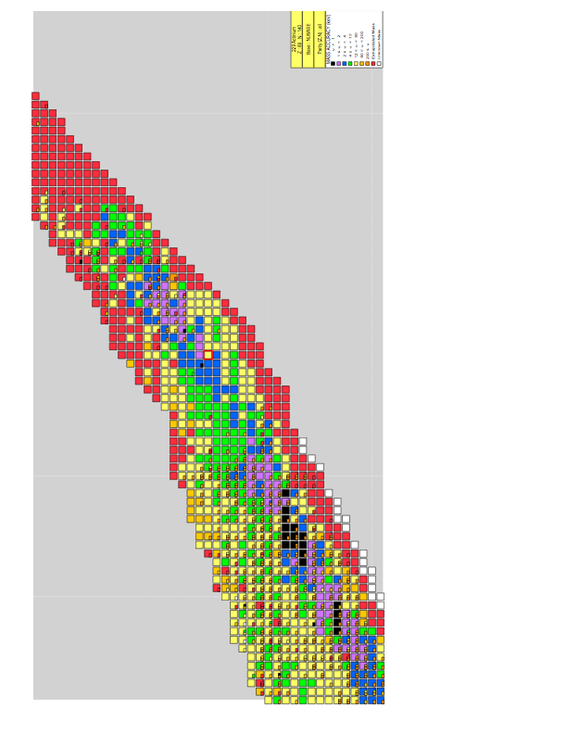

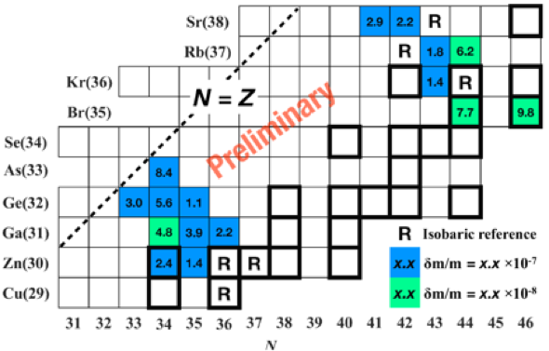
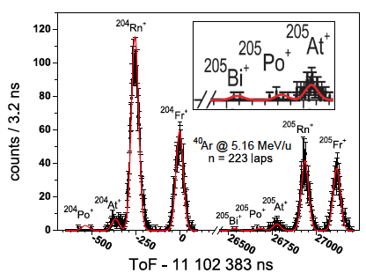
Direct mass measurement
with Multi-Reflection Time-Of-Flight Mass Spectrograph (MRTOF-MS)
S. Kimura et al, arXiv.1706.00186
(submitted to PRC)
Firstly installed at GARIS II
• suitable for the heavy nuclides
→δm<100keV at 100 ions
• fast measuring time ≤20 ms
→available for short-lived nuclides
• compact (~1m)+simple principle
→many applications
Fusion-evaporation
⁴⁸Ca + ^{203,205}Tl/²⁰⁸Pb
¹⁸O/¹⁹F + ²³²Th/²³⁸U
104Rf
103Lr
102No
101Md
Transfer
¹⁸O/¹⁹F + ²³⁵U/²³⁸U
100Fm
99Es
98Cf
• high sensitivity
←identification with 2 ²⁰⁵Bi ions
• high efficiency
←simultaneous measurements
for 9 isotopes
97Bk
Fusion-evaporation
¹⁸O/¹⁹F + ²⁰⁸Pb/²⁰⁹Bi
96Cm
95Am
Fusion-evaporation
⁴⁸Ca + ¹⁶⁹Tm/¹⁶⁵Ho
94Pu
155
93Np
92U
91Pa
90Th
²³⁵U
²³⁸U
150
89Ac
88Ra
87Fr
86Rn
85At
84Po
145
83Bi
MRTOF-MS
@GARIS II
82Pb
^{204, 206-208}Pb
140
115
120
125
130
135
• Masses of more than 80 isotopes were measured in 2016-2017
• More than 30 masses of them were directly measured for the first time
• 6 of them (^{246, 247, 248}Es, ^{249, 250, 252}Md) were newly determined
• Highest precision of 3.5x10⁻⁸ (2.8 keV!!) using 10⁴ ions was achieved for ⁶⁵Ga⁺
→ Feasible for accurate mass measurements in A=60~80 proton-rich mass region
relevant to the rp-process
P. Schury et al, PRC95(‘17)011305(R)
and to be published in NIMB

Slide 10
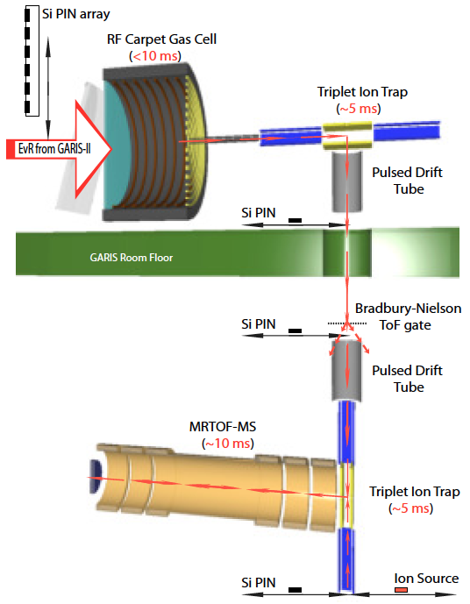
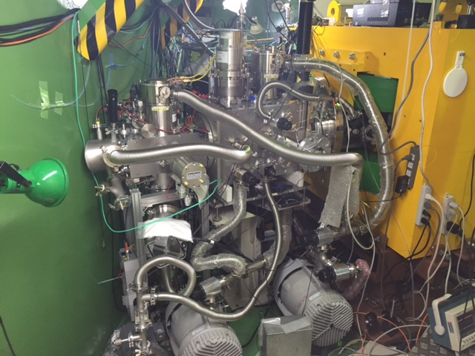
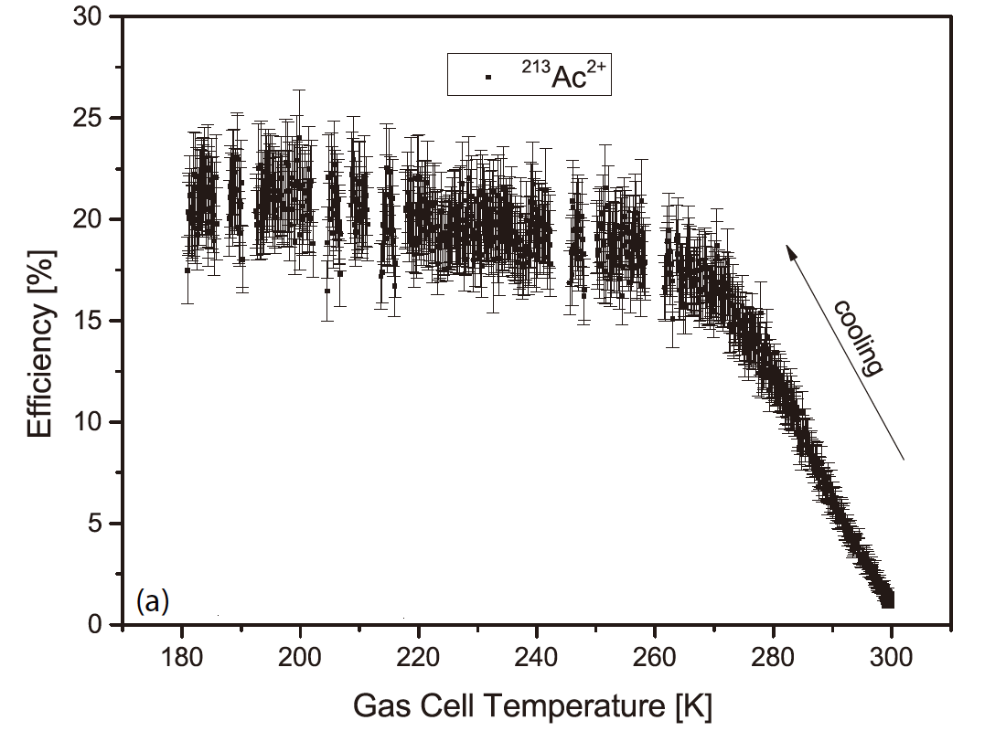
MRTOF-MS @GARIS II
Cryogenic Gas Cell
Ion trap Chamber
写真
Wall
to MRTOF at downstairs
~3 m
IP(Ac²⁺) = 11.8 eV
<< IP (He¹⁺)=24.6 eV
E~1.5 KeV
ΔE < 0.3 eV
Δτ < 20 ns
P. Schury et al., DOI: 10.1016/j.nimb.2017.06.014

Slide 11

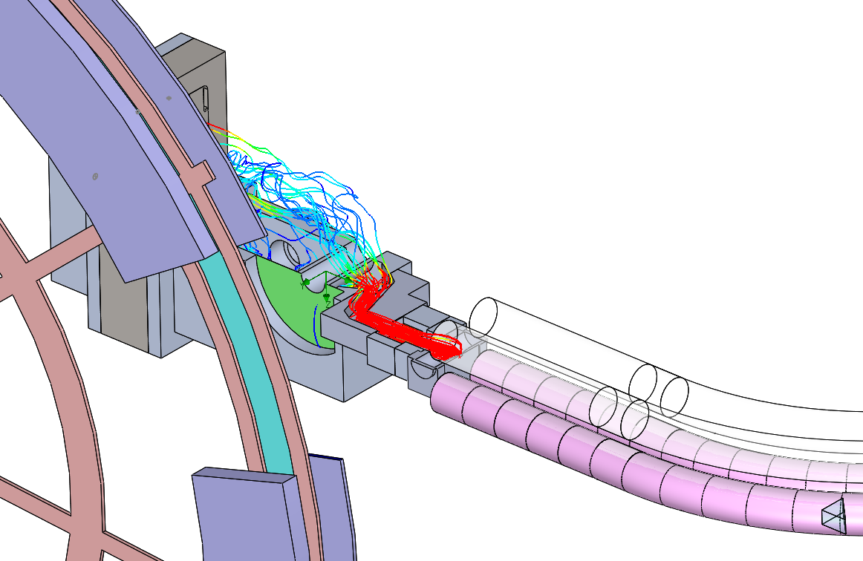
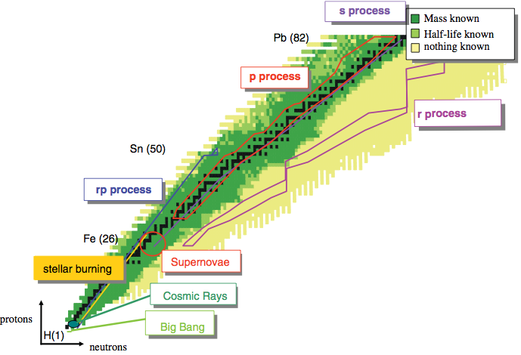
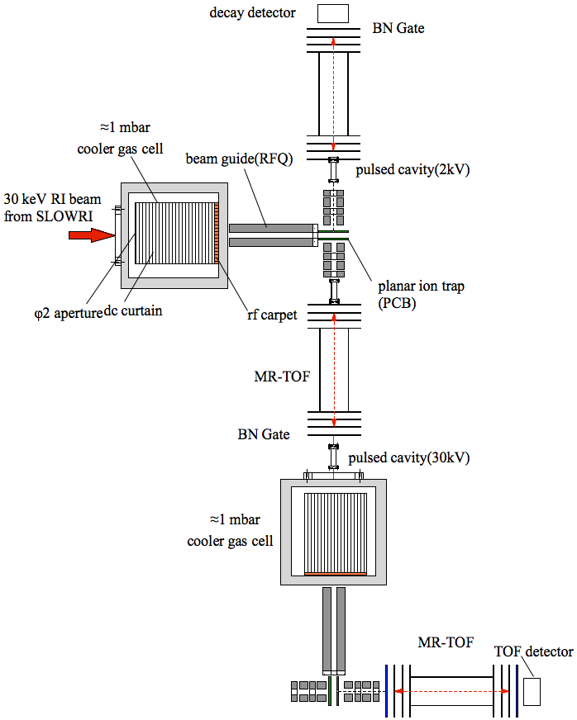
Future’s plan: Stage I to Stage II
-Comprehensive study of element synthesis with precise spectroscopy-
KISS upgrade
Beam dump (~20kW)
²³⁸U beam
11 MeV/A
10 pμA
S-shape RF quadrupole
ion-guide
Mass
Lifetime
Decay scheme
Rotating ¹⁹⁸Pt-target
(~ 7 kW)
Collinear 3 color lasers
radii
moment
Ion. pot.
from SLOWRI
High pure RI
spectroscopy line (HPSP)
β-delayed neutron

Slide 12
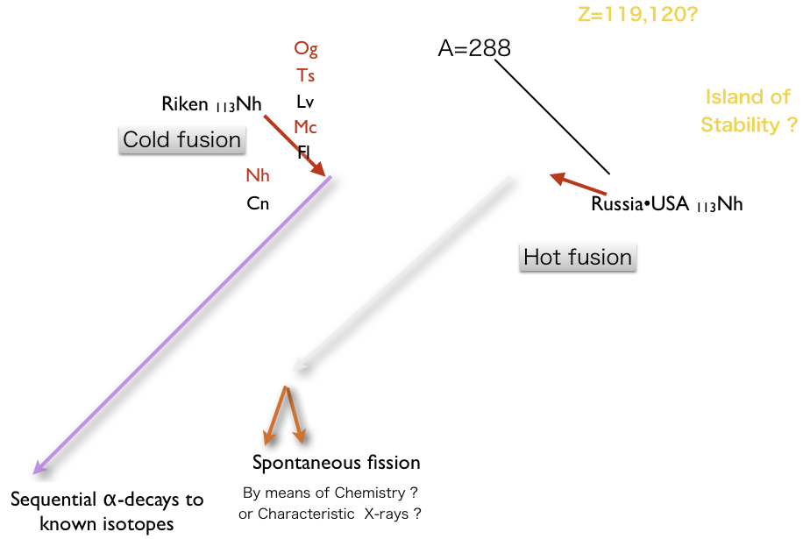
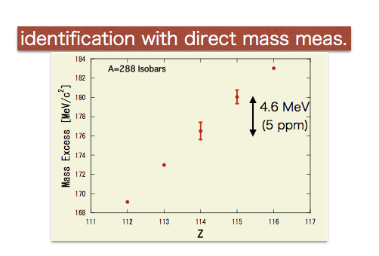
Challenge!!:: Mass and identification of super-heavy nuclides

Slide 13
KISS Stage II: timeline
 | 2017 | 2018 | 2019 | 2020 | 2021
KISS Stage I
KISS upgrade
MRTOF@GARIS
MRTOF@BIGRIPS
High pure RI line
KISS Stage II
Lifetime・Mass・Hfs・γ-Spectroscopy
New-laser system・MRTOF-MS・Intense Primary Beam
Transport
Newly Installation
Newly Installation
SLOWRI R&D・Manufacturing・Installation
Measurements in the Waiting Regions of R-, RP-Processes

Slide 14
Summary
• Charge-radii shifts and magnetic moments of ^{199g, m}Pt, ^{196, 197, 198}Ir were measured for the first time by means of In-gas-cell laser spectroscopy.
• Shape coexistence in ¹⁹⁹Pt is suggested.
• Lifetime measurements in the vicinity of N=126 isotones will be performed soon at the KISS decay measurement station.
• MRTOF-MS has revealed its high performance for mass measurements both in medium- and very-heavy element regions.
• Mass measurements at KISS will be ready within this year.
• R&Ds of KISS Stage II, has been launched since this year for comprehensive study of element synthesis with precise spectroscopy.
• MRTOF will challenge to measure masses of super heavy isotopes.
User collaboration group: SSRI-pns http://research.kek.jp/group/wnsc/ssri-pns/
Calling Letters of Intent concerning to KISS, SLOWRI, MRTOF experimental subjects: submit SSRI-PNS_contact@kek.jp, dead line is 15th, July

Slide 15
end

Slide 16
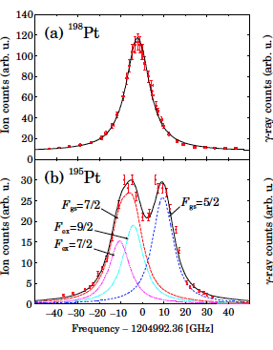
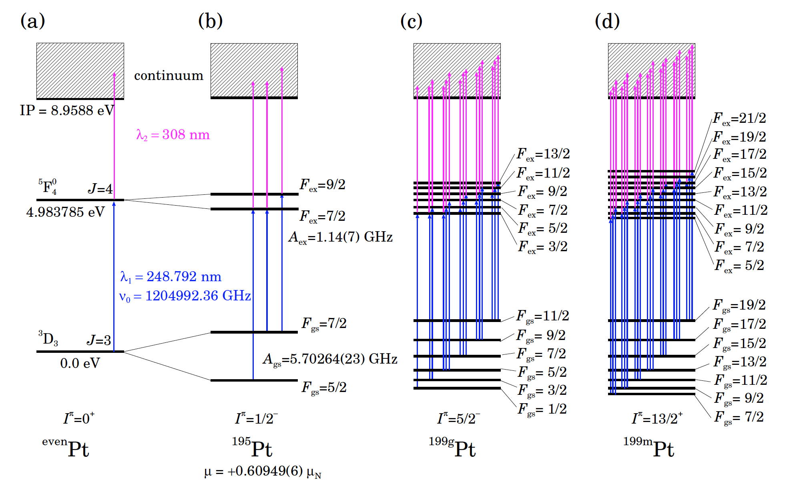
Calibration of measured Hfs with ^{195, 198}Pt
line shape calibration:
Doppler=1.0 GHz @300K
Laser intrinsic linewidth=3.4 GHz
gas-pressure+laser-power broadening=12.1 GHz

Slide 17
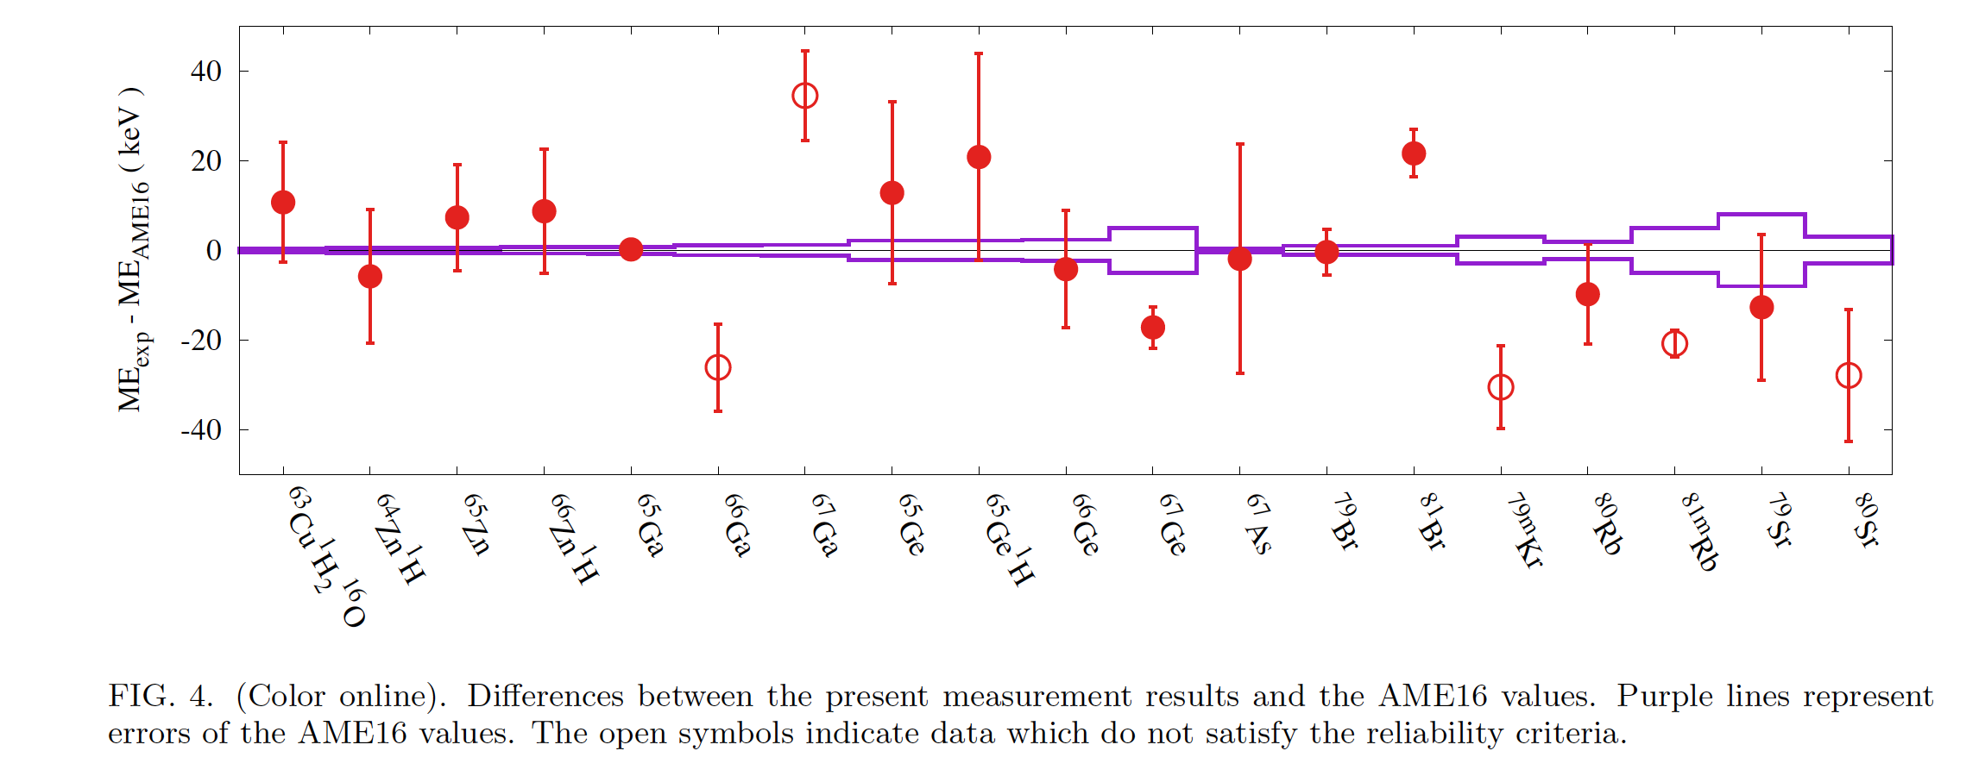
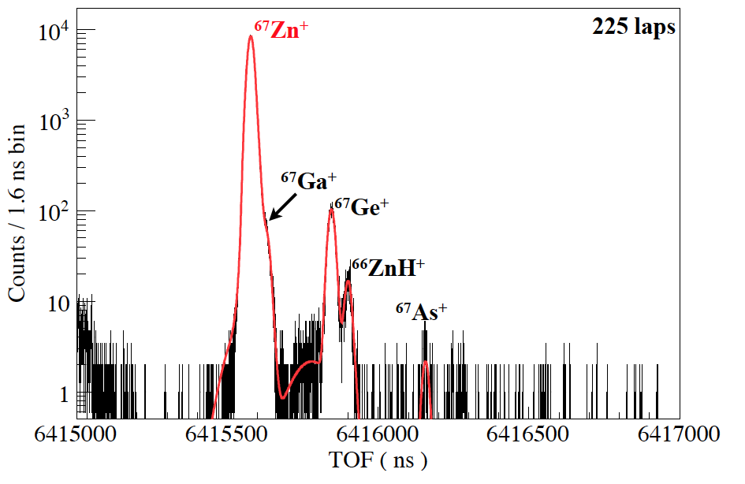
Results of the mass measurements from A=63 to 80
unresolved peak
centroid
Discrepancies between
meas. and AME2016:
• due to indirect evaluation with
reaction Q value, ⁶⁴Zn(α,n)⁶⁷Ge ?
• due to indirect evaluation with
Q_{β} in ⁸¹Br(n, γ)⁸²Br(β⁻)⁸²Kr
S. Kimura et al.,
arXiv.1706.00186

Slide 18
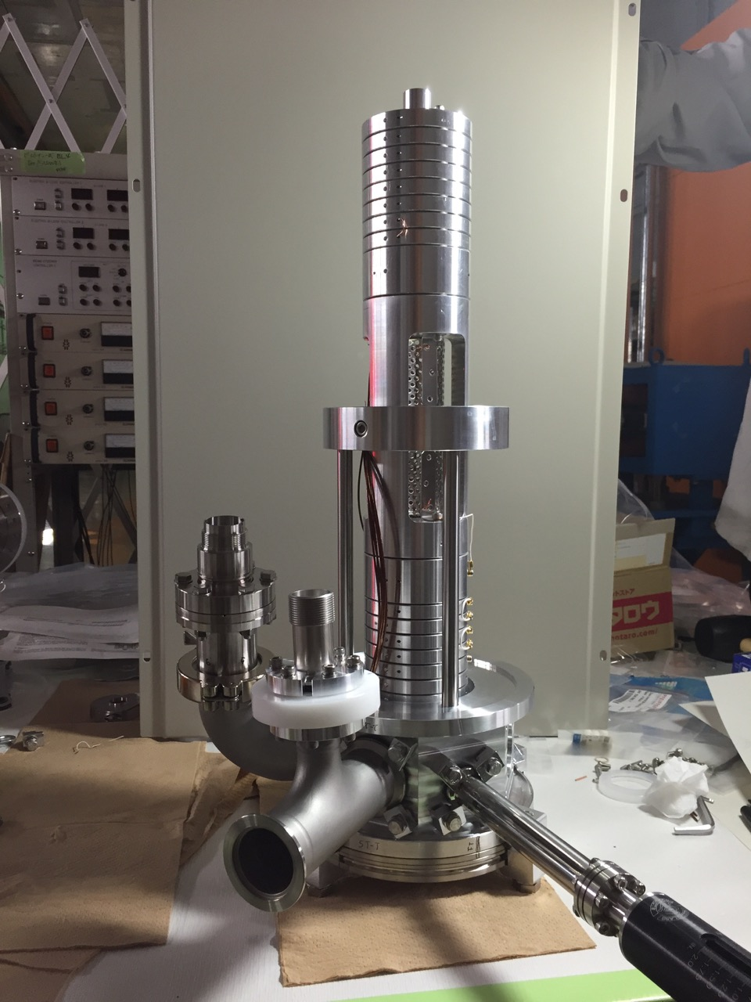
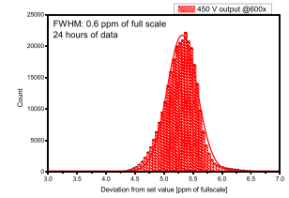
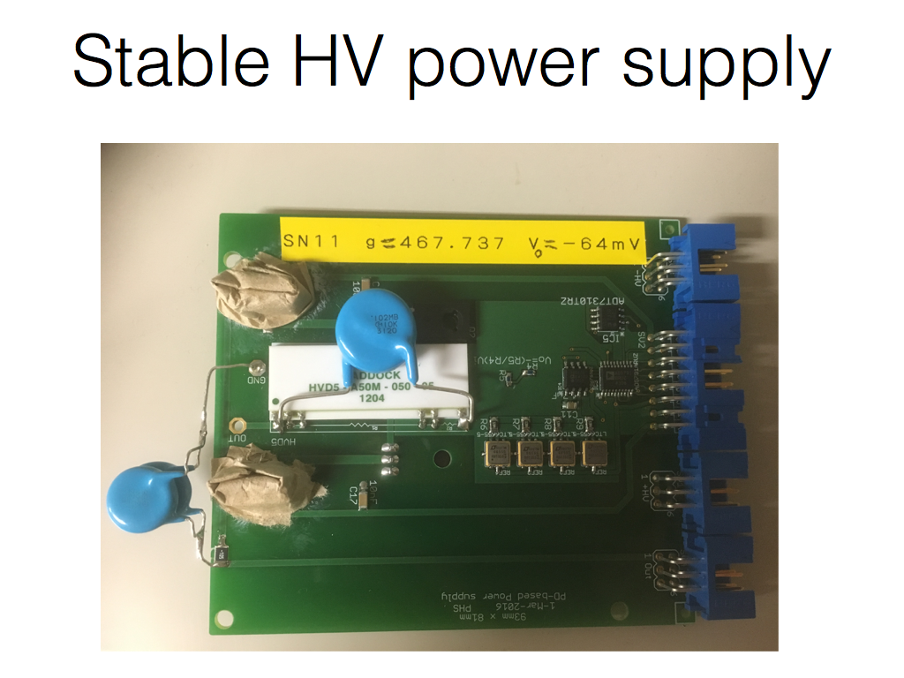
Mini-MRTOF
- improving the portability and efficiency -
• Mass measurements in anywhere: @GARIS I/II,
@SLOWRI, @BIGRIPS, @KISS facilities, etc., in future
• Straight forward configuration of He-gas cell + Ion trap
+ mini-MRTOF
→High detection efficiency
• same resolving power ~1.5 x 10⁵
• Almost ready for the measurements
mini-MRTOF
70 cm
DC-power
supply
stability:
0.6 ppm
Notes:
We are now commissioning so called mini-MRTOF, as shown in this picture.
Actual size is only 70 cm including an injection and detection parts.
This has been developed for mass measurements in anywhere, namely not only at the GARIS II, but also at the GARIS I, SLOWRI, BIGRIPS, and KISS facilities in near future.
Its straight forward configuration of helium gas cell, ion trap, and mini-MRTOF will greatly help to increase overall detection efficiency, compared to the present system.
Expected mass-resolving power will be the same, well above hundred thousand.
This device is almost ready for the measurement.

Slide 19
Future’s plan: Stage I to Stage II
-Comprehensive study of element synthesis with precise spectroscopy-
KISS upgrade
RIBF
・Powerful RI’s production
・Origin of elements
・Ultimate nuclear model
High pure RI
spectroscopy line
New tool !!
MR-TOF
mass measurements of nuclides on all paths
of the element synthesis process
Notes:
So, let me switch my talk to our future’s plan, called as KISS stage II.
It is designed based on the present and near future’s research condition at the RIBF. As you may know, The RIBF has the most powerful RI production ability in the world.
And also this plan will make full use of the MR-TOF device for the first time.
In this plan, we will enlarge our research activities to the comprehensive study of element synthesis by means of the precise nuclear spectroscopy.
Here is the nuclear chart, again. And these lines indicate typical reaction paths of various element synthesis.
Our plan consists of two items,. one is a KISS upgrade and the other is a high pure RI spectroscopy line.
Objective domain of the KISS upgrade includes the third waiting region and a very heavy element region of neutron-rich side. On the other hand, The pure RI spectroscopy line covers medium and heavy elements. So, it is complementary to the KISS upgrade.

Slide 20
(1) KISS upgrade（Heavy-・ SHE-region）
- Rotation target and doughnut-shape gas cell -
Water cooled device
Doughnut-shape gas-cell
Beam dump (~20kW)
Ar-gas
laminar flow
 | Beam | Pt target mg/cm² | Power kW
Stage I | ¹³⁶Xe 8.12 MeV/A, 250 pnA, φ 6 mm | 11 rotated (6 cm dia.) | 0.1
Stage II | ²³⁸U 9 MeV/A, 10 pμA, 6X30 mm² | 13 rotated (60 cm dia.) | 7
Target-like fragments
of MNT-reactions
²³⁸U beam
11 MeV/A
10 pμA
S-shape RF quadrupole
ion-guide
Rotating ¹⁹⁸Pt-target
(~ 7 kW)
Thin window (5μm)
Collinear 3 color lasers
Notes:
Here is a conceptual design of the production area in the KISS upgrade.
Important point in this upgrade is avoiding the direct beam injection into the gas-cell without loosing the extraction efficiency of radioactive ions. This requirement will be satisfied by this modified rotation target and this doughnut-shape gas cell, in principle.
Actually, according to the argon gas flow simulation, we have confirmed the extraction efficiency is almost the same to the present gas cell to be around 40 % for the total yield.
In addition, an S-shape ion-guide will be installed to realize a collinear laser injection to the extracted ions. And a powerful lasers of three colors will be introduced like this way from a new laser system in stead of the old system of around thirty years ago. It will increase the ionization efficiency by one order of magnitude and make it possible to perform the in-gas laser spectroscopy.

Slide 21
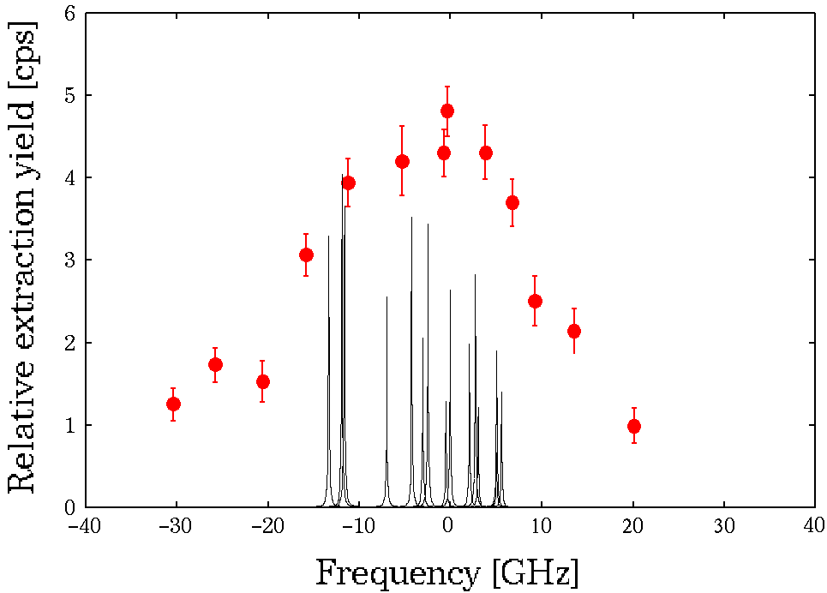
(1) KISS upgrade（Heavy-・ SHE-region）
- Intense laser system for 3 color 3 step resonance ionization -
Excimer laser
∼200 Hz / 10 W
Dye laser
ScanMate 2E
Second harmonic generator (SHG)
high frequency
200 Hz / 0.8 W → 15 kHz / 15 W
wider bandwidth capability
4.5 GHz → 25 GHz
narrower bandwidth capability
Trigger
module
Excimer laser
∼200 Hz / 10 W
Dye laser
FL3002
Oscilloscope
Photodetector
Photodetector
Control PC
Wavelength monitor
Δf=16 GHz
Gas cell
Electro-optic modulator (EOM)
Second harmonic generator (SHG)
Nd:YAG
15 kHz / ∼100 W
Dye laser
15 kHz / 15 W
Dye laser
ScanMate 2E
Trigger
module
Electro-optic modulator (EOM)
Second harmonic generator (SHG)
Nd:YAG
15 kHz / ∼100 W
Dye laser
15 kHz / 15 W
Dye laser
ScanMate 2E
Nd:YAG
15 kHz / ∼100 W
Dye laser
15 kHz / 15 W
Electro-optic modulator (EOM)
Δf=0.2GHz
Oscilloscope
Photodetector
Photodetector
Control PC
Wavelength monitor
Gas cell
Notes:
Here is the present laser system, which can deliver two color laser lights of around 1 watt.
To increase the ionization efficiency, we will replace it to 3 color laser system pumped by powerful NdYAG lasers. It can deliver the intense laser lights of 15 Watt.
Using this powerful laser condition, we can modulate the bandwidth of laser frequency to cover the resonance width of the atomic state. Also it can make use of the in-gas jet laser spectroscopy by narrowing the bandwidth.
Here is a hyperfine structure of 199Pt obtained by the present laser system, as I mentioned before. If we can apply a narrow bandwidth laser with enough power, we will obtain more accurate nuclear moments from precise measurement of the hyperfine structure like this. This kind of physics information will help us to understand nuclear structures in the blank spot.

Slide 22
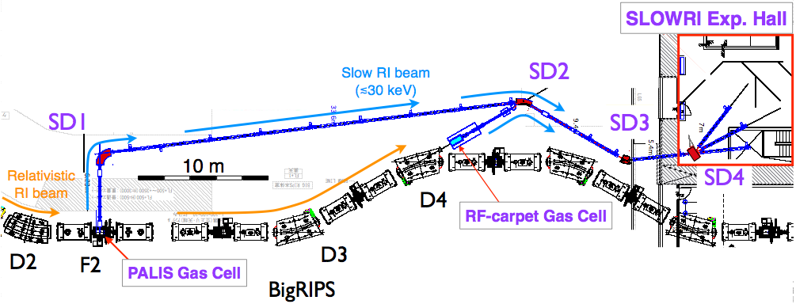
(2) High pure RI spectroscopy line
（medium-・heavy-region）
low emittance, bunched beam
of single isotope
Manipulation of RIs of single isotope –
・lifetime/mass/decay scheme
for unknown 1000 nuclides
Mass
Lifetime
Decay scheme
mass-separated
bunched beam
・Multi-purpose user facility of
precise nuclear spectroscopy
by delivering high-quality RNBs of single isotope
10⁻³ mbar
Charge radii
Nuclear moment
Ionization pot.
SLOWRI（2015~：commissioning)
Generator of slow RI beams using projectile fragments
・Laser resonance ionization / rf ion-guide +
gas-catchers (Ar / He)
β-delayed neutron
Fast (~10ms) extraction
of all RI’s！！
Parasite exp. with
BIGRIPS-MT
Bunched beam of
single isotope
Notes:
On the other hand, the pure RI spectroscopy line will be installed at this SLOWRI experimental hall.
The SLOWRI facility can deliver low energy RI beams by converting relatively high energy RI beams coming from this fragment separator, BIGRIPS. The BIGRIPS is a major device at RIBF to separate and transport many kinds of radioactive isotopes.
So, we can perform the decay spectroscopies of around 1000 unknown nuclei based on the present RI production ability.
Here is a conceptual layout of the pure RI spectroscopy line. It consists of two gas-cell cooler bunchers, here and here and three MR-TOFs.
This is a unique experimental device based on the innovative manipulation techniques of radioactive ions. Thanks to the compactness of the MR-TOF, we can construct a versatile setup to perform various decay spectroscopies in the same time as shown in this figure.

Slide 23
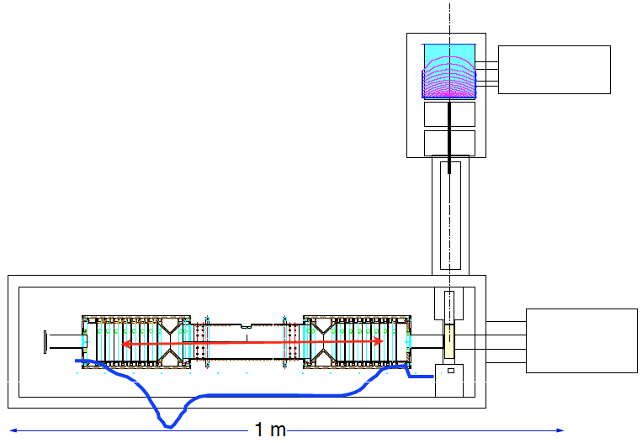
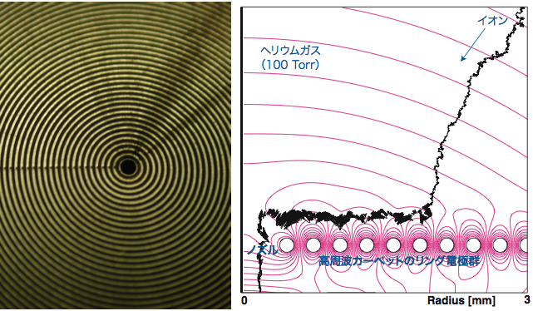
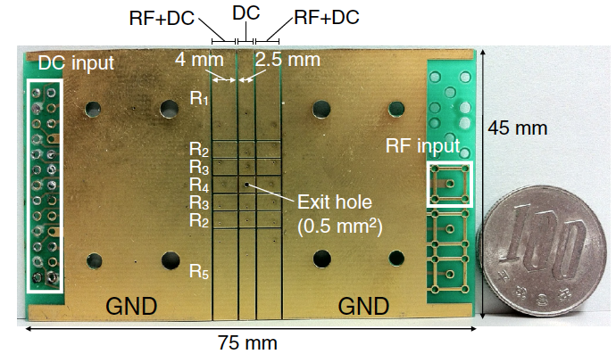

(2) Pure RI spectroscopy line (medium-・heavy- region）
- Injection part of MR-TOF: He gas cell cooler buncher -
function efficiency(%)
Cooling in Gas cell ~ 100
Extraction with RF-Carpet (~5ms) ~ 60
Transp./bunching by OPIG (<1ms) ~ 100
Injection to Flat trap (~6ms) ~ 60
4. Cooling in Flat trap (~2ms) > 50
5. Measurement by MR-TOF (~10ms) ~ 100
Inject.・Meas.(~20ms) > 30
SLOWRI / KISS beam (< 30 keV)
window-less
entrance
Cryo. Pump
DC-field
RF-carpet
RF-Carpet
Flat
trap
Octupole ion-guide
(OPIG)
Carbon OPIG
Flat trap
Cryo. Pump
ΔE_{ion} < 300 meV
Δ_{ion}τ < 20 ns
Notes:
Here is a unit of gas-cell cooler buncher coupled to the MR-TOF. This unit will be installed not only at the pure RI spectroscopy line but also at the present KISS device.
It consists of a helium gas cell cooler buncher, ocutupole ion-guide, a flat trap, and the MR-TOF
The low velocity RI beams from SLOWRI or KISS inject into this gas cell cooler buncher. And ions are trapped and extracted according to these DC field and this rf-carpet. After the OPIG transportation, the ions are cooled down again to the thermal level, as less than 0.3 eV. And then ions are injected into the MR-TOF as a bunched beam with short width less than 20 ns.
So far, the flat trap and OPIG has been successfully operated together with the normal pressure helium gas cell with these typical efficiencies. And at this moment, this window-less gas-cell cooler buncher of low gas pressure of around 2 mbar has been developed. An expected overall transport efficiency is higher than 30 %.

Slide 24
1. KISS project
- How are the elements of gold and platinum synthesized ? -
Type II Supernova (CC-SNe)
Neutron star merger (NS-NS)
H. Grawe et al., Rep. Prog. Phys. 70 (2007), 1525-1582.
A
3rd peak (A∼195)
Solar r-process abundance
2nd peak
Waiting point for
the 3rd peak
（Blank spot）
Atomic number
rapid neutron capture (r-) process
The third peak of the abundance pattern
Unclear estimations with various nuclear models
→ Most important region to pin down the astrophysical origin of the r-process
Neutron number
Notes:
An ultimate goal of the KISS project is finding out how are the elements of gold and platinum synthesized in the universe.
As you may know, these elements are believed to be synthesized by the rapid neutron capture process, so called r-process, under an explosive circumstance.
This is a nuclear map indicating known and unknown nuclei. And here is an observed solar abundance of the r-process.
These two peaks, the second and the third abundance peaks are characterized by nuclear properties of these specific nuclides at neutron magic numbers of 82 and 126, respectively. These areas are called as waiting regions, where we can evaluate the astrophysical condition of this process.
Unfortunately, these waiting nuclei are very far from the stability line, and only the nuclear information of a tiny part of the first and second waiting regions has been obtained. However, based on this knowledge and recent astronomical observation, core-collapse super novae and neutron star mergers become the present candidates as an origin of the r-process.
As for the waiting region of this third peak, there has been no experimental approach, so far. This region is called as a blank spot of experimental nuclear physics due to its difficulty.
In the KISS project, we are going to access and measure this blank spot nuclides at least within this red area.

Slide 25
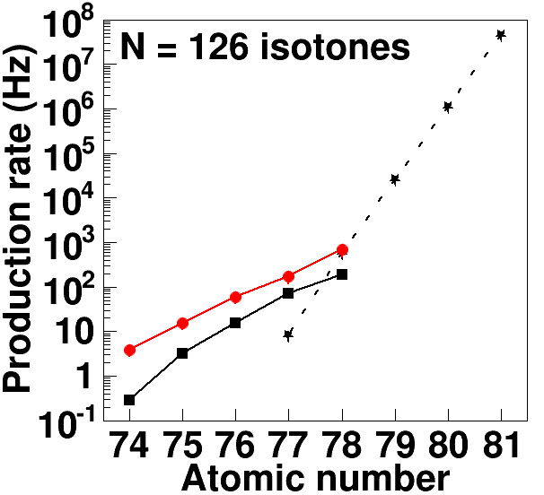
Expected production rates of N = 126 isotones
- Stage I and Stage II -
MNT (Exp.) : ¹³⁶Xe (8 MeV/A, 20 pnA)
+ ¹⁹⁸Pt (2 mg/cm²)
GRAZING : ¹³⁶Xe (8 MeV/A, 20 pnA)
+ ¹⁹⁸Pt (2 mg/cm²)
STAGE II
(21 kW)
STAGE I
Fragmentation :
²⁰⁸Pb (1 GeV/A, 1 pnA) + Be (5 g/cm²)
Production rate (Hz)
Pt
T. Kurtukian-Nieto et al., Phys. Rev. C 89 (2014), 024616.
Ir
GRAZING :
²³⁹U (9 MeV/A, 20 pnA)
+ ¹⁹⁸Pt (13 mg/cm²) -> 0.03 kW !!
Os
Re
W
STAGE I: 0.3 kW level @FY2018
-> ¹³⁶Xe, 250 pnA
-> ²³⁸U, 140 pnA
STAGE II: 1.0 (or 21) kW
-> ²³⁸U, 0.5 (or 10) pμA
* depends on RIBF-UPGRADE
from Y.X. Watanabe & Y.H. Kim
Atomic number
Feasible for decay measurements of unknown isotones, if ε_{extr.} > 0.1 %
Notes:
Anyway, I like to summarize the expected production rate under the realistic condition as shown in this figure. That is confirmed by our recent experiment at GANIL,
The red point indicates the estimated production rate under the combination of the 20 pnA 136Xe beam and 198Pt target. And this black square is the prediction of GRAZING code. As can be seen, measured values are always a little bit larger than the prediction by factor two to ten.
And this star mark is the reported value of the fragmentation reactions at GSI as a reference.
If you accept the predictions by GRAZING code, 238U beam will give more production cross sections by around one order of magnitude with same beam intensity like this blue line.
On the other hand, available uranium beam intensity is 500 pnA at the present RIBF.
So, we are now improving the production condition from only 30W, here to 0.4 kW level as the KISS stage I.
Near future, we are going to the 1.5 kW level as the stage II.
Moreover, if we are lucky to upgrade the RIBF, 30 kW beam power can be realized.

Slide 26
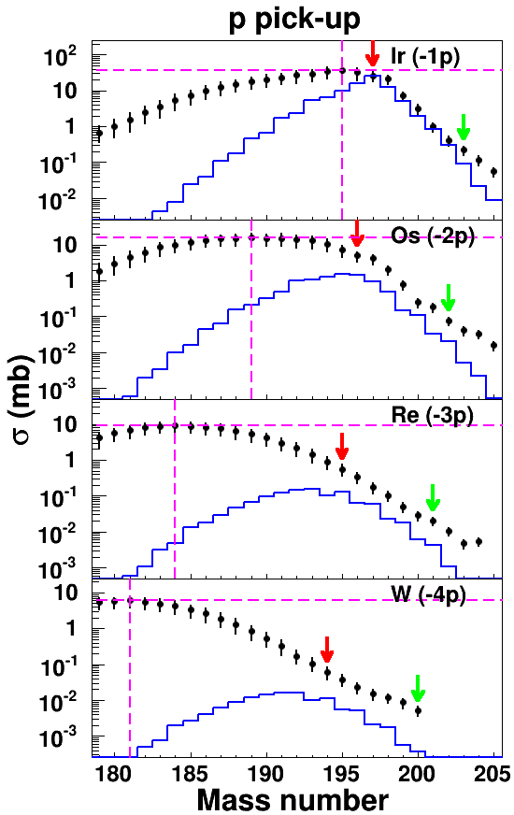
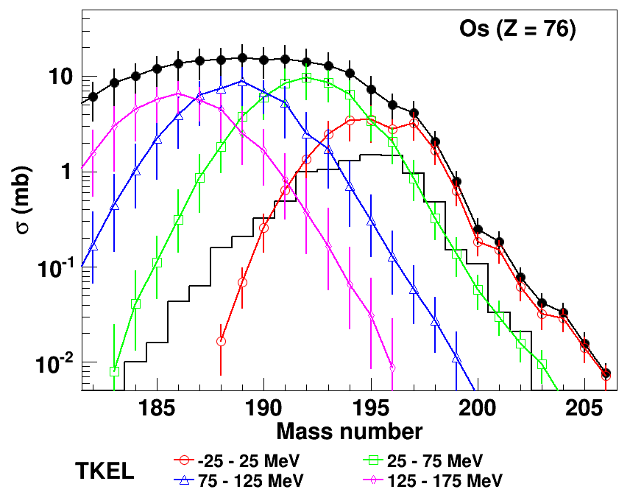
Evaluated cross sections of target-like fragments (TLFs) of MNT reactions
Modest enhancement of cross sections
a factor of 2 το one order of magnitude
2p pick-up
Meas.
GRAZING
N = 126
Maximum
0n
Total
N = 126
TKEL = −25 ∼ 25 MeV
Enhancement is occurred
at low-TKEL region
TKEL = 25 ∼ 75 MeV
TKEL = 75 ∼ 125 MeV
TKEL = 125 ∼ 175 MeV
GRAZING
Notes:
So far, we have checked this prediction with VAMOS spectrometer at GANIL using the MNT reactions of 136Xe and 198Pt system.
These black dots are the evaluated target like fragment, TLF cross sections from Iridium to Tungsten isotopes.
These values are obtained from the PLF cross sections, which are counter partners of TLF, by taking account of the particle evaporation process.
This red arrow indicates a cross section of the 0n- transfer channel. And this green arrow indicates the cross section of N=126 isotone.
As can be seen, the N=126 isotones will be produced with relatively large cross section compared to the GRAZING predictions ranging from 100 micro barn to 10 micro barn. Grazing values are indicated by these solid lines.
This figure shows partial cross sections of osmium isotopes sorted by an appropriate TKEL windows. TKEL means total kinetic energy loss, which corresponds the dumped energy in the reaction system. And again, this solid line indicates the grazing prediction.
The magenta line indicates a lowest TKEL component up to 25 MeV. And this green is from 25 to 75 MeV. And the pink line comes from the highest TKEL region, namely large dumped region.
As can be seen, production of neutron-rich isotope is mainly governed by the the low TKEL component near the quasi elastic region. That is an interesting feature observed in this experiment. And it is reasonable result, if you take into account a fast charge equilibration and less neutron evaporation probability in this region.
In addition, we can find that the cross sections in lighter isotopes are largely enhanced with deep inelastic events compared to the predictions. It may indicate the grazing code fails to describe the MNT reactions in the dumped region.

Slide 27
IGLIS
- for efficient collection & separation of TLF’s -
filled with
50 kPa Ar gas
Laser resonance
ionization
(Z selection)
Beam
diameter : ∼ φ 2 mm
emittance : ∼ 10π mm · mrad
Ar gas
OPIG
SPIG
+
ISOL
(A separation)
+
+
+
rotation
tgt(¹⁹⁸Pt)
Separation of Z and A is achieved by laser resonance ionization and ISOL.
2nd chamber
1.0 Pa
MBP
6000 m³/h
SP
630 m³/h
Ion source
chamber
4x10⁻³ Pa
TMP
1300 L/s
3rd chamber
10⁻² Pa
TMP
800 L/s × 2
Extraction chamber
3×10⁻⁵ Pa
TMP
1500 L/s
¹³⁶Xe, ²³⁸U
βεαμσ
V_{RF}
∼
V_{SPIG}
V₀ ∼ 20 kV
Notes:
Let me switch my talk to the on-going developments.
This is a schematic view of the present gas cell chamber of the KISS device. A primary beam comes from here and hit the target.
And produced radio activities scattered at wide angle are stopped and neutralized in this argon gas of 50 kPa.
According to the argon gas flow, single neutral atoms are transported to be ionized element selectively by this two color lasers just before the exit hole. Finally singly charged ions are transported by this couple of ion-guides and are mass separated by the classical ISOL technique.
At this moment, we have largely modified the gas cell chamber.
Firstly we installed a doughnut shape gas cell, which has a beam penetrating pipe to avoid direct beam injection into the argon gas.
And secondly, we introduced this rotation target for accepting intense primary beam as much as possible.
And Finally, we will set this inner wall to separate vacuum conditions of these rooms. Namely, the gas cell is set in the high vacuum region compared to these differential pumping regions.

Slide 28

Large modification of argon gas cell chamber
- Doughnut-shaped gas cell &Rotation target -
δ, X-rays, UV
shield
Essential for introducing intense ²³⁸U, ¹³⁶Xe beams as well as for improving the extraction efficiency
Rotating
target
laser
Unstable ¹⁹⁹Pt
¹³⁶Xe
ε_{ext} x 5
• Ten times intense
RNB’s are available
since 2016.Sept.
RI’s
fixed target
@Mar. 2016
laser
¹³⁶Xe-beams
Doughnut-shaped gas cell
Notes:
Here is a picture around the argon gas cell before installing the inner wall. This is a primary beam line and this is a doughnut-shape argon gas cell.
Here is a side view of the doughnut-shape gas cell facing to the primary beam. This is a beam penetrating pipe, which can avoid a direct beam injection into the argon gas.
Produced target like fragments have a large angular distribution and can enter the gas cell through this thin Kapton window.
By the help of this installation, we have obtained 5 times higher extraction efficiency from here to here and also we could irradiate effectively the target with 3 to 4 times intense primary beams. Now around 10 times intense RNBs are available since this September.
Now, new gas cell chamber including the inner wall has been installed instead of this chamber. And we are expecting more intense beam can be accepted.

Slide 29
Present activities：KISS Stage I
- opened for users (2016~) -
KISS stage I: Lifetime & Mass of nuclei
in the vicinity of the waiting region
Approved Subjects at 2016 NP-PAC
• P.M. Walker, NP1512-RRC37
“The Structure and Decay of High-K
Isomers in ¹⁸⁷Ta”: W-target
• Y. Watanabe, NP1512-RRC40
“Yield development of KEK Isotope
Separation System (KISS)”: ²³⁸U-Beam
• Y. Hirayama, NP1512-RRC41
“Lifetime measurement of nuclei
around N=126 using KISS”:
KUTY : H. Koura, T.Tachibana, M. Yamada, http://wwwndc.jaea.go.jp/CN14/index.html
Expected ：T_{1/2}
²⁰³Ir
Au
Pt
¹⁹⁸Pt
measured region
Ir
²⁰³Ir
1 h
²⁰²Os
1 h
Os
¹³⁶Xe : I=20pnA
unknown region 1
(Stage I)
²⁰¹Re
Re
¹³⁶Xe : I=250pnA
²⁰⁰W
W
Ta
unknown region 2
(Stage II / present RIBF)
¹⁹⁹Ta
²³⁸U :
I=500pnA
Hf
1 s
Waiting
region
1 s
Lu
unknown region 3
(Stage II / RIBF upgrade)
²³⁸U :
I=10pμA
Yb
120
121
122
123
124
125
126
127
Νευτρον νυμβερ
COMPETITORS::
GALS project@FLNR, Russia: under construction
REGLIS3 project@GANIL, France: under designing for SPIRAL 2 facility → Full operation will be around 2020
N=126 factory@ANL, USA: under discussion
Notes:
So far, these experimental subjects have been approved at the last and recent RIBF-PAC.
The third one is our major subject concerning to the lifetime measurements.
Here is a part of nuclear chart around the blank spot. And this white line indicates a feasibility of the lifetime measurement as a function of the primary beam intensity. So, in this subject, we are trying to measure unknown lifetimes of these nuclei above this first white line.
In the next step, KISS Stage II, we will access these region 2 and 3, which include expected waiting nuclei.

Slide 30
Hyperfine structure

Slide 31


Further developments under progress
- New gas-cell chamber, Det. St., MRTOF-MS -
• New gas cell chamber→ isolate the gas cell in a high-vacuum region
• 4 super-clover Ge-det’s + low-BG β-ray gas counter
→ maximize detection efficiency for β-γ decay spectroscopy
• MRTOF-MS→ powerful tool for investigating a mass systematics
in the blank spot region
β-ray gas counter
KISS beam
High vacuum
Rotating target
Gas cell
β−γ, lifetime
Lifetime
Beam
On
Beam
Off
Primary beam
Beam dump
Differential
pumping
Laser
MRTOF-MS
Ion beam
KISS beam

Slide 32


Initial mass measurement in trans-uranium region at GARIS II
• P. Schury, NP1512-LINAC07R1: “Initial Study of Atomic Masses in Trans-Uranium Elements at GARIS-II by Means of a Multi-Reflection Time-of-Flight Mass Spectrograph” (2016~)
P. Schury et al., P.R. C95(‘17)011305(R)
• Our first attempt to determine the absolute
masses in SHE region by detecting a small
amount of radioactive ions
• Masses of 8 proton-rich isotopes in the
heavy-mass region have been directly
measured, for the first time
• Various isobars can be measured at the
same time.
Notes:
Anyway, the MRTOF has already been used in the direct mass measurements at the GARIS II facility.
The first subject of this setup is aimed at initial mass measurements in trans-uranium region. It is the first our attempt to determine the absolute masses in super heavy element region by detecting a small amounts of radioactive ions. So, this subject included some technical issues that were confirmed under real experimental conditions.
To find out the solutions, it took a relatively long time than expected.
However, in the measurement of this year, we have succeeded to measure 8 proton-rich isotopes in the region from francium to polonium elements, for the first time, as shown in this tof spectrum.
This is a summary of the measured masses.
The result is now submitted to the physical review..

Slide 33
Subjects in 2017 - 2020
mini-MRTOF
extr. rate
(cps)
Pt | ¹⁹⁸Pt
Ir
Os
Re
W
Ta
 | 120 | 121 | 122 | 123 | 124 | 125 | 126
10⁴
10³
10²
10¹
~70 cm
10⁰
10⁻¹
10⁻²
10⁻³
10⁻⁴
KISS Stage I(~2020)
10⁻⁵
50 pnA
¹³⁶Xe
Neutron Number
KISS-MRTOF
since 2016
under the IBS collaboration
T_{1/2} measured (KISS)
measured (GSI)
to be measured (KISS)
HFS measured (KISS)
to be measured (KISS)
Mass to be measured (KISS)
+ isomer spectroscopies in this region
Notes:
Based on the first success of the direct mass measurement at GARIS II, we are now constructing a mass measurement station at the KISS device under the collaboration with IBS.
Here is a mini-MRTOF having short total length around 70 cm. That is under development and will be installed at KISS within this year as I mentioned before.
This nuclear map indicates an experimental plan during these three years. Black, Red, and Brown dashed triangles are lifetime, hyperfine structure, and mass unknown nuclides and to be measured with the present KISS stage I setup, which will accept intense 136Xe primary beam of 50 pnA without large modification.

Slide 34


NP1512-LINAC24
- Mass measurements in N=152 deformed shell closure region -
• Y. Ito, NP1512-LINAC24: “Probing N=152 Deformed Shell Closure via High-precision Mass Measurement with Direct and Decay Production”(2016~)
ToF: 8.5 ms
FWHM: 38 ns
Ref.: ¹³³Cs⁺
²²³Th¹⁶O⁺⁺
R_{m}=1.12 x 10⁵
• First direct mass measurements of actinide
isotopes under high mass-resolving power
• Reasonable extraction efficiency (~25%) of the
cryogenic gas-cell for actinide elements
• Large deviations of S_{2n}-values for ^{223,224}Th from
evaluations based on α-decay energies
• Irregularity at N=133 is also found in Th
systematics
• Upcoming experiments (this Dec.) will reach
to the N=152 region
Notes:
Thirdly, direct mass measurement in very heavy mass region has been also performed with interest of the N=152 deformed shell gap.
Here is a typical TOF spectrum and summary obtained at the first experiment.
This is the first direct mass measurement of actinide isotopes with present system.
Mass resolving power is achieved to be well above hundred thousand.
And thanks for this resolution, estimated precision is less than 100 keV.
These data were obtained under reasonable extraction efficiency around 25% of the cryogenic He-gas cell.
As shown in this figure, resultant 2-neutron separation energies both of ^{223,224}Th have large deviations from the estimations, which are based on the alpha decay energies.
And irregularity at N=133 is also found in the thorium and proto-actinium systematics like actinium and radium systematics.
Upcoming experiments in this December will reach to the N=152 region.

Slide 35
Colleagues of KEK-WNSC
KEK Scientific staff:
  H. Miyatake, M. Wada,
  Y.X. Watanabe, Y. Hirayama
KEK Technical staff:
  M. Oyaizu, Y. Kakiguchi
Secretary:
  M. Izawa
Students (3)
SLOWRI & MRTOF-MS
  , P. Schury (from 2016, Jan.)
KISS
MRTOF-MS
MNT & KISS
• IBS staff:
  J.Y. Moon, J.H. Park (from 2016, Mar.)
MRTOF-MS
Super Clover Ge
for group activities,
→http://research.kek.jp/group/kekrnb/en/
for contact the SSRI-PNS
→SSRI-PNS_contact@kek.jp
Room 415&416@4th floor of RIBF bldg.
Notes:
Here is a present member list of the WNSC.
Just after the last PAC meeting, Schury Peter has joined. And two researchers, Moon san and Park san from IBS, Korea have also joined for the MRTOF and Super Clover Ge collaborations.
Thank you for the attention.

Slide 36
Laser ionization schemes
Ionization potential
λ₂ = 308 nm (4.03 eV)
Frequency tunable Dye lasers :
NarrowScan , ScanMate + SHG
pumped by two excimer laser (LPX240)
Intermediate state
λ₁ ～ 250nm (resonance)
Off-line test :
Saturation of the number of laser ionized atoms
Isotope shift, pressure shift, pressure broadening
Initial state
(ground state)
Atomic energy levels
Ionization schemes for Ta (NP1512-RRC37) and Os (NP1512-RRC41)
Laser band width of λ₁ ~ 1 pm@250nm
Element | Ionization Potential (eV) | HF coupling constant | λ₁(nm) | λ₁(eV) | Off-line test in gas cell | Isotope shift (pm/δA) | Pressure shift (pm/100kPa)
Pt (Z=78) | 8.96 | Known | 248.7920 | 4.98 | Done | −0.13 | 0.35
Ir (Z=77) | 8.97 | Known | 247.5871 | 5.01 | Done | 0.24 | 0.26
Os (Z=76) | 8.44 | Known | 247.7583 | 5.00 | Done | −0.17 | 1.0
Re (Z=75) | 7.83 | Known | 252.0763 | 4.92 | Done | 0.28 | 0.30
W (Z=74) | 7.86 | Known | 255.2115 | 4.86 | Not yet | - | -
Ta (Z=73) | 7.55 | Known | 248.5706 | 4.99 | Done | - | 1.3

Slide 37
SSRI-pns Collaboration Meeting 2016
So far approved: 2
1
1
Notes:
Anyway, collaboration meeting, so called as SSRI-pns meeting has also been held in this year. This meeting is a kind of user meeting concerning research activities of KISS, SLOWRI, and GARIS facilities.
16 pre-proposals were submitted to this meeting,

Slide 38



SLOWRI facility at RIBF
-Low-energy RNBs of all elements-
Under commissioning stage !!
Parasite exp. during the BIGRIPS
machine time
Fast (~10ms) extraction
of all RI’s！！

Slide 39
Timeline of KISS exp’s & developments
 | 2015 | 2016 | 2017 | 2018 | 2019
KISS for Users
Lifetime Measurements I Pt, Ir, Os
Lifetime Measurements II Os, Re, W, Ta
Low background β-ray counters
Gas cell development
β-γ spectroscopy
Ge-arrays
Mass Measurements
MR-TOF Injection beamline
11 LOIs
-> 3 approved
6 LOIs
(-> 2 approved)
NP1512-RRC41
NP1512-RRC40
²³⁸U beam
0.01cps
a few cph
a few cpd
doughnut
rotation tgt
fast extraction
with φ2
NP1512-RRC37
Notes:
Finally, I like to mention a little bit on the timetable concerning to the research activities of KISS.
So far, we have organized user collaboration group, SSRI-pns, which promote scientific opportunities for potential users to perform experimental subjects not only with KISS, but also with GARIS, MRTOF, and future’s SLOWRI facilities. And 11 letters of intent to the last meeting and 6 letters of intent to the present meeting have been discussed. At last, we have now 3 approved subjects as the KISS machine time. In addition, 2 subjects will be added in this year.
Anyway, those approved subjects will be performed according to this development schedule concerning to the decay spectroscopy station and the mass measurement station.

Slide 40

Double layer segmented proportional gas counter
- for very low BG rate < 0.01cps -
Tape
Anode wire
(Be-Cu/C 100μφ）
9.2
4.8
7.8
ABS
4.8
Cathode foil
(25 μm aluminized mylar)
P10 gas
1atm
ΔΩ = 79% (4π)
6.4
β
KISS beam
KISS beam
BG
Mesh
&
Myler foil
2 layers ×16 segments
Notes:
Here is a new beta-ray gas counter. Thai is now under the commissioning stage.
Here is a top view of this counter. This device is manufactured by low-atomic number materials to suppress scattered gamma-rays and electrons by themselves.
Double layer segmented proportional counters are set cylindrically around the tape, here. And detail structure of each couple of counter cells are such like this.
Anyway, Kiss beam comes from here and is implanted on this tape. Then, beta-ray from implanted source can be detected by this unique hit pattern only.
On the other hand, we can discrete back-ground radiations, such as cosmic muon, labeled by other hit pattern like this.
This is a side view of this counter. Its effective solid angle will reach to 79 % of 4 pi.
Goal of suppressed back ground rate is 0.01 cps., which is lower than present plastic telescope system by one order of magnitude.

Slide 41

Inflation of MRTOF-MS at RIBF
Precise mass
measurements
for more than
1000 nuclides

Slide 42



Upgrade plan of the RIBF
- Breakthrough in Heavy Element Science by Upgrading the RIKEN RIBF -
SHE
20160212, H. Sakurai＠学術会議・素核シンポに加筆
RCNP, Osaka-U
High-spin
KEK
Heavy element(KISS)
Next generation γ-det. 2016～
Very low energy (E<30 keV) RNB
produced by MNT-reactions
KISS
GARIS-II+MR-TOF
(SLOWRI+MR-TOF)
RRC
SRC
CNS, U-Tokyo
High-Ex.
S-RILAC
Low energy (5<E/A<50 MeV) RNB
+Spectrometer
S-LINAC
new fRC
Nishina, Riken
n-rich RNB
New-fRC
Intense HI-beams
x２０@KISS (²³⁸U, 10 pμA)
High energy (50<E/A<300 MeV) RNB
Notes:
In addition, I like to mention a little bit on an upgrade plan of the RIBF facility itself.
Here is a present facility lay-out. KISS device is installed here.
And MR-TOF R&Ds are performed at GARIS and SLOWRI facilities, at this moment.
Anyway, in this upgrade plan, Riken will construct a super-conducting linac and this new cyclotron to increase the primary beam intensity by twenty times.
It means we can use 10 particle micro Amp uranium beam at the KISS production target in near future.
This plan has been established based on the collaboration with domestic major institutes, IPNS, RCNP, and CNS.
And it has been submitted to the science council of Japan.

Slide 43







Hfs of ¹⁹⁶⁻¹⁹⁸Ir
gs + is (Sep)
¹⁹⁷Ir (I^{π} =3/2⁺, t_{1/2}=5.8(7) min)
¹⁹⁶Ir (I^{π} = (0,1)⁻, t_{1/2}=52(1) s)
Very Preliminary
Analysis is under progress by M. Mukai
- positive μ
- negative μ
μ＝+0.24(3)μ_{N}
I = 1
isomer
I = 2
I = 0
¹⁹⁸Ir (I^{π} =unknown, t_{1/2}=8(1) s)
I = 3
I = 1

