Slide 1
Precision Mass Measurements of Short-lived Nuclei at CSRe-Lanzhou
“China-Japan collaboration workshop”, University of Tsukuba, June 26-28, 2017
Meng Wang
Institute of Modern Physics, CAS

Slide 2
CSRe mass measurement collaboration
Y. H. Zhang, M. Wang, H. S. Xu, R. J. Chen, X. C.Chen, C. Y. Fu, B. S. Gao, Y.H. Lam, P. Shuai, M.Z. Sun, X. L.Tu, Y.M. Xing, X. Xu, X. L. Yan, Q. Zeng, P. Zhang, X. Zhou, X. H. Zhou, Y. J. Yuan, J. W. Xia, J. C. Yang, Z. G. Hu, S. Kubono, X. W. Ma, R. S. Mao, B. Mei, G. Q. Xiao, H. W. Zhao, T. C. Zhao, W. L. Zhan (IMP-CAS, Lanzhou, China)
Yu.A. Litvinov, S. A. Litvinov, S.Typel (GSI, Darmstadt, Germany)
K. Blaum (MPIK, Heidelberg, Germany)
Baohua SUN (Beihang University)
Y. Sun (Shanghai Jiao Tong University, Shanghai, China)
F.R. Xu (Beijing University, China)
H. Schatz, B. A. Brown (MSU, USA)
G. Audi (CSNSM-IN2P3-CNRS, Orsay, France)
A. Ozawa (University of Tsukuba, Japan)
T. Yamaguchi (Saitama University, Saitama, Japan)
T. Uesaka, S. Naimi, Y. Yamaguchi (RIKEN, Saitama, Japan)

Slide 3
Outline
Motivation and background
Method and technical improvements
Results and discussions
Perspective and summary

Slide 4



Motivation: why do we measure nuclear masses?
Mass → binding energy → interaction
= N× +Z×
－ binding energy
Filed of application | Required uncertainty
Chemistry: identification of molecules | 10⁻⁵–10⁻⁶
Nuclear physics: shells, sub-shells, pairing | 10⁻⁶
Nuclear fine structure: deformation, halos | 10⁻⁷–10⁻⁸
Astrophysics: r-process, rp-process, waiting points | 10⁻⁷
Nuclear models and formulas: IMME | 10⁻⁷–10⁻⁸
Weak interaction studies: CVC hypothesis, CKM unitarity | 10⁻⁸
Atomic physics: binding energies, QED | 10⁻⁹–10⁻¹¹
Metrology: fundamental constants, CPT | 10⁻¹⁰
√
√
√
√
K. Blaum, Physics Reports 425 (2006) 1–78

Slide 5
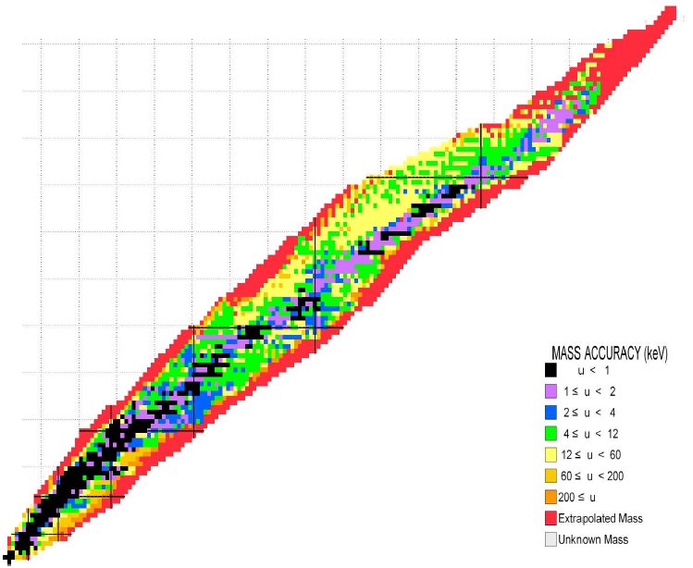
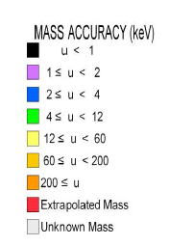
Background: current status of mass measurements
predicted ~7000
discovered ~3200
mass known ~2500
AME2016

Slide 6
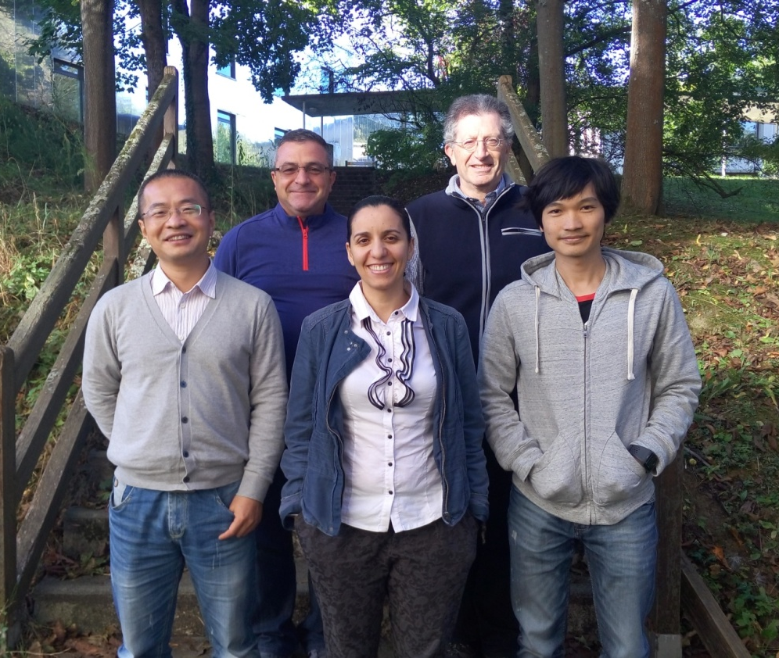


AME2016 Atomic mass evaluation
AME2016 published as
Chinese Physics C
Vol. 41, No. 3 (2017)
030001 ,
030002 ,
030003
Files can be downloaded at
http://amdc.impcas.ac.cn.
AME collaboration:
Meng Wang (IMP), G. Audi (CSNSM), F.G. Kondev (ANL), W.J. Huang (CSNSM), S. Naimi (RIKEN) and Xing Xu (IMP)

Slide 7
Nuclear masses: AME2012

Slide 8
Nuclear masses: AME2016

Slide 9
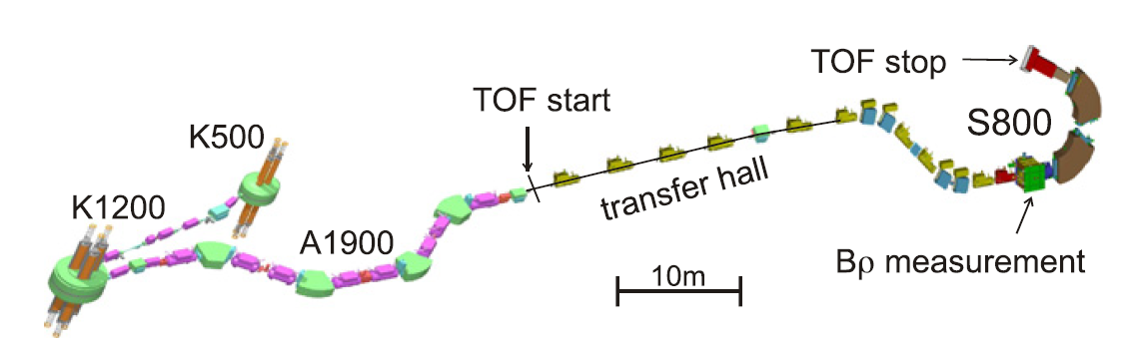
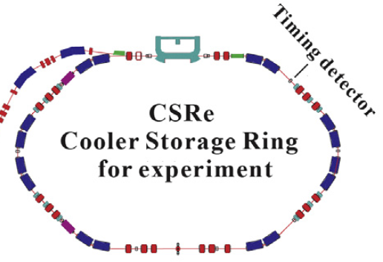

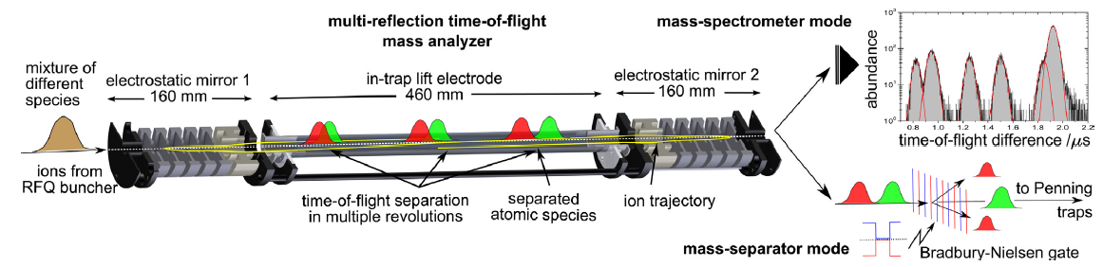
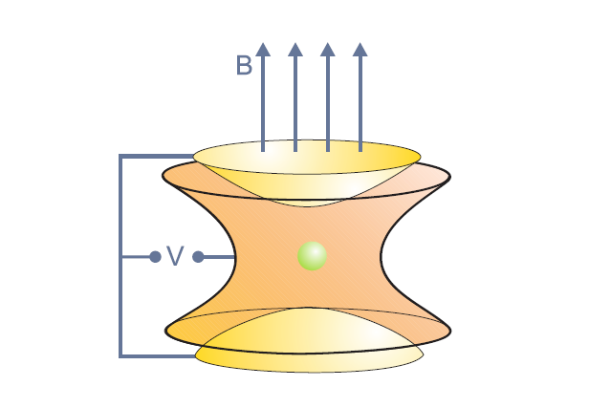
Background: worldwide activities
JYFL
MSL
GANIL
JGU
TRIUMP
ANL
JINR
CIAE
MSU
GSI
RIKEN
ORNL
IAEA
LBL
BNL
CERN
IMP
FSU
Main institutions of nuclear research
Facilities for direct mass measurements

Slide 10
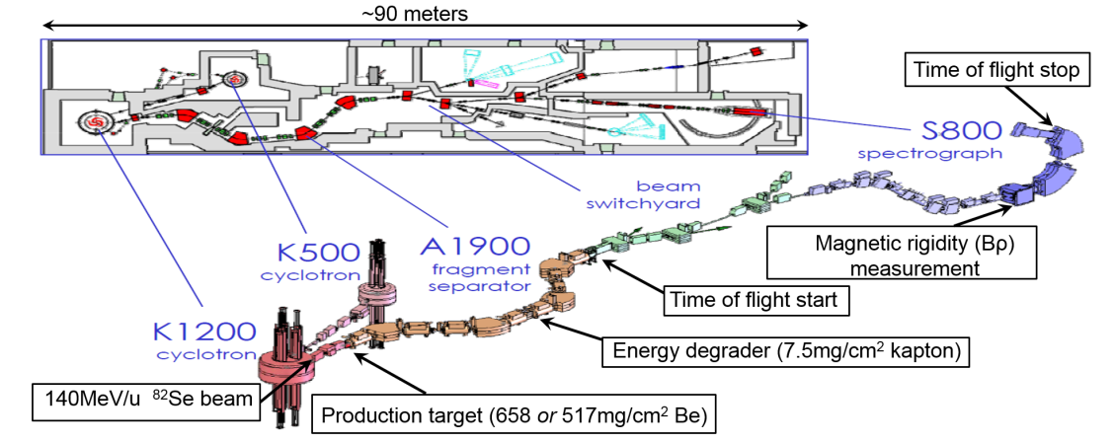
New results in AME2016

Slide 11
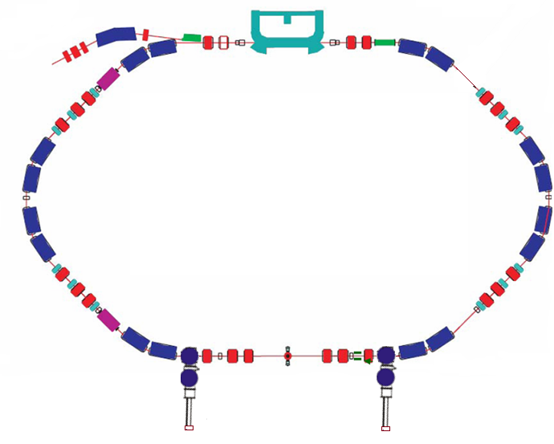
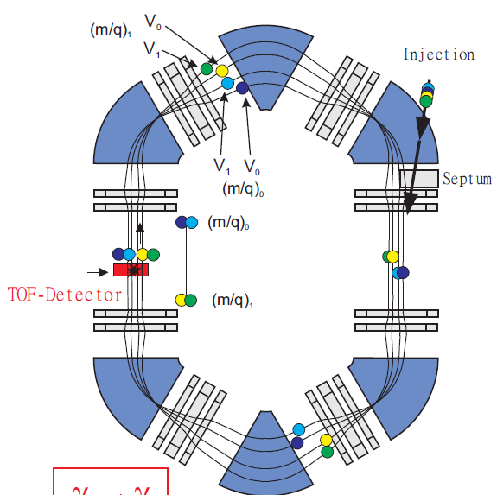
New results in AME2016

Slide 12
New results in AME2016

Slide 13
New results in AME2016

Slide 14
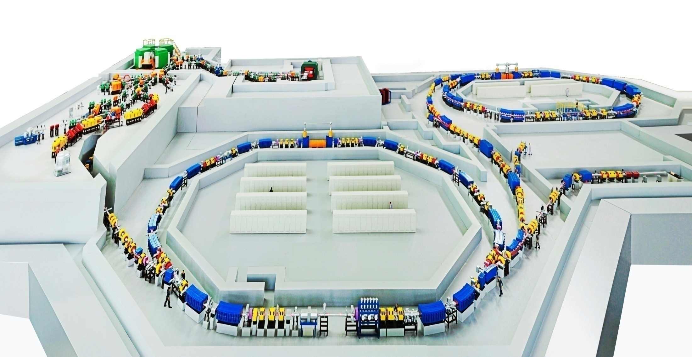
Background: HIRFL-CSR research facility
Research aims:
establish the IMS technique; measure nuclear masses; study the associated physics
CSRe
RIBLL1
RIBs at tens of AMeV
RIBLL2
RIBs at hundreds of AMeV
CSRm
1000 AMeV (H.I.), ≤ 2.8 GeV (p)
Heavy Ion Research Facility in Lanzhou

Slide 15
Method and technical improvements
Principle
Setting optimization
Double ToF
Correction for magnetic-field fluctuation

Slide 16

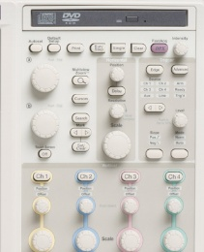

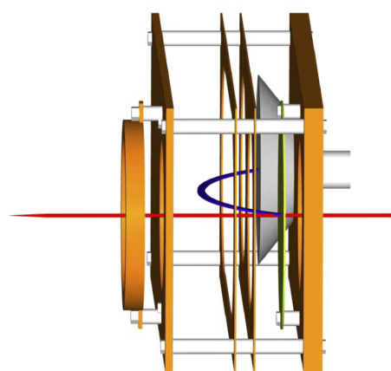
Procedure of mass measurements
SSC
SFC
DT
CSRe
TOF detector
CSRm

Slide 17
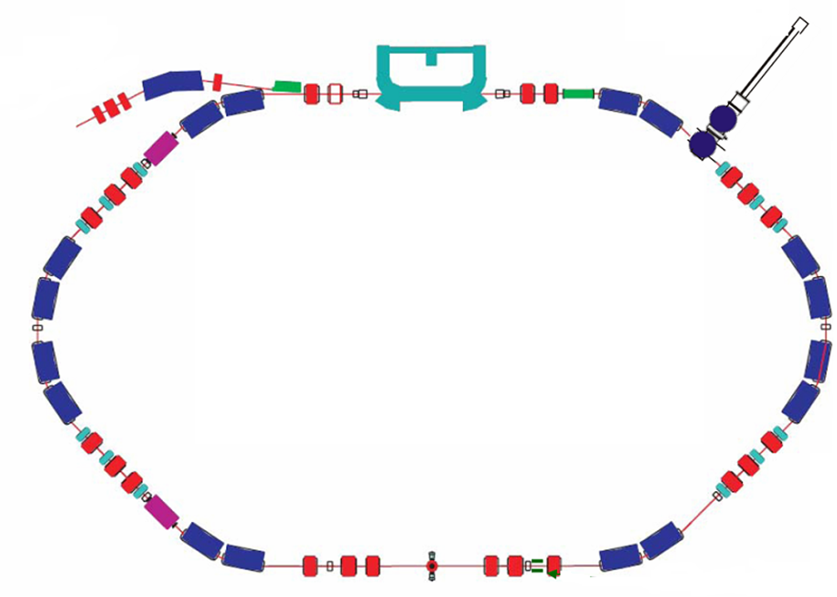
Principle
T=L/v
Bρ=m/q βγc

Slide 18
Principle : isochronous mass spectrometry
T=L/v
Bρ=m/q βγc

Slide 19
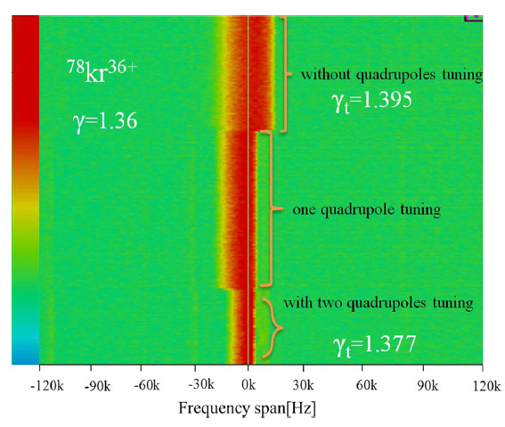
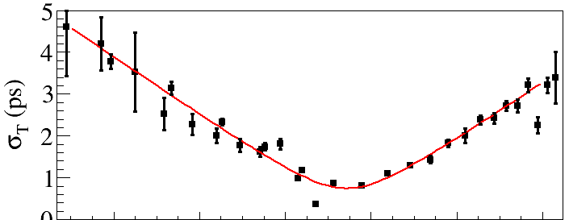
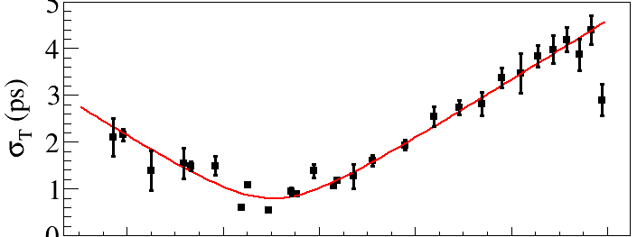
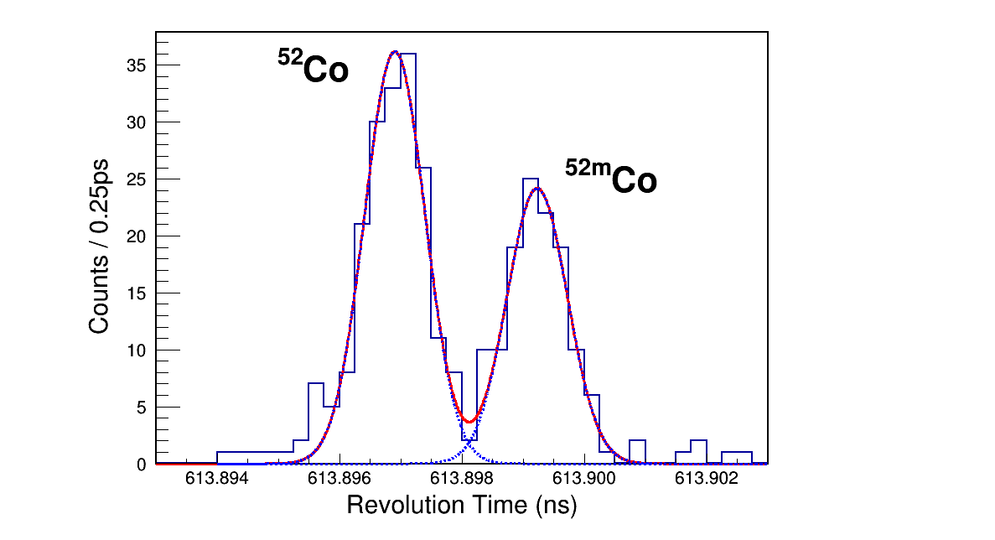
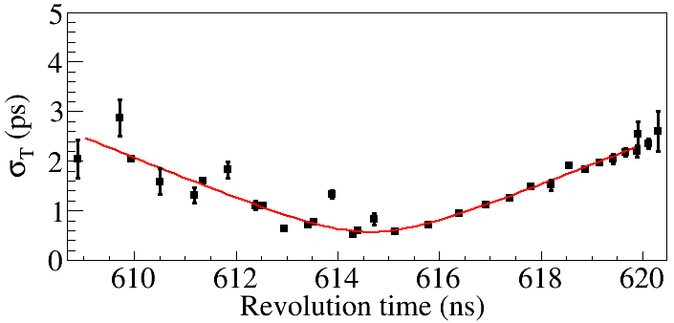
Optimizing the IMS setting
目标核
NIM A 763
(2014) 53-57
γ_{t}= γ

Slide 20
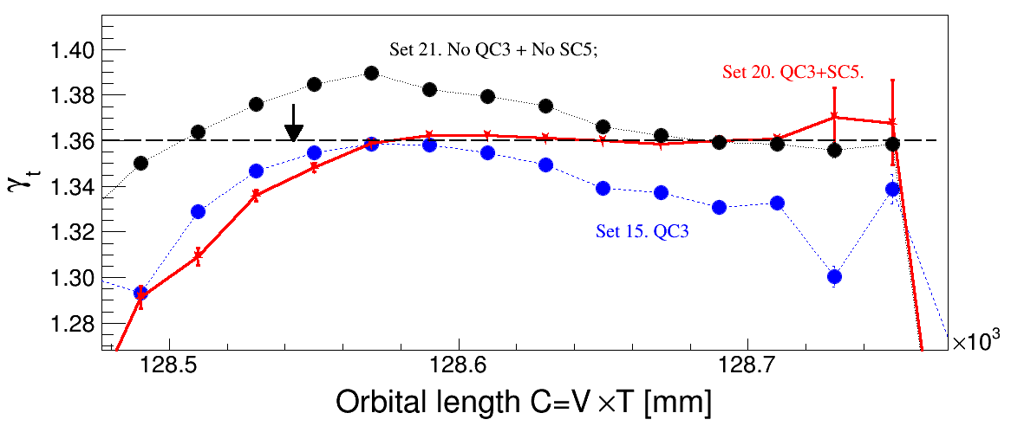
Optimizing the IMS setting
Optimized the isochronous setting by tuning
quadrupoles and sextupoles
Dr. Chen Ruijiu’s talk, next session

Slide 21
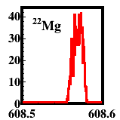
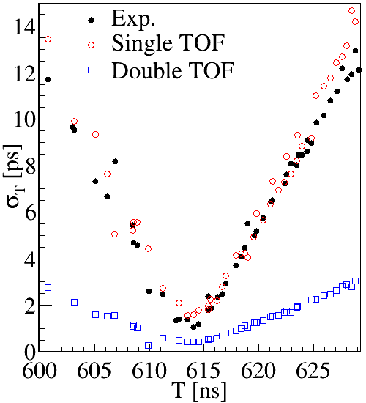
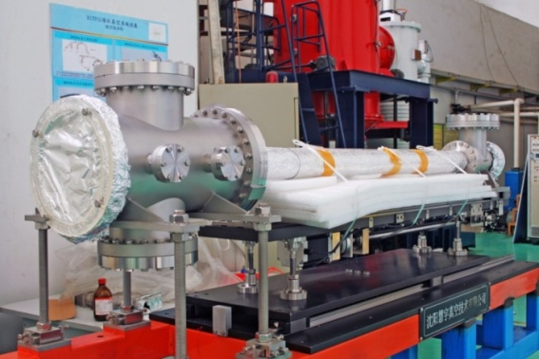
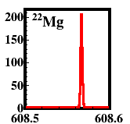
Double-TOF IMS
Singal TOF
Doubel TOF
Two ToF detectors:
ds=18 m
X. Xu et al.,
Chin.Phys.C 39, 106201 (2015)

Slide 22
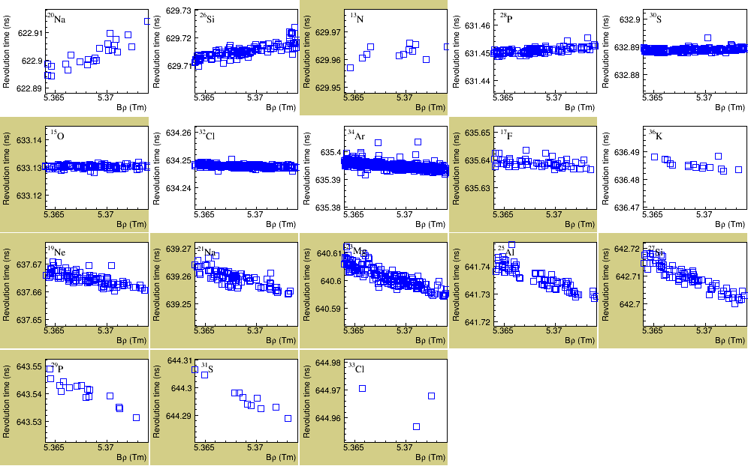
Double-TOF IMS
Revolution time vs Bρ
22
2017/6/26

Slide 23
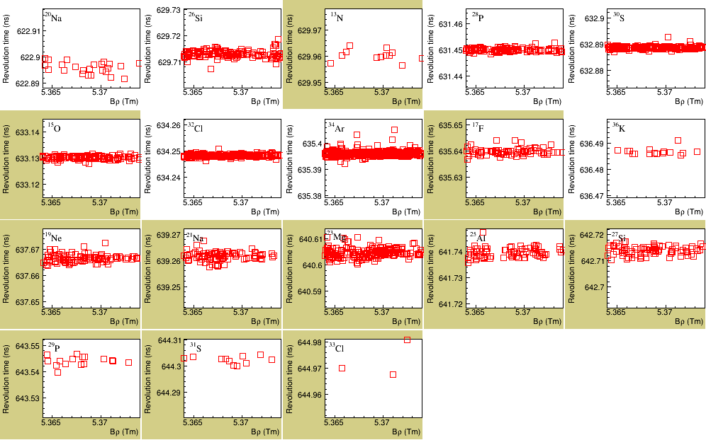
Double-TOF IMS
Revolution time vs Bρ
23
2017/6/26

Slide 24
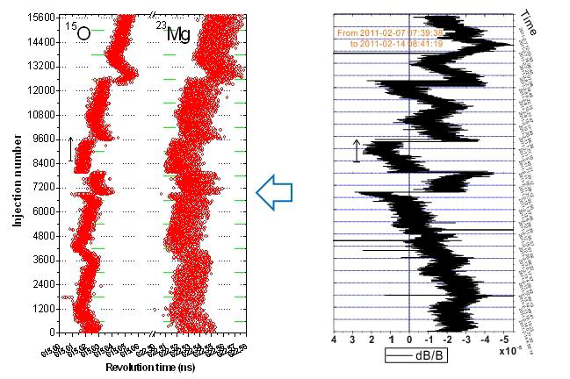
Correction for drift of the magnetic fields

Slide 25
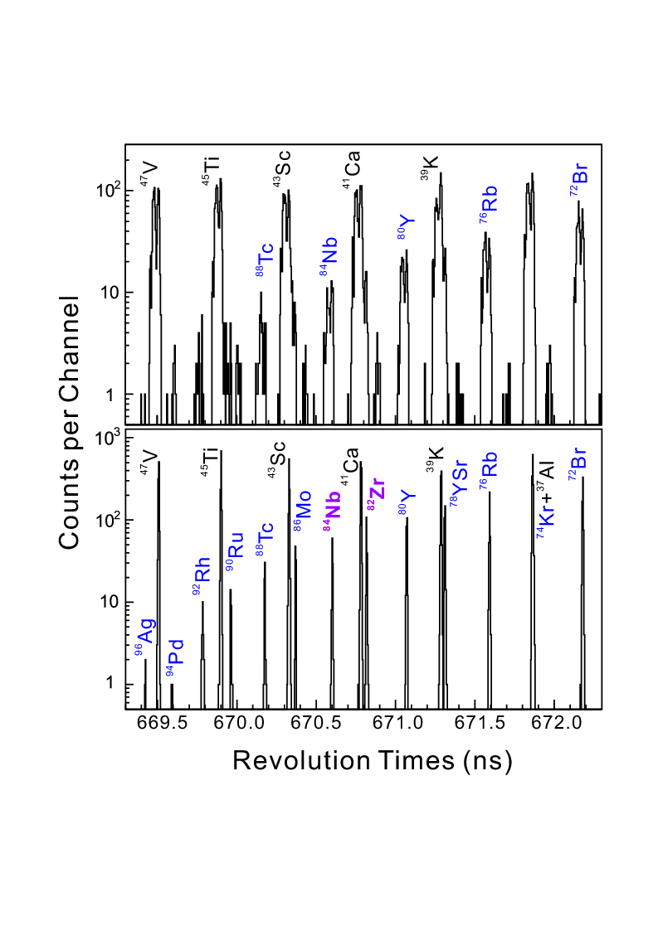
Correction for drift of the magnetic fields
arXiv:1407.3459

Slide 26
Results and discussions
Overview
Mass of ^{52g,m}Co and relevant physics
In-ring decay

Slide 27
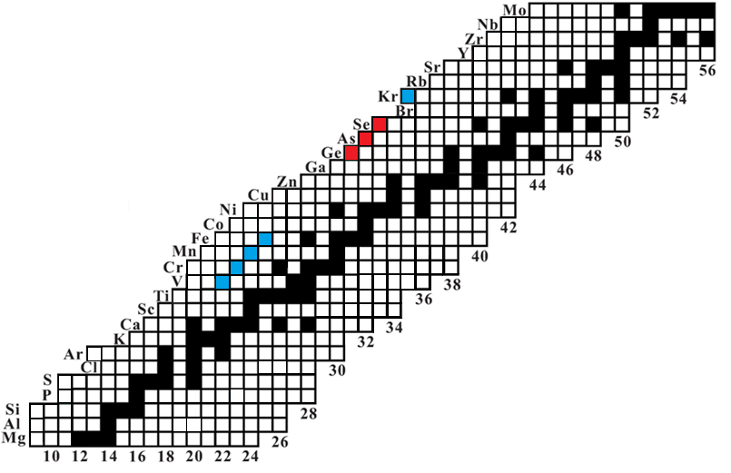
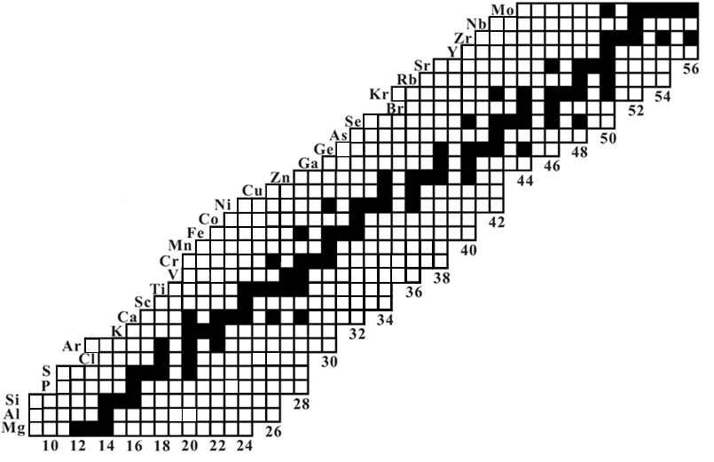
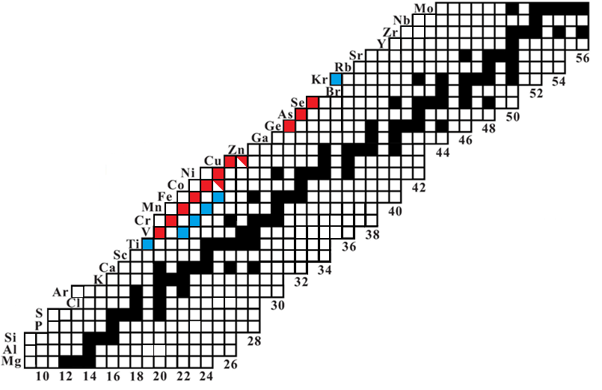
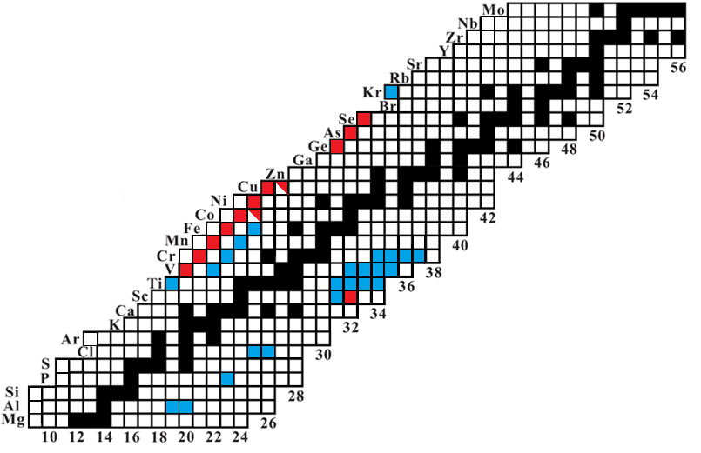
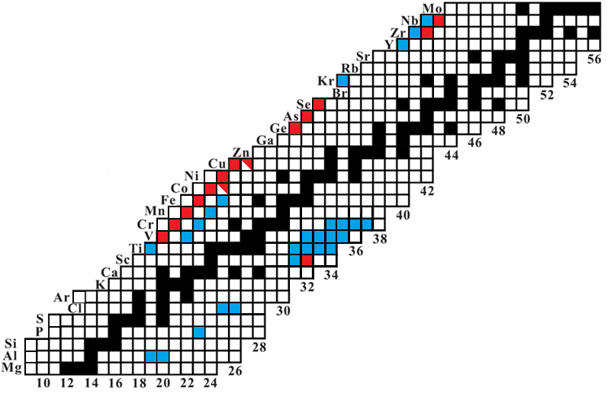
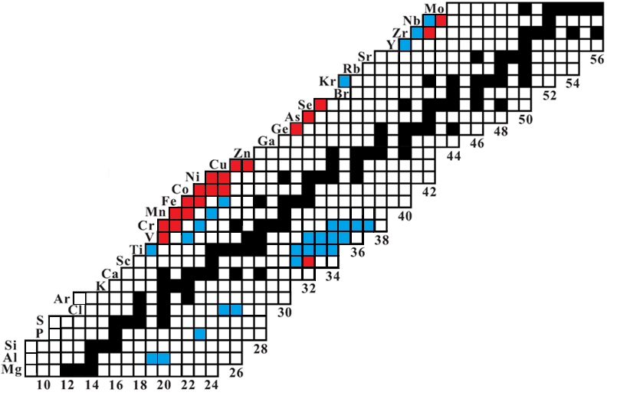
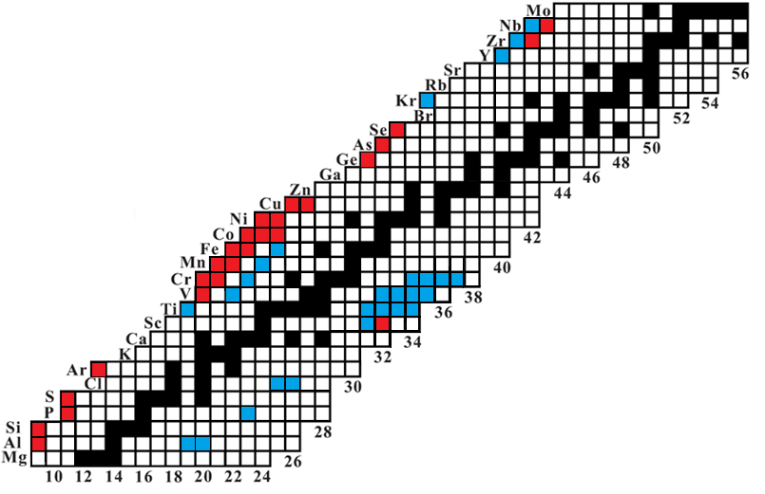
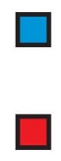
Overview of experimental results
Beams: ⁷⁸Kr,
⁵⁸Ni,
⁸⁶Kr,
¹¹²Sn,
⁵⁸Ni,
³⁶Ar
X. L. Tu et al., PRL 106, 112501 (2011)
Y. H. Zhang et al., PRL 109, 102501 (2012)
X. L. Yan et al. ApJ 766, L8 (2013)
P. Shuai et al., PL B 735,327 (2014)
X. Xu et al., PRL 117, 182503 (2016)
P. Zhang et al., PLB 767, 20 (2017)
Precision
10⁻⁶~10⁻⁷
(20-200 keV)
Double
TOF
Improved precision
Measured first time

Slide 28
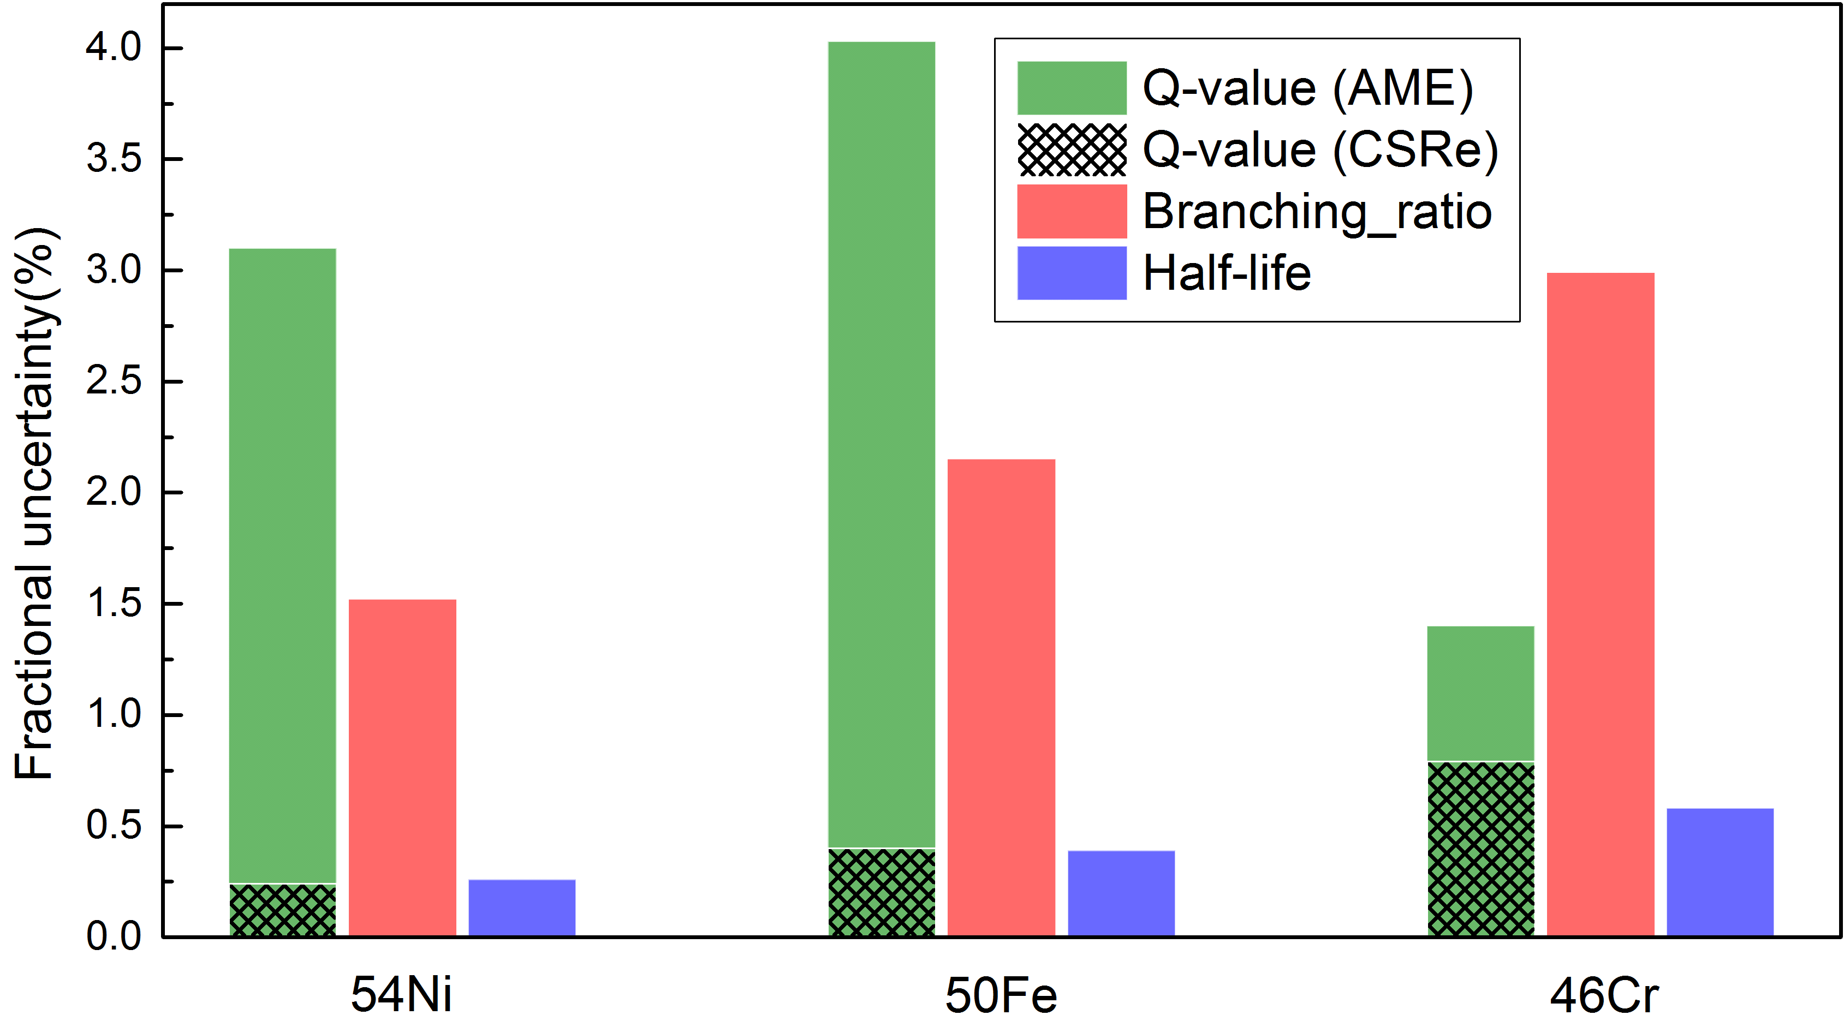
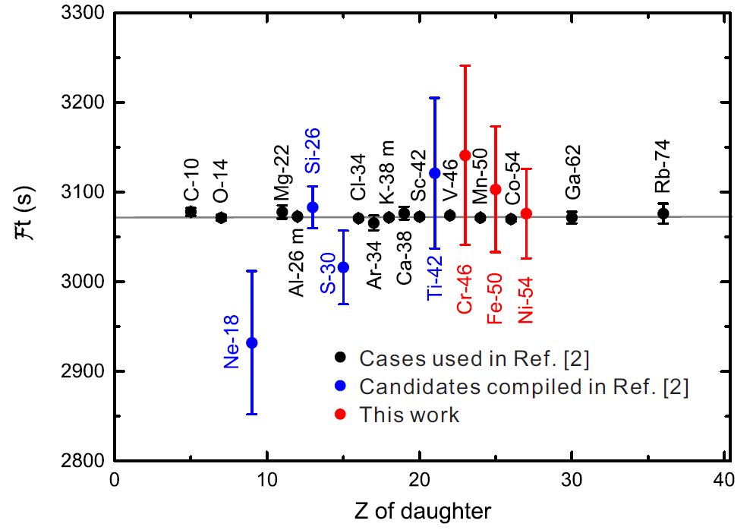
High precision
Test of CVC hypothesis
P. Zhang et al.,
Physics Letters B
767: 20–24 (2017)
Zhang Peng’s talk,
next session

Slide 29
Mass of ^{52g,m}Co
X. Xu et al.,
PRL 117, 182503 (2016)
D.A. Nesterenko et al.,
J. Phys. G 44, 065103 (2017)

Slide 30
Mass of ^{52g,m}Co and the relevant physics
β-p of ⁵²Ni
Existing information
⁵²Ni T=2
E_{p}=1349
I_{p}=9.4%
Theory prediction：
β decay branching to IAS ~66%
J^{π}=0⁺
β⁺
β-γ of ⁵²Ni
ME=-31561(13)
2407 keV
I_{𝞬}=42%
1⁺, 2875
0⁺, 2938 IAS
1⁺, 2636
Ep=1352
Ep=1048
2378
ME=-32913(9)
2407
⁵¹Fe+p
Starting point
141 keV
L. Faux et al., PRC 49, 2440 (1994).
C. Dossat et al., NPA 792, 18 (2007).
S. E. A. Orrigo et al., PRC 93, 044336 (2016).
168
ME=-33968
141
1⁺, 546
2⁺, 378
ME=-34109
Isomer
6⁺, g.s
ME= x
g.s
⁵²Mn
⁵²Co

Slide 31
Mass of ^{52g,m}Co and the relevant physics
d-coefficient of IMME
⁵²Ni T=2
Theory prediction：
β decay branching to IAS ~66%
J^{π}=0⁺
β⁺
ME=-31561(13)
0⁺, 2938 IAS
1⁺, 2875
1⁺, 2636
Ep=1352
Ep=1048
ME=-32913(9)
2407
2378
⁵¹Fe+p
Starting point
ME=-33968
141
168
1⁺, 546
ME=-34109
Isomer
2⁺, 378
ME= x
g.s
6⁺, g.s
⁵²Co
⁵²Mn

Slide 32
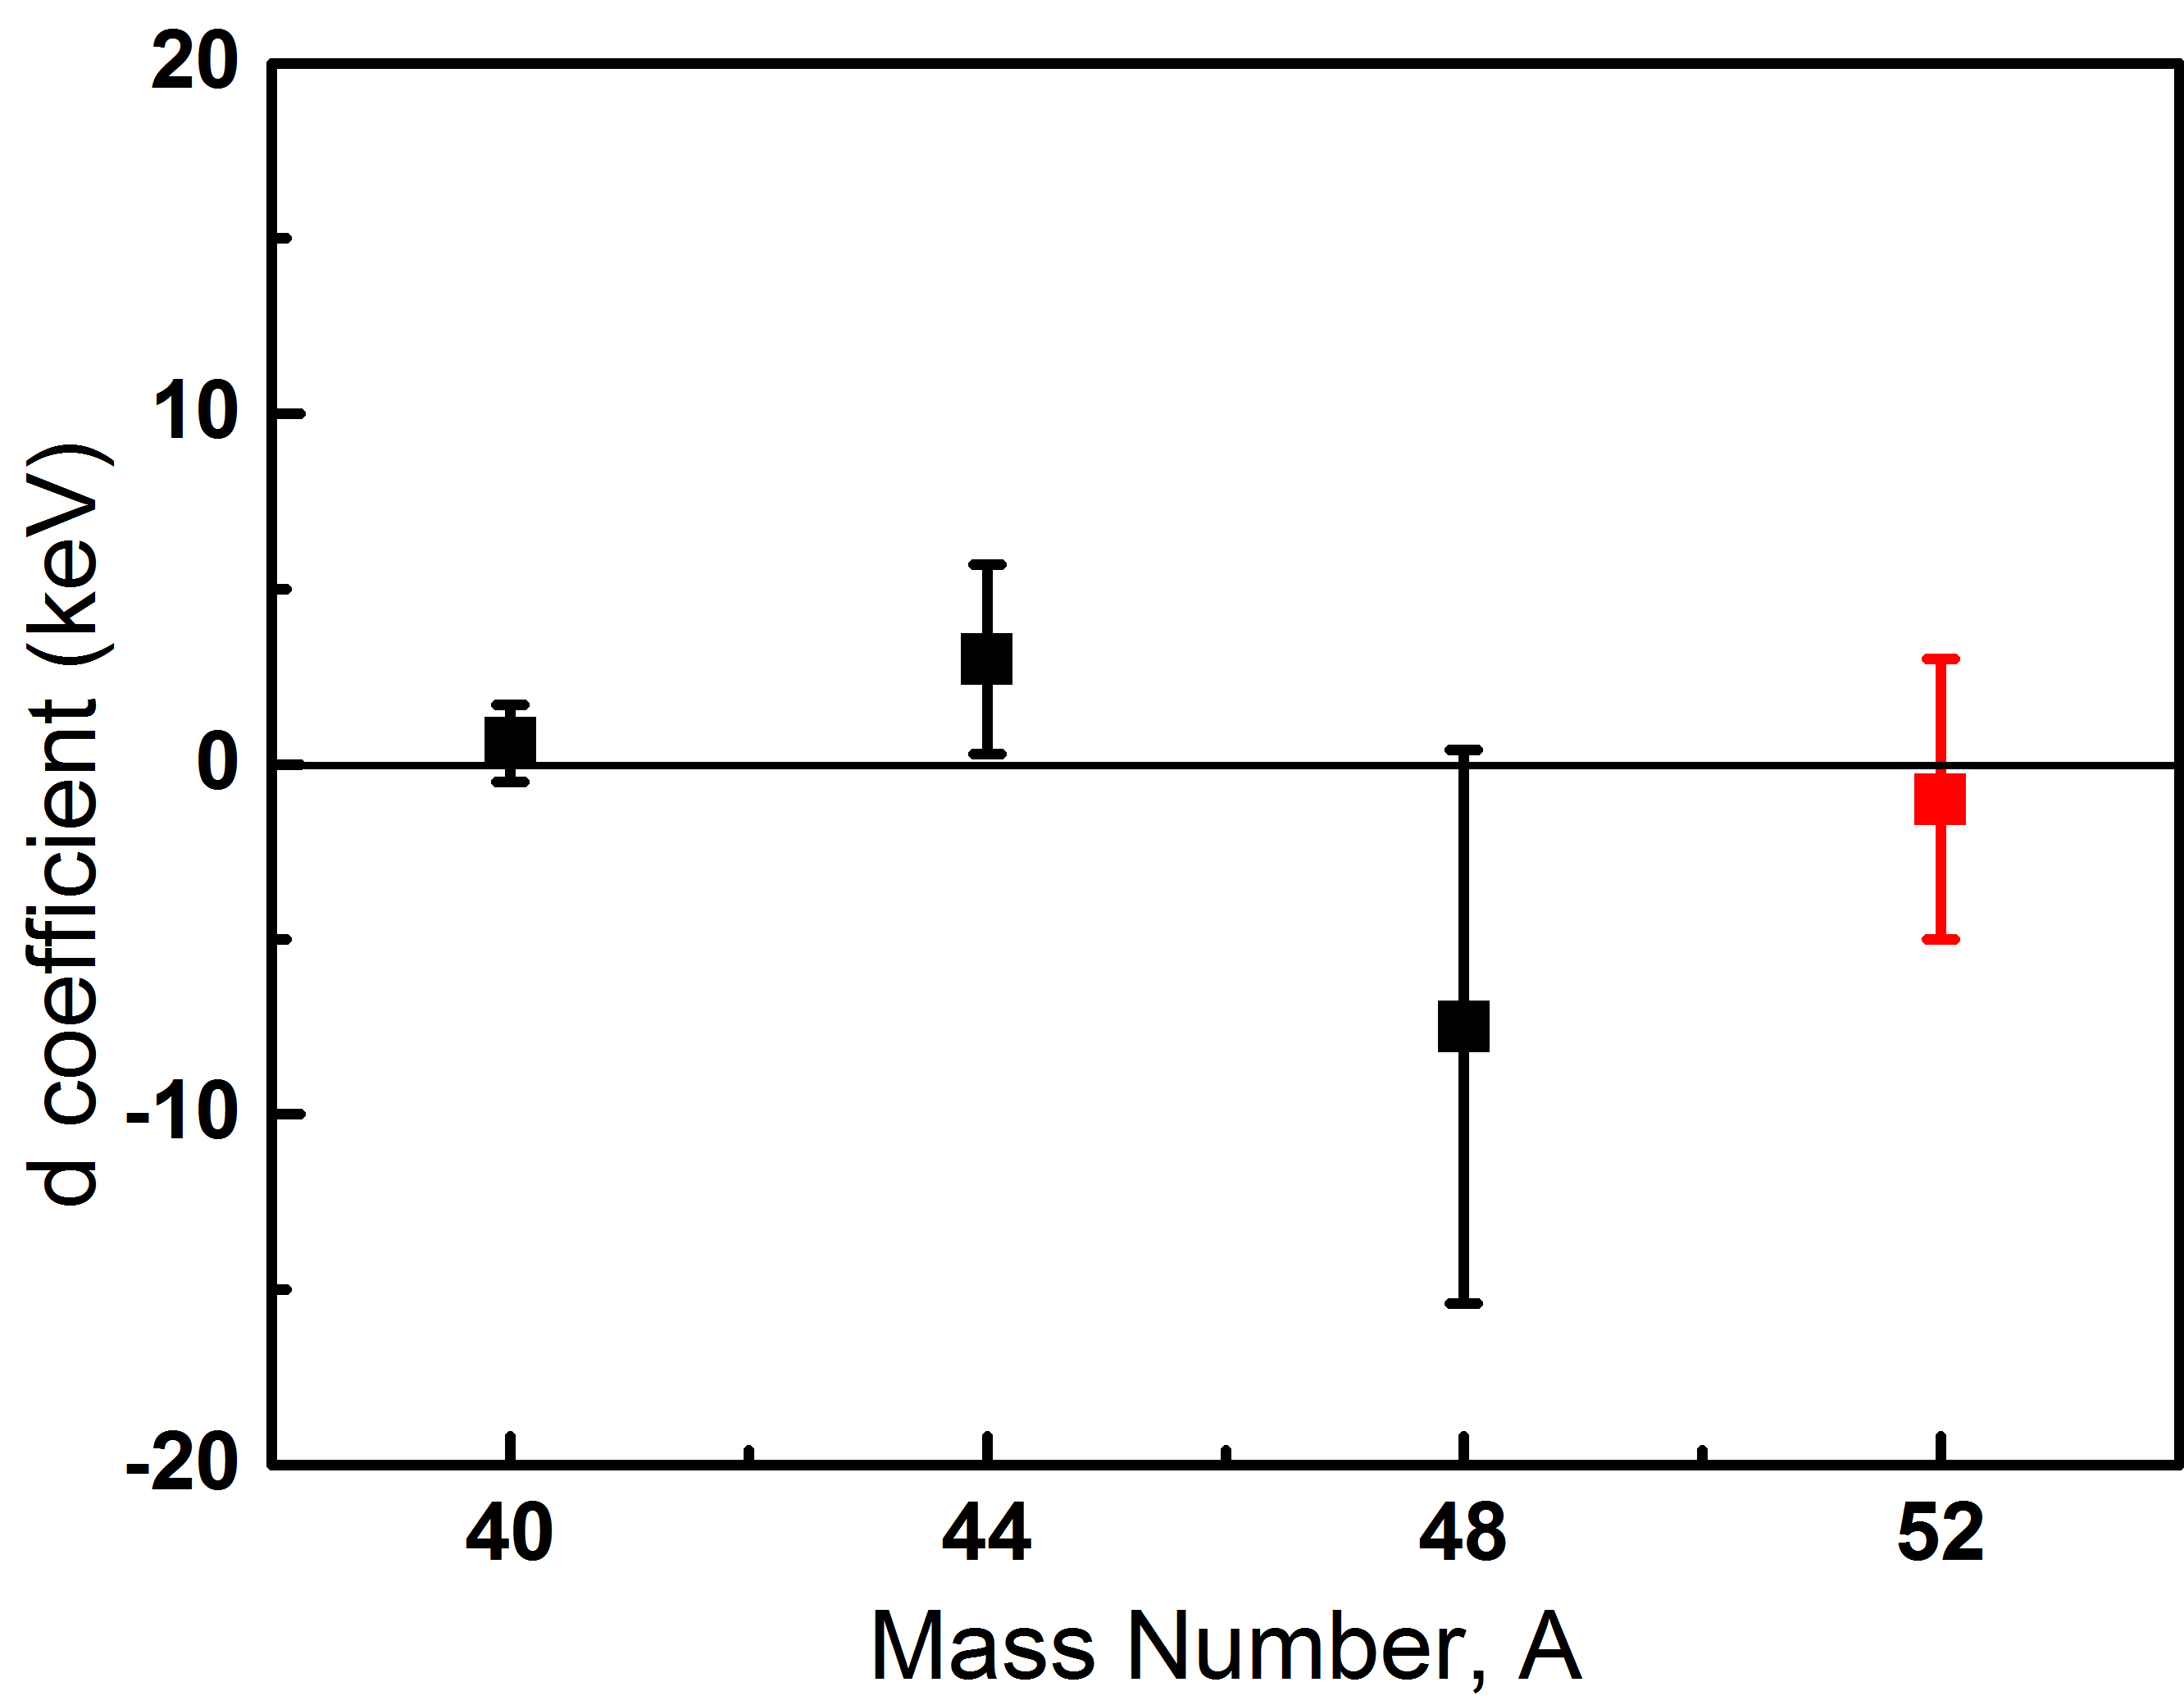
Mass of ^{52g,m}Co and the relevant physics
d-coefficient
⁵²Ni T=2
J^{π}=0⁺
DME=135(17) deviation by 8σ
β⁺
66%
ME=-31426(10)
0⁺, 2938 IAS
2935(13) IAS
1⁺, 2875
2800(16) 1+
1⁺, 2636
2496(16) 1+
???
Ep=1352
13.7%
Ep=1048
7.3%
42%
2378
ME=-32913(9)
2407
⁵¹Fe+p
43%
168
CSRe
1⁺, 546
Isomer
141
528(13) 1+
ME=-33974(10)
387(13) 2+
2⁺, 378
g.s
6⁺, g.s
ME= -34361(8)
g.s
Starting point
⁵²Co
⁵²Mn

Slide 33
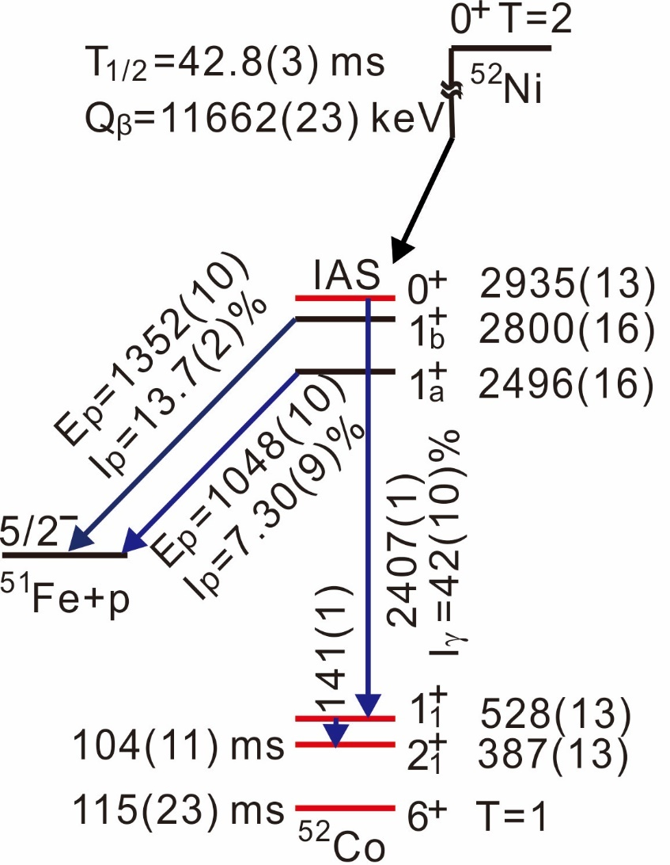
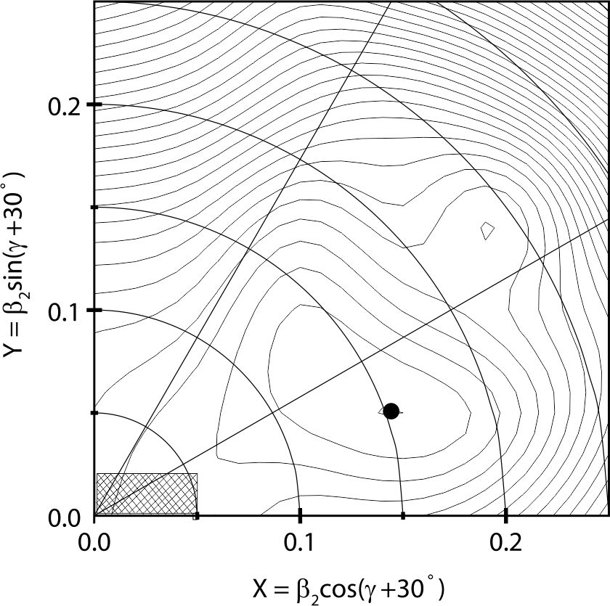
Mass of ^{52g,m}Co and the relevant physics
Potential energy surface calculations for ⁵¹Fe

Slide 34
Mass of ^{52g,m}Co and the relevant physics
● Masses of ^{52g,52m}Co measured for the first time with σ ~10 keV.
● The T=2, J^{π}=0⁺ IAS in ⁵²Co was newly assigned:
 question conventional identification of IASs from β-p method
 masses of the T=2 multiplet fit well into the IMME
 Mirror symmetry satisfied
● IAS in ⁵²Co decays predominantly via γ-transitions while the
proton emission is negligibly small due to very low isospin
mixing in the IAS
● Shape coexistence in ⁵¹Fe was proposed in order to explain
the details of the β⁺-decay branching ratios of ⁵²Ni.

Slide 35
In-ring decay of T_{1/2} = 71 μs Isomer in ⁹⁴Ru
^{94m}Ru
T_{1/2} = 71 ms
Ex=2645 keV
8⁺
6⁺
4⁺
2⁺
Neutral atom
bare atom
internal conversion coefficient
α=0.335
T_{1/2} ?
0⁺
Notes:
Finally I would like to draw your attention to our recent measurement on a short-lived isomer. It is often claimed the IMS has advantages over penning-trap-based mass spectrometry concerning the short half-life. But no clear example. Now I show you that.

Slide 36
In-ring decay of T_{1/2} = 71 μs Isomer in ⁹⁴Ru
^{94m}Ru
T_{1/2} = 71 μs
Ex=2645 keV
8⁺
6⁺
4⁺
2⁺
Decay point
Revolution time obtained from 30 turns
0⁺
In progress
Notes:
Finally I would like to draw your attention to our recent measurement on a short-lived isomer. It is often claimed the IMS has advantages over penning-trap-based mass spectrometry concerning the short half-life. But no clear example. Now I show you that.

Slide 37
Perspective and summary

Slide 38
Next beamtime, test of double TOF
Primary beam : ⁵⁸Ni

Slide 39
Summary
Thank you!

