Slide 1
Self-consistent "band" calculation of inner crust of neutron star
Y. Kashiwaba
T. Nakatsukasa
(University of Tsukuba)

Slide 2
Neutron stars matter
Outer crust
Nuclei + electrons gas
Inner crust
Neutron rich Nuclei
+ neutrons gas
+ electrons gas
Core
Uniform nuclear matter
+ electrons
Neutron drip line
0.001ρ₀
0.5 ρ₀
1.4~2$M_{⊙}$
3~10 ρ₀
(ρ₀=3×10¹⁴ g cm⁻³ )
William G. Newton (2013)
Notes:
First I’ll talk about the neutron star matter as a Introduction.
As the density increase from surface to the center, the neutron star is divided into three parts, outer and inner crusts and core part.
In the outer crust, they consist of crystalized nuclei and electron gas.
As the density increase with depth, electrons capture begins to occur creating Neutron rich nuclei.
In the inner crust, these nuclei reach the neutron drip line, and their some neutrons leak out of nuclei.
At the core part, their nuclei completely melt into uniform nuclear matter.

Slide 3
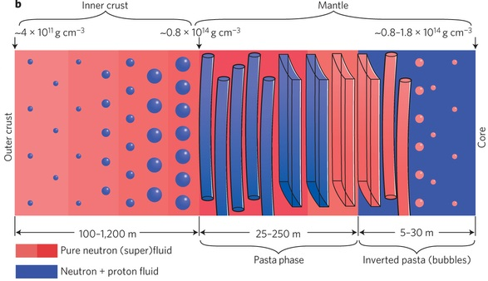
Bottom layer of inner crust
Nuclei are expected to be complex structures.
Outer crust
Core
mixed phase of
gas and liquid
0.2~0.5 ρ₀
William G. Newton (2013)
Notes:
Now we are focusing on the bottom layer of inner crust.
Nuclei are expected to be complex structures.

Slide 4
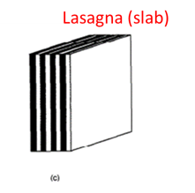
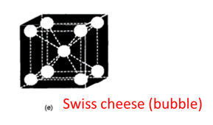
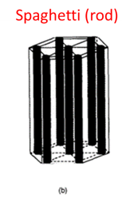
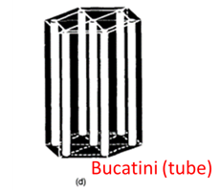
“Pasta phase” in inner crust
Black : liquid
White : gas
~0.2ρ₀
High density
uniform
K. Oyamatsu(1993)
0.5ρ₀~
attractive nuclear interaction ⇔ Coulomb repulsion
Notes:
These exotic shapes are called “Pasta phase”.
As the density increase, the shape of nuclei change into droplet, rod, slab, tube, and bubble before reaching the uniform nuclear matter.
They consist of periodic Coulomb lattice.
This is due to the competition between the attractive nuclear interaction and coulomb repulsion.
These phase are sometimes called food-like names.
Such as Gnocchi or meat-ball phase, Spaghetti phase, Lasagna phase, Bucatini or anti-Spaghetti phase, and Swiss cheese phase.

Slide 5
Pasta influence
Crustal oscillation
low frequency oscillation
Cooling process
low thermal conductivity
Glitch phenomena (suddenly spin-up)
angular momentum transfer from superfluid neutrons gas
to normal component (nuclear lattice)
H. Sotani et al.: Phys. Rev. Lett 108 (2012) 201101.
C. J. Horowitz et al.: Phys. Rev. Lett. 114 (2015) 031102.
B. Carter et al.: Int. J. Mod. Phys. D 15(2006) 777.
Static and dynamical properties of the pasta nuclei
are important
Notes:
Their exotic structures of pasta has relation to observables
for example the crustal oscillation,
cooling process,
and Glitch phenomena.
the leading glitch model involves angular momentum transfer in the crust from superfluid neutrons gas to the normal components.
So static and dynamical properties of the pasta nuclei are important.

Slide 6
Previous works
Semi-classical method
Thomas-Fermi approximation
Quantum Molecular Dynamics (QMD) calculation
Quantum method
Kohn-Sham(KS) method
periodic boundary condition
Wigner-Seitz approximation
Bloch type boundary condition is required
considering Bragg scattering of dripped neutrons.
Notes:
In previous works there have been a number of studies in the past using semi classical approaches such as the Thomas-Fermi approximation and the quantum molecular dynamics.
Recently, Kohn-Sham method is available for the quantum-mechanical treatment.
Their studies typically use periodic boundary condition or Wigner-Seitz approximation.
However Bloch type boundary condition is required considering Bragg scattering of dripped neutrons.

Slide 7
Bloch type boundary condition
${\left|ψ\left(z+a\right)\right|}^{2}={\left|ψ\left(z\right)\right|}^{2}$ periodic density
→$ψ_{k_{z}}\left(z+a\right)=ψ_{k_{z}}\left(z\right)e^{ik_{z}a}$
→$ψ_{k_{z}}\left(z\right)=φ_{k_{z}}\left(z\right)e^{ik_{z}z}, (φ\left(z+a\right)=φ\left(z\right))$
Bloch wave number k_{z} $(−\frac{π}{a}<k_{z}<\frac{π}{a})$ is equally discretized into N points as $k_{z}=(k_{z}^{\left(1\right)},…,k_{z}^{(N)})$
→$ψ_{k_{z}}\left(z+Na\right)=ψ_{k_{z}}(z)$
This allows us to reduce a large space to a unit cell.
$$0<z<Na⇒0<z<a$$
By taking sufficient N, we can consider infinitely large lattice.
first Brillouin zone
Notes:
Next, I’ll explain Bloch type boundary condition for 1D case.
When the density have periodic distribution, the wave function can deviate a phase factor from normal periodicity.
Then the wave function can be factored into the normal periodic function and the plane wave.
This k is the bloch wave number.
The wave number takes value inside the first Brillouin zone.
If the first Brillouin zone is equally discretized into N points, the wave function have the normal periodicity for N time’s larger space than unit cell.
By taking sufficient N, we can consider infinitely large space.
This treatment allows us to reduce a large space to a unit cell.

Slide 8
Main Purpose
Analyze pasta nuclei using the microscopic density functional approach
Current Target : Slab nuclei
Ground State (T = 0K)
Parallel to each other
Equally spaced by distance : a
Uniform electron distribution
distance : a [fm]
Notes:
Our Main purpose is to analyze those pasta properties using the microscopic density functional approach.
In our calculations, for the simplest case, We study the ground state of the slab shaped nuclei.
The slab nuclei are assumed to be parallel to each other and equally spaced by distance a.
The electron gas is assumed to have a uniform distribution.

Slide 9
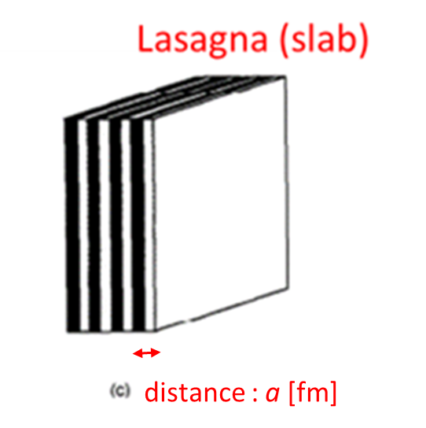
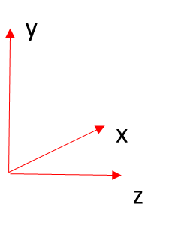
Bloch wave function
The potential is periodic(z axis),
constant (x, y directions).
V(z + a)=V(z)
KS equation : H(k)φ(k, z)=E φ(k, z)
(k : 30 points)
$$ψ\left(\vec{k},\vec{r}\right)=e^{i\vec{k}∙\vec{r}}φ\left(k_{z},z\right), (φ\left(z+a\right)=φ\left(z\right))$$
From Bloch theorem
HΨ(z)=EΨ(z), (0<z<Na)
→H(k)φ(k, z)=εφ(k, z), (0<z<a), independent every k
Notes:
For the slab phase, the single-particle potential is periodic along z-axis and the potential is constant for the directions parallel to the slab.
From the Bloch theorem, the single particle wave functions can be written in this form.
We have to solve KS equations each Bloch number k.
Now we adopt 30 points of k.

Slide 10
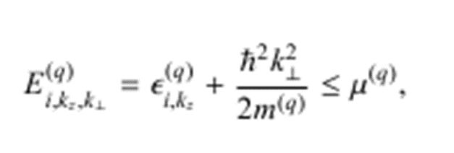
Self-consistent solutions
①Construct the proton and neutron density
②Calculate the potentials
use Barcelona-Catania-Paris-Madrid
(BCPM) energy functional
(m*/m = 1, L=52.96 MeV, K0=212.4 MeV)
③Solve the Kohn-Sham (KS) equations
Δz=0.2 fm , k_{z} : 30 points
Notes:
To solve the KS equations we have to calculate iteratively until the density converges.
We use the BCPM density functional.
This functional have advantage of energy for low density neutrons matter.

Slide 11
Energy functional
Barcelona-Catania-Paris-Madrid(BCPM) density functional
Volume term : local density approximations
based on ab initio nuclear and neutron matter EOS
(m*/m = 1, L=52.96 MeV, K₀=212.4 MeV)
Surface term : Gaussian folding
fixing binding energy of finite 579 even-even nuclei
M. Baldo, L. M. Robledo, X. Vinas, Phys.Rev.C87,064305(2013)
$$E_{vol}=\int{dr}\left[\left(1−β^{2}\left(r\right)\right)\sum_{n=1}^{5}{{a_{n}ρ}^{n}\left(r\right)+β^{2}\left(r\right)\sum_{n=1}^{5}{b_{n}ρ^{n}\left(r\right)}}\right]ρ(r)$$
$$E_{suf}=\sum_{q,q^{′}=p,n}{V_{qq′}^{}\left[\int{drdr^{′}ρ_{q}\left(r\right)ρ_{q′} (r^{′})e^{−{\left(r−r^{′}\right)}^{2}/r_{0}^2}}−\int{dre^{−r^{2}/r_{0}^{2}}\int{dr^{′}ρ_{q}\left(r^{′}\right)ρ_{q′}(r^{′})}}\right]}$$
Notes:
The BCPM density functional consist of volume term and surface term.
The volume term is given by the local density approximations.
It is based on ab initio nuclear and neutron matter EOS.
And the surface term is given by a form of the Gaussian folding.
It is optimized by fixing the binding energy of finite even-even 579 nuclei.

Slide 12
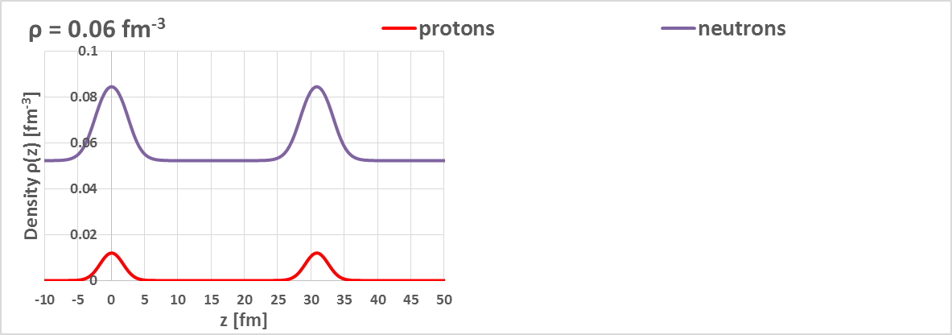
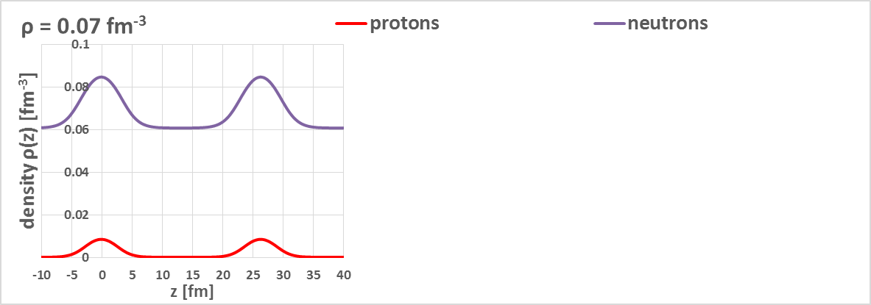
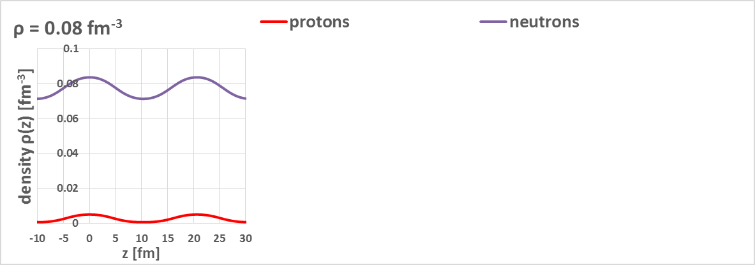
Results :Density distributions
beta equilibrium
$$μ_{n}=μ_{p}+μ_{e}$$
$$n⇆p+e+ν$$
$ρ=0.06$ fm⁻³
Neutrons
Dripped Neutrons
Z/A = 2 ~4 %
30.8 fm
Protons
$ρ=0.07$ fm⁻³
26.4 fm
$ρ=0.08$ fm⁻³
20.4 fm
High density
Notes:
Let’s move on to the results.
Those figures show the density distributions under beta equilibrium.
Each purple line represents neutrons distribution, and red line shows protons distribution.
We find neutron drip in these figures.
As the density increase the distance of slabs becomes short, and the nuclei approach uniform nuclear matter.

Slide 13
Results: Band structures of neutrons (k>0,ε_{ik}=ε_{i-k})
ρ = 0.07 fm⁻³
fermi surface
Band structures contain
dynamical properties of pasta
energy levels $ε_{ik}^{(n)}$ [MeV]
unbound
“Effective mass” m*
$$\frac{1}{m^{∗}}=\frac{1}{ℏ^{2 }}\frac{{d^{2}ε}_{ik}}{dk^{2}}$$
bound
k=0
k=π/a
Bloch wave number k [fm⁻¹]
Effective mass (solid physics) is changed
from bare neutron mass by Bragg scattering.
Notes:
Next results, We obtain band structures of neutrons from Bloch treatment.
This figure show the neutrons single particle energy levels at the density of 0.07 fm^-3.
Band structures contain dynamical properties of pasta such as “effective mass” in solid physics.
The effective mass is determined by inverse of energy curvatures.
This Effective mass is changed from bare neutron mass by Bragg scattering.
For example, there are negative effective mass at the left and right side in this figure.

Slide 14
Bragg scattering
Nuclear lattice
Neutrons (k=nπ/a) are scattered by nuclear lattice
n
free neutrons
n
n
a [fm]
$$k=\frac{nπ}{a}, (n=0,±1,±2,…)$$
Notes:
Due to Bragg scattering, Neutrons which have a wavenumber of n times pi over a are scattered by nuclear lattice.
They make standing wave.
They cannot move in the lattice.

Slide 15
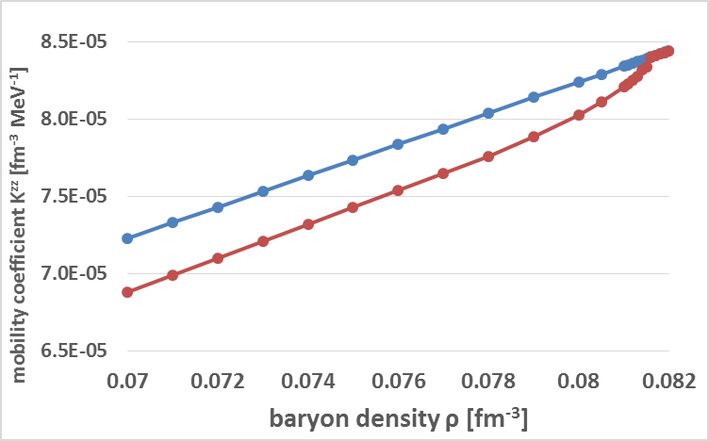
Results: Mobility coefficient K
How easily neutrons flow in nuclear lattice
$J_{i}=K^{ij}p_{j}$
$J$ : current density
$K$: mobility coefficient
$p$ : momentum
Uniform
5% down
Slab
Mobility coefficient of neutrons for slab is about 5% smaller than uniform phase
⇒Neutrons gas becomes difficult to flow due to Bragg scattering of nuclear Pasta
Notes:
In relation to them,
we calculate Mobility coefficient given by the integral of energy curvatures.
This parameter means how easily neutrons flow in nuclear lattice.
Look at this figure.
This figure shows the mobility coefficient as a function of the baryon density.
The blue and red line show the mobility of uniform matter and slab nuclei.
In this figure, you can see mobility coefficient of slab phase is about 5% smaller than uniform phase.
This means neutrons gas becomes difficult to flow due to bragg scattering of nuclear lattice.
This effect may cause some modifications to the dynamical simulation of the neutrons star, such as pulsar glitch.

Slide 16
Summary
We have obtained the self-consistent solutions for the slab-like nuclei using Bloch type boundary conditions.
Neutrons gas becomes difficult to flow due to Bragg scattering with nuclear lattice.
This effect may cause some modifications to dynamical simulations such as glitch phenomena.
Future works
2D (rod, tube), 3D (droplet, bubble) calculations
Notes:
On Summary
We have obtained the self-consistent solutions for the slab-like nuclei using Bloch type boundary conditions.
Neutrons gas becomes difficult to flow due to bragg scattering with crystalized nuclei.
In Future works, I’ll try to 2D and 3D calculations to analyse other pastas.

