Slide 1
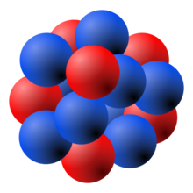
China-Japan collaboration workshop on Nuclear mass and life for unravelling myseries of r-process, Tsukuba University, 2017.6.26-6.28
Nuclear incompressibility and ISGMR energies from radius-constrained RMF model
Kun Wang Supervisor: Shan-Gui Zhou
Institute of Theoretical Physics, Chinese Academy of Sciences
2017/6/28

Slide 2
Outline
Introduction
Theoretical Framework
Results and Discussions
Summary
1

Slide 3
Outline
Introduction
Theoretical Framework
Results and Discussions
Summary
2

Slide 4
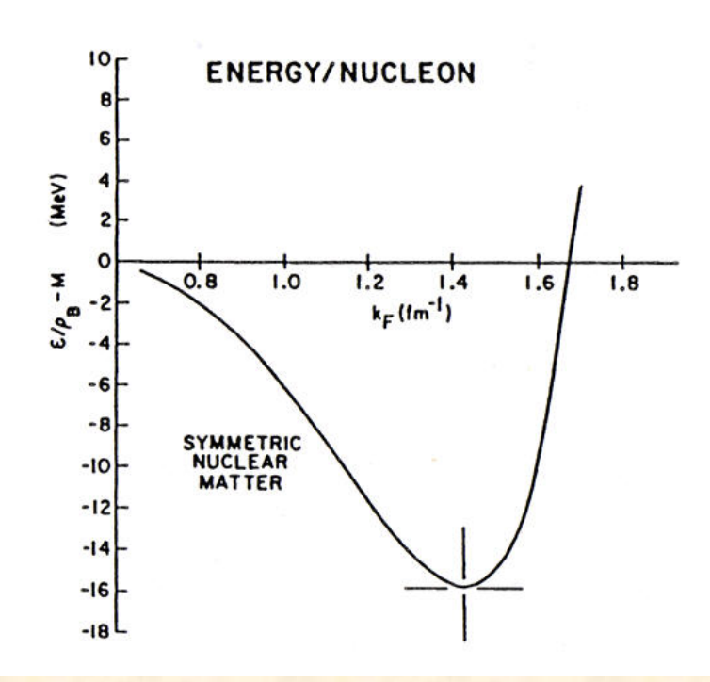
$K_{∞}$ in nuclear matter
Nuclear incompressibility is important for the study of:
Properties of nuclei
Supernova collapses
Neutron stars
Heavy-ion collisions
J.P. Blaizot, Phys. Rep. 64 (1980) 171
$$K_{∞}=K_{F}^{2}\frac{∂^{2}}{∂K_{F}^{2}}\left({E_{B}}/A\right)$$
From 2016.3.10 Umesh Garg’s talk at ITP
$$K_{F}={\left(\frac{3π^{2}}{2}ρ_{0}\right)}^{1/3}$$
EoS of the symmetric nuclear matter
3

Slide 5
$K_{A}$ and ISGMR energy in finite nuclei
Consider a nucleus which is vibrating in breathing mode, we expand its energy up to the 2nd order,
$$E=E_{G.S.}+\frac{1}{2}{AK}_{A}s^{2}+\frac{1}{6}K_{3}s^{3}+…$$
where
$$s=\frac{R{−R}_{G.S.}}{R_{G.S.}}$$
With harmonic approximation (small amplitude limit), $K_{A}$ writes
$$K_{A}={\left.\frac{1}{A}R^{2}\frac{d^{2}E}{dR^{2}}\right|}_{R=R_{G.S.}}$$
Knowing $K_{A}$, the ISGMR energy can be obtained as
$$E_{GMR}=\sqrt{\frac{{ℏ^{2}AK}_{A}}{MR_{G.S.}^{2}}}$$
J.P. Blaizot, Phys. Rep. 64 (1980) 171
4

Slide 6
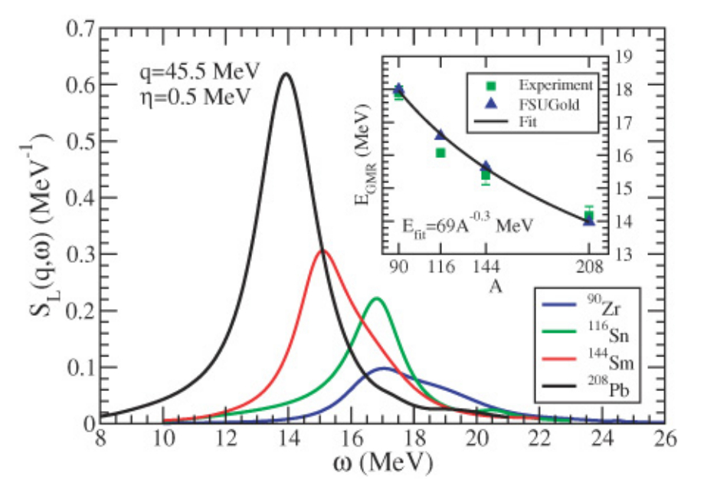
Softness of Sn
J. Li, G. Colo and J. Meng, Phys Rev. C 78 (2008) 064304
L. G. Cao, H. Sagawa and G. Colo, Phys. Rev. C 86 (2012) 054313
……
RPA
Pairing
Why is Sn so soft?
J. Piekarewicz, Phys. Rev. C 76 (2007) 031301
U. Garg et al., Nucl. Phys. A 788 (2007) 36c
5

Slide 7
Outline
Introduction
Theoretical Framework
Results and Discussions
Summary
6

Slide 8
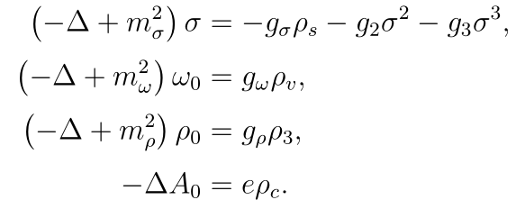
Relativistic Mean Field Model
The Lagrangian density in non-linear meson-exchange RMF model：
Equations of motion:
The Dirac equation can be solved iteratively.
Serot and Walecka, 1986_ANP16-1
Reinhard, 1989_RPP52-439
Ring, 1996_PPNP37-193
Vretenar, Afanasjev, Lalazissis and Ring, 2005_PR409-101
Meng, Toki, Zhou, Zhang, Long and Geng, 2006_PPNP57-470
Liang, Meng and Zhou, 2015_PR570-1
Zhou, 2016_PS91-63008
7

Slide 9
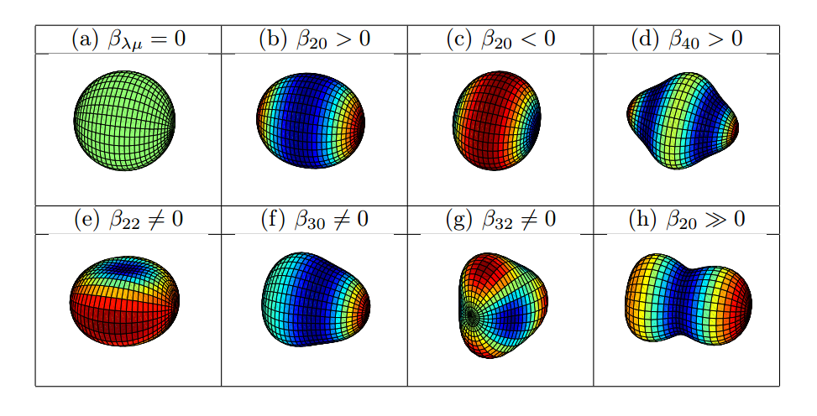
MDC-RMF Model
Deformation parameters:
Constraint:
B.N. Lu, E.G. Zhao and S.G.Zhou, Phys. Rev. C 85 (2012) 011301(R)
B.N. Lu, J. Zhao, E.G. Zhao and S.G. Zhou, Phys. Rev. C 89 (2014) 014323
J. Zhao, B.N. Lu, T. Niksic and D. Vretenar, Phys. Rev. C 92 (2015) 064315
S.G. Zhou, Phys. Scr. 91 (2016) 063008
Courtesy by B.N. Lu
Fission barrier
Lu2012_PRC85-011301(R), Lu2014_PRC89-014323, Zhao2016_PRC93-044315, …
Exotic shape
Zhao2017_PRC95-014320, …
……
8

Slide 10
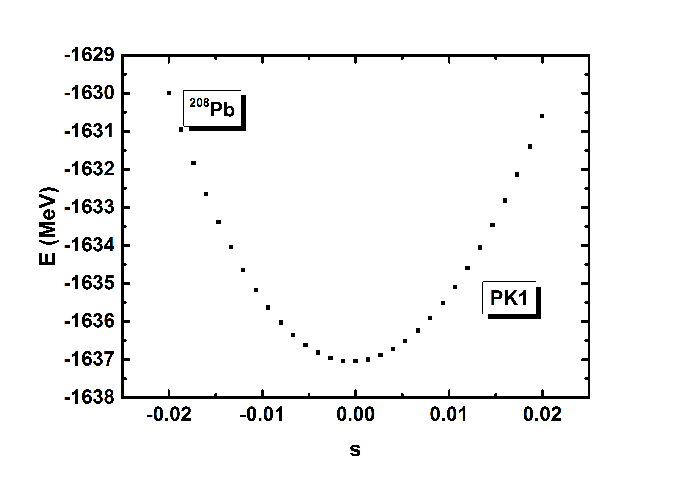
Radius-constraint in MDC-RMF Model
To study ISGMR, we shall constrain the radii of the nuclei.
We write the Hamiltonian,
$$H^{′}=H+λr^{2}$$
With radius-constraint, the expectation of the Hamiltonian is
$$E^{′}=E_{RMF}+λ\left\langle r^{2}\right\rangle$$
$$s=\frac{R−R_{G.S.}}{R_{G.S.}}$$
The frequency of the GMR,
$$ω=\sqrt{\frac{K_{A}}{B}}$$
The ISGMR energy
$$E_{GMR}=ℏω=\sqrt{\frac{ℏ^{2}K_{A}}{B}}$$
9

Slide 11
Non-relativistic mass parameter
The non-relativistic mass parameter can be derived from the scaling method.
Scaling transformation on the solution of Schrodinger equation $ψ(r$):
$$r_{s}=ηr, s=\frac{η−1}{η}$$
Approximately, we write:
$$η=\frac{R_{G.S.}}{R}$$
From the continuity equation and with small amplitude approximation, the energy $E$ is written as,
$$E=E_{k}+E_{A}\left(η\right)=E_{A}+\frac{1}{2}MA\left\langle r^{2}\right\rangle {\left(\dot{s}\right)}^{2}+\frac{1}{2}AK_{A}s^{2}$$
This is the harmonic vibration of $s$.
$$ω=\sqrt{\frac{K_{A}}{B_{nr}}}=\sqrt{\frac{K_{A}}{MR_{G.S.}^{2}/A}} with B_{nr}= \frac{1}{A}MR_{G.S.}^{2}$$
$B_{nr}$ is the non-relativistic mass parameter.
J.P. Blaizot, Phys. Rep. 64 (1980) 171
Z.X. Wang, Nuclear Matter, Beijing: Peking University Press, 2014 (in Chinese)
10

Slide 12
Relativistic mass parameter
Lorentz boost on the constrained spinors,
$$ψ_{i}\left(x,t\right)=\frac{1}{\sqrt{γ}}\hat{S}\left(v\right)ψ_{i}\left(x,λ\right)$$
$$\hat{S}\left(v\right)=cosh\left(\frac{φ}{2}\right)+α⋅\frac{v}{\left|v\right|}sinh\left(\frac{φ}{2}\right)$$
$\hat{S}(v)$ is the Hermitian local Lorentz boost operator.
Use the continuity equation,
$$\dot{s}\frac{∂ρ(r,λ)}{∂s}+∇⋅\left[ρ\left(r,λ\right)v\left(r,t\right)\right]=0$$
The mass parameter of the monopole vibration is obtained as,
$$B_{rel}=A^{−1}\int{u^{2}\left(r\right)ℋ_{RMF}(r)d^{3}r}$$
Thus, $ω_{rel}=\sqrt{\frac{K_{A}}{B_{rel}}}$ is different from $ω=\sqrt{\frac{K_{A}}{MR_{G.S.}^{2}/A}}$ (derived from the non-relativistic scaling method).
T. Maruyama and T. Suzuki, Phys. Lett. B 219 (1989) 43
M.V. Stoitsov et al., J. Phys. G: Nucl. Part. Phys. 20 (1994) L149
11

Slide 13
Outline
Introduction
Theoretical Framework
Results and Discussions
Summary
12

Slide 14
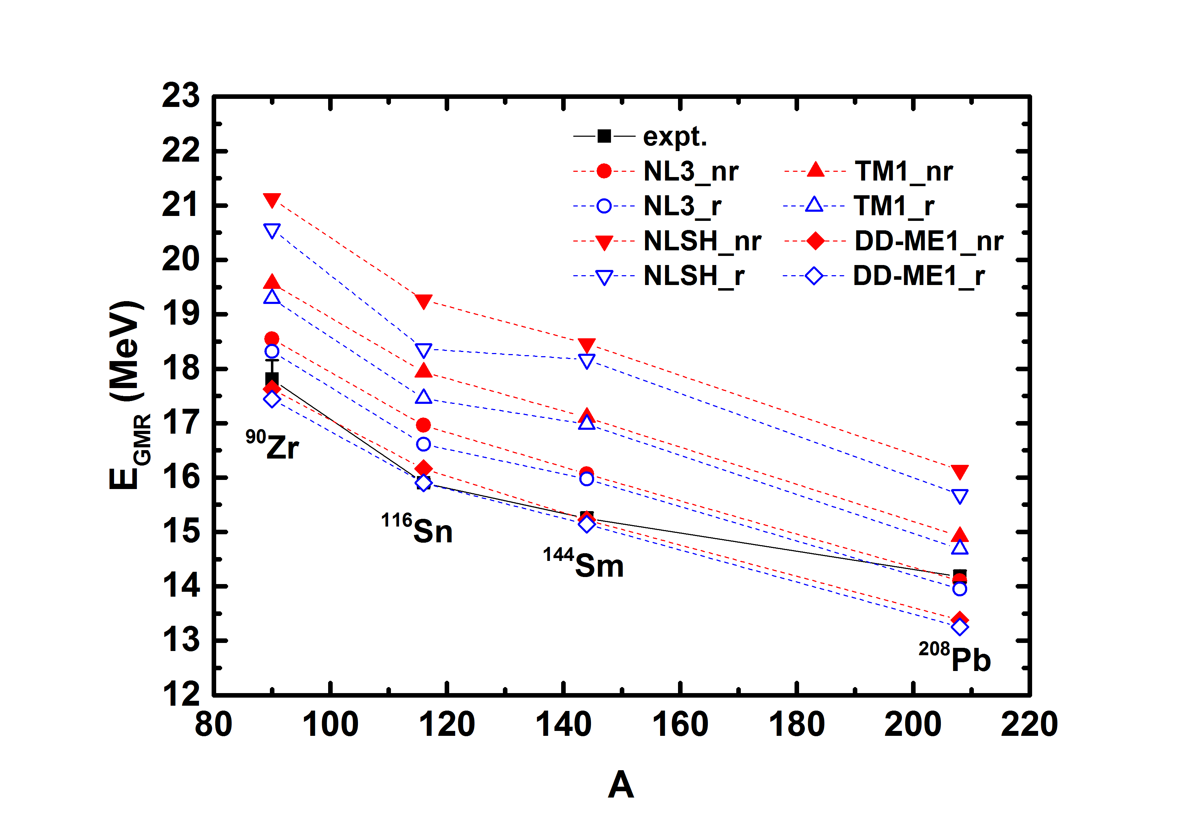
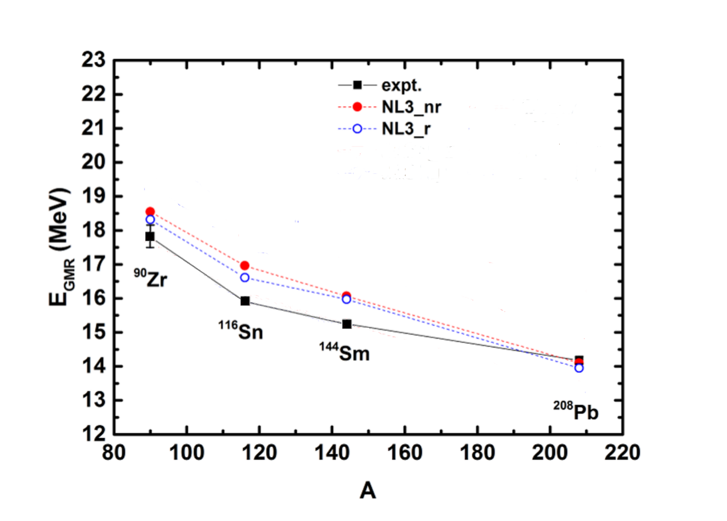
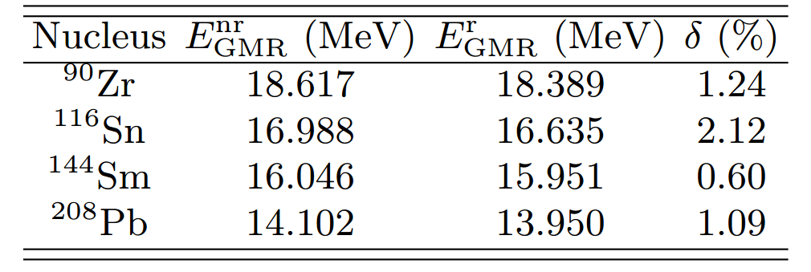
$E_{GMR}$ of several typical nuclei and Sn isotopes
Reductions of the ISGMR energies with the relativistic mass parameter:
The reduction for Sn is the largest!
The experimental values are taken from:
D.H. Youngblood et al., Phys. Rev. Lett. 82 (1999) 691
13

Slide 15
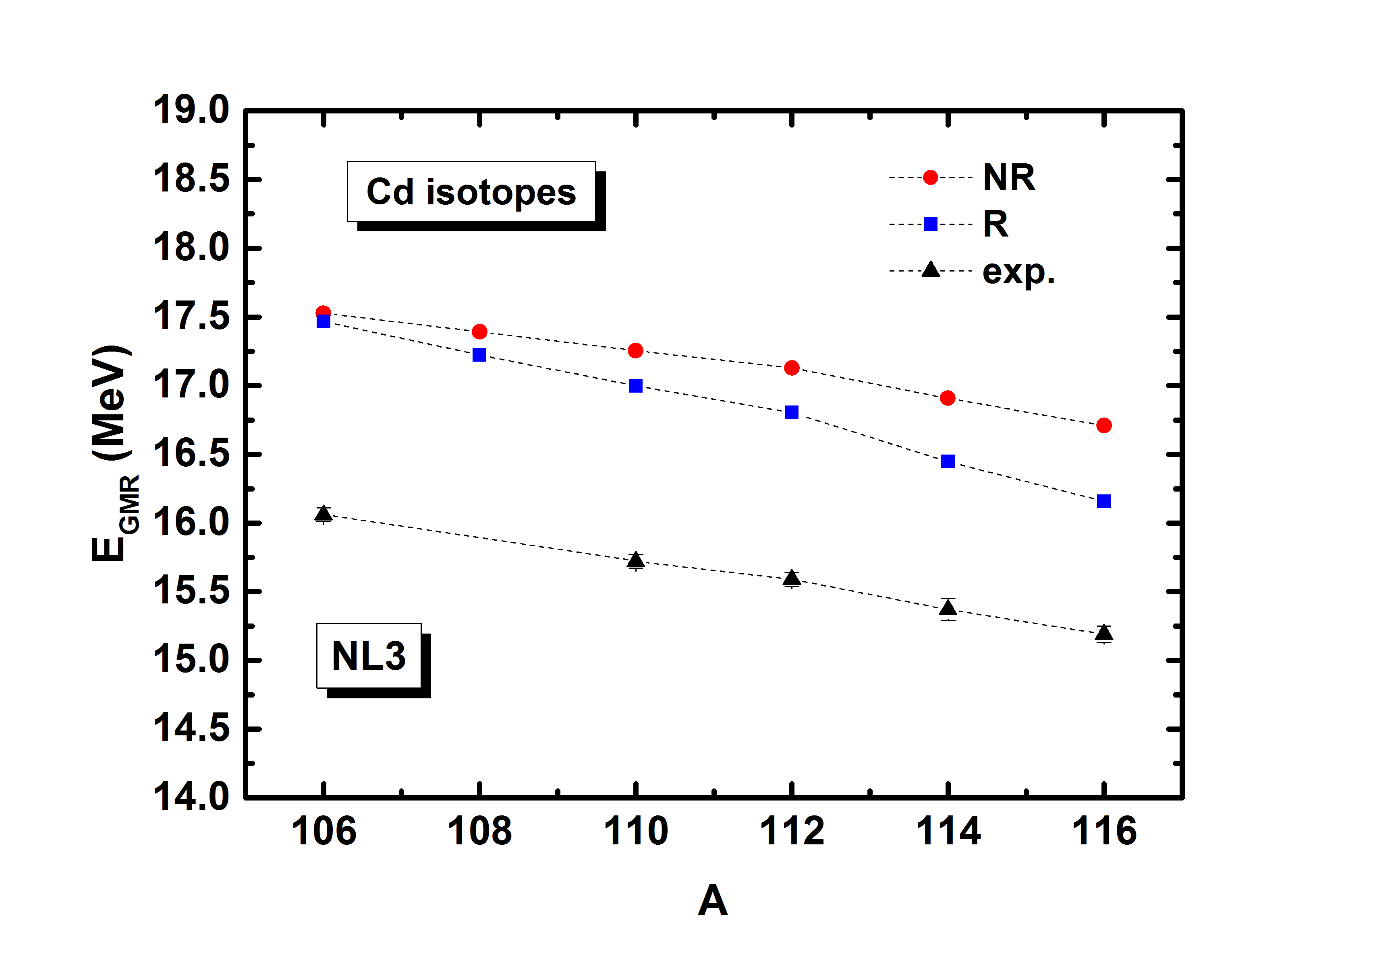
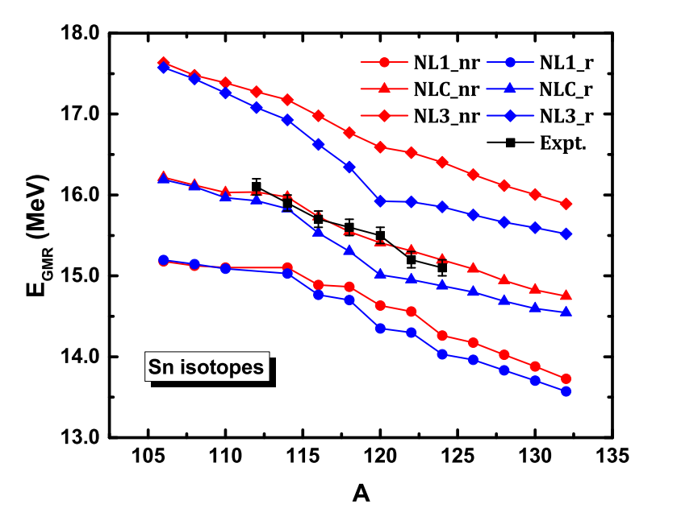
Sn and Cd isotopes
Experimental values from:
T. Li et al., Phys. Rev. Lett. 99 (2007) 162503
Softness for the open-shell nuclei
Cd isotopes: similar to Sn!
D. Patel et al., Phys. Lett. B 718 (2012) 447
14

Slide 16
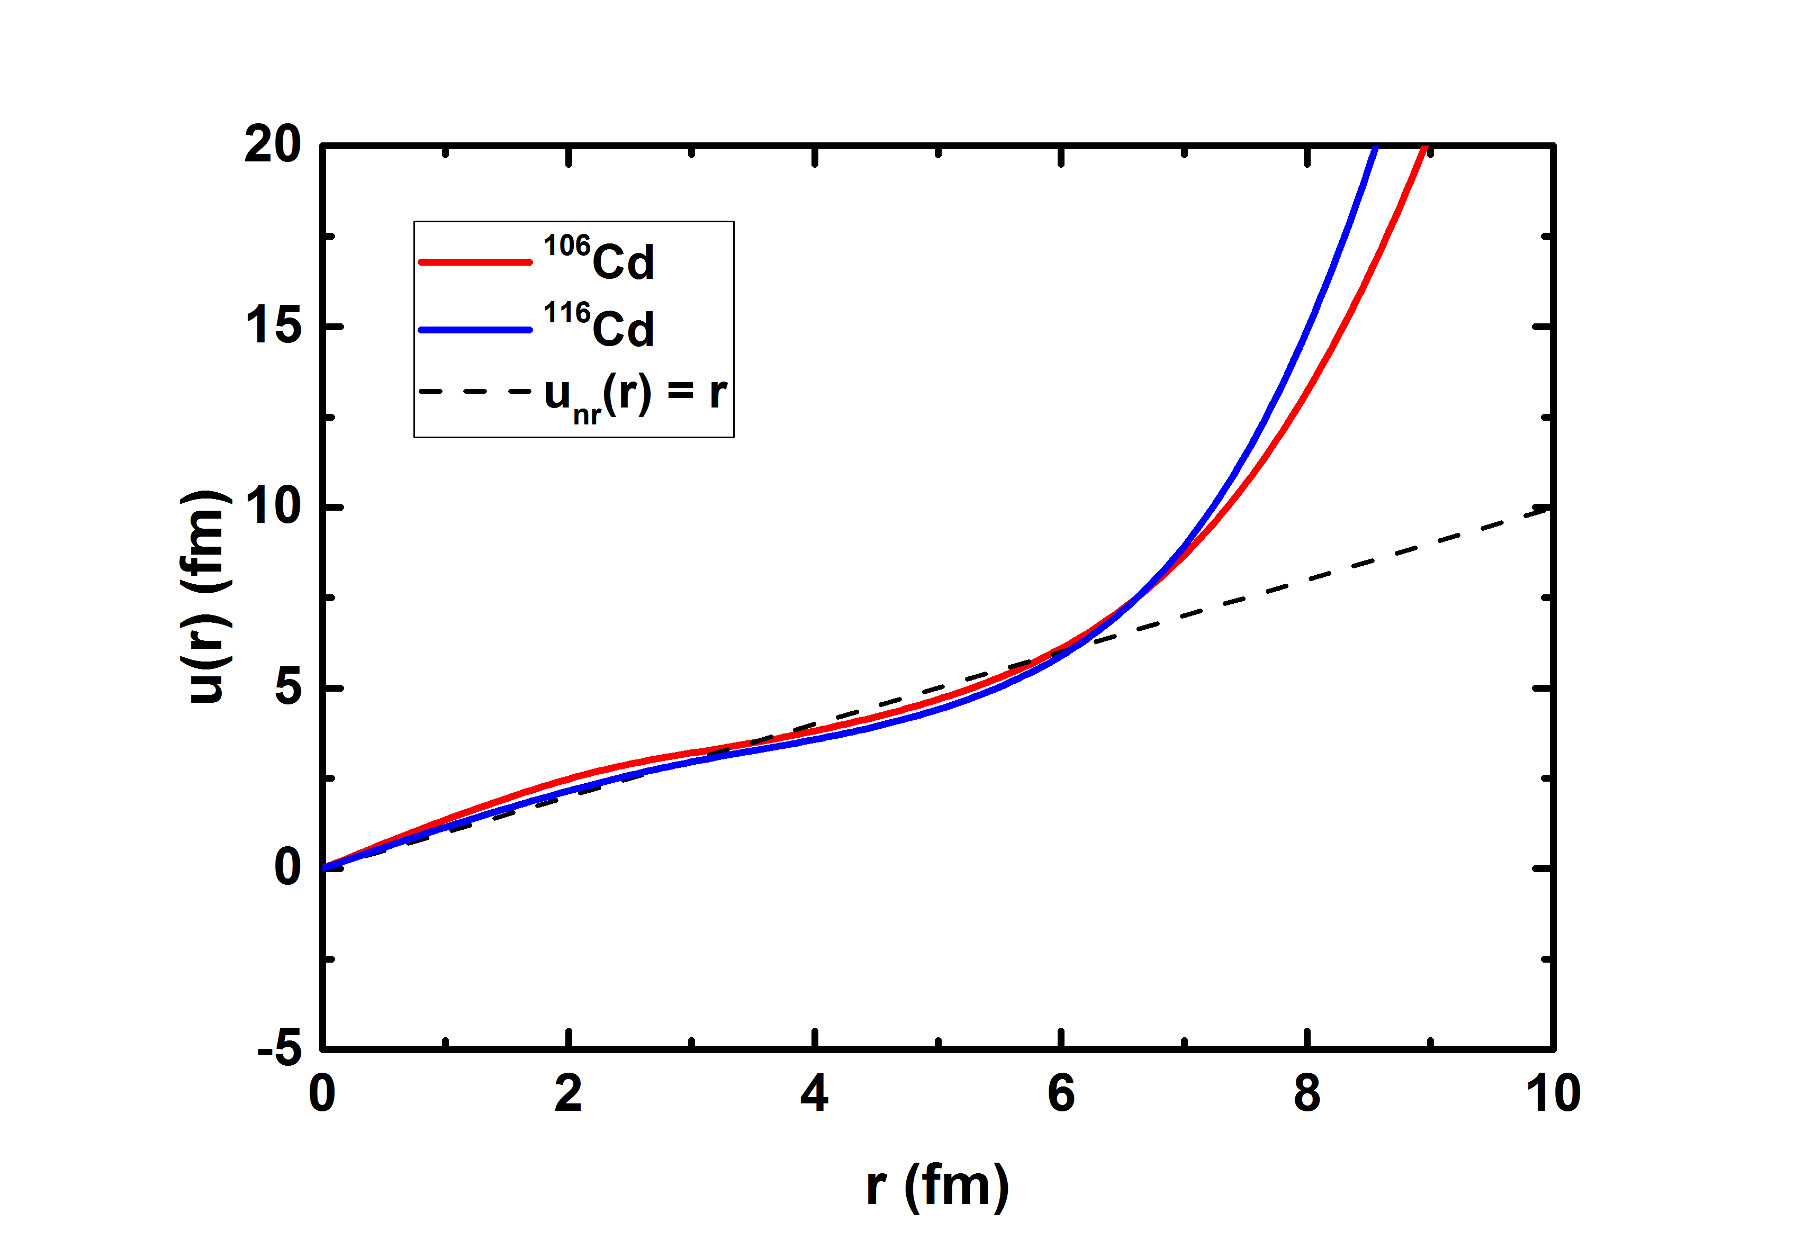
Why softer with rel. mass parameter?
$$B_{nr}=A^{−1}\int{r^{2}Mρd^{3}r \overset{⇒}{} }B_{rel}=A^{−1}\int{u^{2}\left(r\right)ℋ_{RMF}(r)d^{3}r}$$
$Mρ\underset{⇒}{}ℋ_{RMF}(r)$ contributes about 0.5% on the $E_{GMR}$. The rest comes from $u\left(r\right).$
$u_{nr}\left(r\right)=r$ from the non-relativistic scaling model.
$$r<6 fm:u\left(r\right)≈r;$$
$$r>6 fm: u\left(r\right)>r.$$
Collective velocity field:
15

Slide 17
Outline
Introduction
Theoretical Framework
Results and Discussions
Summary
16

Slide 18
Summary
We developed a radius constrained RMF model based on MDC-RMF model, we can obtain the incompressibility and GMR energy from the calculation.
We employed the relativistic mass parameter for the GMR of finite nuclei, the GMR energy is reduced with the inclusion of relativistic mass parameter. The reduction for Sn is obvious, which can be a possible reason for the softness puzzle for open-shell nuclei.
17

Slide 19
ありがとうございます！
Thanks for your attention!
Kun Wang Supervisor: Shan-Gui Zhou
Institute of Theoretical Physics, Chinese Academy of Sciences
2017/6/28

