Slide 1

Dynamics of nuclear pairing model
China-Japan collaboration workshop
2017/06/26-28
Univ. of Tsukuba
NI Fang (倪 放)
Collaborator: NAKATSUKASA Takashi (中務 孝)

Slide 2
Outline
Introduction
  Pairing collective motion, Motivation
Dynamics in nuclear pairing model
  Exact solution
  Approximation method
Summary
Notes:
I will show the outline in my talk. First is introduction. I will explain about … … .
Next, I will show … and result.
Finally is summary.

Slide 3
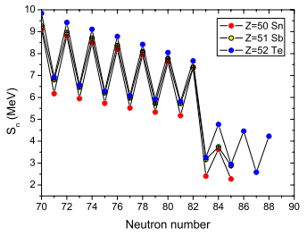
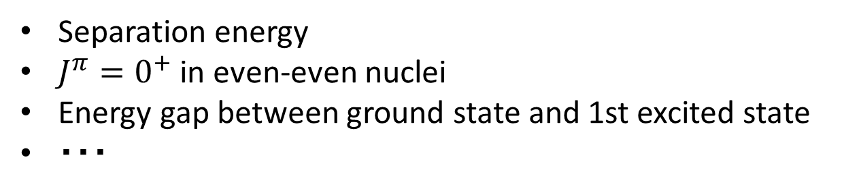

Pairing correlation in nuclei
$$J=0$$
Evidence in ground state
Separation energy
$J^{π}=0^{+}$ in even-even nuclei
Energy gap between ground state and 1st excited state
・・・
A Kankainen, et. al. JPG (2012)
Notes:
Before get onto the main topic, I’d also like to explain pairing correlation. As you know, pairing is one of the most important correlation in nuclei. There are many evidences from experiment, such as different structure between odd-even and even-even nuclei. For ground states, they are well understood by BCS or HFB theory. However, although small amplitude collective motion such as pairing vibration, pairing rotation are known, in general, the study of pairing collectivity including large amplitude collective motion is limited.
The question is, how can we describe pairing collective motion? Are there some proper collective coordinates such as pairing gap Delta? To answer these questions, let’s consider a simple pairing model, it is Richardson model.

Slide 4
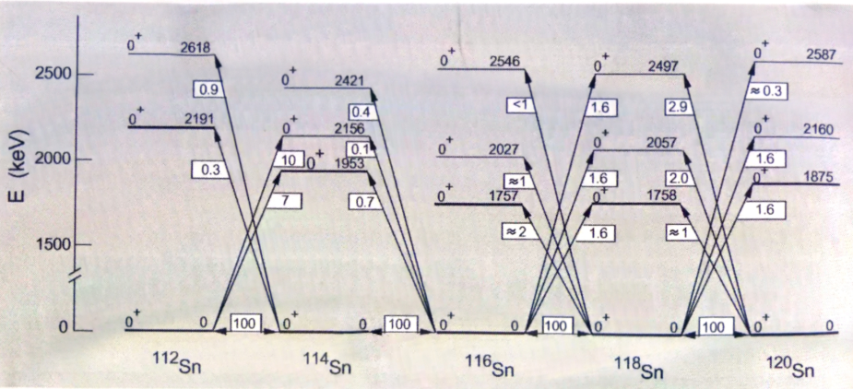
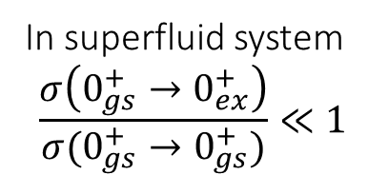
Pairing collective motion
Cross section of pair-transfer is good observable
ex) (t,p) or (p,t) reaction in even-even Sn isotope
D. J. Rowe, J. L. Wood, “Fundamentals of Nuclear Models”
Pairing rotation (gs⬄gs)
Pairing vibration (gs⬄ex)
E
E
In superfluid system
$$\frac{σ\left(0_{gs}^{+}→0_{ex}^{+}\right)}{σ(0_{gs}^{+}→0_{gs}^{+})}≪1$$
Re⊿
Re⊿
Im⊿
Im⊿

Slide 5
Motivation
Low-lying excited states in nuclei…
Coupling between pairing and quadrupole is important
Large amplitude collective motion
Quadrupole correlation → Bohr Hamiltonian
Pairing → ??
Final goal： Elucidate large amplitude pairing collective motion in nuclei
First step:
Elucidate pairing dynamics in simple pairing model

Slide 6


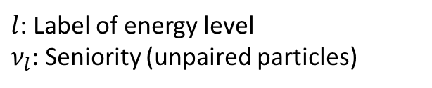
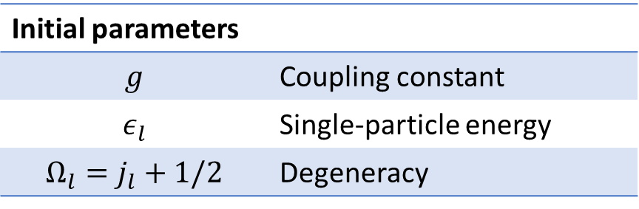

Richardson model
(pairing model, multi-seniority model)
$$g$$
$$J=0$$
Initial parameters
$$g$$ | Coupling constant
$$ε_{l}$$ | Single-particle energy
$$Ω_{l}=j_{l}+1/2$$ | Degeneracy
$l$: Label of energy level
$ν_{l}$: Seniority (unpaired particles)
Notes:
This is Richardson model. The Hamiltonian consists of two terms, the first one is one body term. The second term is two body interaction which couples two particles into zero angular momentum. The initial parameter we have to input is, coupling constant g, which means the strength of pairing, single particle energy epsilon and degeneracy for each orbital. The merit of the pairing model is exactly solvable, and possible to obtain nu=0 excited states. Nu=0 means no unpaired particle. These are the candidate of collective excited states. The task we have to do is using collective coordinate to describe these states.

Slide 7
Outline
Introduction
  Pairing collective motion, Motivation
Dynamics in nuclear pairing model
  Exact solution
  Approximation method
Summary
Notes:
I will show the outline in my talk. First is introduction. I will explain about … … .
Next, I will show … and result.
Finally is summary.

Slide 8
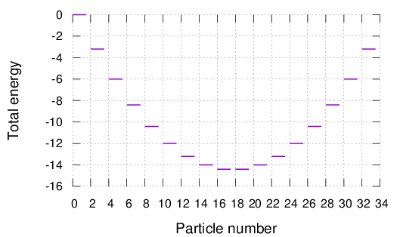
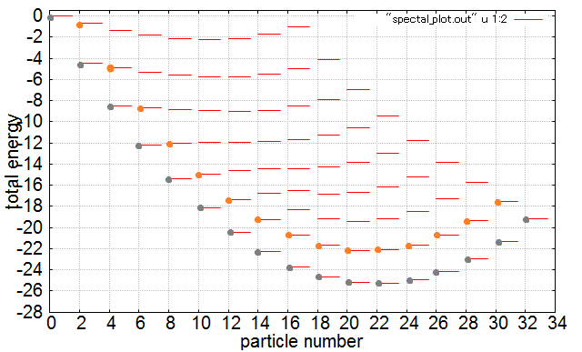
Energy spectra
Single-j
Multi-j
Collective excited states emerge in multi-level ($L≥2$) system!
→ We study the properties of collective excited states
Notes:
では厳密解による計算結果を示す。まず、セニョリティが0の状態のエネルギー固有値をプロットしたものである。横軸は粒子数、縦軸は全エネルギーである。もし対相関がなかったら、粒子を単に下の準位から詰めることになるから、スペクトルは直線的で、閉殻の左右で振る舞いが変わるが、対相関があると、放物線的になる。目安として結合定数が0.05,0.1、0.2はそれぞれ対結合が弱い、中間、強い場合として分類する。

Slide 9
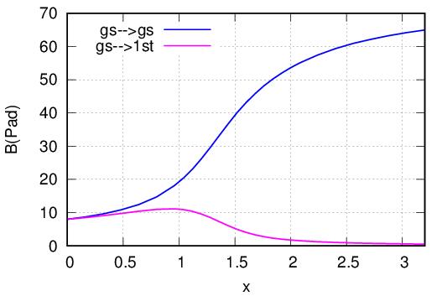
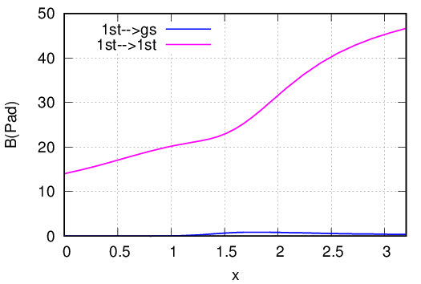

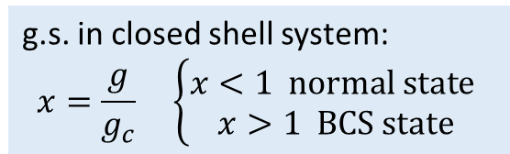



Two-particle transfer
$$B\left(Pad\right)={\left|⟨N,α\right|S}_{+}{\left|N−2,β⟩\right|}^{2}$$
N=14 → N=16${ \left|⟨N,α\right|S}_{+}{\left|N−2,0_{1}^{+}⟩\right|}^{2}$
System
N=14 → N=16${ \left|⟨N,α\right|S}_{+}{\left|N−2,0_{2}^{+}⟩\right|}^{2}$
Ω＝8
$Δε=\text{1}$(MeV)
Ω＝8 (16 particles)
g.s. in closed shell system:
$$x=\frac{g}{g_{c}} \left\{\begin{aligned}x<1 normal state \\ x>1 BCS state\end{aligned}\right.$$
Weak pair correlation
Strong pair correlation
$$0_{2}^{+}$$
$$0_{2}^{+}$$
$$0_{2}^{+}$$
$$0_{2}^{+}$$
$$0_{1}^{+}$$
$$0_{1}^{+}$$
$$0_{1}^{+}$$
$$0_{1}^{+}$$
N-2
comparable
N
N-2
dominant
N
Notes:
それから2粒子付加反応について注目する。14粒子から16粒子への2粒子付加で、横軸は結合定数、縦軸は遷移強度である。この2つのグラフで注目したいことは、対相関が強い場合では、始状態を基底状態にしても、第一励起状態にしても、同じ励起状態への遷移強度が支配的で、違う励起状態にほとんど遷移しない点である。もう一度占有確率を見ると、基底状態がBCS凝縮した場合、励起状態と基底状態が全く違う構造になっていることが読み取れるから、非常に遷移しづらいと解釈できる。

Slide 10








Two-neutron additional transfer in Sn isotope
Ratio of transition strength
$$r_{12}=$$
H. Shimoyama et al., PRC 84, 044317 (2011)
System
$$h_{9/2 }$$
$$f_{7/2}$$
82
$$h_{11/2}$$
$$d_{3/2}$$
$$s_{3/2}$$
After N=82, $r_{12}$ increase dramatically!
We are expecting experimental result
We can predict pair transition strength in realistic nuclei

Slide 11
Outline
Introduction
  Pairing collective motion, Motivation
Dynamics in nuclear pairing model
  Exact solution
  Approximation method
Summary
Notes:
I will show the outline in my talk. First is introduction. I will explain about … … .
Next, I will show … and result.
Finally is summary.

Slide 12
Why we apply approximation method?
Understand classical picture of pairing dynamics
Explore reasonable method to describe pairing dynamics in realistic system from microscopic theory
Classical trajectory in phase space
Collective coordinate
Combine some new approach with DFT (HFB)

Slide 13




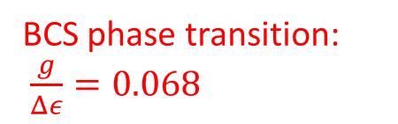

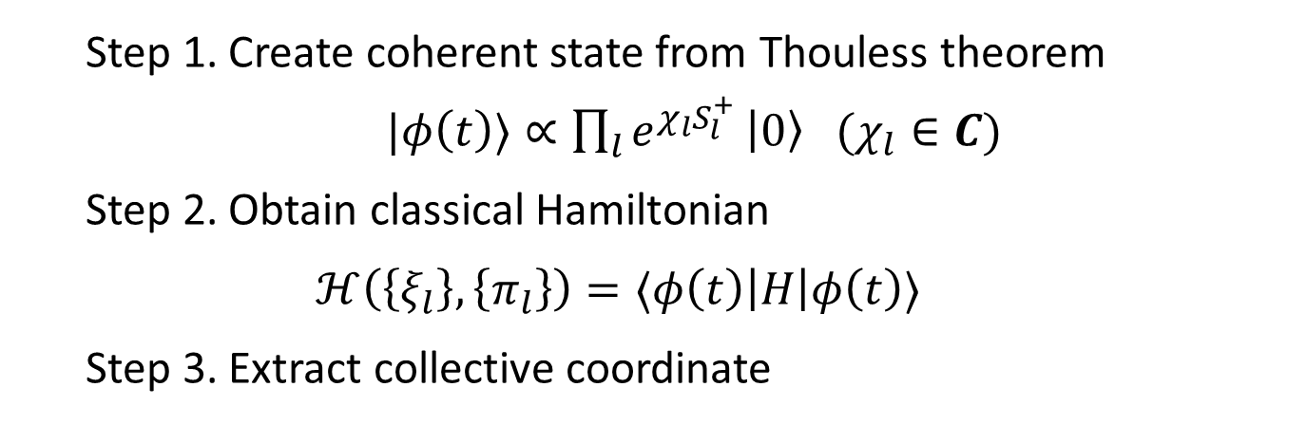



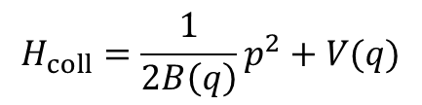


Quantization of TDHFB
  Step 1. Create coherent state from Thouless theorem
  $|φ\left(t\right)⟩∝\prod_{l}{e^{χ_{l}S_{l}^{+}}}\left|0\right\rangle (χ_{l}∈C)$
  Step 2. Obtain classical Hamiltonian
  $$ℋ\left(\left\{ξ_{l}\right\},\left\{π_{l}\right\}\right)=⟨φ\left(t\right)\left|H\right|φ\left(t\right)⟩$$
  Step 3. Extract collective coordinate
TDHFB
$${\left\{ξ_{l},π_{l^{′}}\right\}}_{PB}=δ_{ll^{′}}$$
$$V(ξ)$$
$$V(q)$$
$$H\left(ξ,π\right)⇒H_{coll}\left(q,p\right)$$
$$ξ_{N}$$
$$q_{2}$$
・・・
$$ξ_{1}$$
・・・
$$q_{1}$$
$$ξ_{2}$$
$$ξ_{α}$$
A few variables!
Many variables…
$$H_{coll}=\frac{1}{2B\left(q\right)}p^{2}+V(q)$$
  Step 4. Requantization (ex. $\left[q,p\right]=i$)
Notes:
We applied self-consistent collective coordinate method. Let me explain the procedure. First, we create coherent state from Thouless theorem. The coherent state is the combination of different particle number states, and only contains nu=0 element. Second, we define the canonical variables by certain transformation, and derive the Classical Hamiltonian. Next, we extract the collective coordinates from original classical Hamiltonian. And finally, we requantize the collective Hamiltonian. I will explain Step 3 in detail.

Slide 14


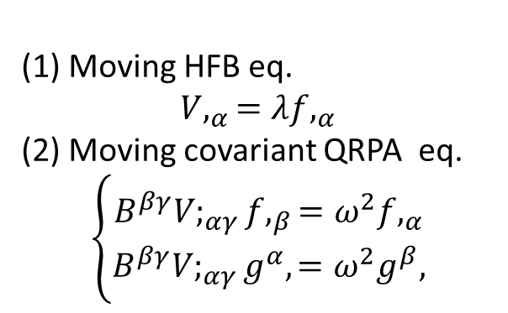






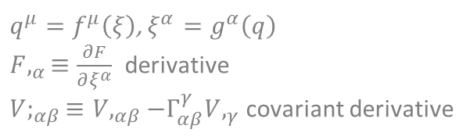

1D self-consistent collective coordinate (SCC)
Basic equation
(1) Moving HFB eq.
$$V,_{α}=λf,_{α}$$
(2) Moving covariant QRPA eq.
$$\left\{\begin{aligned}B^{βγ}V;_{αγ}f,_{β}=ω^{2}f,_{α} \\ B^{βγ}V;_{αγ}g^{α},=ω^{2}g^{β},\end{aligned}\right.$$
$q^{μ}=f^{μ}\left(ξ\right)$, $ξ^{α}=g^{α}\left(q\right)$
$F,_{α}≡\frac{∂F}{∂ξ^{α}}$ derivative
$V;_{αβ}≡V,_{αβ}−Γ_{αβ}^{γ}V,_{γ}$ covariant derivative
T. Nakatsukasa, PTEP 01A207 (2012)
$$ξ_{}^{β}$$
$$q+dq$$
Collective path
+
$$ξ_{}^{β}+dξ_{}^{β}$$
+
+
+
+
$$dξ^{μ}=g^{μ},dq$$
+
$$ξ_{}^{β}$$
+
+
+
+
+
+
$$ξ_{}^{α}$$
$$ξ_{}^{α}$$
$$ξ_{}^{α}+dξ_{}^{α}$$
Notes:
To obtain one dimensional collective coordinate self-consistently, the basic equations are moving HFB and moving covariant QRPA equation. Actually, we ignore the moving HFB equation to employ 0th order approximation of collective path. The starting point is energy minimum point. It can be obtained by HFB or BCS equation. Next, we apply the QRPA equation, choose the lowest mode basically. Also, we can obtain eigenvector simultaneously, the eigenvector help us to decide the direction which system will move. So we can go to the neighborhood point. At the point, we apply step 2 and step 3 iteratively, we can obtain the collective path.

Slide 15

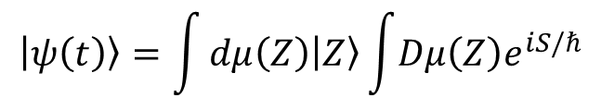

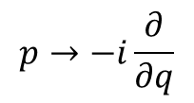

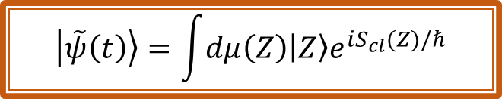
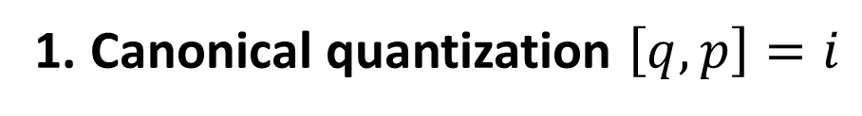

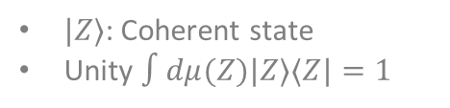
Requantization
1. Canonical quantization $\left[q,p\right]=i$
$$p→−i\frac{∂}{∂q}$$
Wave function ○ Pair transfer △
2. Semiclassical approach
T. Suzuki et al PTP Vol.79 No.2 (1988)
Time dependent wave function
$$\left|ψ\left(t\right)\right\rangle =\int{dμ\left(Z\right)\left|Z\right\rangle \int{Dμ\left(Z\right)e^{iS/ℏ}}}$$
$|Z⟩$: Coherent state
Unity $∫dμ(Z)|Z⟩⟨Z|=1$
Path integral
Only take classical trajectory
$${δS}_{cl}=0$$
$$t=t_{0}$$
TDHFB trajectory
$$Z=Z_{0}$$
$$\left|\tilde{ψ}\left(t\right)\right\rangle =\int{dμ\left(Z\right)\left|Z\right\rangle e^{iS_{cl}(Z)/ℏ}}$$
$$t$$
Microscopic wave function
⬄ macroscopic wave func. from canonical quantization
Particle number projection is automatically contained
Notes:
用いる手法について説明します. First, we create coherent state from Thouless theorem. The coherent state is the combination of different particle number states, and only contains nu=0 element. 次に、正準変数を定義し、最小作用の原理から系を古典的描像に落とします.そのときハミルトニアンの期待値が古典的ハミルトニアンに対応します。 最後に再量子化を行います。この一連の手法を一言で言えば、TDHFBの量子化です。

Slide 16
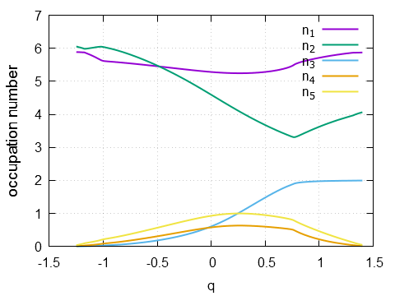
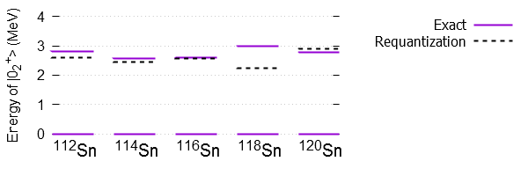
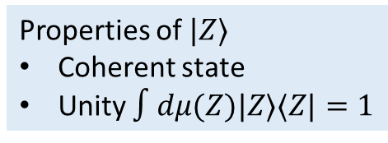
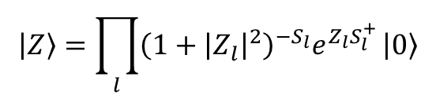
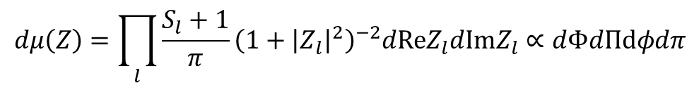

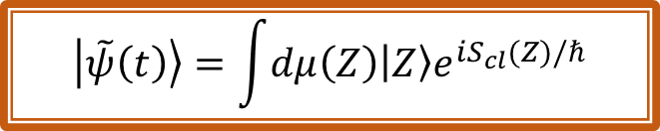


Result from SCC
Neutron occupation number in collective path (¹¹²Sn)
82
82
$$h_{11/2 }$$
$$h_{11/2 }$$
$$d_{3/2}$$
$$d_{3/2}$$
BCS g.s.
$$s_{1/2}$$
$$s_{1/2}$$
$$g_{7/2}$$
$$g_{7/2}$$
$$d_{5/2}$$
$$d_{5/2}$$
50
50
1st excitation energy
Well reproduced!
Notes:
Let me show the result in 112Sn. This is occupation number in each level as a function of collective coordinate. Q=0 correspond BCS ground state. We can see at both ends, all occupation number converge to even number. Especially, at the left end, all particles are filled from bottom level to Fermi energy surface. I only take 112Sn as an example, but this feature always exists in other cases.

Slide 17
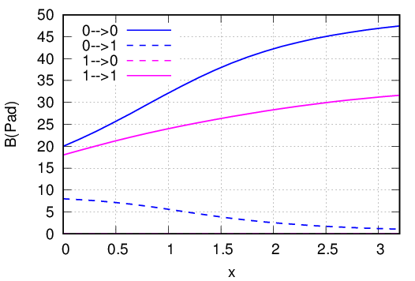
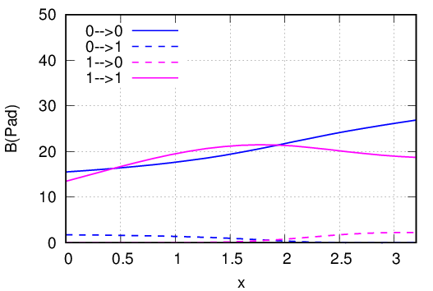
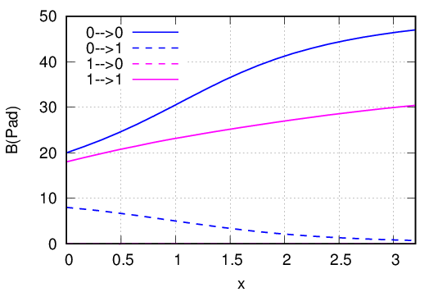
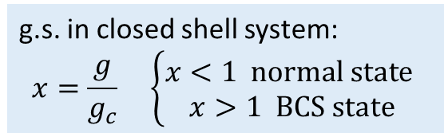
Two-particle transfer in two-level system
System
Ω＝8
N=6→8
Exact
$Δε=\text{1}$(MeV)
Ω＝8 (16 particles)
g.s. in closed shell system:
$$x=\frac{g}{g_{c}} \left\{\begin{aligned}x<1 normal state \\ x>1 BCS state\end{aligned}\right.$$
Canonical quantization
Semiclassical

Slide 18
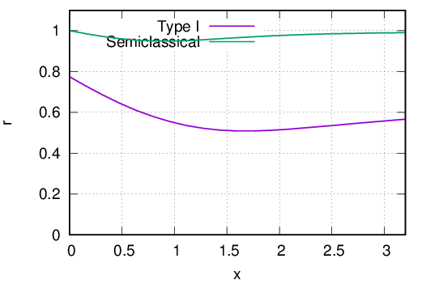
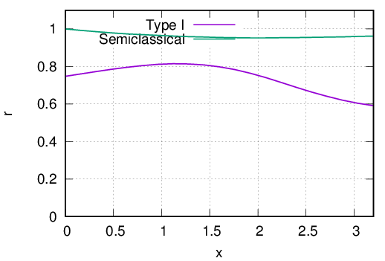
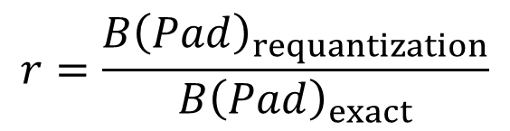
$$r=\frac{B{\left(Pad\right)}_{requantization}}{B{\left(Pad\right)}_{exact}}$$
Ratio
N=6, g.s. → N=8 g.s.
N=6, 1st → N=8 1st
Semiclassical approach is much better than canonical quantization in pair transition strength

Slide 19
Summary
We studied pairing dynamics in Richardson model
From exact solution
It is useful to predict pair transition strength qualitatively in nuclei
From time-dependent theory
We attempt to describe large amplitude pairing collective motion by self-consistent collective coordinate method
Semiclassical approach is reasonable to deal with pair transition
Next step, toward realistic system…
Combine semiclassical approach with SCC
Thank you!
Notes:
まとめです。リチャードソン模型の2準位系における集団座標の量子化を行いました。今回は正準量子化を行い、結果として閉軌道から開軌道に転移する領域以外では良い近似手法であり、また、ハミルトニアンの2次までの展開、つまり断熱的に扱えることを確認しました。今後は集団座標をmulti-j、現実的な系に適応していきたいと思います。

Slide 20
Back up

Slide 21
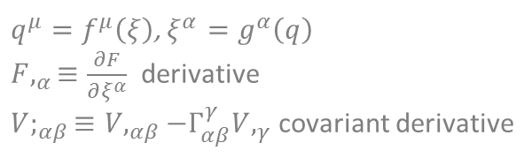
1D self-consistent collective coordinate (SCC)
Basic equation
(1) Moving HFB eq.
$$V,_{α}=λf,_{α}$$
(2) Moving covariant QRPA eq.
$$\left\{\begin{aligned}B^{βγ}V;_{αγ}f,_{β}=ω^{2}f,_{α} \\ B^{βγ}V;_{αγ}g^{α},=ω^{2}g^{β},\end{aligned}\right.$$
Step 1. Find energy minimum point by solving HFB or BCS eq.
Step 2. Diagonalize moving QRPA eq.
choose the lowest mode basically
iteration
$q^{μ}=f^{μ}\left(ξ\right)$, $ξ^{α}=g^{α}\left(q\right)$
$F,_{α}≡\frac{∂F}{∂ξ^{α}}$ derivative
$V;_{αβ}≡V,_{αβ}−Γ_{αβ}^{γ}V,_{γ}$ covariant derivative
Step 3. Decide the neighborhood point of collective path from eigenvector.
T. Nakatsukasa, PTEP 01A207 (2012)
$$ξ_{}^{β}$$
$$q+dq$$
Collective path
+
$$ξ_{}^{β}+dξ_{}^{β}$$
+
eigenvector
+
+
+
$$dξ^{μ}=g^{μ},dq$$
+
$$ξ_{}^{β}$$
+
+
+
+
+
+
$$ξ_{}^{α}$$
$$ξ_{}^{α}$$
$$ξ_{}^{α}+dξ_{}^{α}$$
Notes:
To obtain one dimensional collective coordinate self-consistently, the basic equations are moving HFB and moving covariant QRPA equation. Actually, we ignore the moving HFB equation to employ 0th order approximation of collective path. The starting point is energy minimum point. It can be obtained by HFB or BCS equation. Next, we apply the QRPA equation, choose the lowest mode basically. Also, we can obtain eigenvector simultaneously, the eigenvector help us to decide the direction which system will move. So we can go to the neighborhood point. At the point, we apply step 2 and step 3 iteratively, we can obtain the collective path.

Slide 22
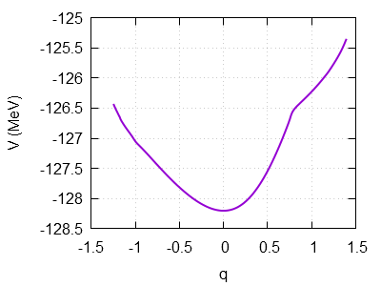


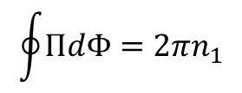
Requantization
  $$\left[q,p\right]=i$$
Collective potential of ¹¹²Sn
Dirichlet boundary condition:
$$ψ\left(q_{left}\right)=ψ\left(q_{right}\right)=0$$
Other Sn isotopes…
Notes:
The last task is to requantize the collective Hamiltonian. This is collective potential. We set Dirichlet boundary condition of wave function. I show the energy of 2nd 0+ state not only for 112Sn, but also for other Sn isotopes. Exact means exact solution from Richardson model. There are no so much difference between requantization solution and exact one. We can conclude requantization result is reasonable.

Slide 23
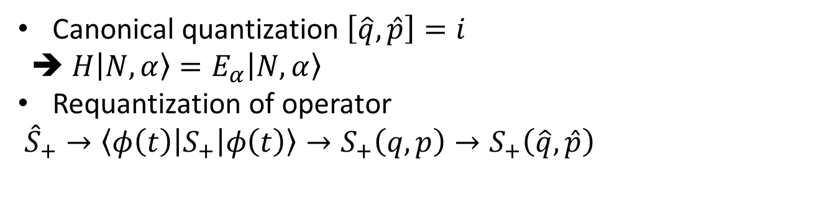

Two-neutron transfer in Canonical quantization
Canonical quantization $\left[\hat{q},\hat{p}\right]=i$
➔ $H\left|N,α\right\rangle =E_{α}\left|N,α\right\rangle$
Requantization of operator
${\hat{S}}_{+}→\left\langle φ\left(t\right)\left|S_{+}\right|φ\left(t\right)\right\rangle →S_{+}\left(q,p\right)→S_{+}\left(\hat{q},\hat{p}\right)$
Original Classical SCC Requantized
$$B\left(Pad\right)={\left|⟨N,α\right|S}_{+}{\left|N−2,β⟩\right|}^{2}$$
Under estimate in gs→gs, over estimate in gs→1st
➔ We consider another approach!
Notes:
We can obtain requantized operator as Hamiltonian. However, because the number of initial and final states are different, the coordinate systems are different too after obtaining collective coordinate. So we cannot calculate this matrix element directly

Slide 24
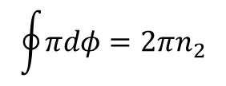


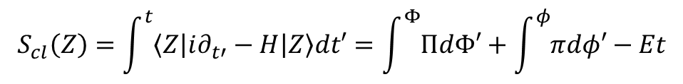

Application in two-level system
$$\left|\tilde{ψ}\left(t\right)\right\rangle =\int{dμ\left(Z\right)\left|Z\right\rangle e^{iS_{cl}(Z)/ℏ}}$$
2*2D phase space
Invariant value: E, N
➔ Integrable system
Measure
$$dμ\left(Z\right)=\prod_{l}{\frac{S_{l}+1}{π}}{\left(1+{\left|Z_{l}\right|}^{2}\right)}^{−2}dReZ_{l}dImZ_{l}∝dΦdΠdφdπ$$
Coherent state
Phase space
$$\left|Z\right\rangle =\prod_{l}{{\left(1+{\left|Z_{l}\right|}^{2}\right)}^{−S_{l}}e^{Z_{l}S_{l}^{+}}}\left|0\right\rangle$$
$$π$$
Action
$$S_{cl}\left(Z\right)=\int^{t}{\left\langle Z\left|i∂_{t′}−H\right|Z\right\rangle dt′}=\int^{Φ}{ΠdΦ′}+\int^{φ}{πdφ′}−Et$$
Quantization condition = Sommerfeld quantization
$$φ$$
$$\oint{ΠdΦ=2πn_{1}}$$
$$\oint{πdφ=2πn_{2}}$$
$${{(n}_{1},n}_{2}=0,1,2,⋯)$$
Wave function
$$\left|{\tilde{ψ}}_{n}\right\rangle$$
Particle number projection!
Notes:
用いる手法について説明します. First, we create coherent state from Thouless theorem. The coherent state is the combination of different particle number states, and only contains nu=0 element. 次に、正準変数を定義し、最小作用の原理から系を古典的描像に落とします.そのときハミルトニアンの期待値が古典的ハミルトニアンに対応します。 最後に再量子化を行います。この一連の手法を一言で言えば、TDHFBの量子化です。

Slide 25
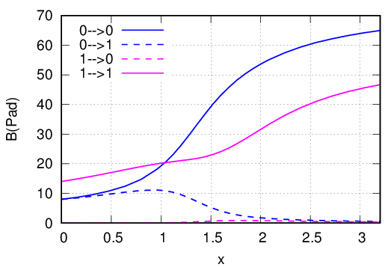
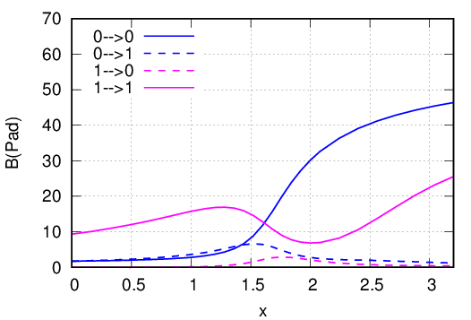
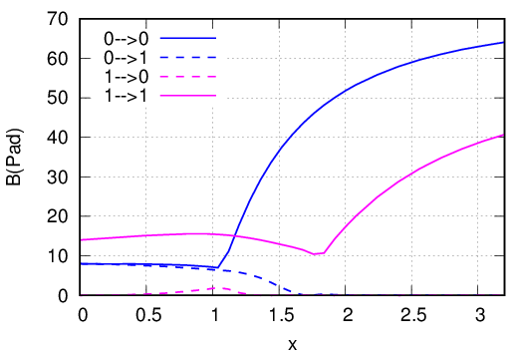

Two-particle transfer in two-level system
System
Ω＝8
E(MeV)
0
-1
N=14→16
Exact
$Δε=\text{1}$(MeV)
Ω＝8 (16 particles)
g.s. in closed shell system:
$$x=\frac{g}{g_{c}} \left\{\begin{aligned}x<1 normal state \\ x>1 BCS state\end{aligned}\right.$$
Canonical quantization
Semiclassical

Slide 26
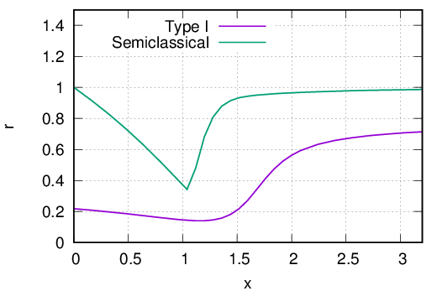
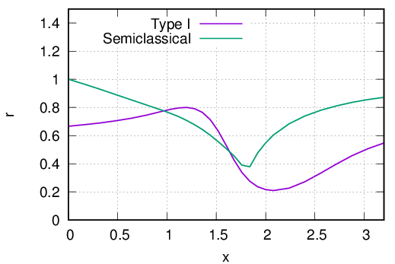
$$r=\frac{B{\left(Pad\right)}_{requantization}}{B{\left(Pad\right)}_{exact}}$$
Ratio
N=14, g.s. → N=16 g.s.
N=14, 1st → N=16 1st
Semiclassical approach is much better than canonical quantization
Semiclassical approach can well describe pairing dynamics except phase transition region

Slide 27
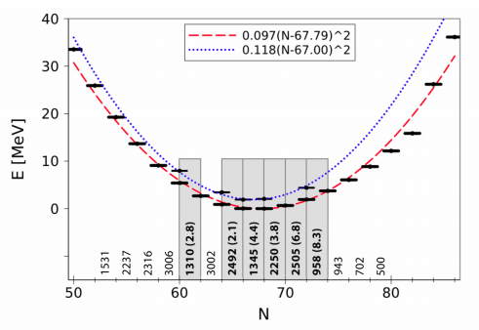
・・・
$$ξ_{1}$$
・・・
$$ξ_{2}$$
$$ξ_{α}$$

Slide 28
Established theory
New approach
DFT, TDDFT,
HFB ...
Combine
Self-consistent collective coordinate (SCC)
Semiclassical approach
…
Elucidate pairing dynamics in nuclei!

