Slide 1
Nonuniform nuclear matter in a strong magenetic field
Xia Cheng-Jun (夏铖君)
Ningbo Institute of Technology,
Zhejiang University
Collaborators: Maruyama Toshiki, Yasutake Nobutoshi
China-Japan collaboration workshop on “Nuclear mass and life for unravelling mysteries of r-process”
June 28th, 2017

Slide 2
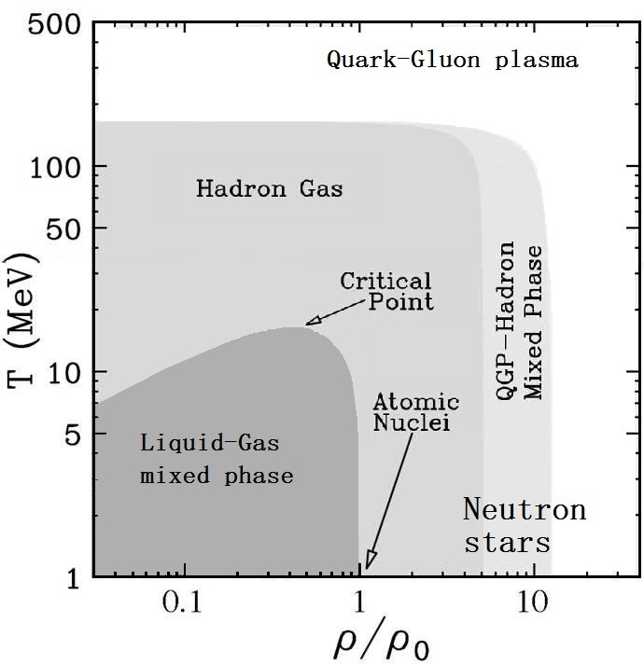
Nuclear matter phase diagram

Slide 3
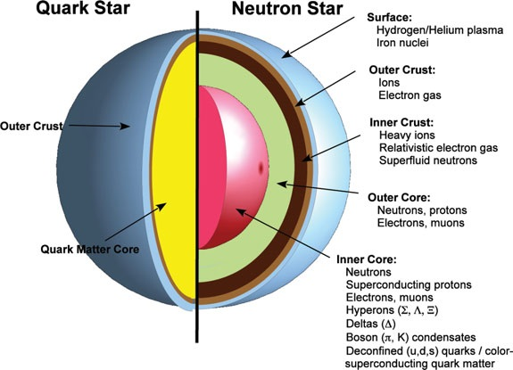
Compact star structures [Weber, Orsaria, Rodrigues, Yang]

Slide 4
Motivation
The pasta structures are important to
the glitch, cooling, and rotation of neutron stars, and the properties of supernova matter [Mochizuki_Izuyama1995_ApJ440-263, Pons_Viganò_Rea2013_NatPhys9-431, ...];
the crust oscillations of neutron stars [Strohmayer2006_ApJ653-593, Watts2012_ARAA50-609, Sotani2011_MNRAS417-L70, ...];
star quake and gravitational waves emitted by neutron stars [Horowitz2009_PRL102-191102, Horowitz2010_PRD81-103001, ...]
There exists strong magnetic fields inside neutron stars, e.g.,
magnetars (reaching 10¹⁴⁻¹⁵ G on the surface and ~10¹⁸ G inside).
Note:
[Cardall_Prakash_Lattimer2001_ApJ554-322]
A first study of the pasta phase in a strong magnetic field was carried out in [Lima_Avancini_Providência2013_PRC88-035804].
However, the Wigner-Seitz approximation was adopted, the variation of the magnetic field or the nucleon AMM were not considered.

Slide 5
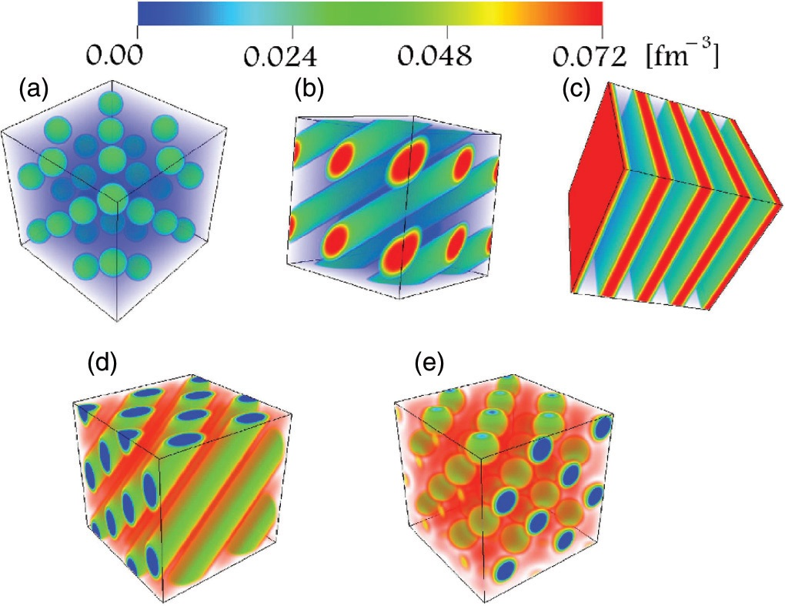
Inner Crust [Okamoto_Maruyama_Yabana_Tatsumi2013_PRC88-025801]

Slide 6
Method
Relativistic mean field (RMF) model
Thomas-Fermi approximation
Considering the variation of the magnetic field
Introducing the nucleon anomalous magnetic moments (AMM)
Solved in a periodic three-dimensional cuboid cell with no assumptions on geometrical symmetries
The Lagrangian density of the RMF model is
with

Slide 7
Equation of motion
Fermions:
Mesons:
Photons:
with the effective magnetic charge density
Source currents:
Total energy:

Slide 8
Landau quantization
[Broderick2000_ApJ537-351, Rabhi_Pais_Panda_Providência2009_JPG36-115204, ...]
Charged particles:
The momentum perpendicular to the magnetic field B becomes
with the Landau levels
The single particle energies:
The density of states:
Uncharged particles:
The single particle energies:

Slide 9
Numerical recipe
Based on the numerical code developed in [Okamoto_Maruyama_Yabana_Tatsumi2012_PLB713-284, Okamoto_Maruyama_Yabana_Tatsumi2013_PRC88-025801], we further include the effects of the magnetic field (MagNonuniform V0.1).
The boson fields and density profiles are solved iteratively inside a 3D periodic unit cell with discretized space coordinate, i.e.,
Assume initial boson fields that determine the potentials for fermions;
Obtain the density distributions of fermions at given total particle numbers, where the chemical potentials are constants;
Solve the boson field equations with Relexation Method;
Readjust the boson fields according to the Modified Broyden's method [Johnson1988_PRB38-12807];
Go to step 2 until convergence is reached.

Slide 10
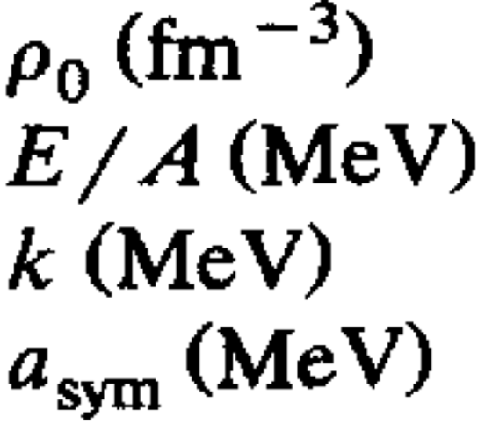
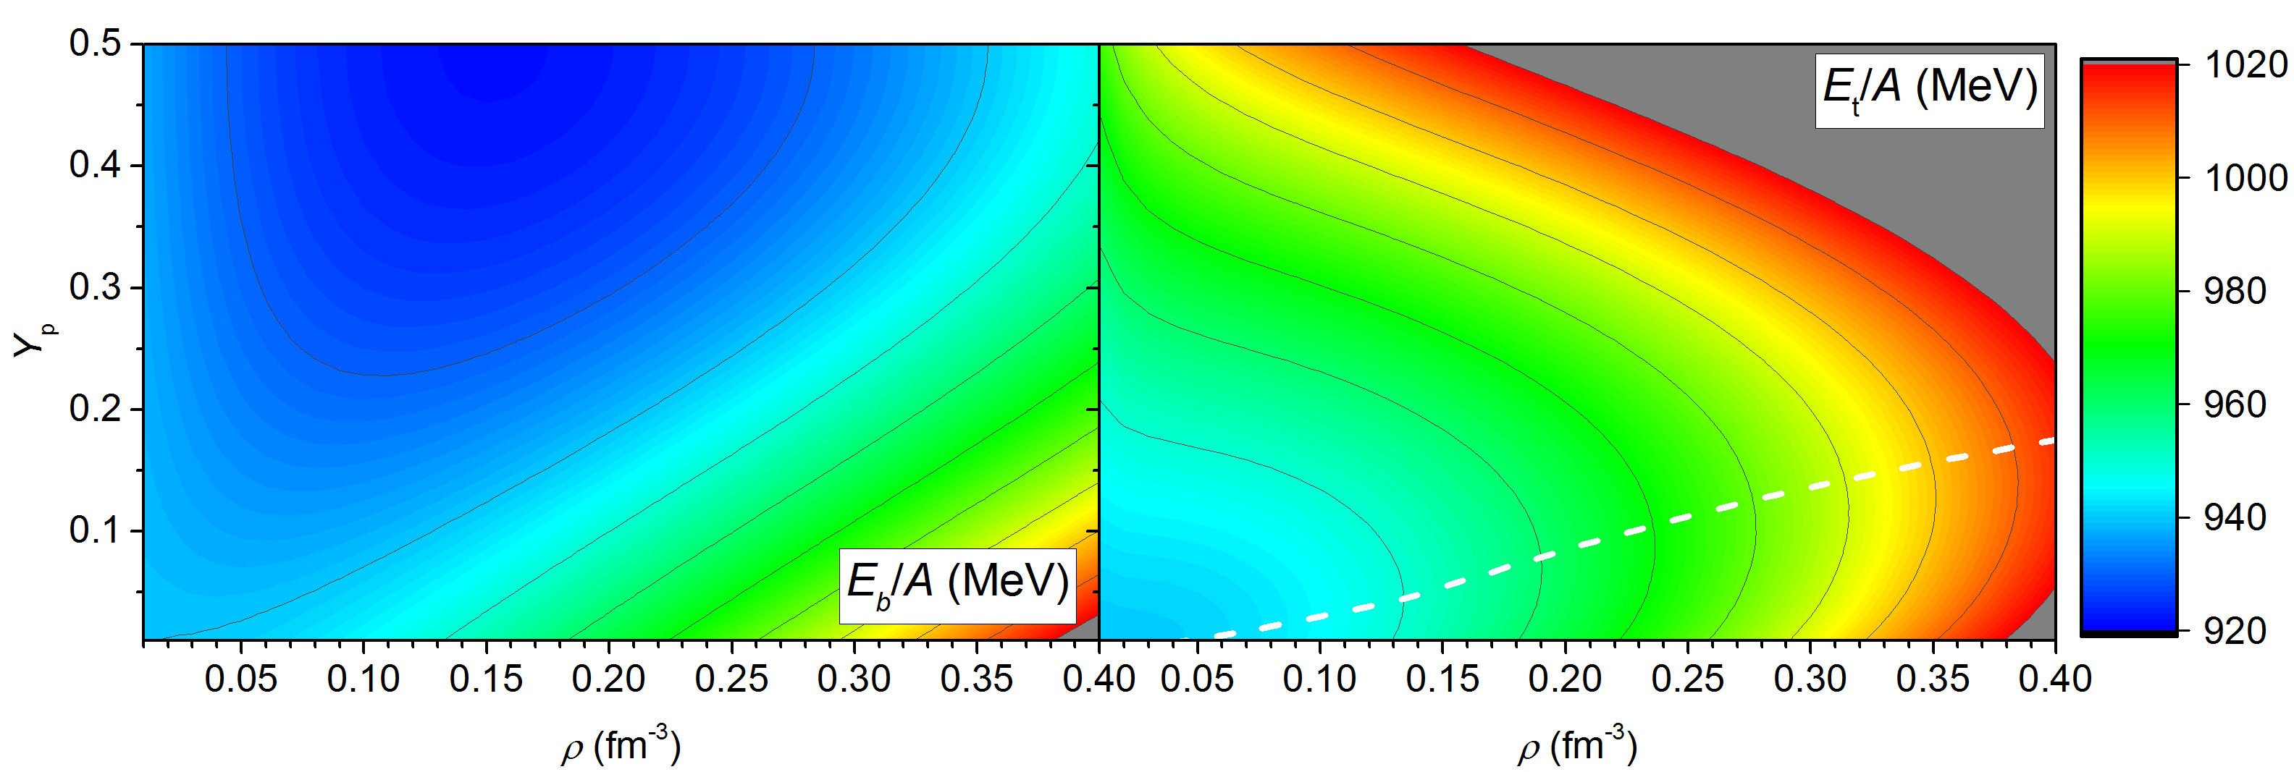
Parameters
The adopted parameter set for RMF theory [Maruyama_Tatsumi_Voskresensky_Tanigawa_Chiba2005_PRC72-015802]
1. the saturation density:
2. the energy:
3. the incompressibility:
4. the symmetry energy:
0.153
-16.3
240
32.5

Slide 11
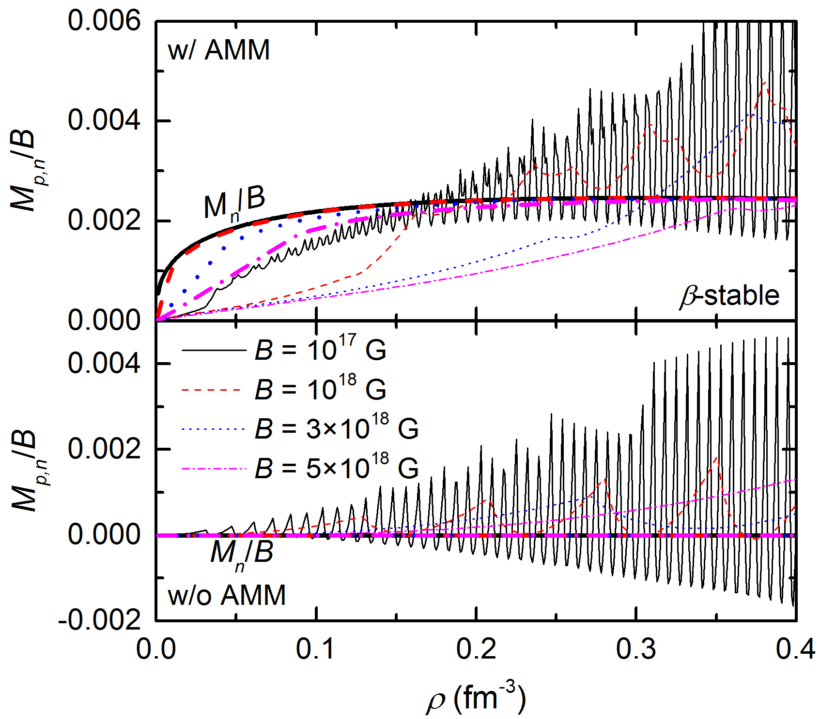
Magnetic susceptibility

Slide 12
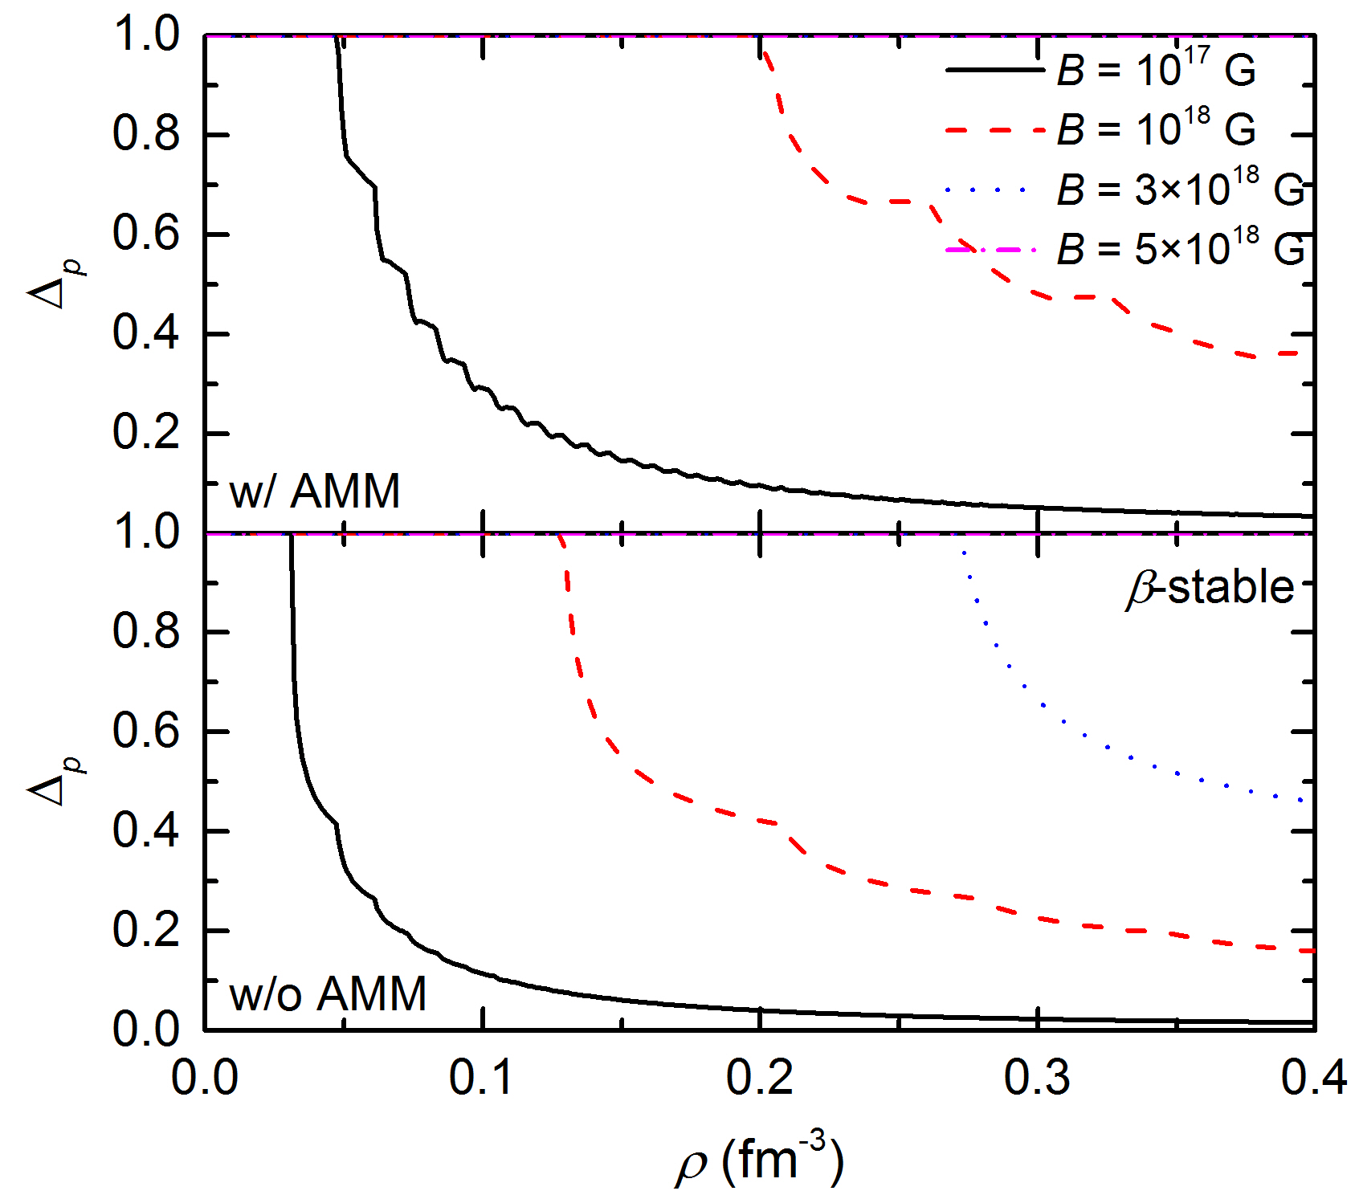
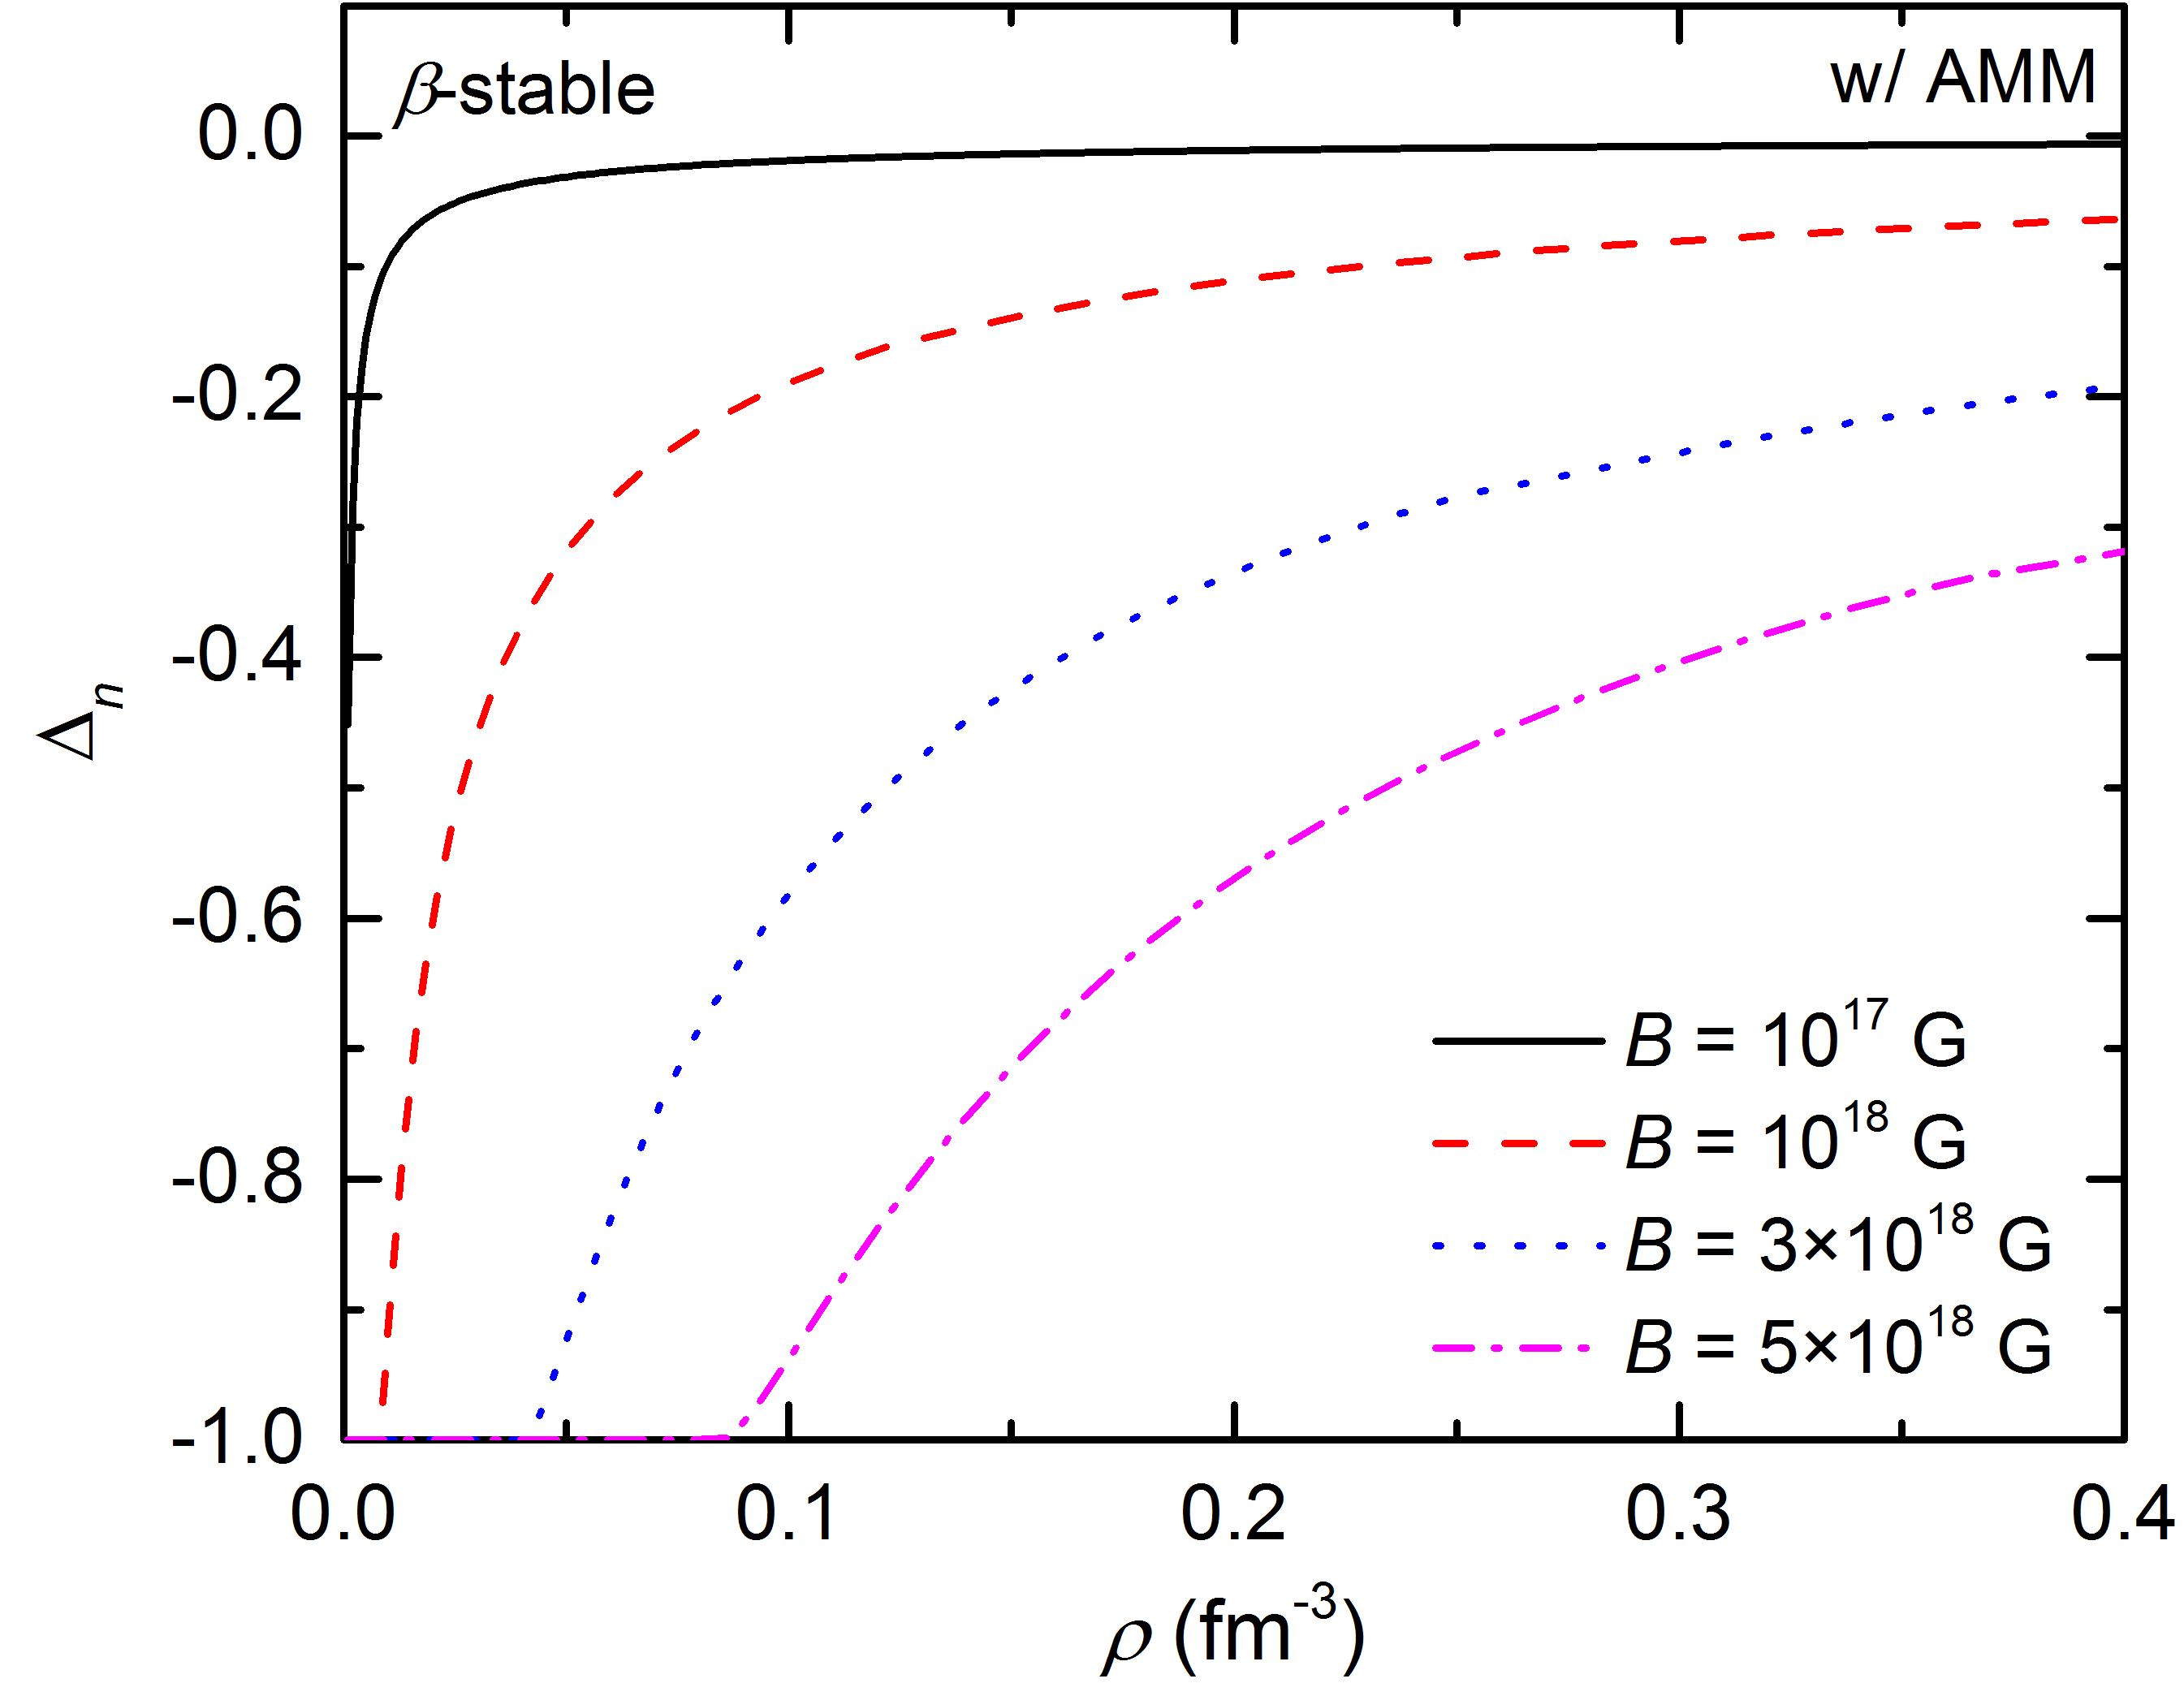
Relative polarizations

Slide 13
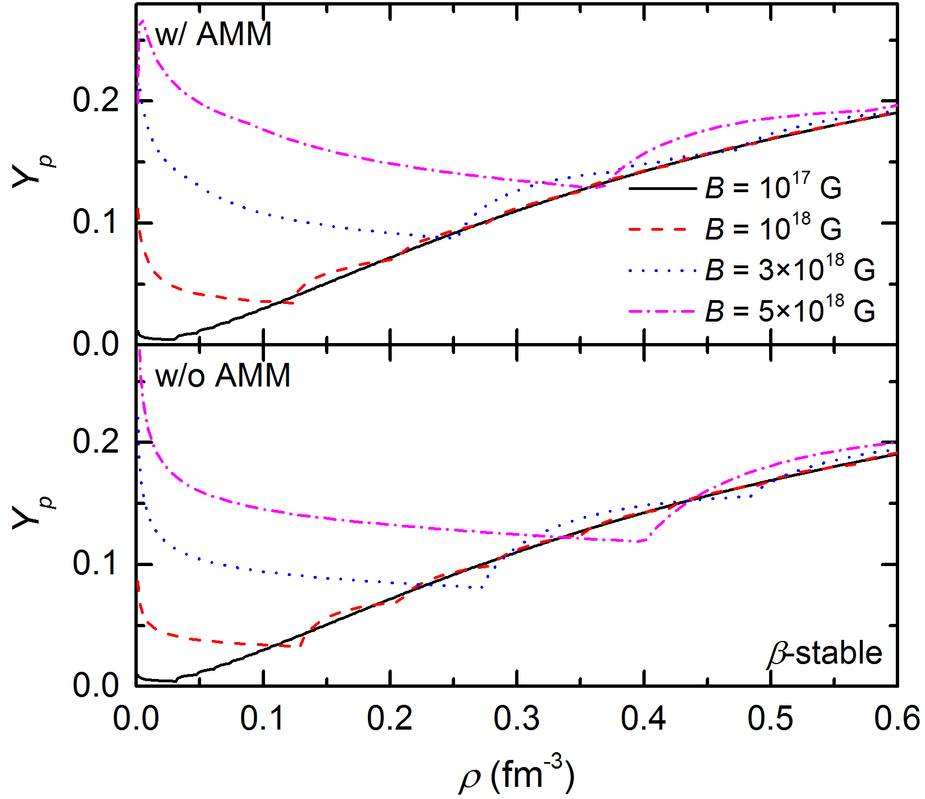
Proton fraction

Slide 14
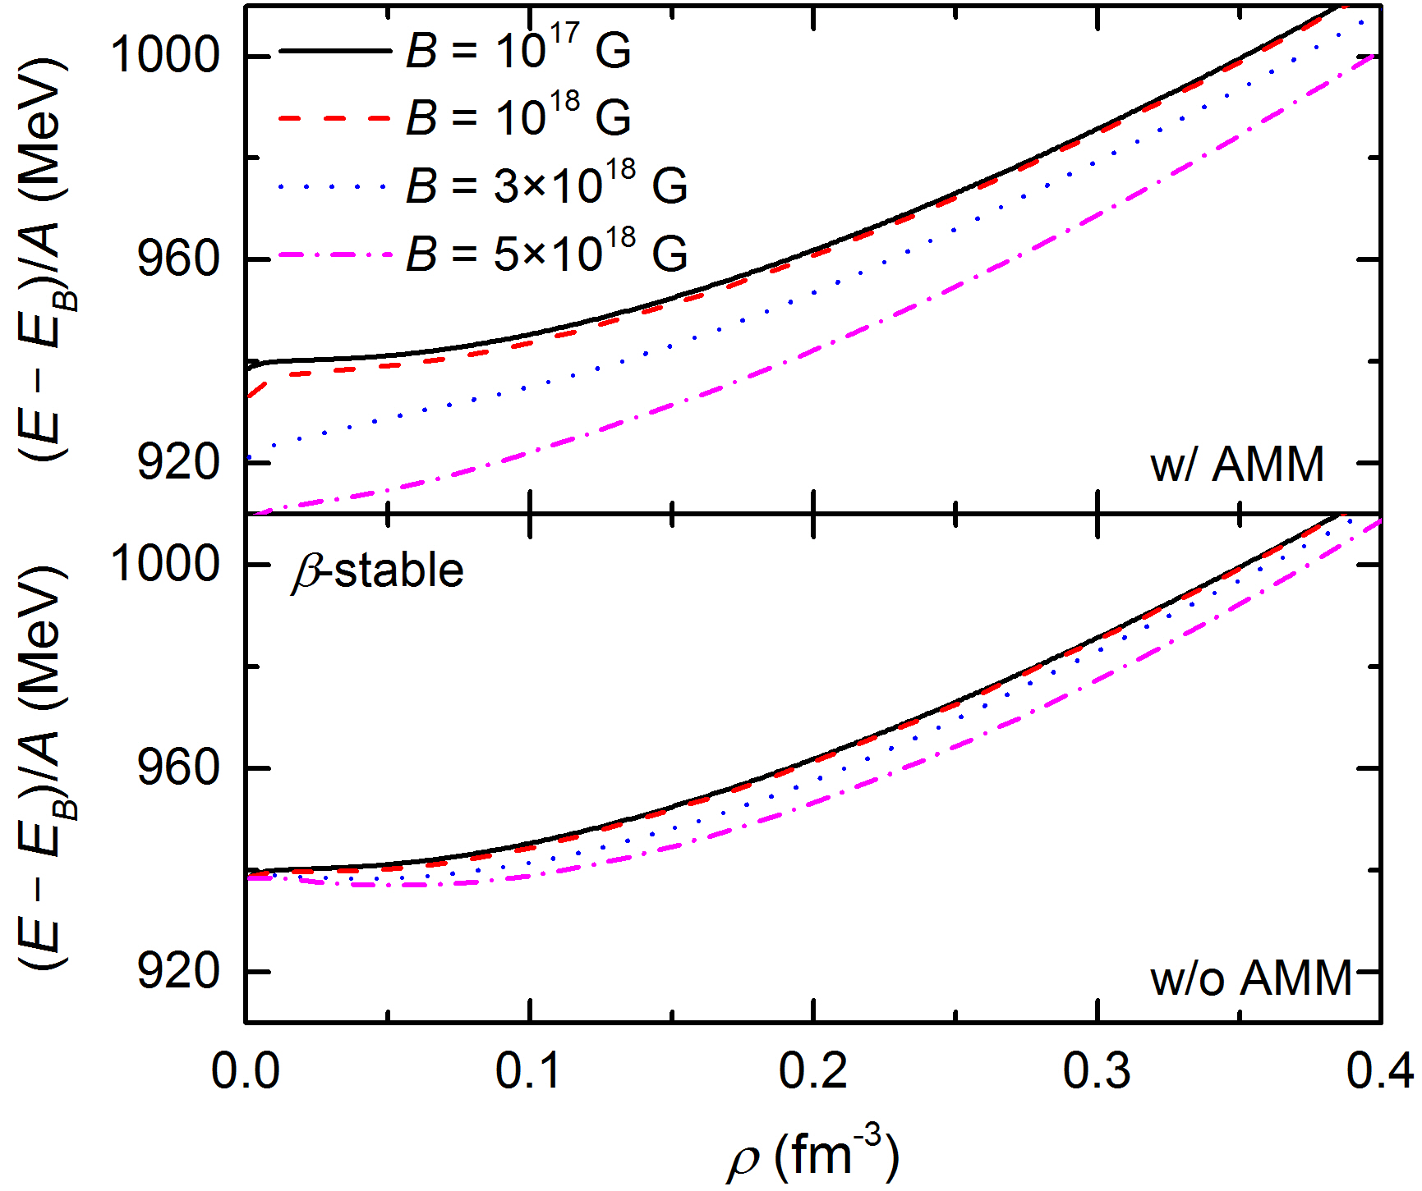
Energy per baryon
AMM is important

Slide 15
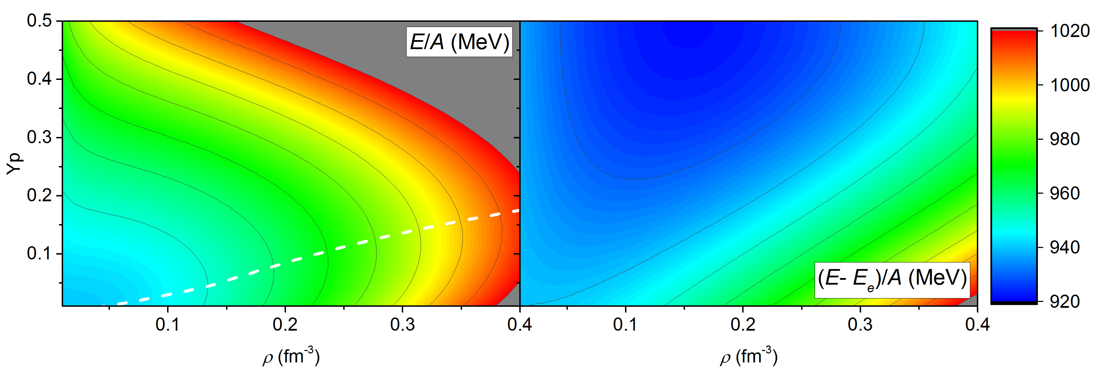
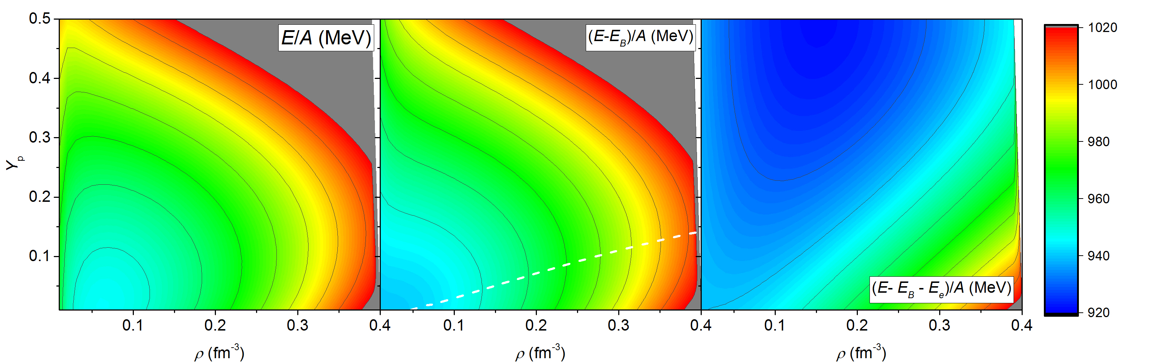
Energy per baryon (w/ AMM)
B = 0
B = 10¹⁷ G

Slide 16
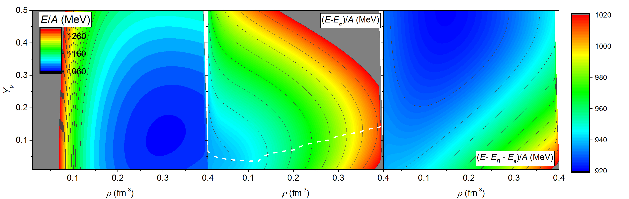
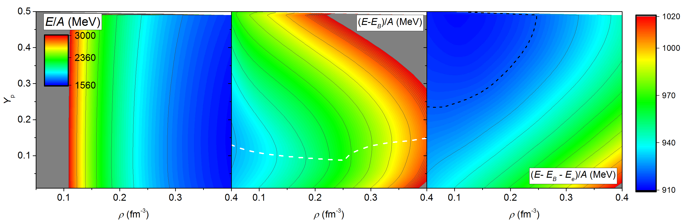
Energy per baryon (w/ AMM)
B = 10¹⁸ G
B = 3×10¹⁸ G

Slide 17
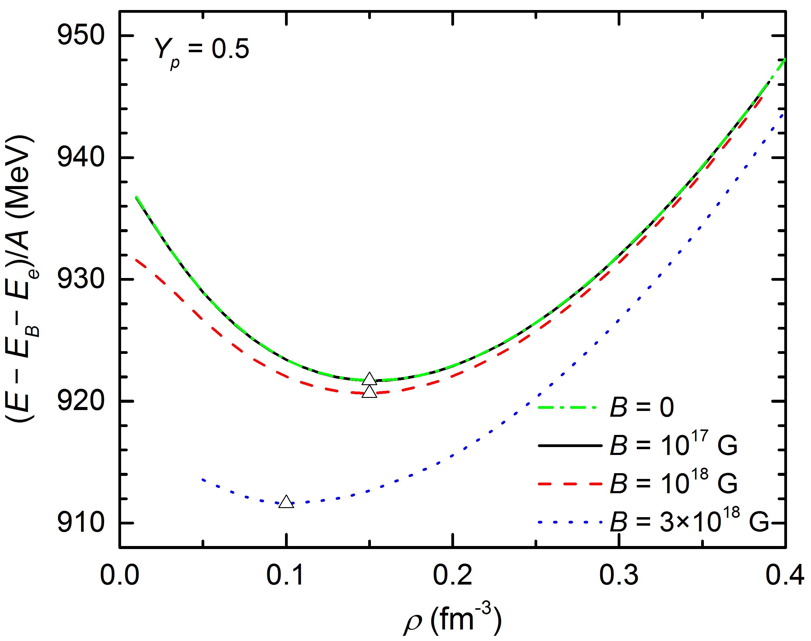
Energy per baryon (w/ AMM)

Slide 18
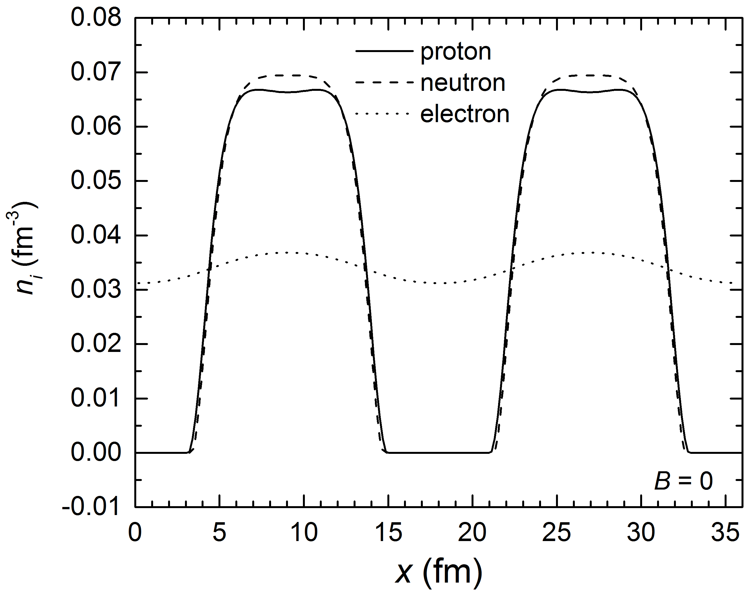
Slab phase at ρ = 0.068 fm⁻³ , Y_{p}= 0.5, and B = 0
R_{cell} = 17.907 fm
E/A = 998.6 MeV

Slide 19
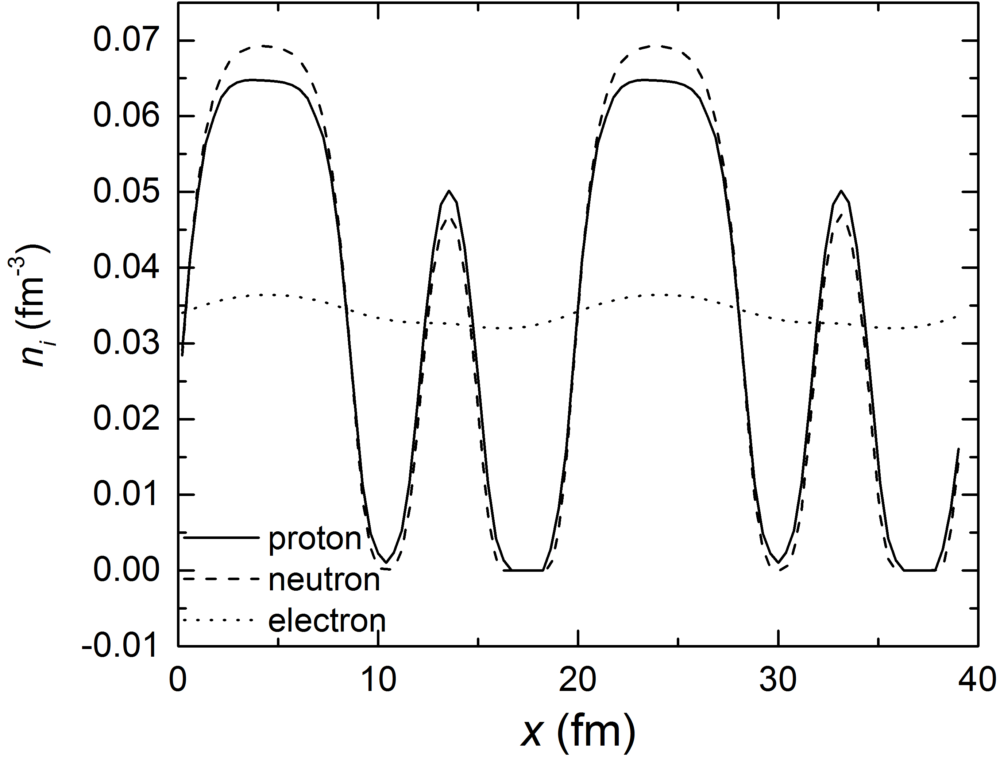
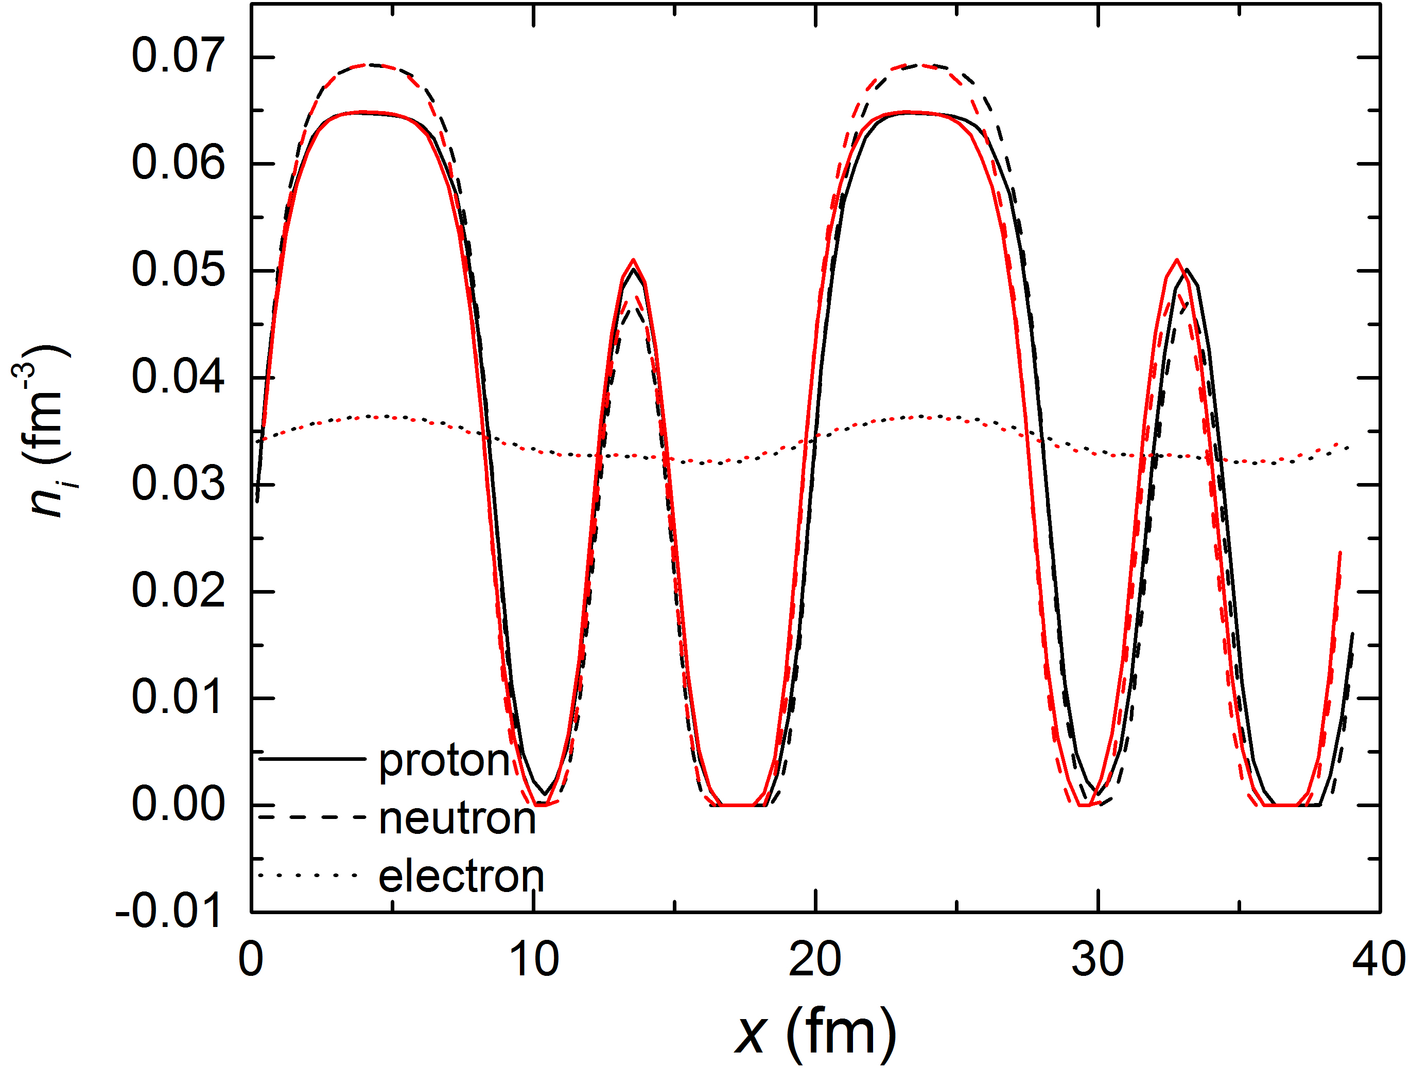
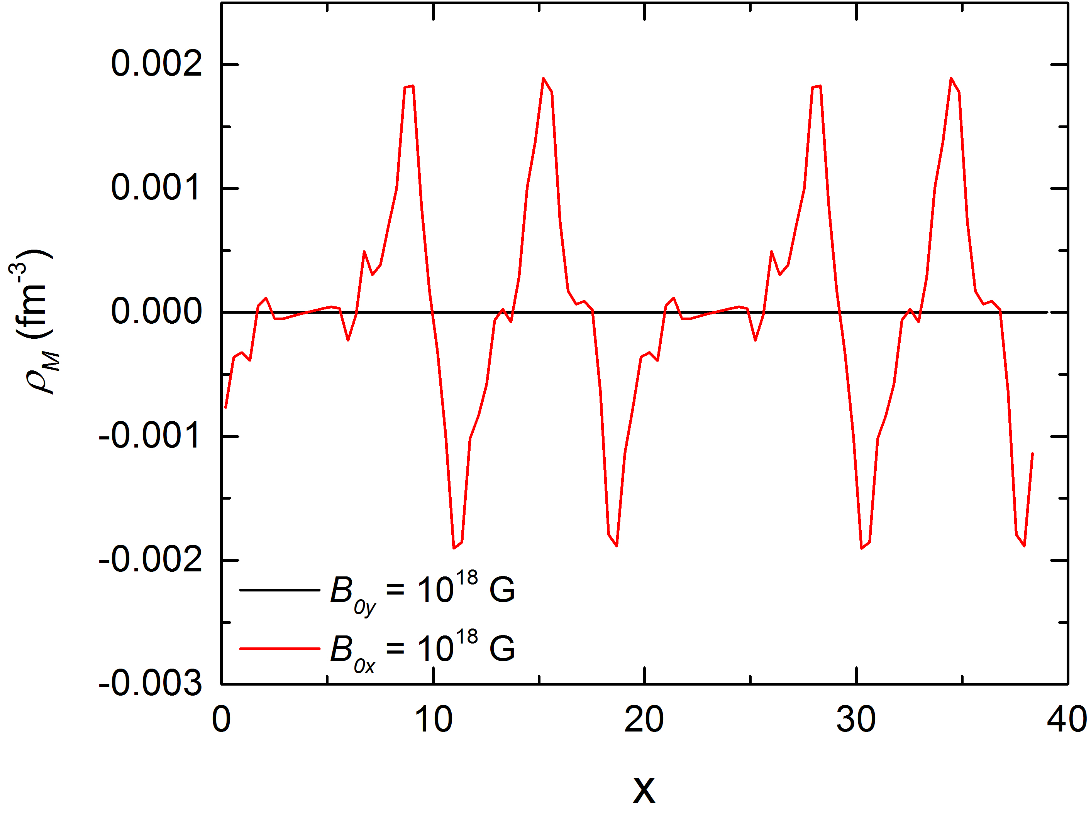
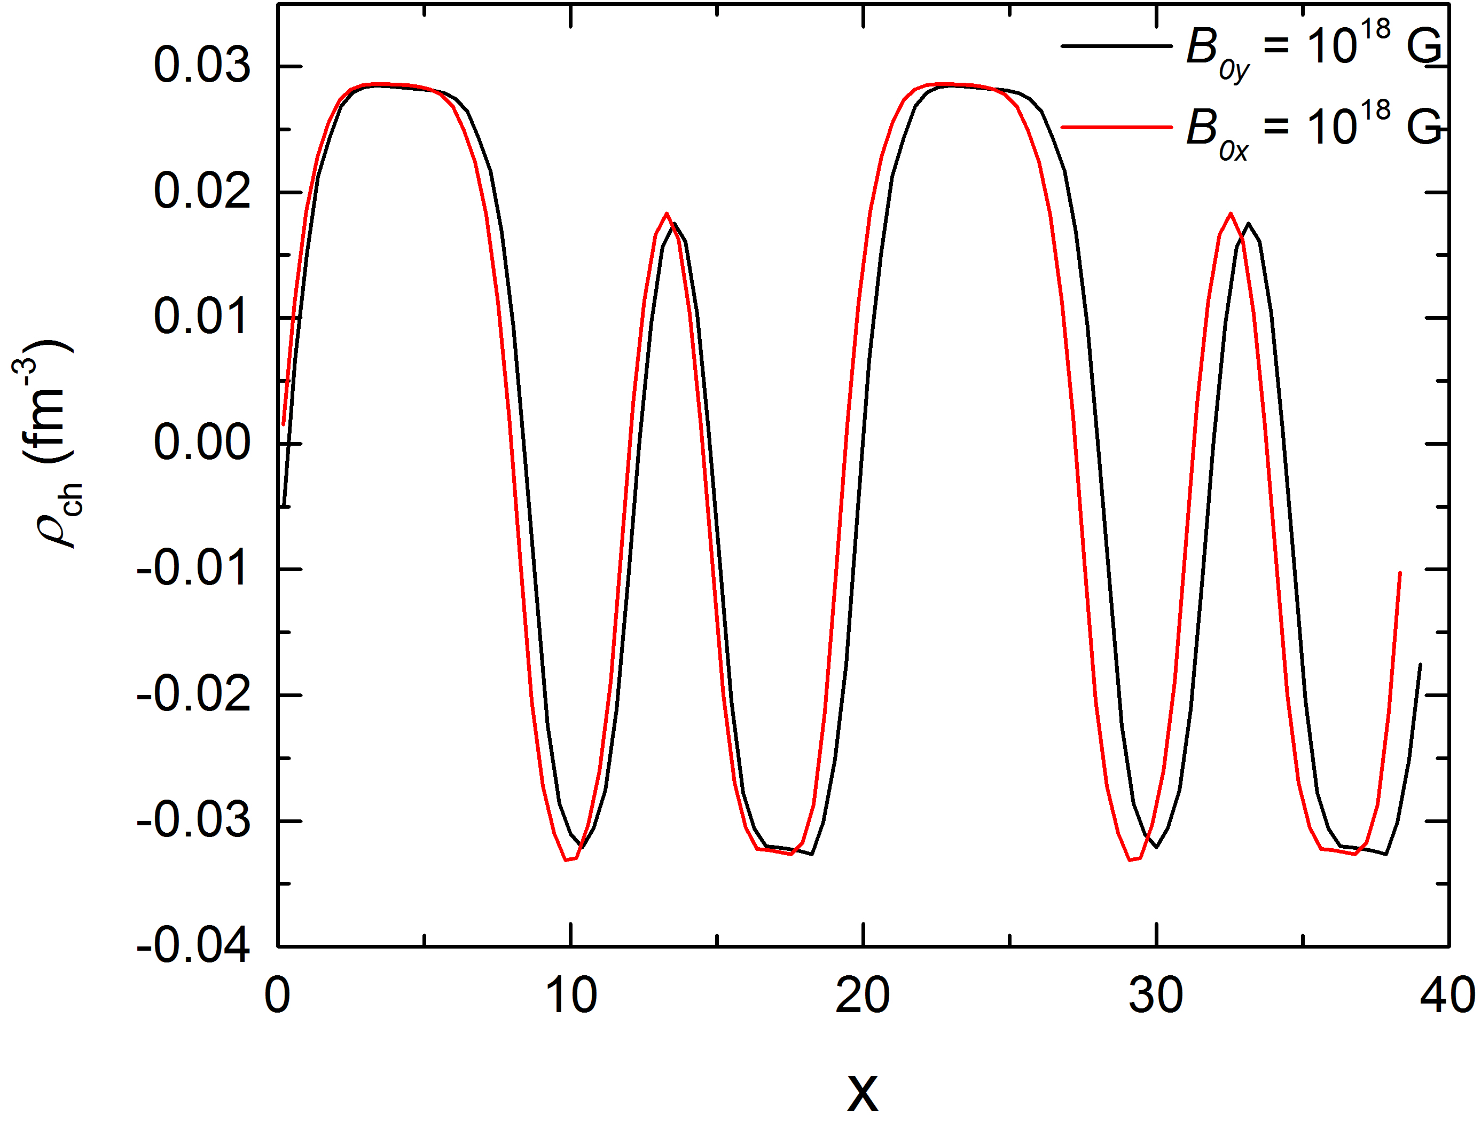
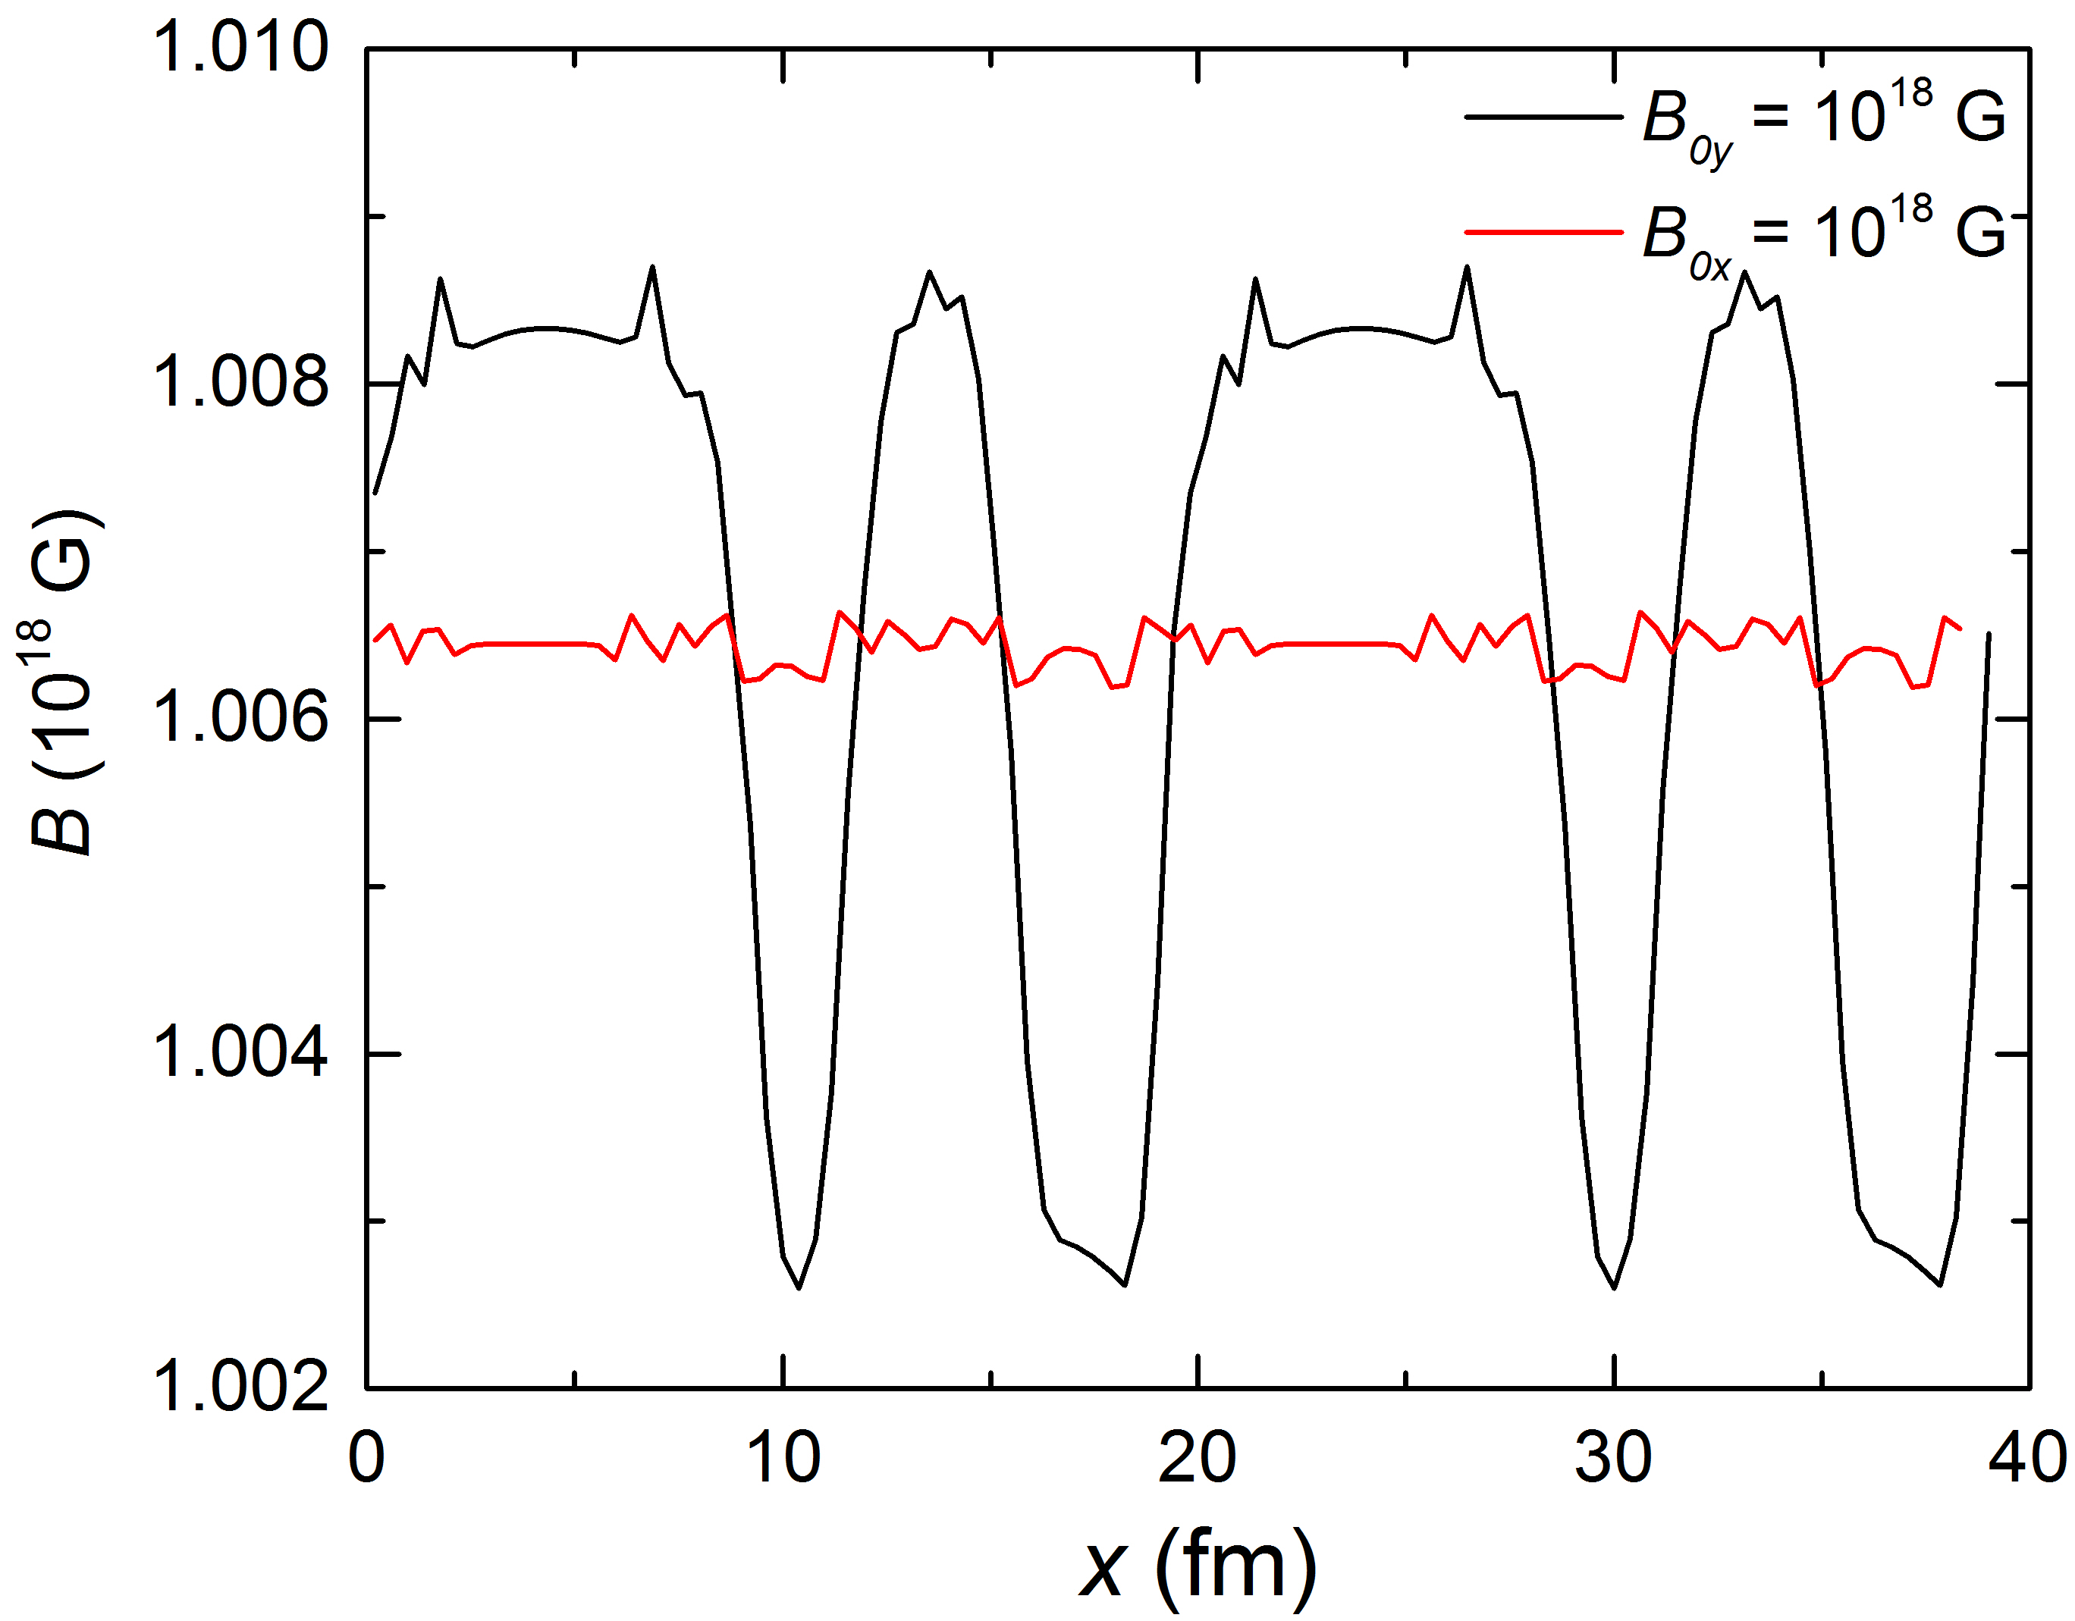
Slab phase at ρ = 0.068 fm⁻³ , Y_{p}= 0.5, and B₀ = 10¹⁸ G
B_{0y} = 10¹⁸ G
R_{cell} = 19.61 fm
E/A =1366.65 MeV
(E-E_{B})/A = 996.52 MeV
B_{0x} = 10¹⁸ G
R_{cell} = 19.26 fm
E/A =1366.62 MeV
(E-E_{B})/A = 996.54 MeV
B_{0x}
B_{0y}

Slide 20
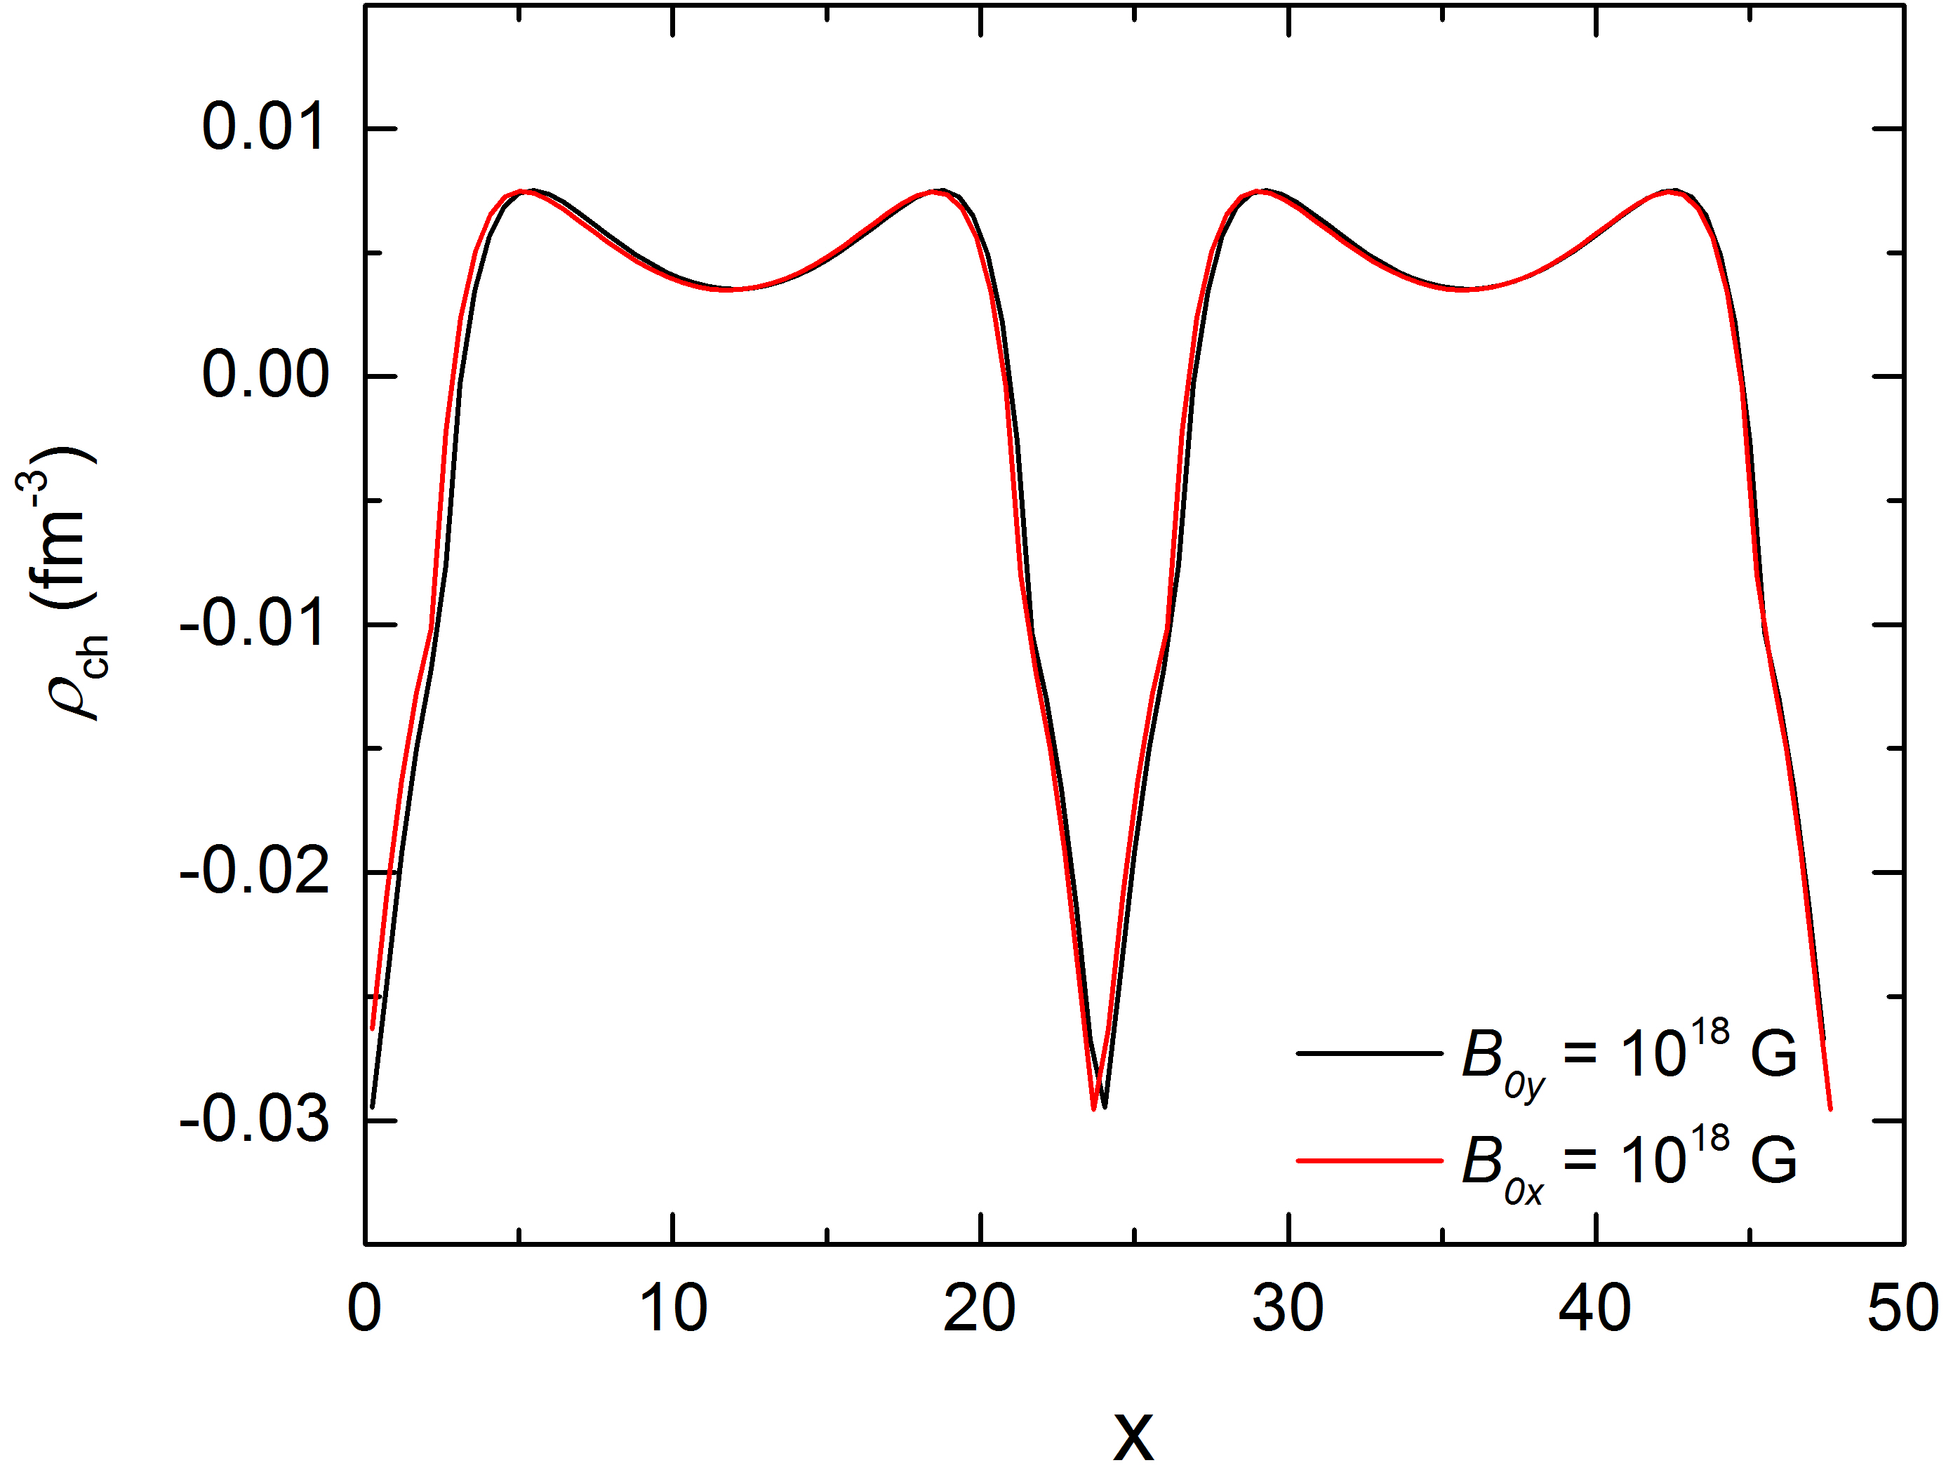
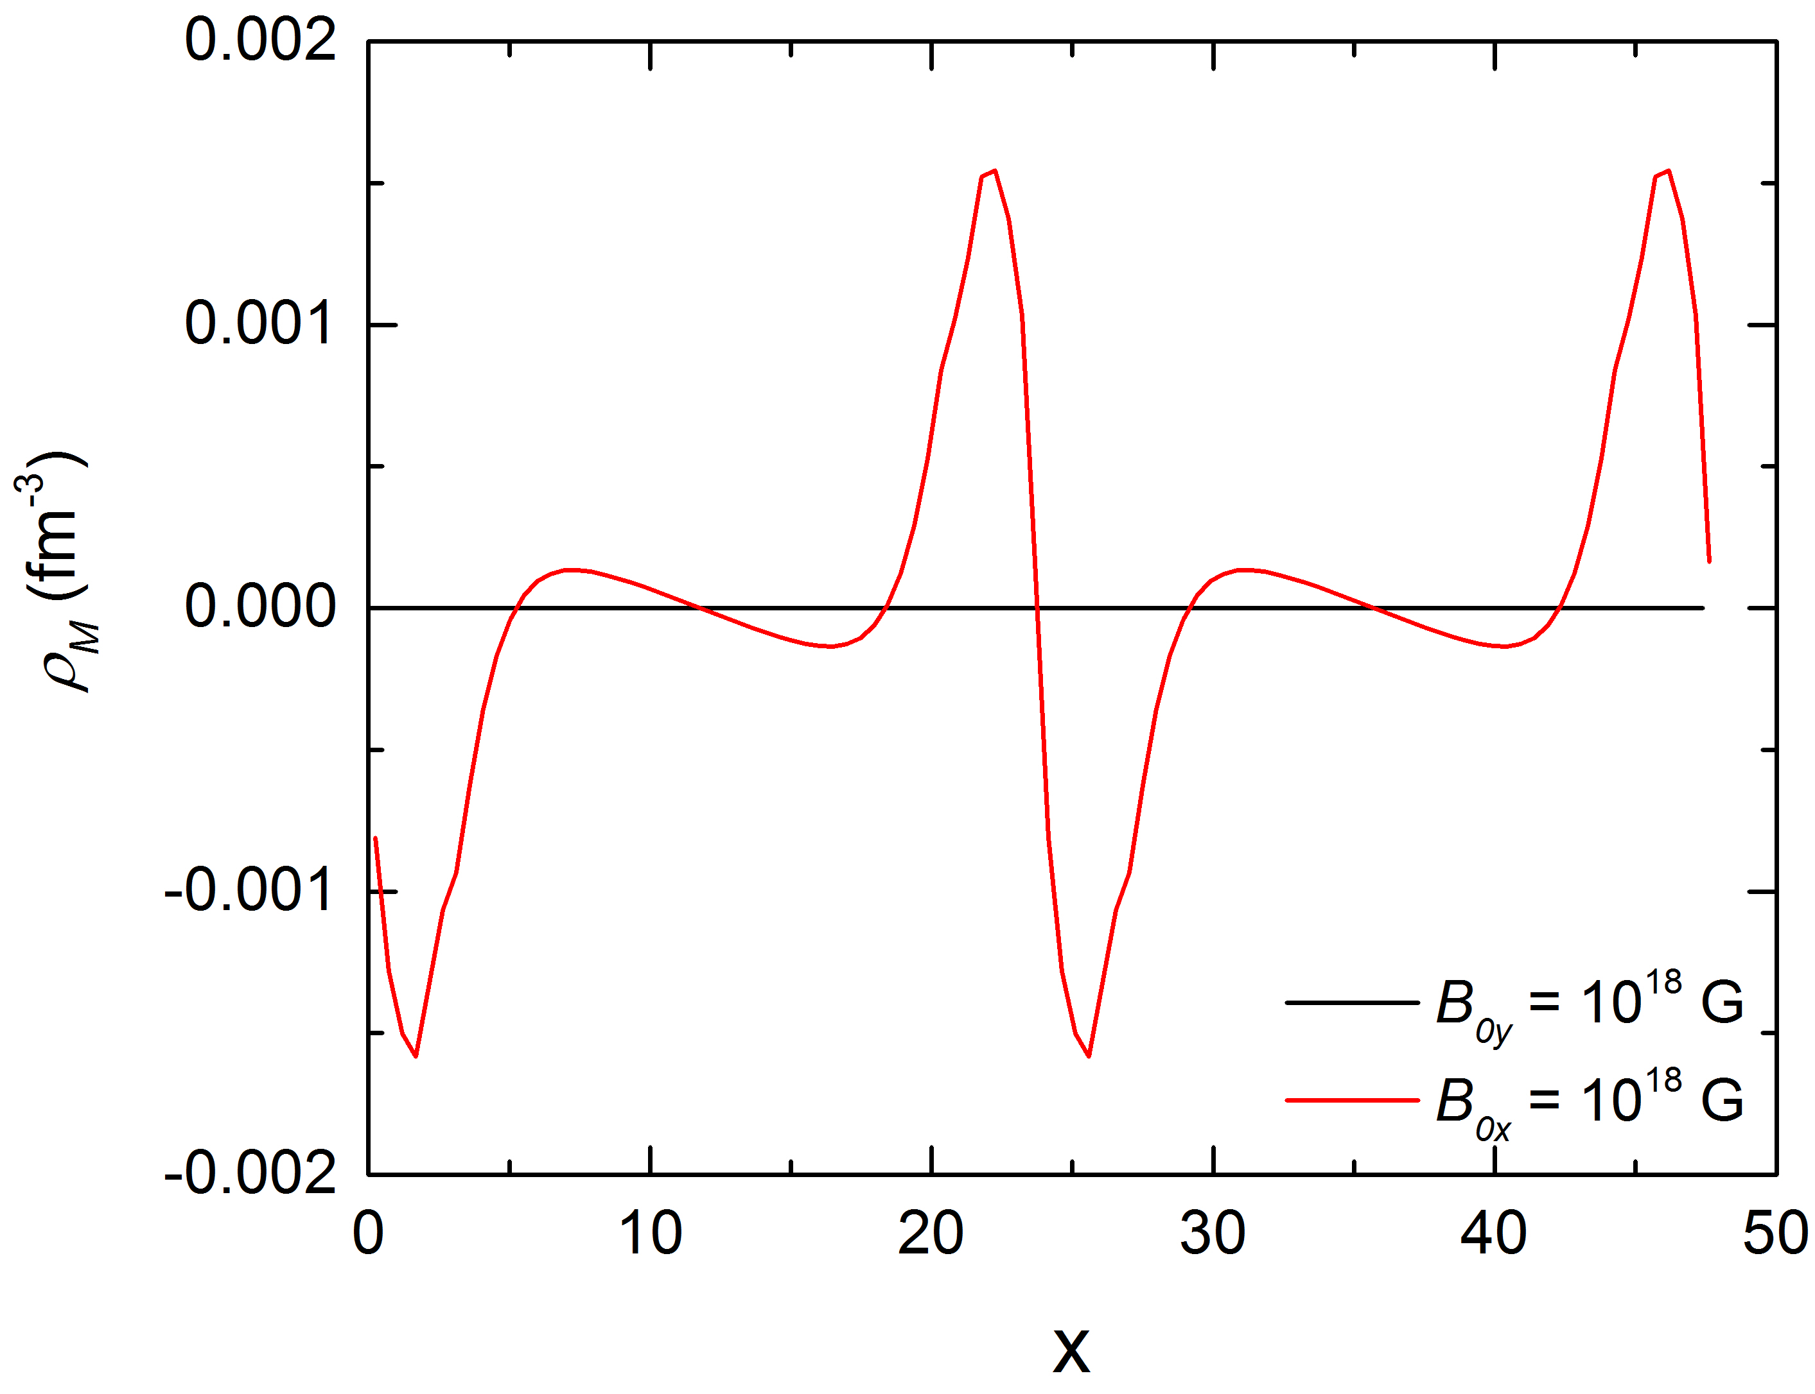
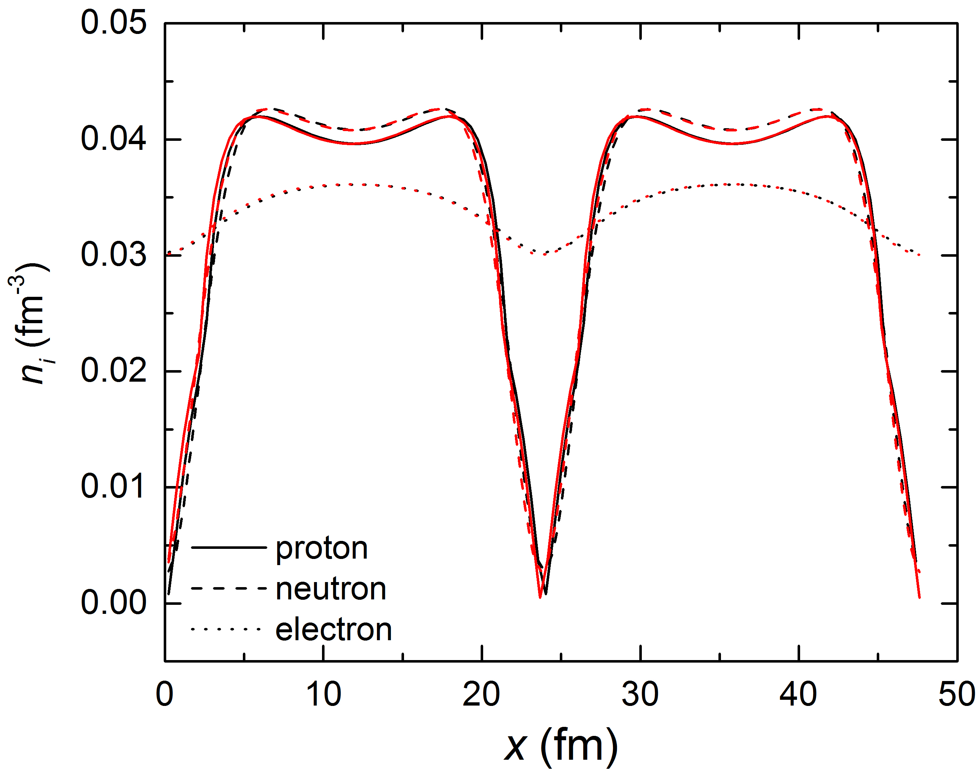
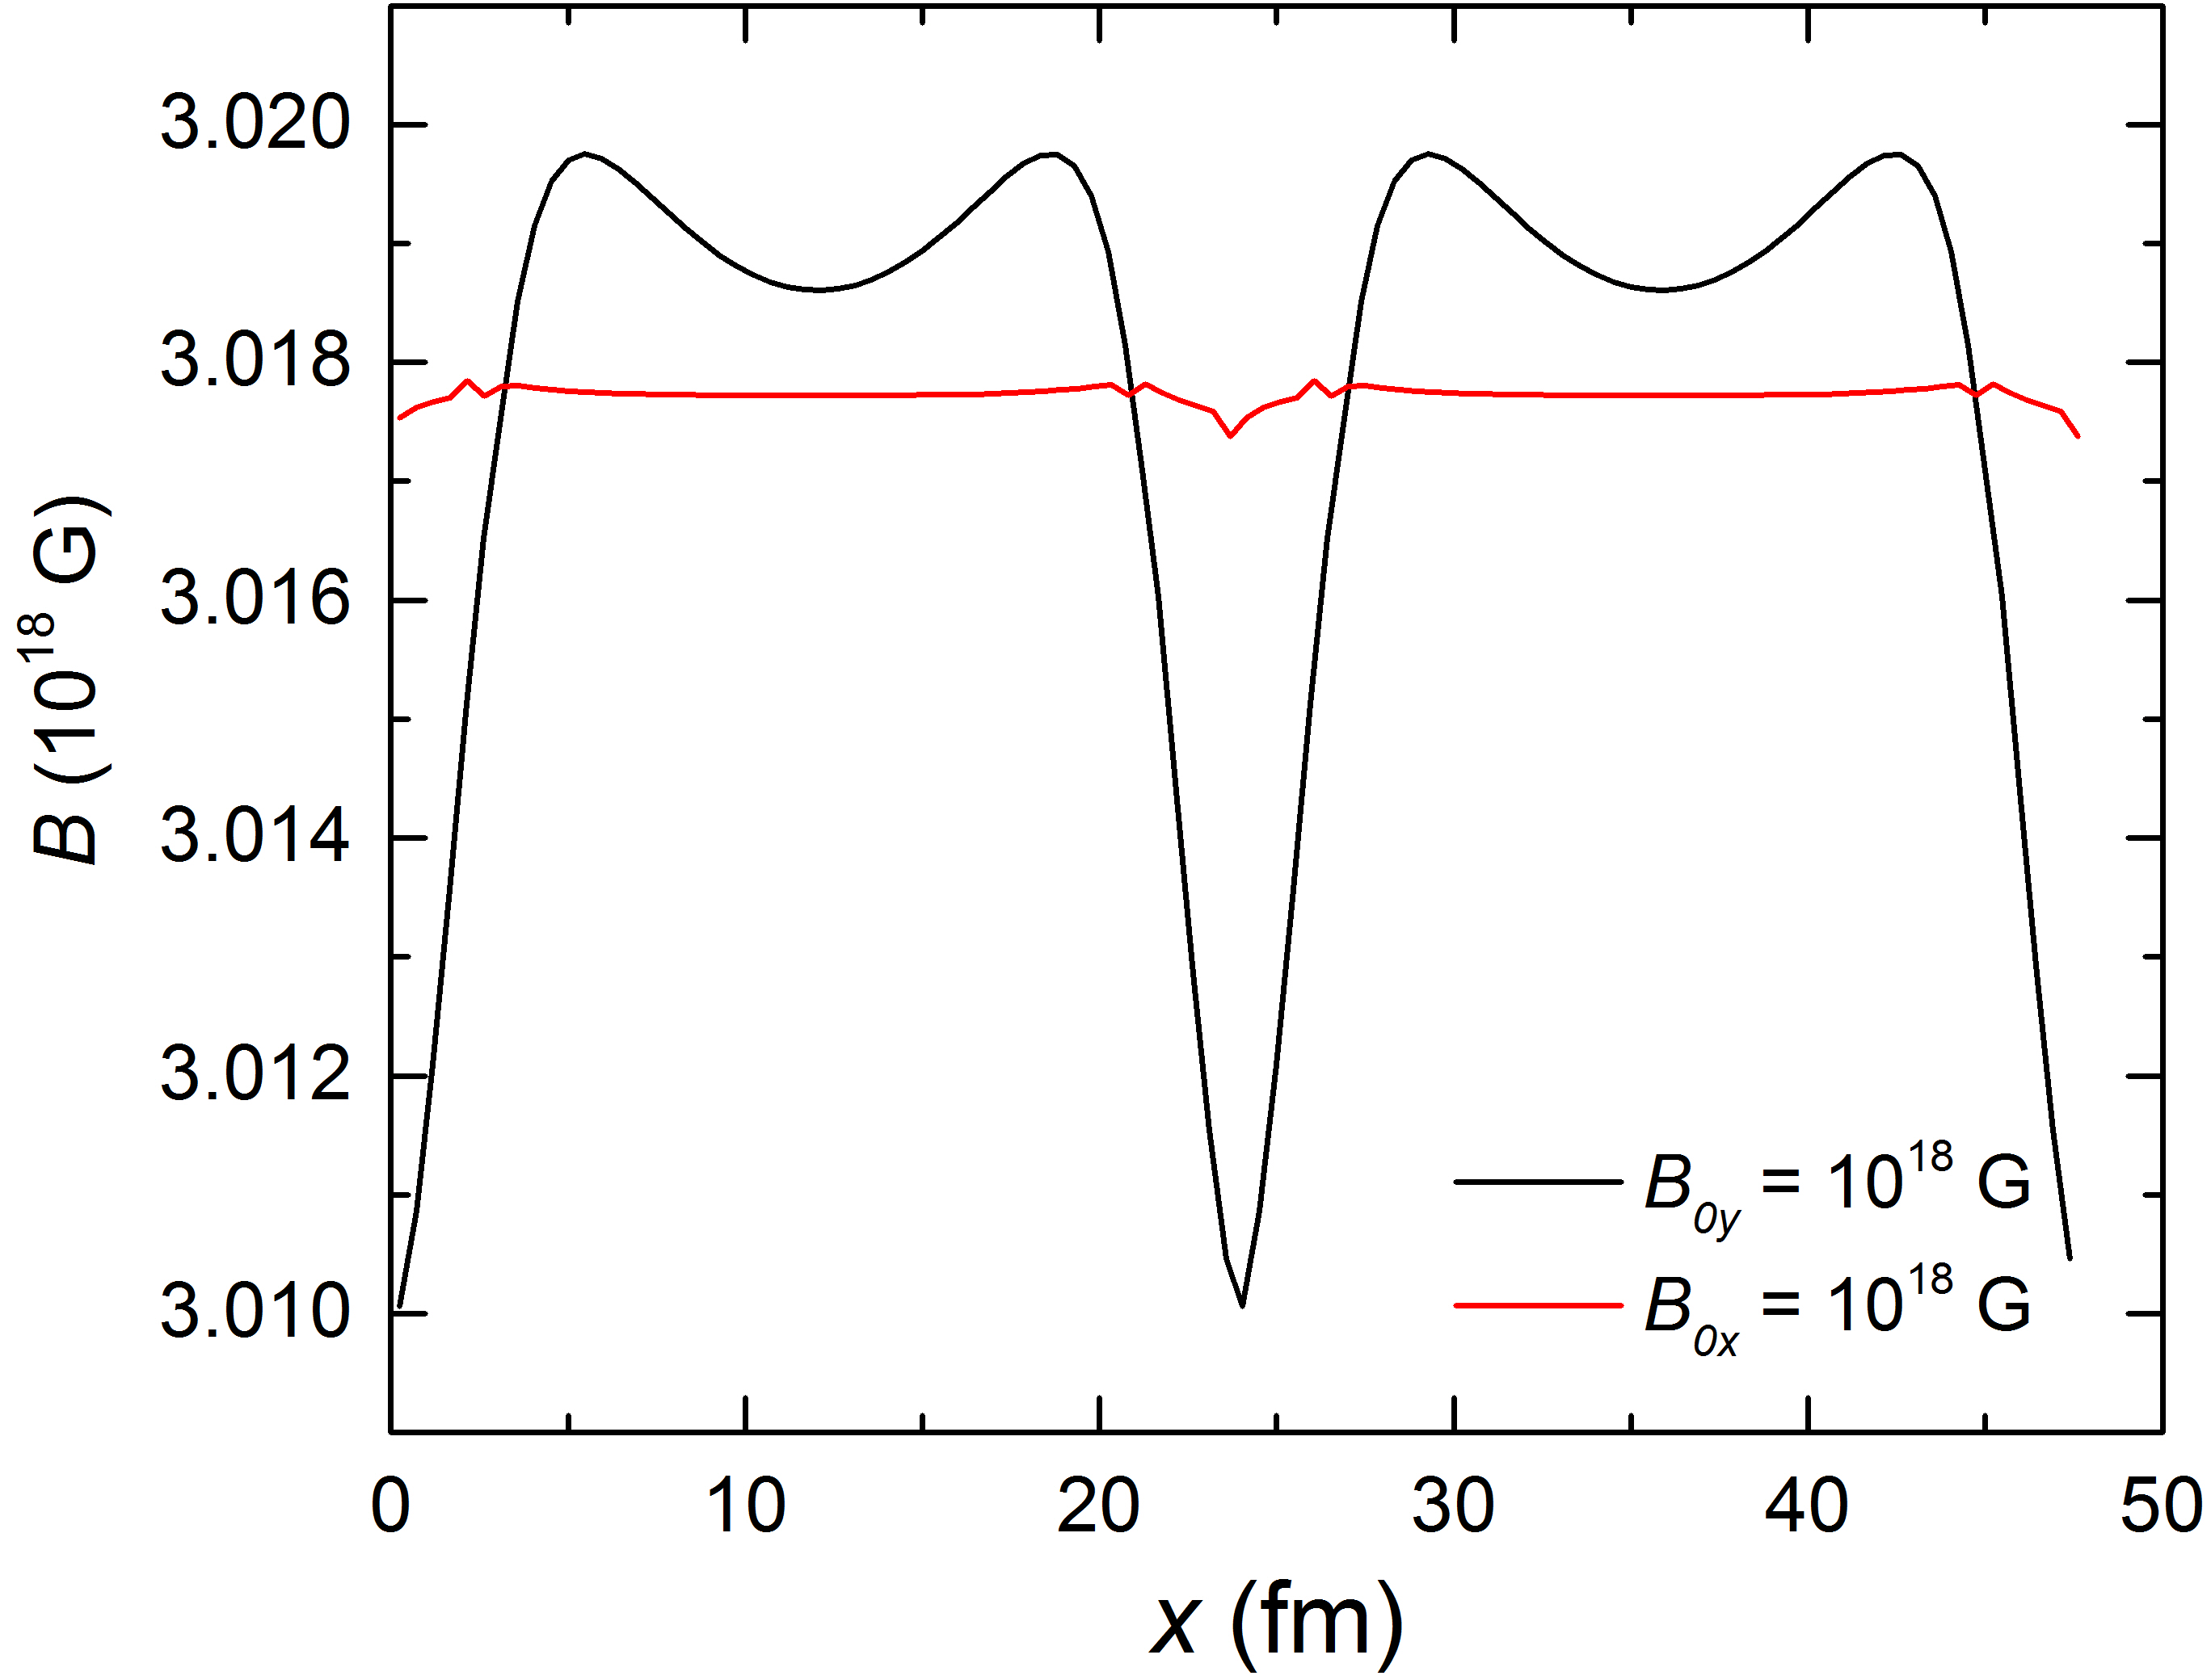
Slab phase at ρ = 0.068 fm⁻³ , Y_{p}= 0.5, and B₀ = 3×10¹⁸ G
B_{0y} = 3×10¹⁸ G
R_{cell} = 23.81 fm
E/A = 4303.41 MeV
(E-E_{B})/A = 976.236 MeV
B_{0x} = 3×10¹⁸ G
R_{cell} = 23.92 fm
E/A = 4303.43 MeV
(E-E_{B})/A = 976.241 MeV
B_{0x}
B_{0y}

Slide 21
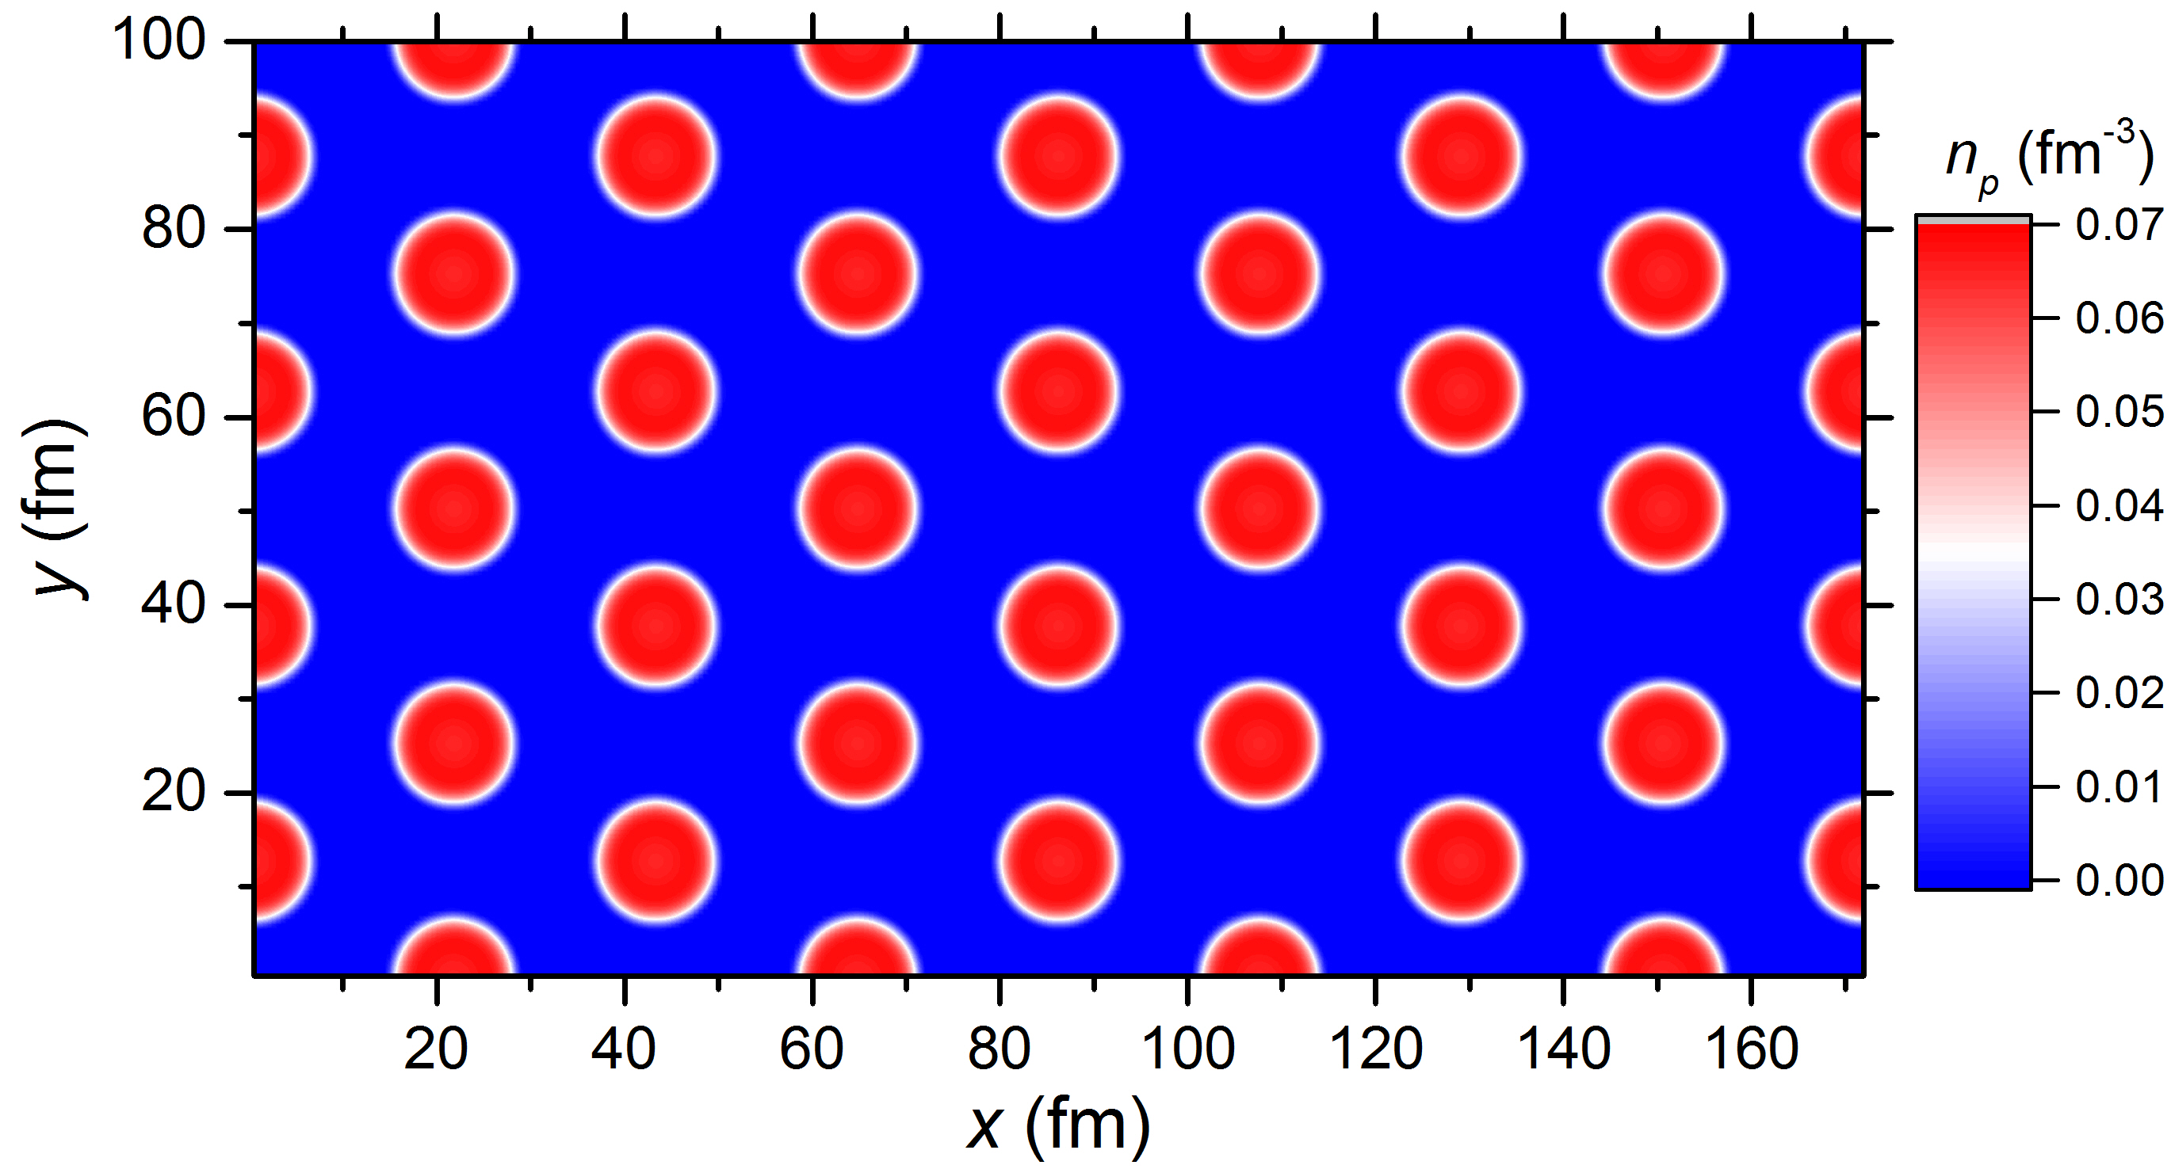
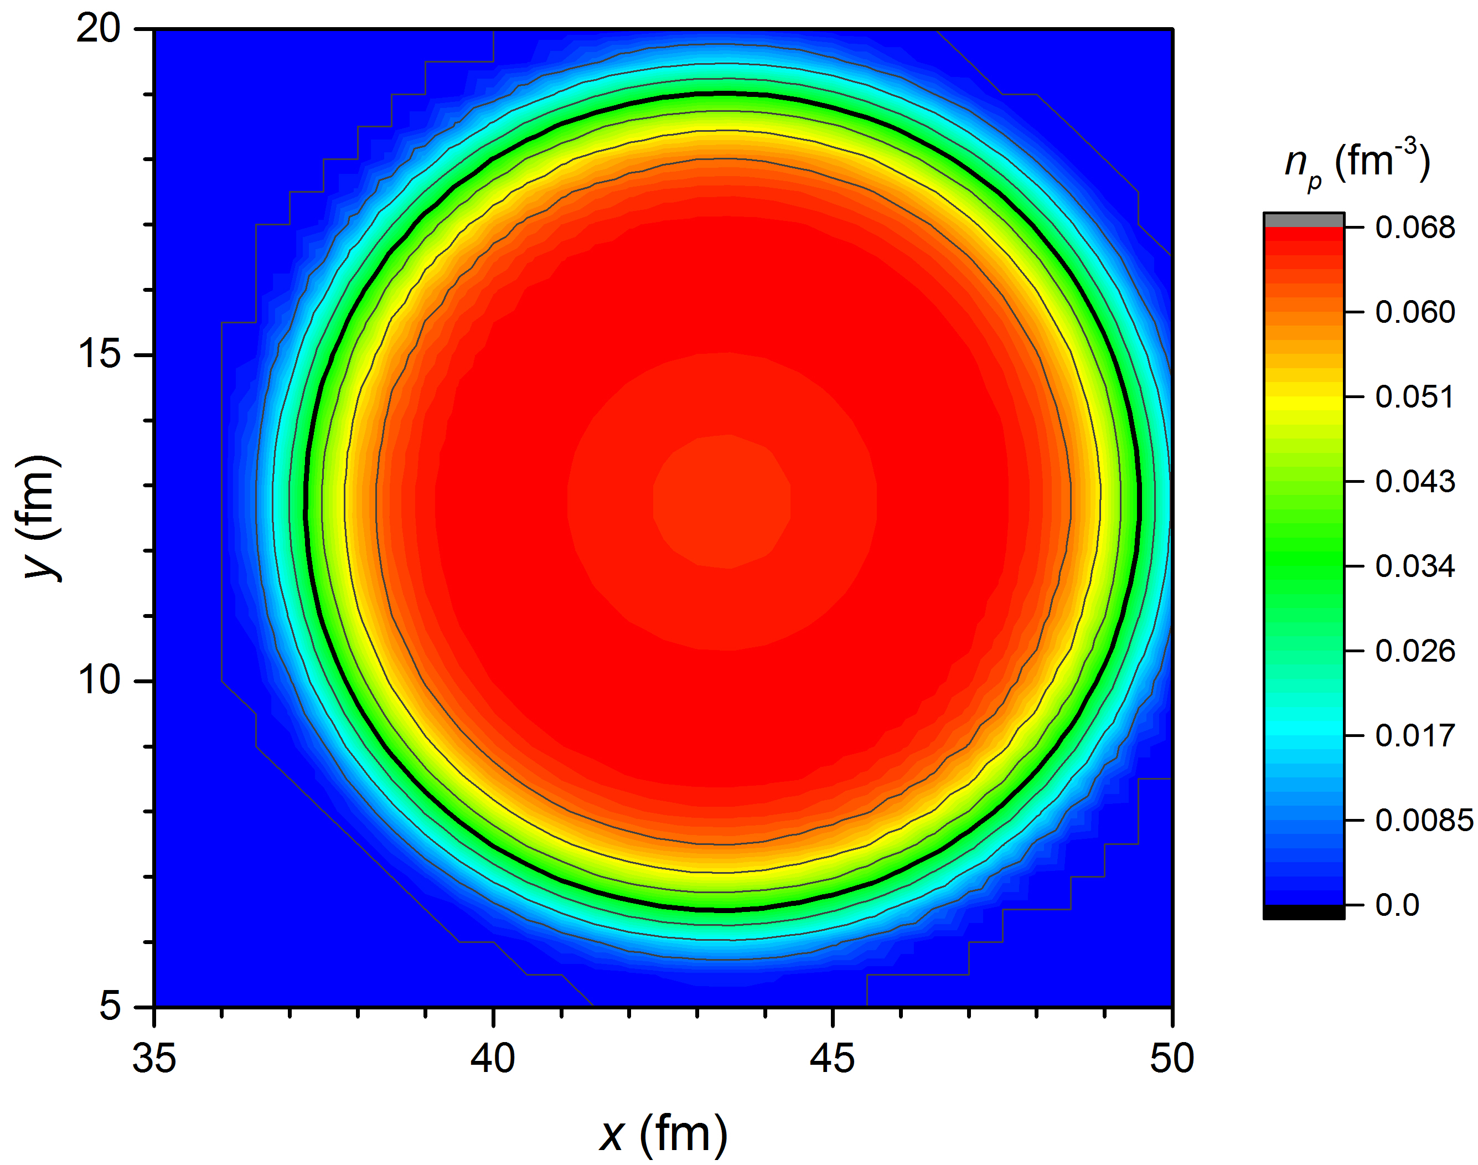
Rod phase at ρ = 0.03 fm⁻³, Y_{p}= 0.5, and B₀ = 0
12.3 fm
12.5 fm
X_{cell} = 43 fm
Y_{cell} = 25 fm
E/A = 982.757 MeV

Slide 22
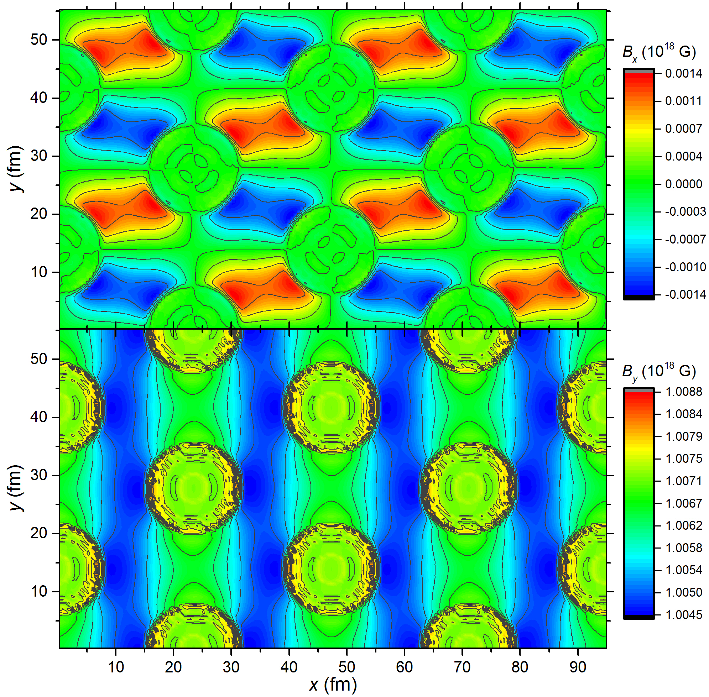
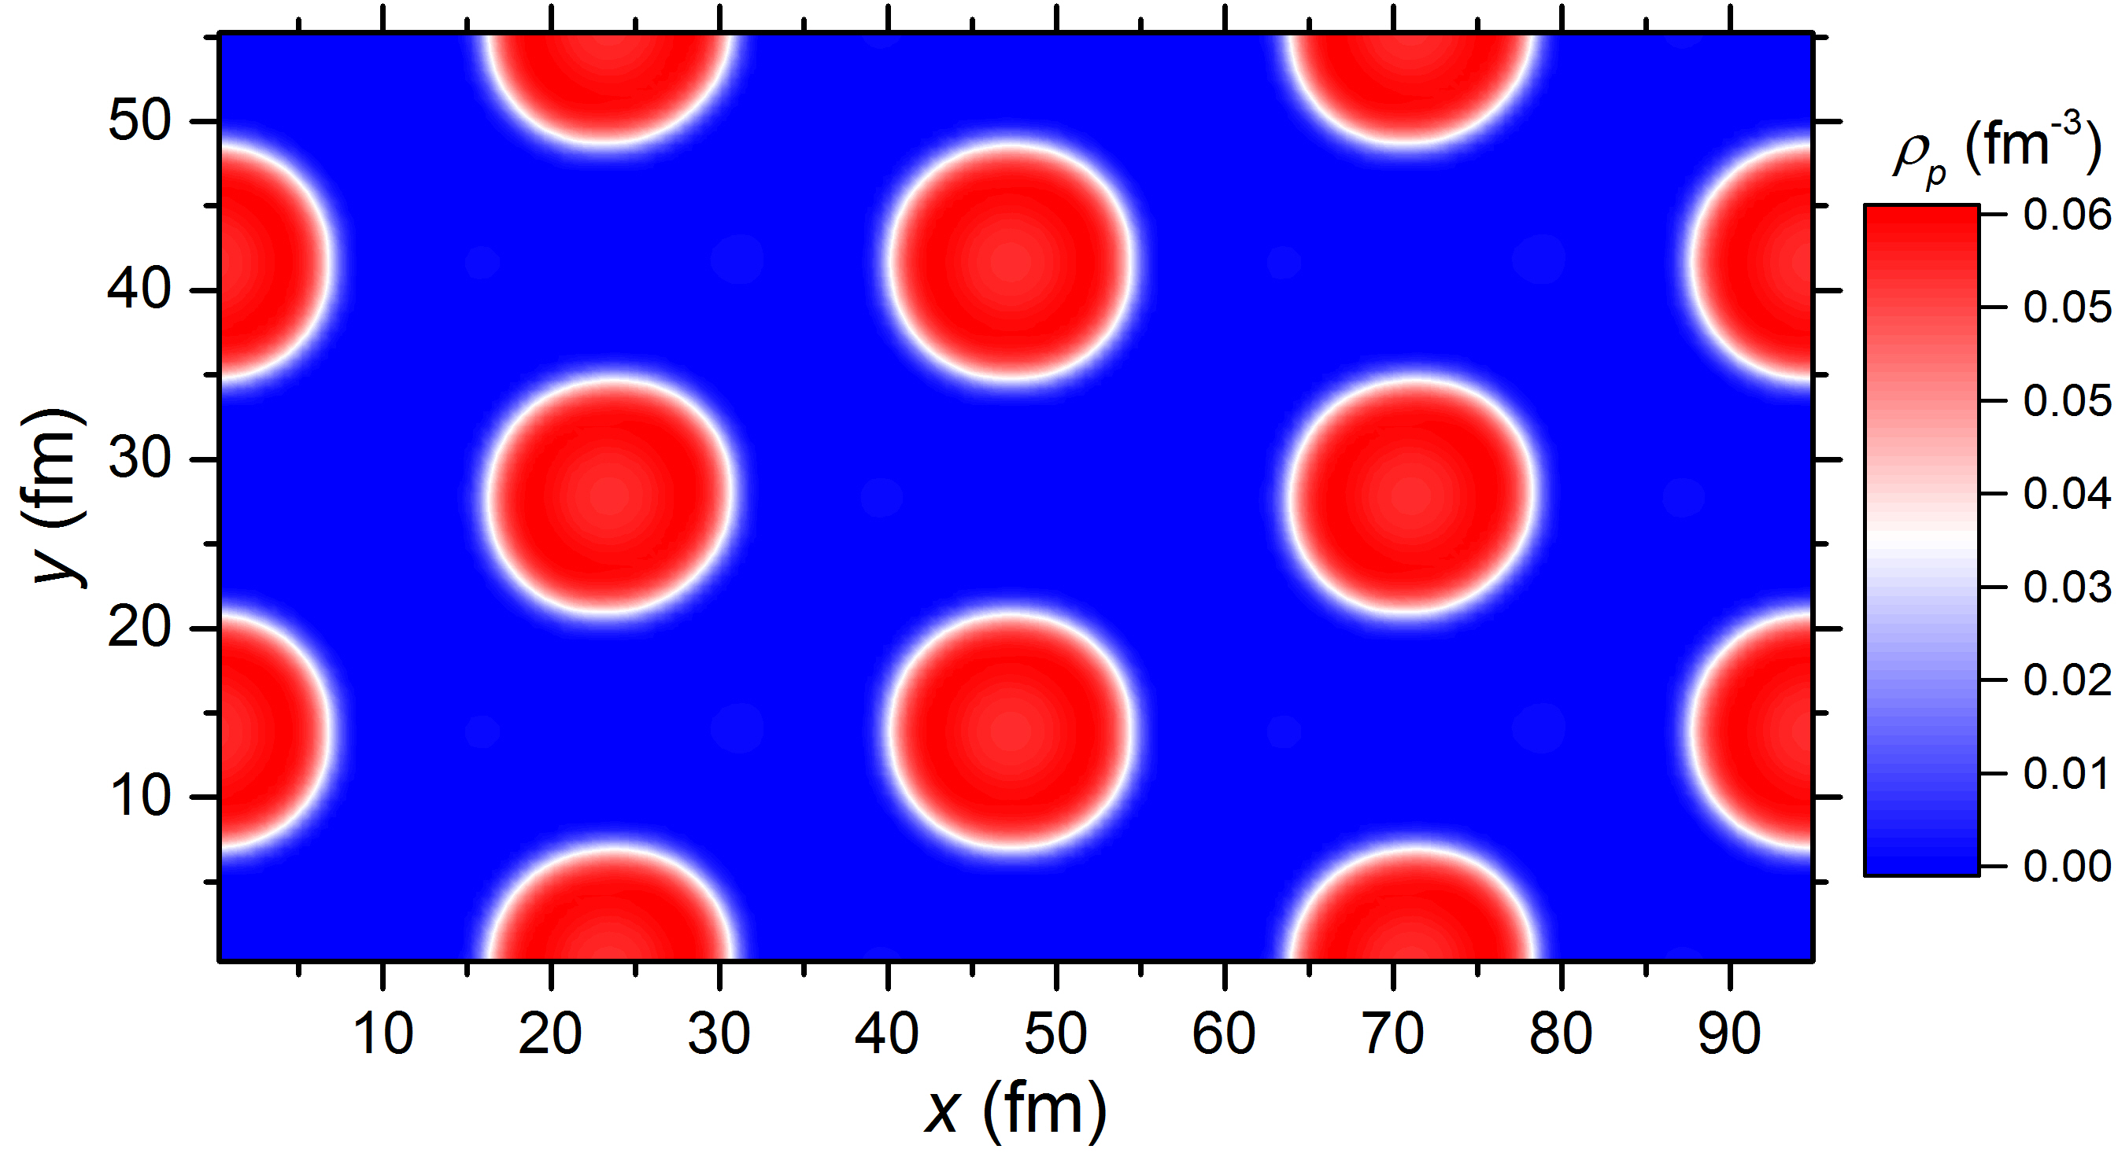
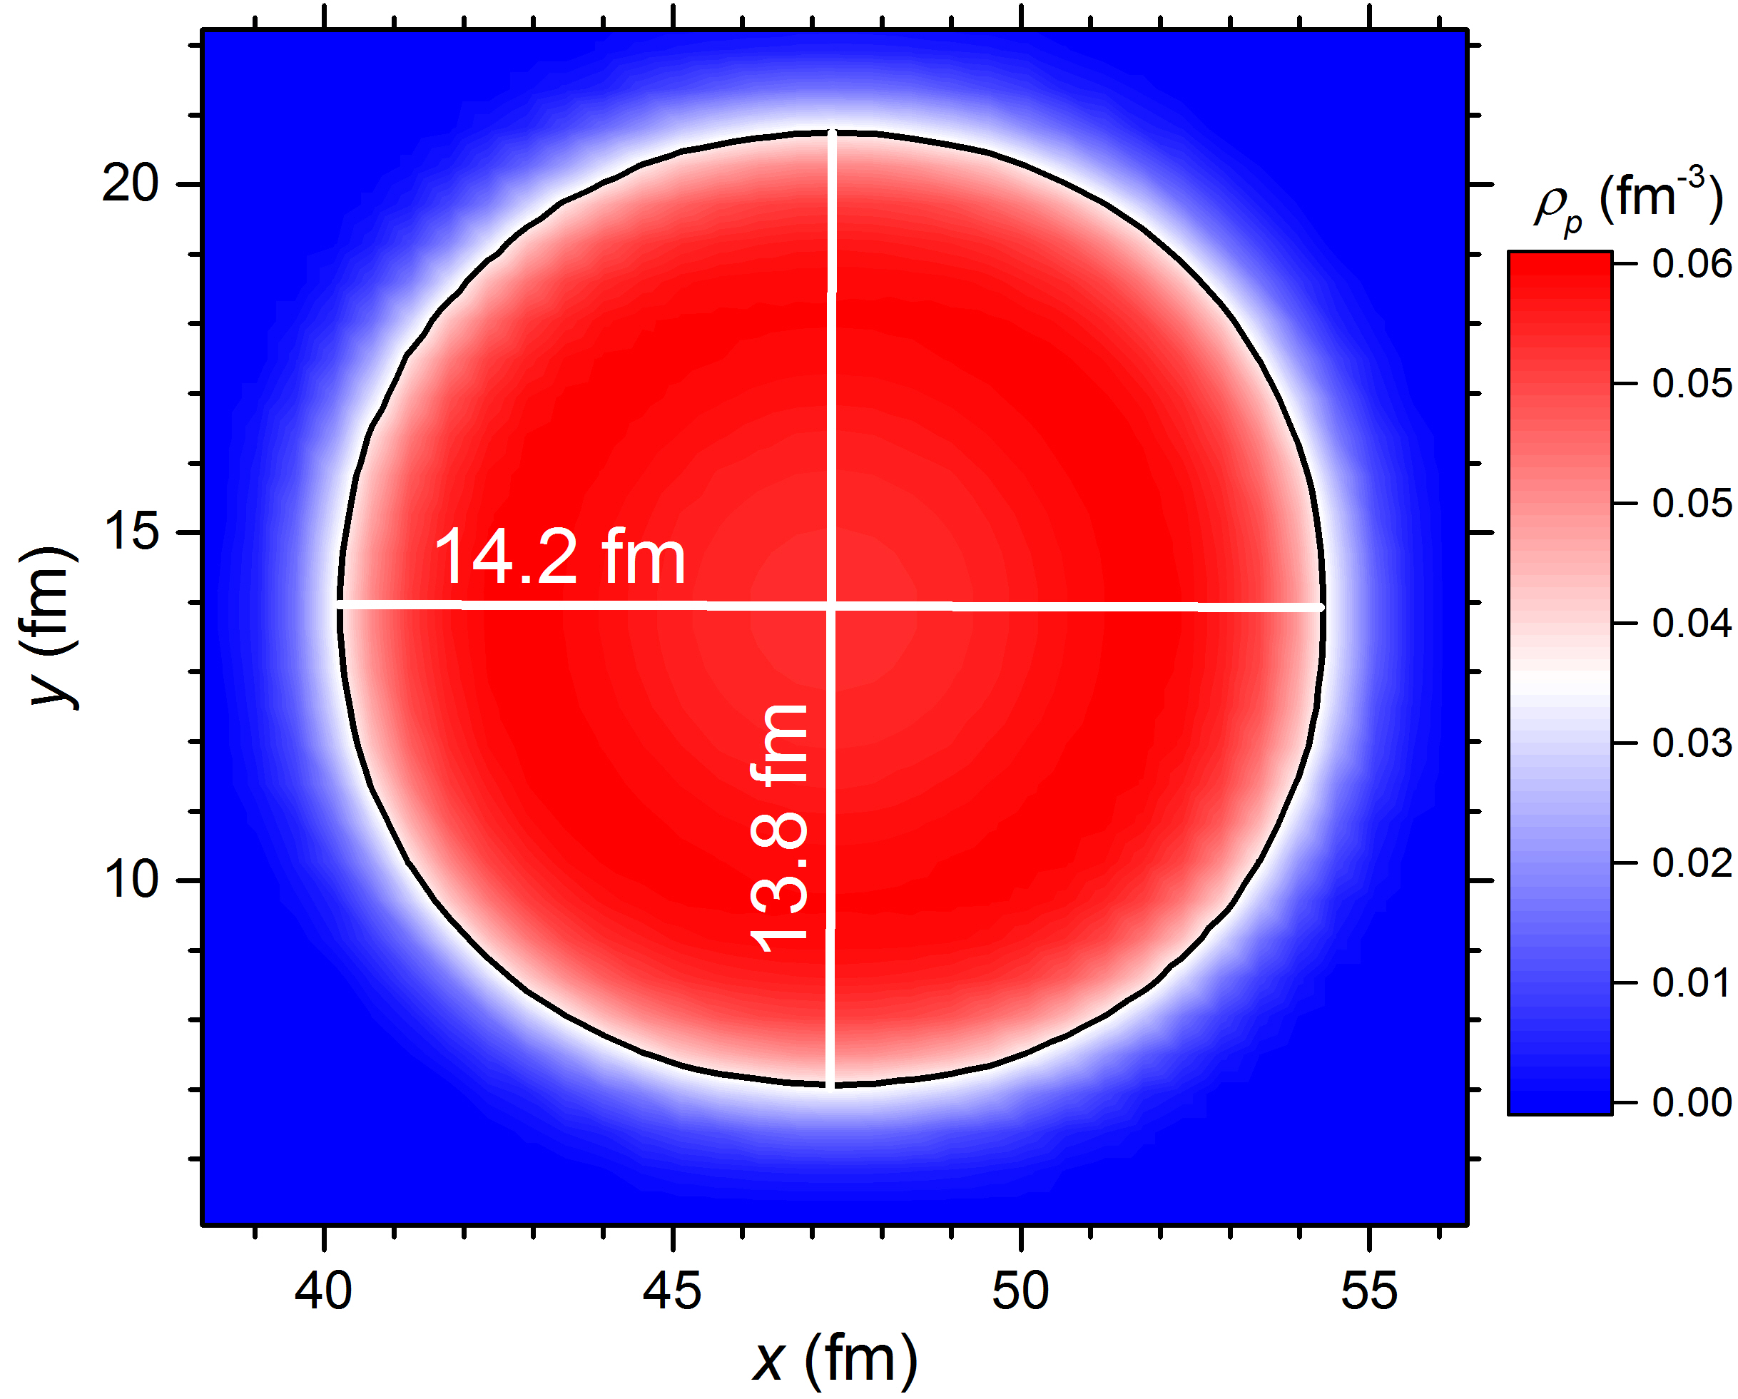
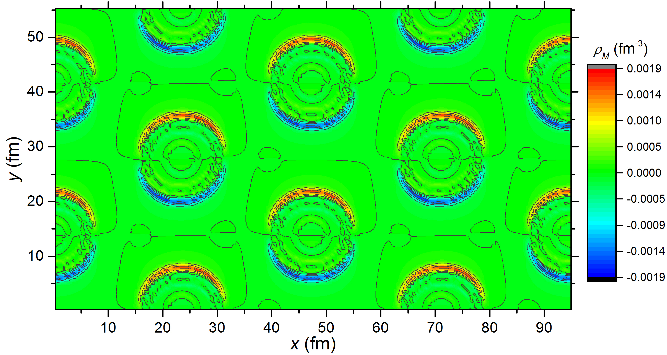
Rod phase at ρ = 0.03 fm⁻³, Y_{p}= 0.5, and B_{0y} = 10¹⁸ G
B_{0y} = 10¹⁸ G
X_{cell} = 47.61 fm
Y_{cell} = 27.76 fm
E/A = 1816.626 MeV
(E-E_{B})/A = 978.250 MeV

Slide 23
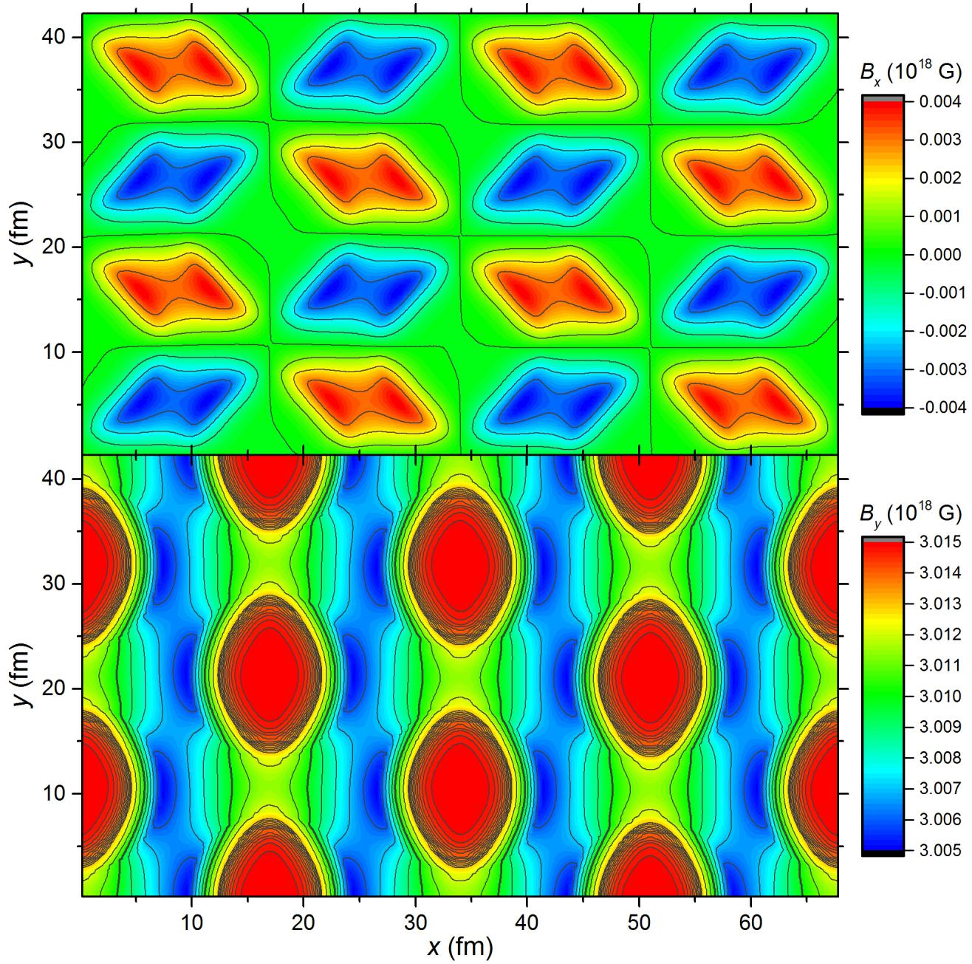
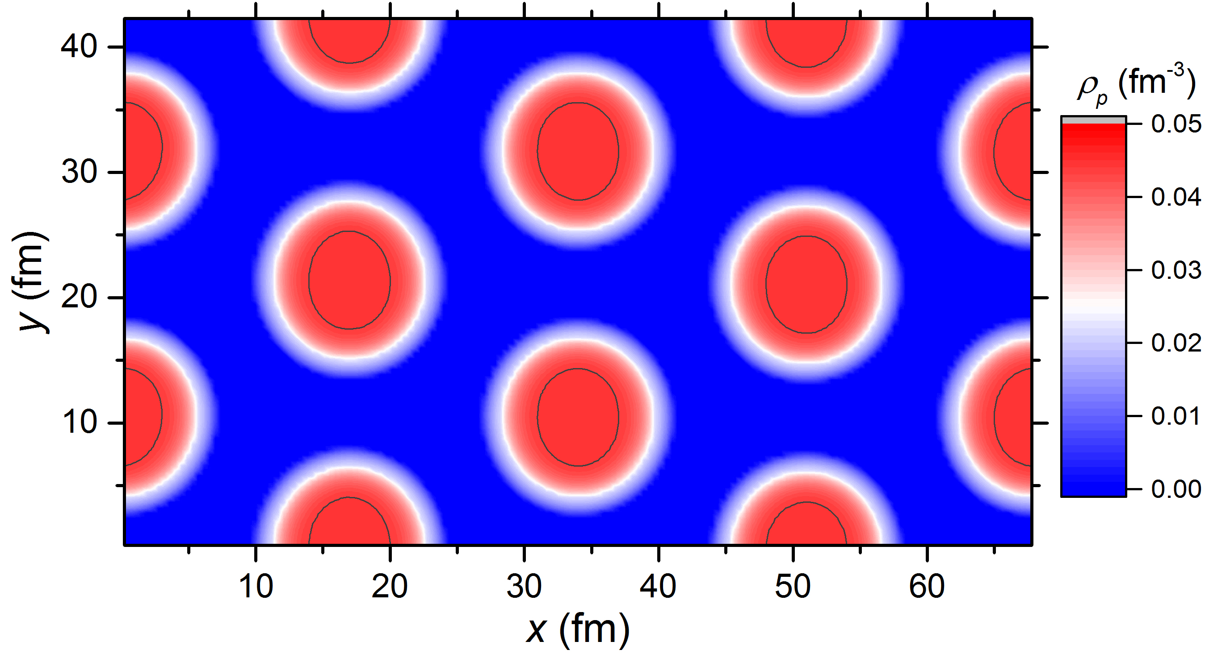
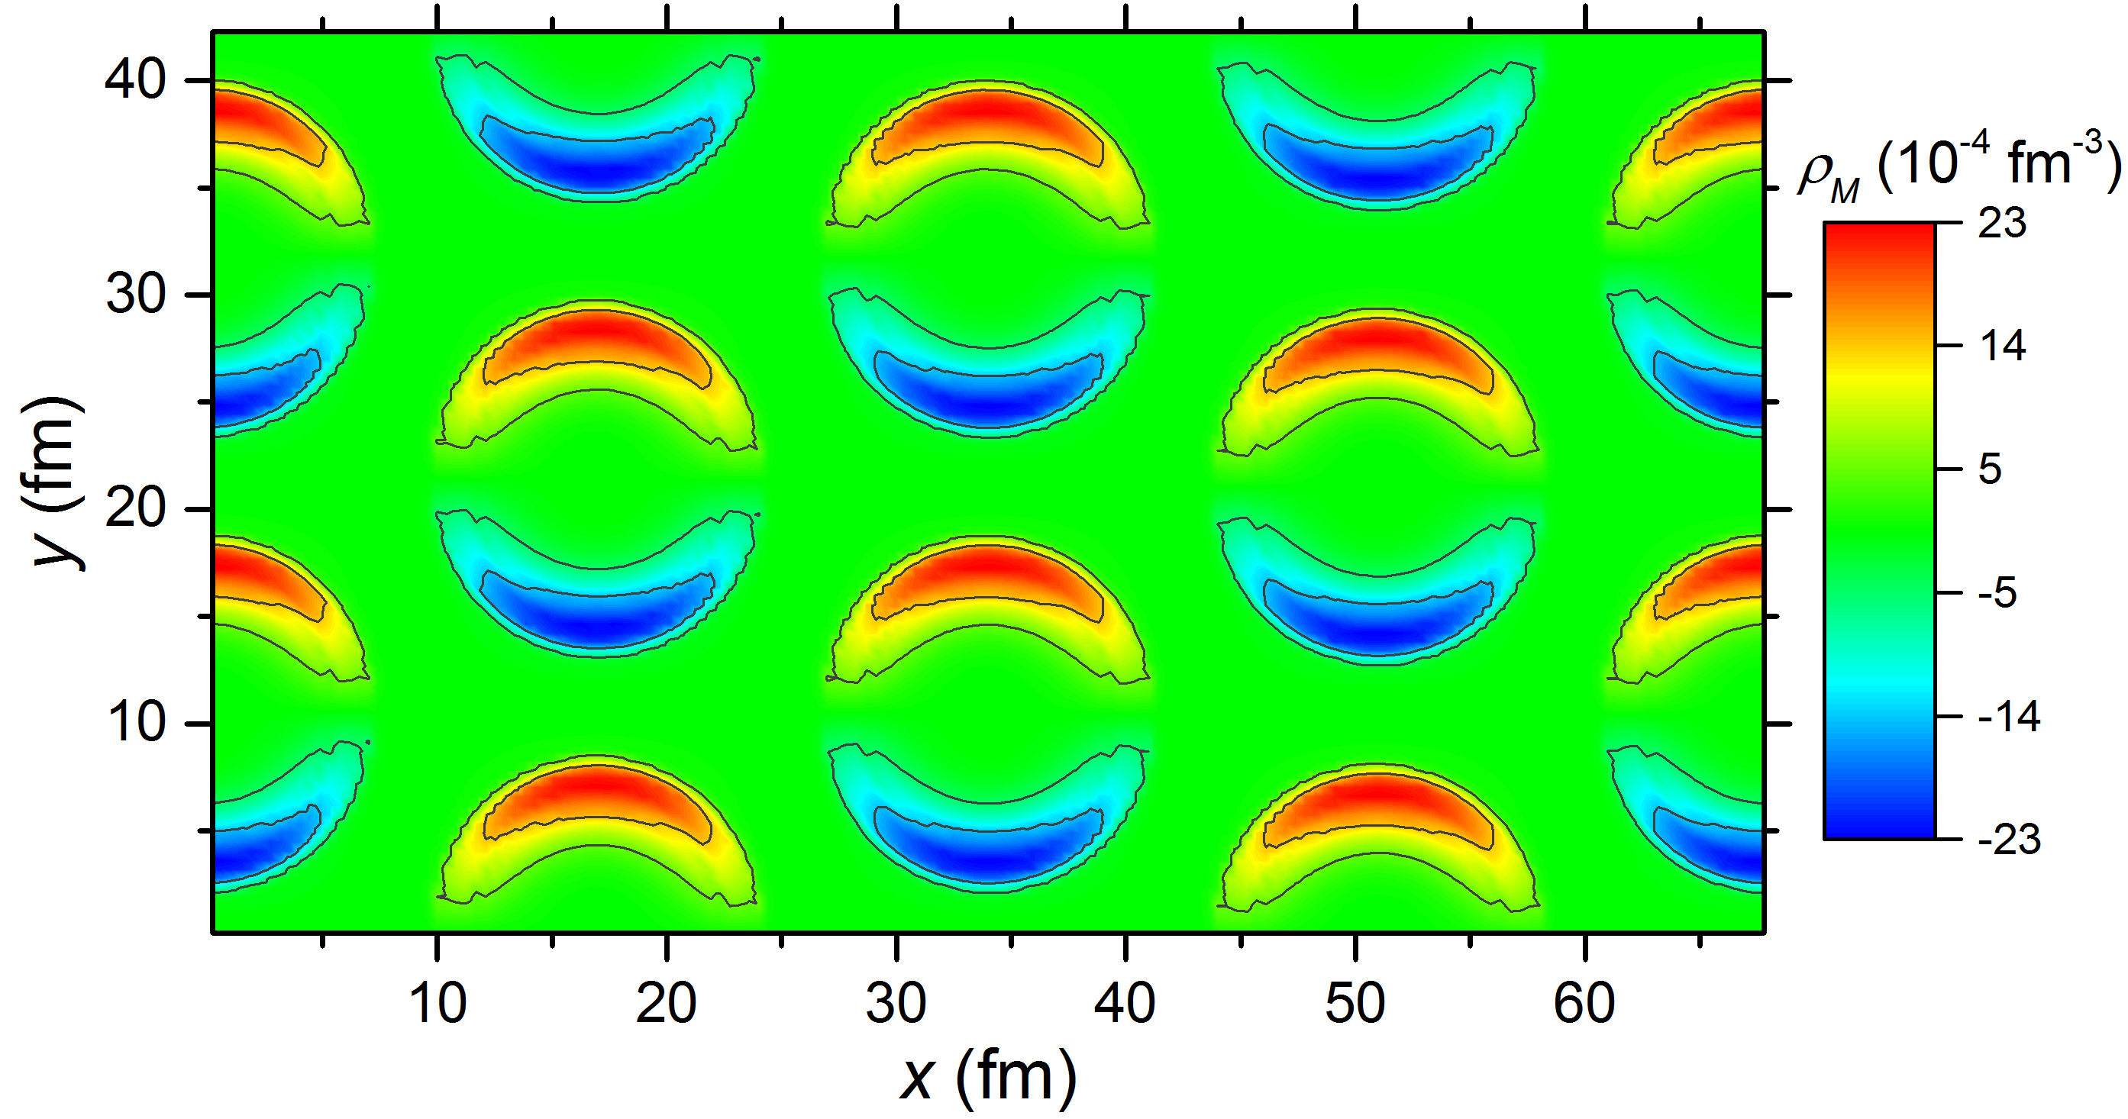
Rod phase at ρ = 0.03 fm⁻³, Y_{p}= 0.5, and B_{0y} = 3×10¹⁸ G
Preliminary

Slide 24
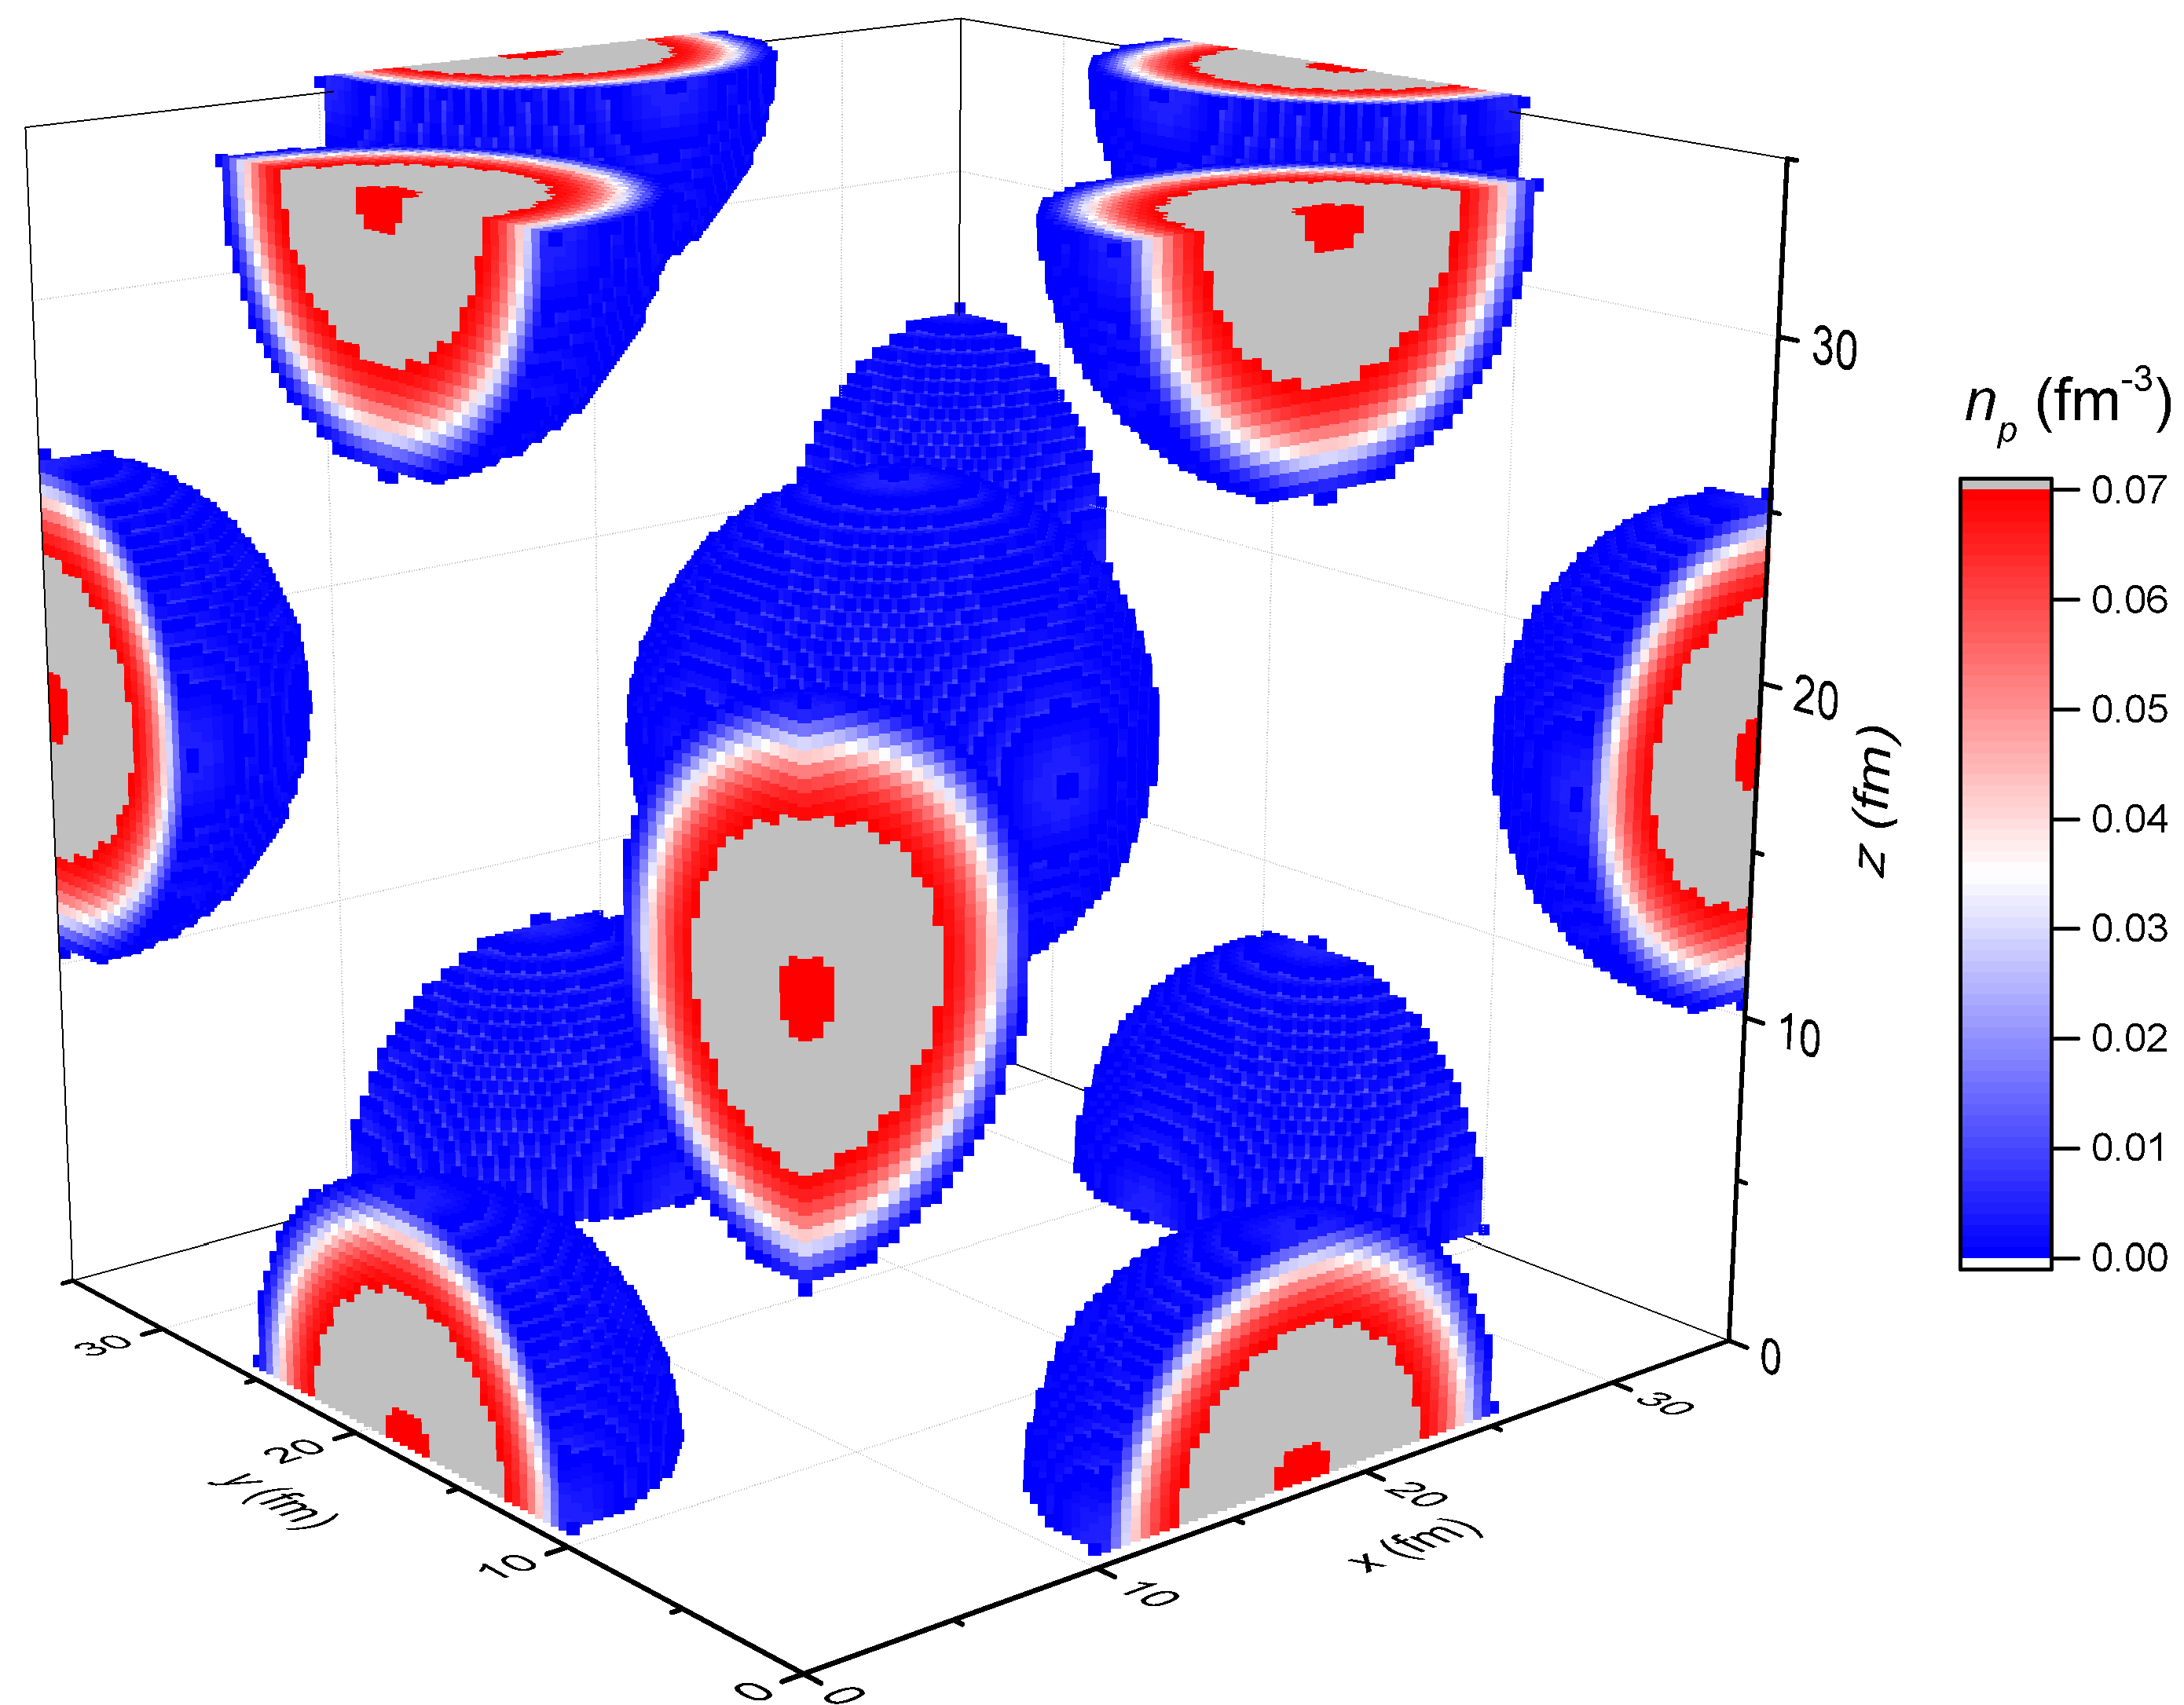
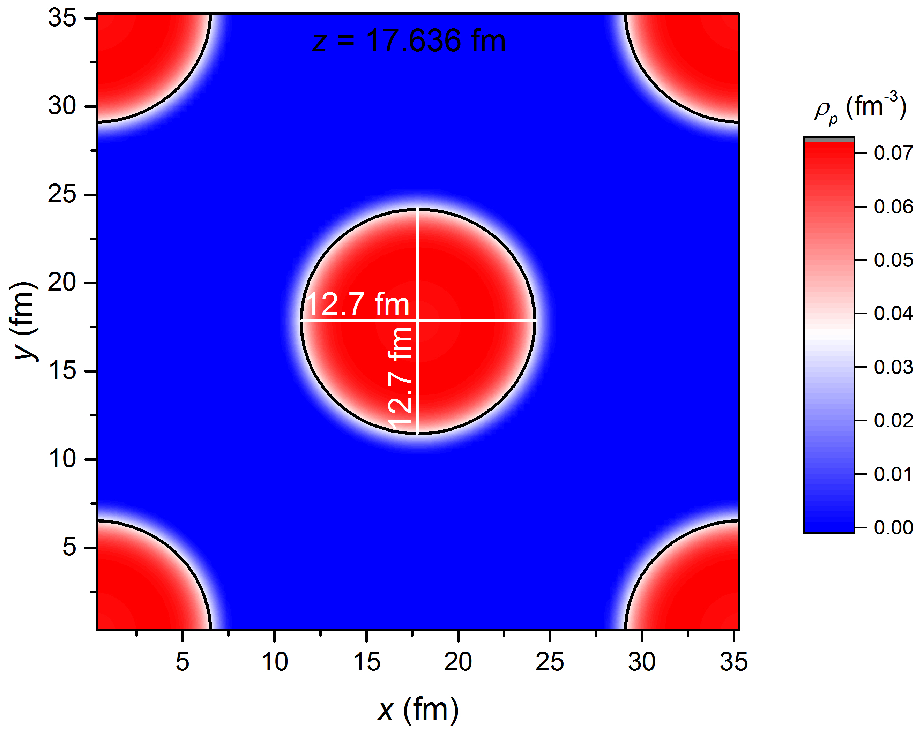
Droplet phase at ρ = 0.014 fm⁻³, Y_{p}= 0.5, and B = 0
X_{cell} = 35.272 fm
Y_{cell} = 35.272 fm
Z_{cell} = 35.272 fm
E/A = 970.98 MeV

Slide 25
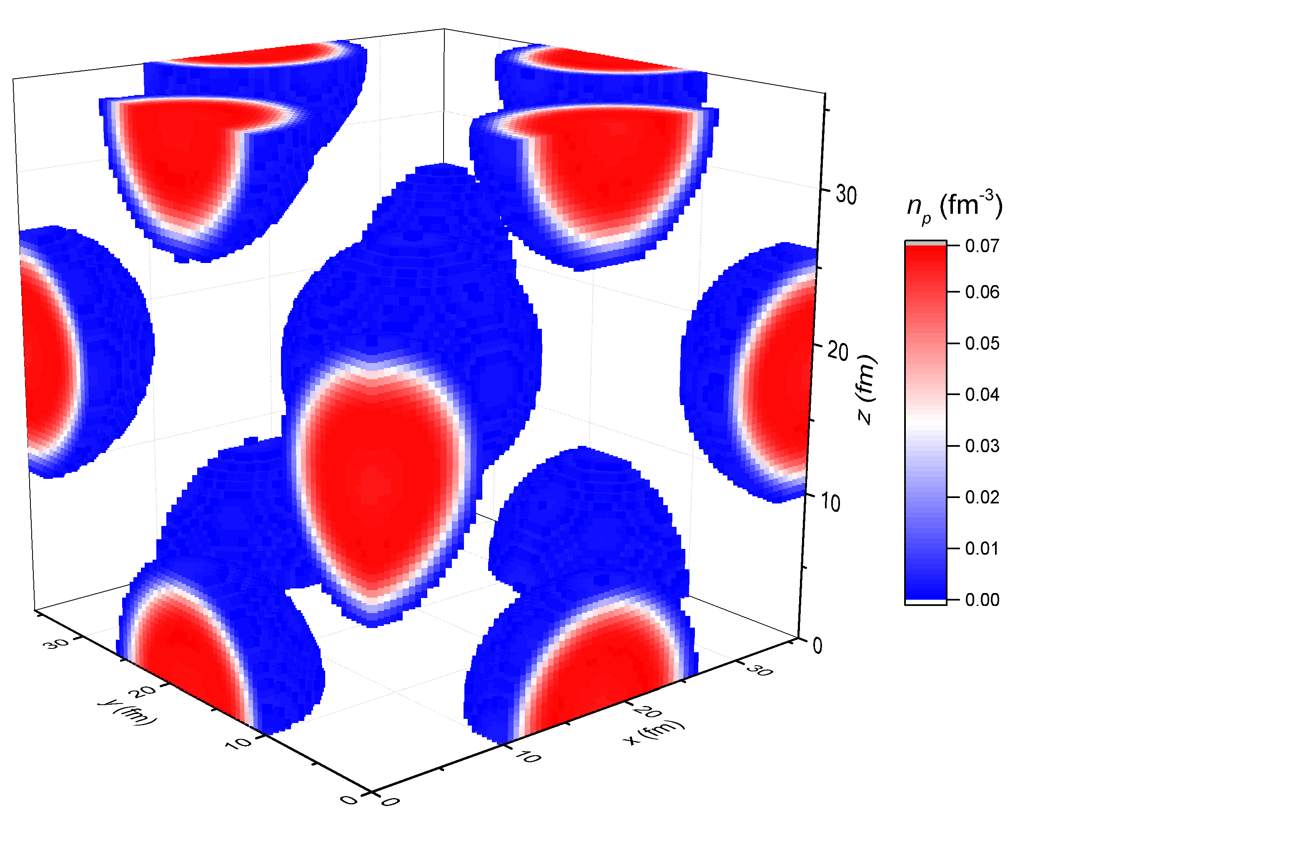
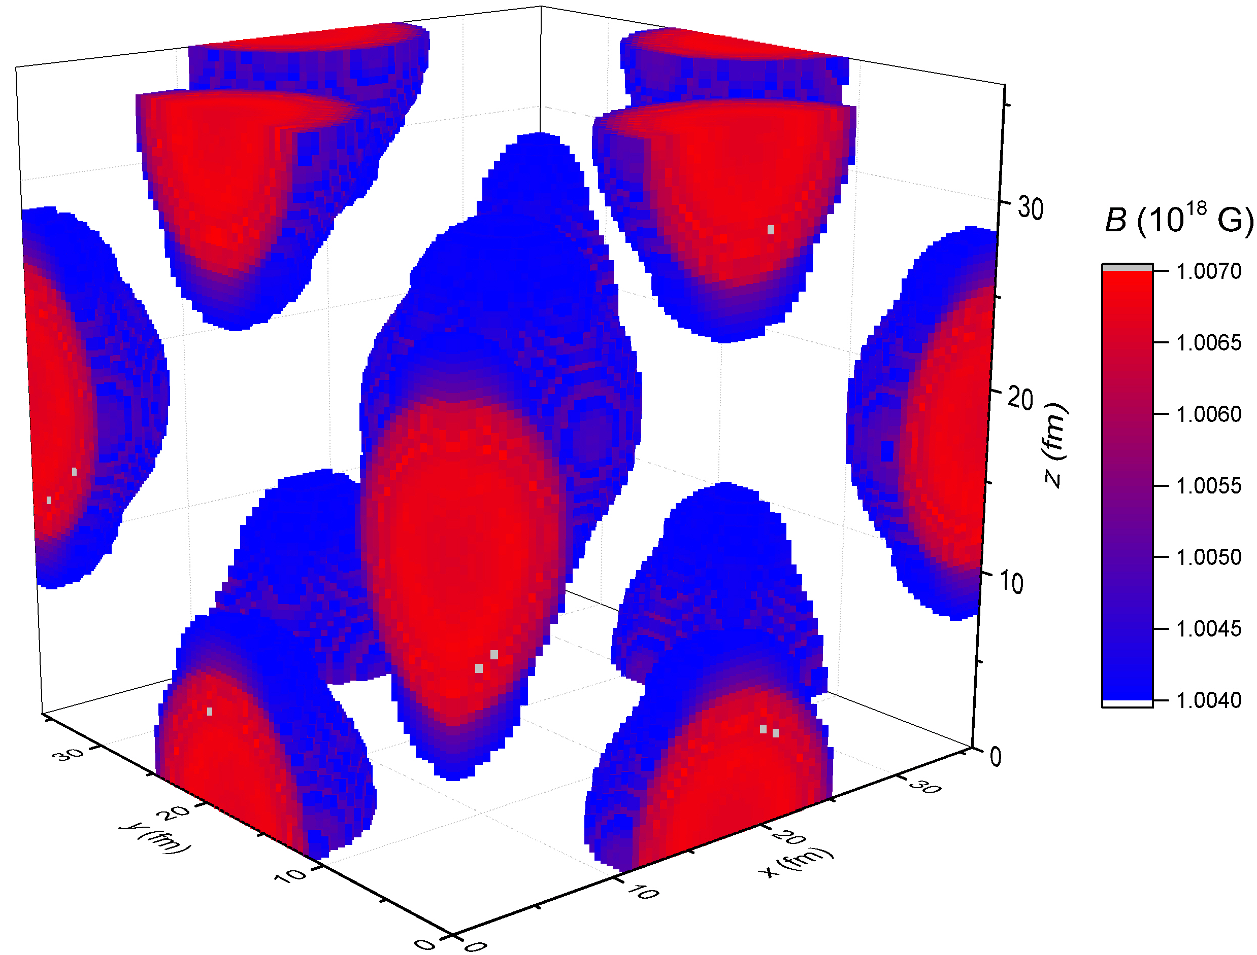
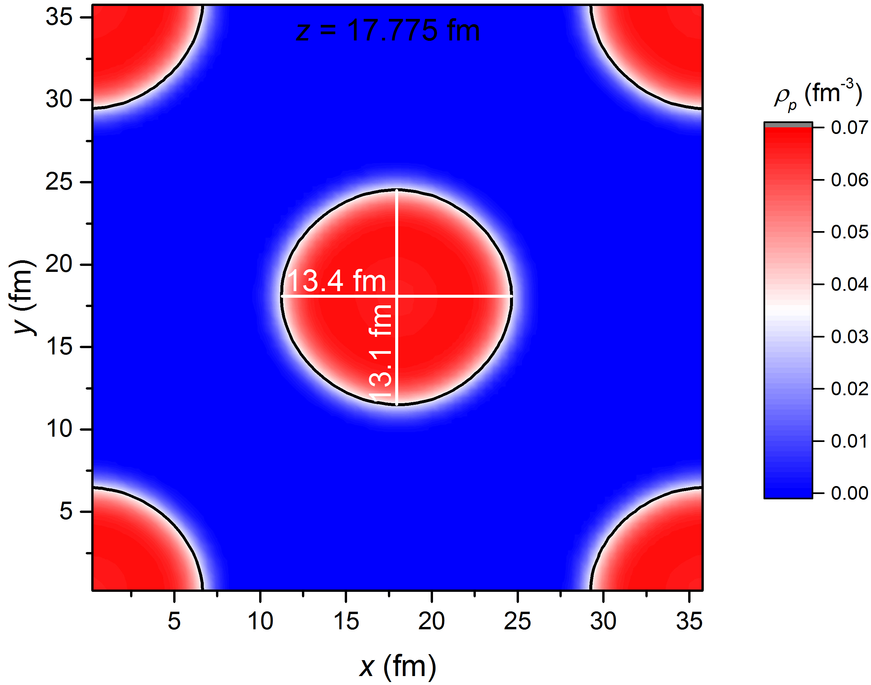
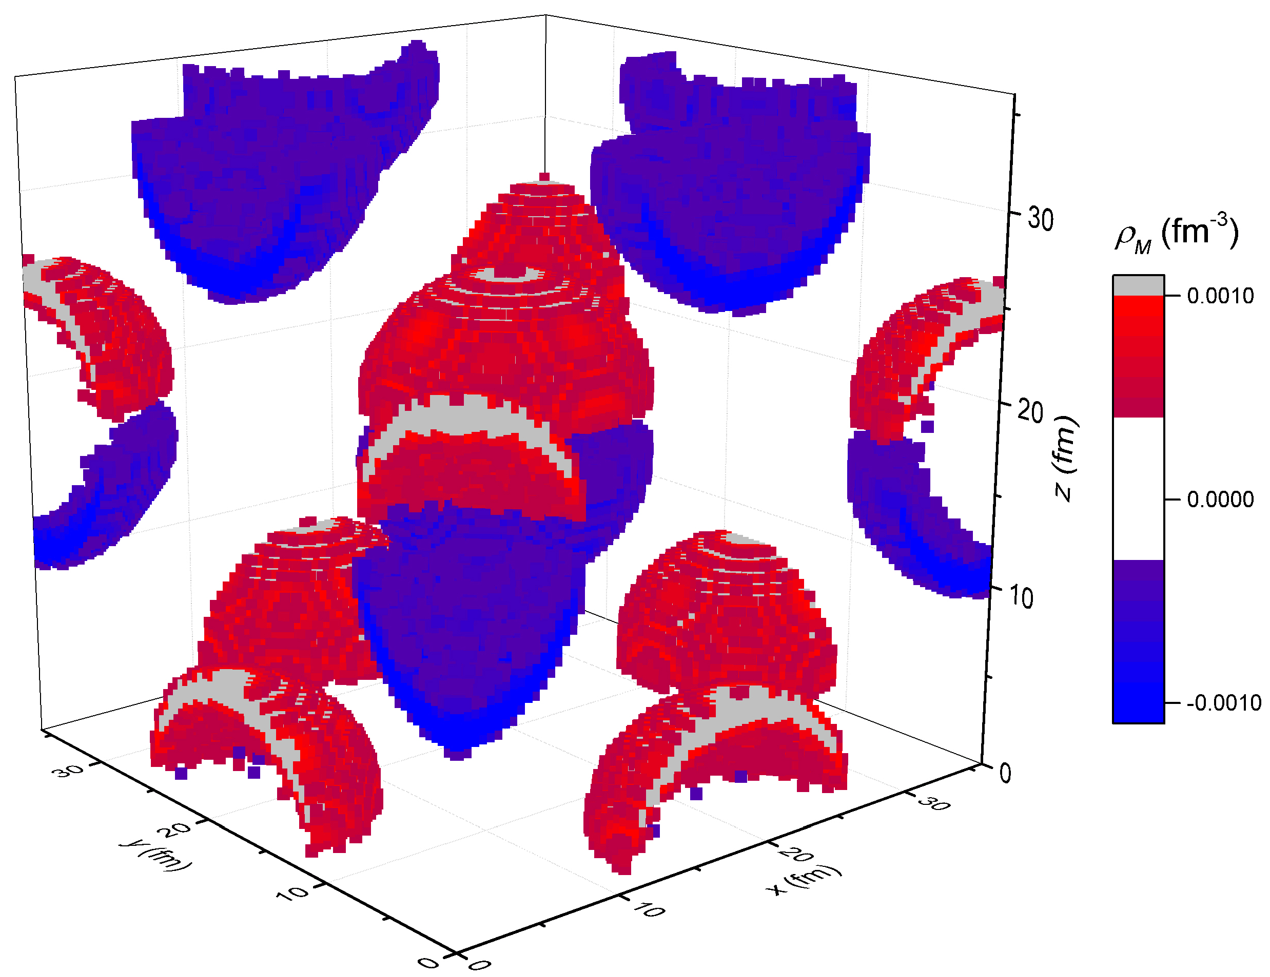

Droplet phase at ρ = 0.014 fm⁻³, Y_{p}= 0.5, and B₀ = 10¹⁸ G
Preliminary
B_{0z} = 10¹⁸ G
E/A = 2750.56 MeV
(E-E_{B})/A = 963.93 MeV

Slide 26
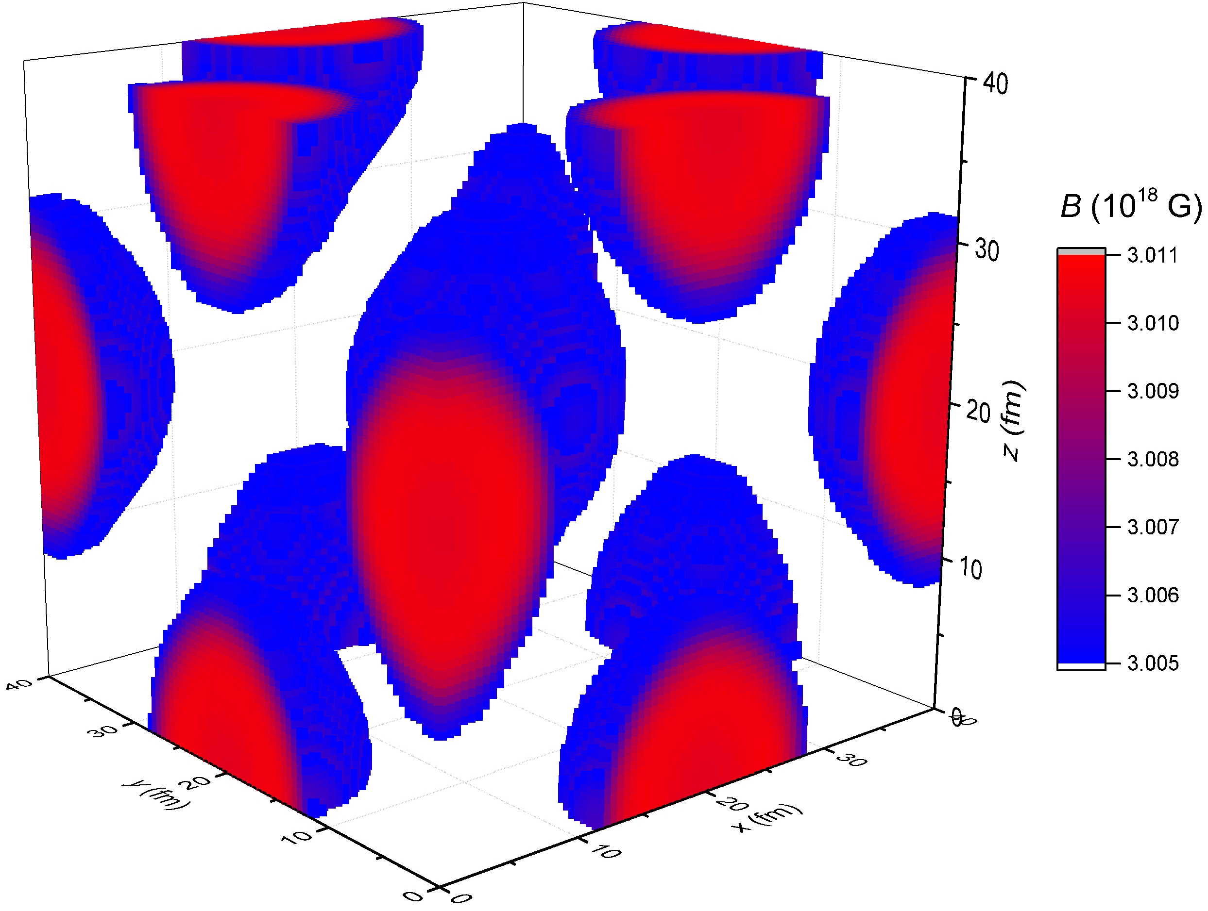
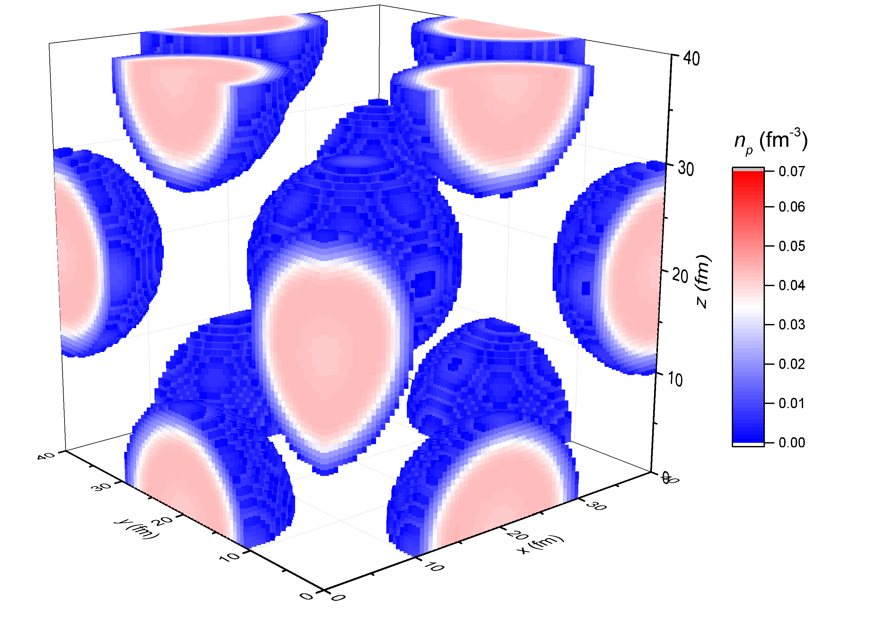
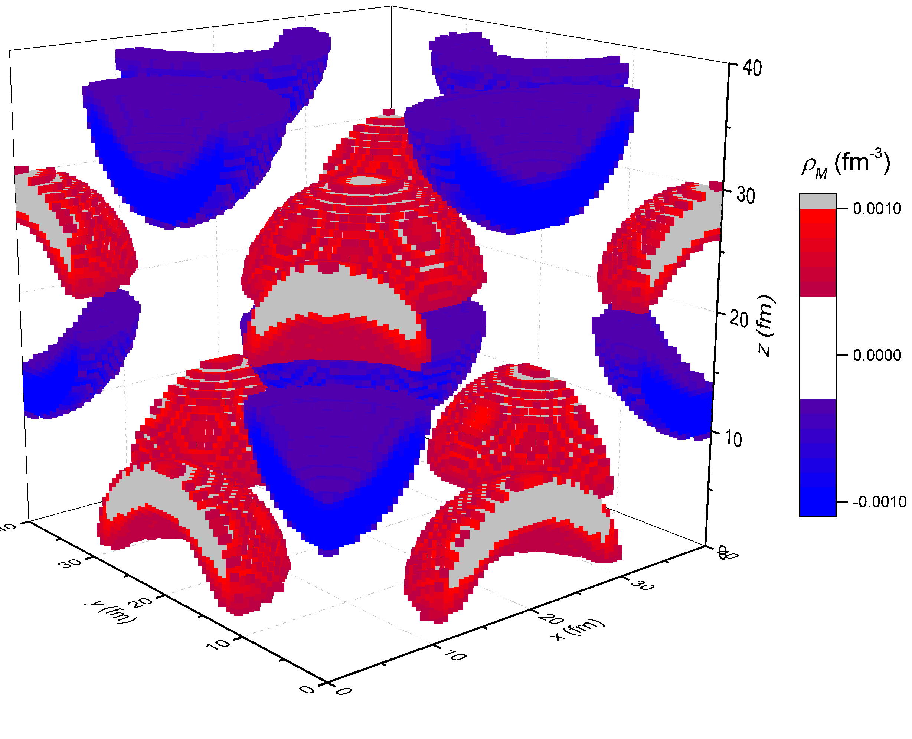
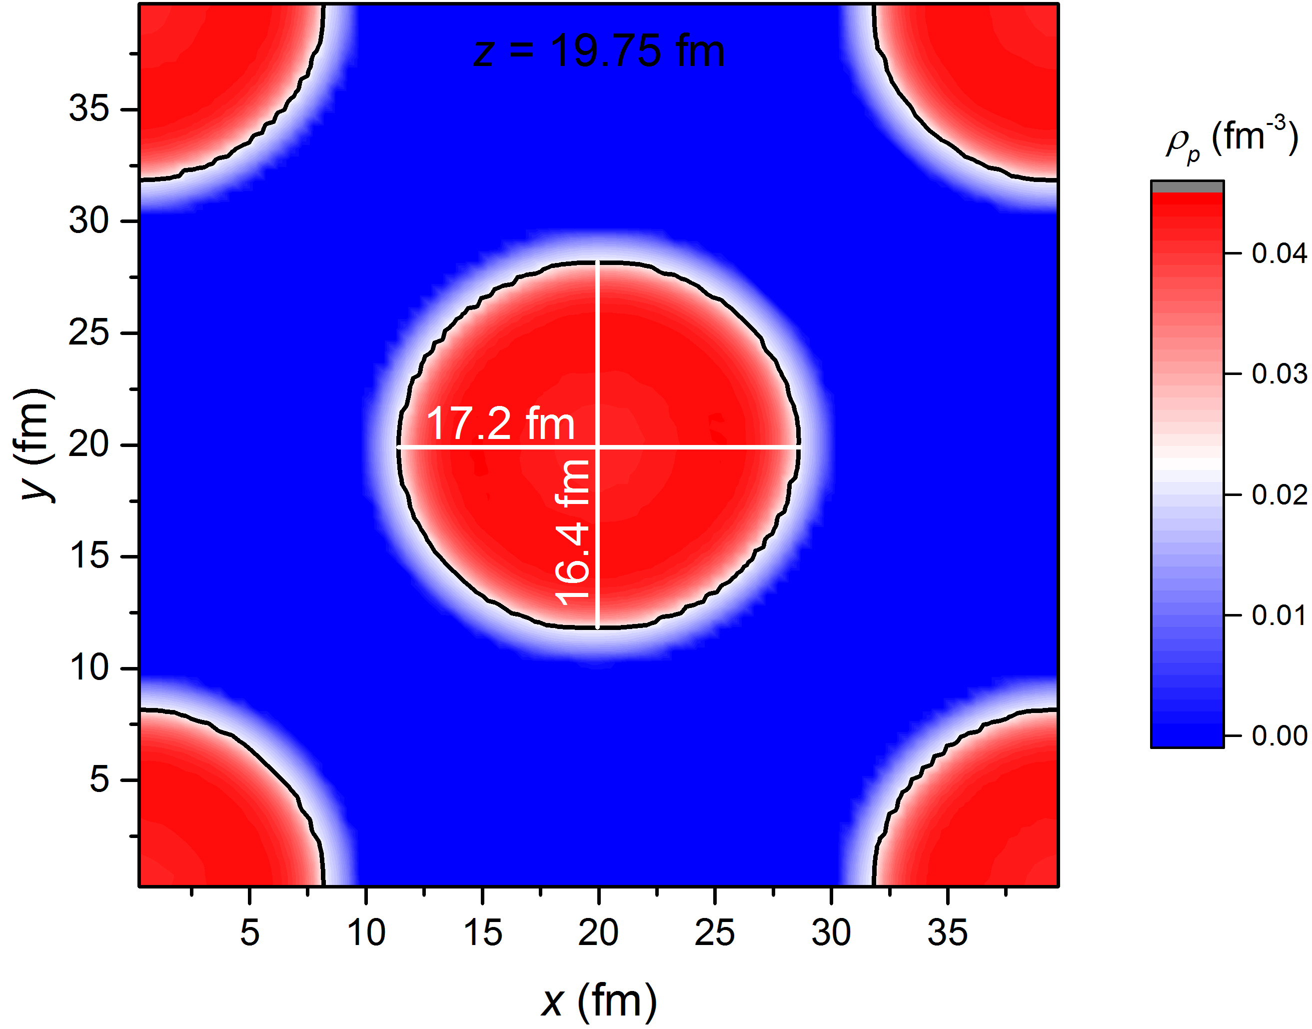

Droplet phase at ρ = 0.014 fm⁻³, Y_{p}= 0.5, and B₀ = 3×10¹⁸ G
Preliminary
B_{0z} = 3×10¹⁸ G
E/A = 16936.84 MeV
(E-E_{B})/A = 929.76 MeV

Slide 27
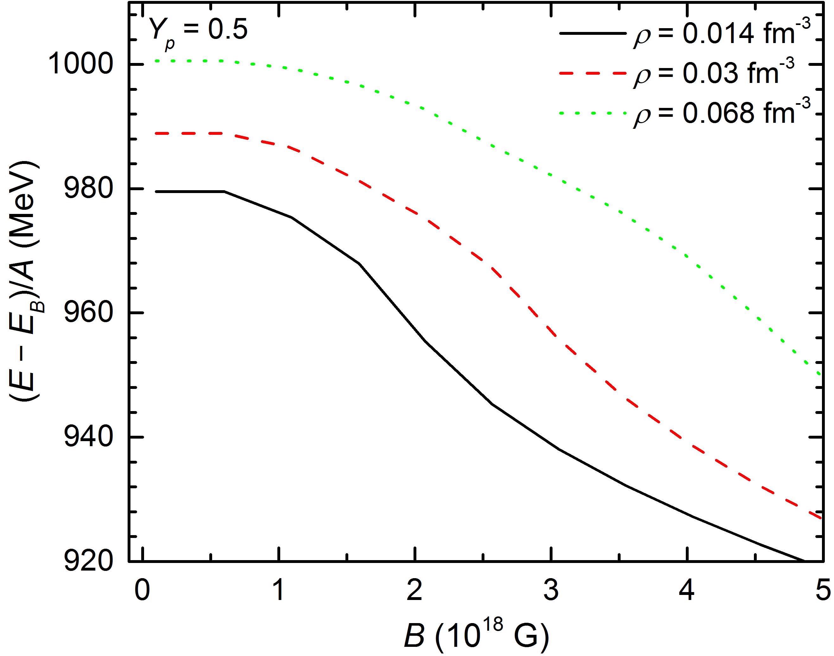
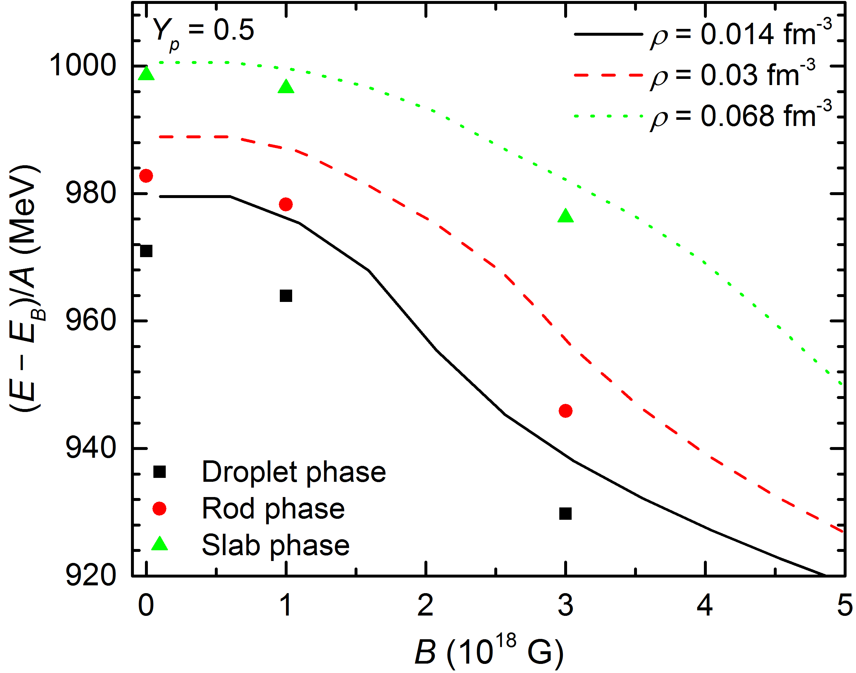
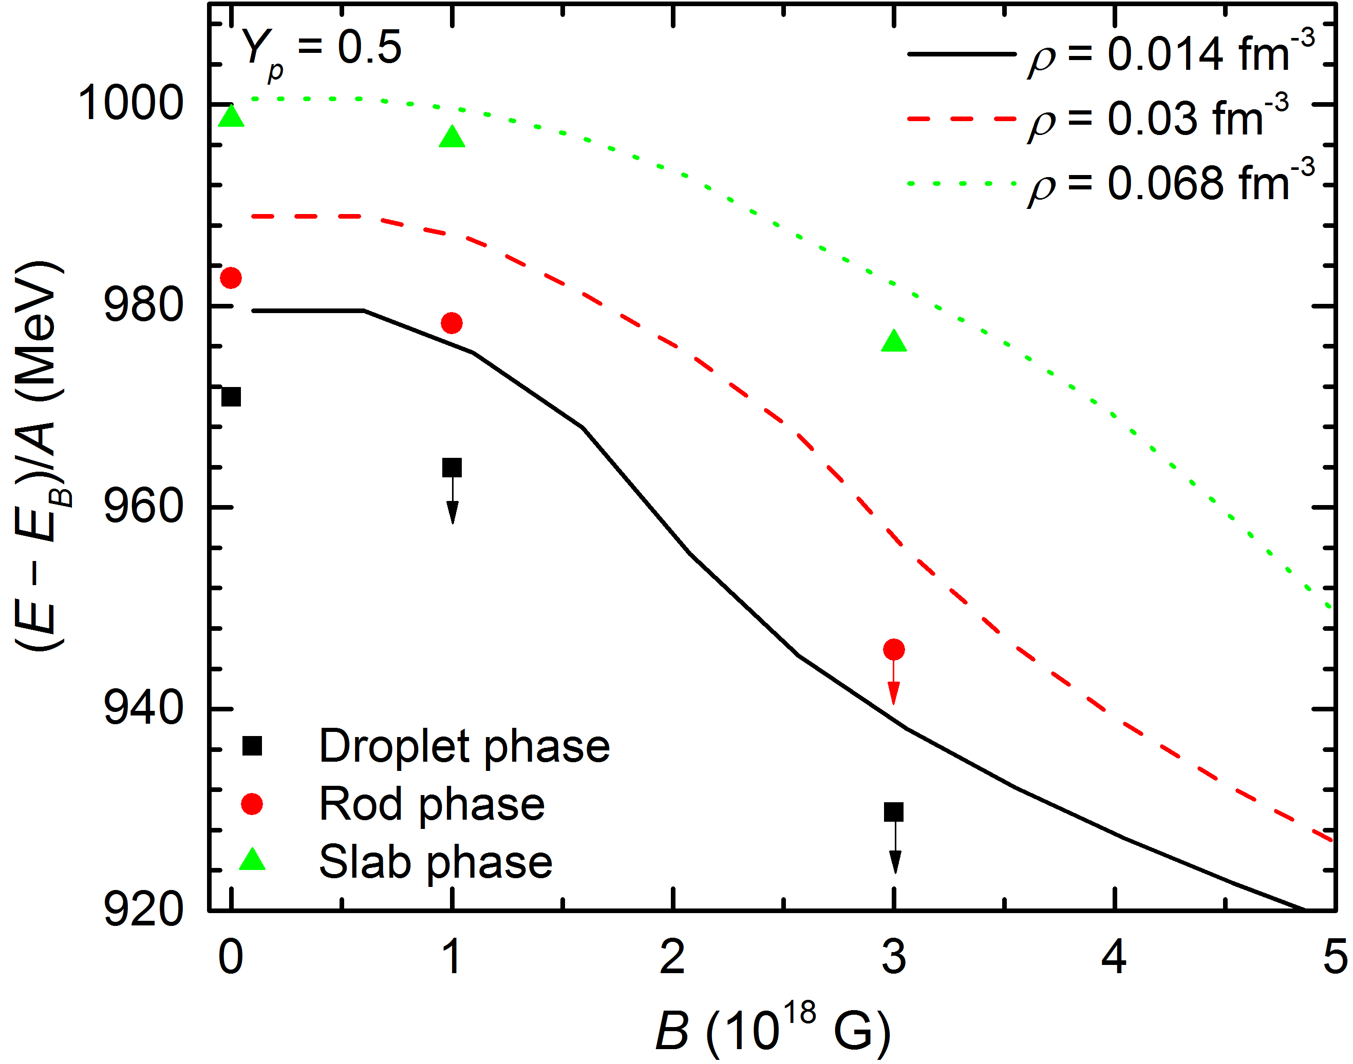
Energy per baryon

Slide 28
Summary
We investigated the nonuniform nuclear matter in a strong magnetic field. It was found that:
The nucleon anomalous magnetic moments (AMM) plays an important role;
The magnetic field is affected by the nonuniform nuclear matter;
The structrue of the pasta phase is altered by the strong magnetic field (geometrical symmetries are broken);
...
Question: What about ordinary nuclei in a strong magnetic field?
Thank you!!!

