Slide 1



Demonstration of mass measurements at the Rare-RI Ring facility
China-Japan collaboration workshop on “Nuclear mass and life for unravelling mysteries of r-process”
June 28th, 2017
Saitama University
Shunichiro Omika
D. Nagae, Y. Abe, Y. Yamaguchi, F. Suzaki,
K. Wakayama, N. Tadano, R. Igosawa, K. Inomata, Y. Arakawa,
K. Nishimuro, T. Fujii, T. Mitsui, T. Yamaguchi, T. Suzuki,
S. Suzuki, T. Moriguchi, M. Amano, D. Kamioka, A. Ozawa,
S. Naimi, Z. Ge, Y. Yanagisawa, H. Suzuki, H. Baba, S. Michimasa,
S. Ota, G. Lorusso, Yu.A. Litvinov, M. Wakasugi, T. Uesaka, and Y. Yano

Slide 2
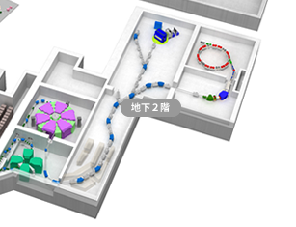
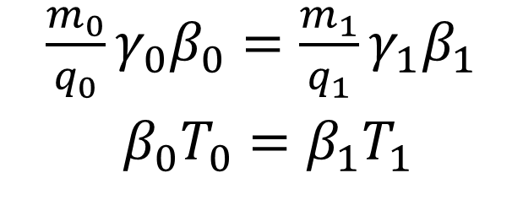
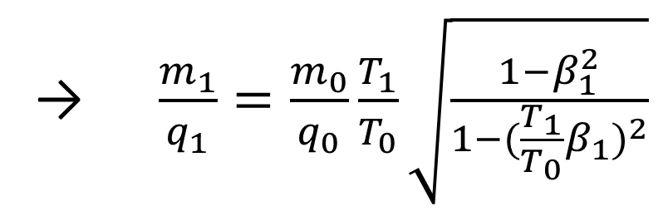
Introduction
RIBF@RIKEN
Rare-RI Ring
Overview of Rare-RI Ring is presented by A. Ozawa
・Rare RI Ring is a device for the precise mass
measurements for short-lived nuclei.
・ The magnetic field in the ring is adjusted to
be isochronous by using trim coils.
・Rare RI Ring aims precision of mass determination
better than 10⁻⁶ with less than ～1 ms measurement time.
SHARAQ
BigRIPS
$\frac{m_{0}}{q_{0}}γ_{0}β_{0}=\frac{m_{1}}{q_{1}}γ_{1}β_{1}$
$β_{0}T_{0}=β_{1}T_{1}$
→ $\frac{m_{1}}{q_{1}}=\frac{m_{0}}{q_{0}}\frac{T_{1}}{T_{0}}\sqrt{\frac{1−β_{1}^{2}}{1−{(\frac{T_{1}}{T_{0}}β_{1})}^{2}}}$
m/q : charge to mass ratio
T : revolution time
Index
0 : particle of reference
1 : particle of interest
1/15

Slide 3
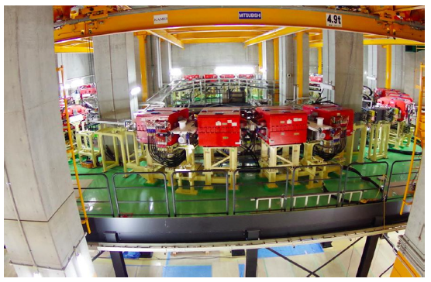
Commissioning experiments
2015
- First machine study (MS01) using ⁷⁸Kr beam in June.
- Establishment of the self-trigger injection method.
- Succeeded in storage of single-ion.
- Confirmation of trim-coils effects after extraction.
→Extraction efficiency ~1%
- Second machine study (MS02) using ³⁶Ar and ³⁵Cl in Dec.
- Injection / Extraction of two nuclei in the same setting.
- Demonstrate the feasibility of mass measurement.
2016
- Third machine study (MS03) using ⁷⁸Ge,⁷⁷Ga,⁷⁶Zn, etc. in Nov.
- Injection/Extraction many nuclei.
- Check the performance of R3.
2/15

Slide 4
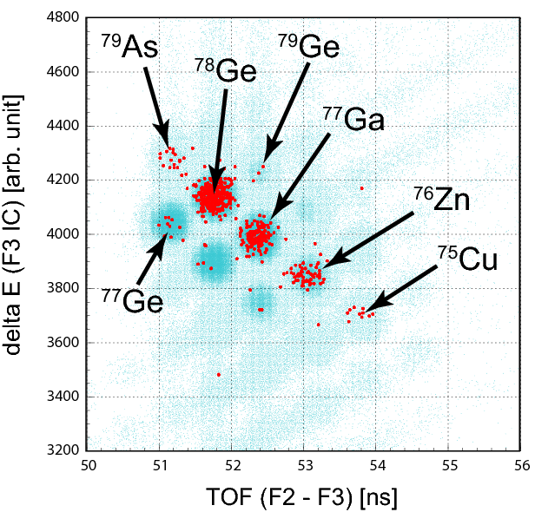
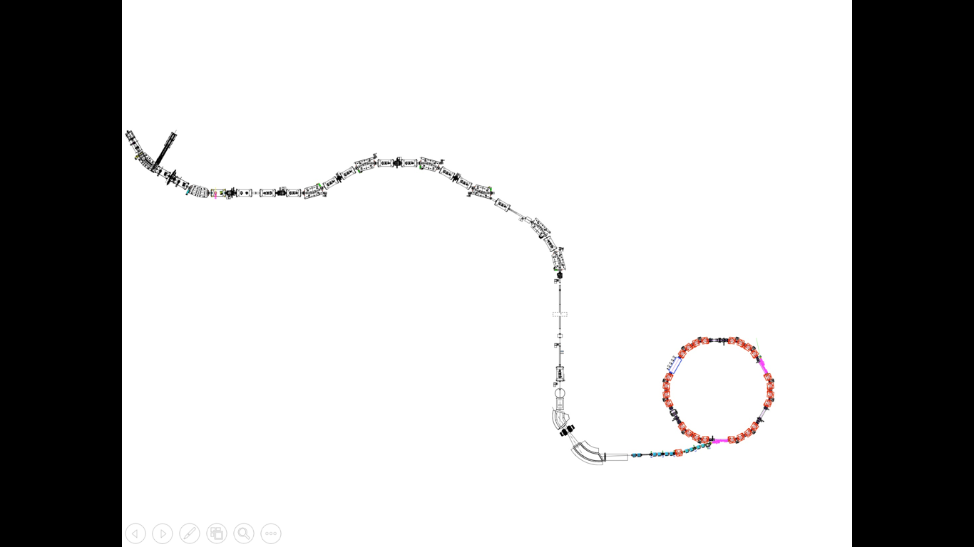

3rd experiment setup
²³⁸U Beam @345MeV/u
From SRC
F6
PPAC
F2
F3
→Momentum determination
F0
Be Target
10 mm²
Blue : PID@BigRIPS
Red : Extracted Events
Pla
Pla
PPAC
IC
ToF measurement
→ β determination
ELC
$$\frac{m_{1}}{q_{1}}=\frac{m_{0}}{q_{0}}\frac{T_{1}}{T_{0}}\sqrt{\frac{1−β_{1}^{2}}{1−{(\frac{T_{1}}{T_{0}}β_{1})}^{2}}}$$
Pla
MCP + foil
S0
ToF measurement
→ Circulation time determination
3/15

Slide 5
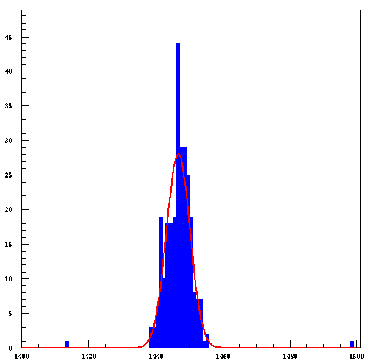
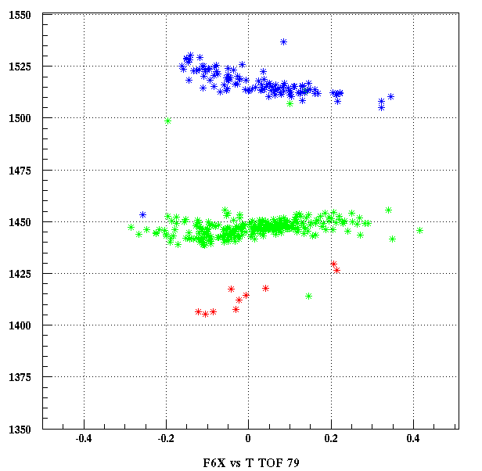
Time of flight in Rare-RI Ring (S0 -> ELC)
The Isochronous filed of R3 is tuned by ⁷⁸Ge with 175 MeV/nucleon.
Count
701750
78Ge
77Ga
40
701700
701650
30
701600
78Ge
701550
ToF_{S0->ELC} [ns]
20
701500
701450
10
79As
701400
Preliminary
701350
0
-0.4
-0.2
0.0
0.2
0.4
701400
701420
701440
701460
701480
701500
momentum@F6 [%]
ToF_{S0->ELC} [ns]
4/15

Slide 6
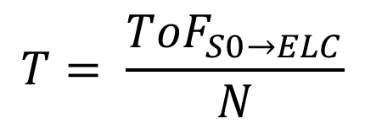
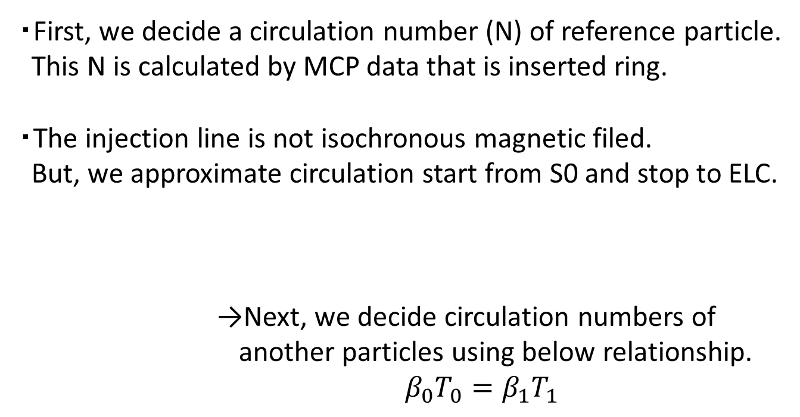
Circulation time
・First, we decide a circulation number (N) of reference particle.
This N is calculated by MCP data that is inserted ring.
・The injection line is not isochronous magnetic filed.
But, we approximate circulation start from S0 and stop to ELC.
→Next, we decide circulation numbers of
another particles using below relationship.
$β_{0}T_{0}=β_{1}T_{1}$
$$T= \frac{{ToF}_{S0→ELC}}{N}$$
RI Beam
From BigRIPS
ELC
S0
MCP + foil
5/15

Slide 7
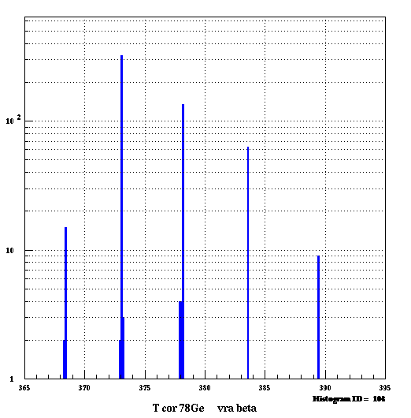
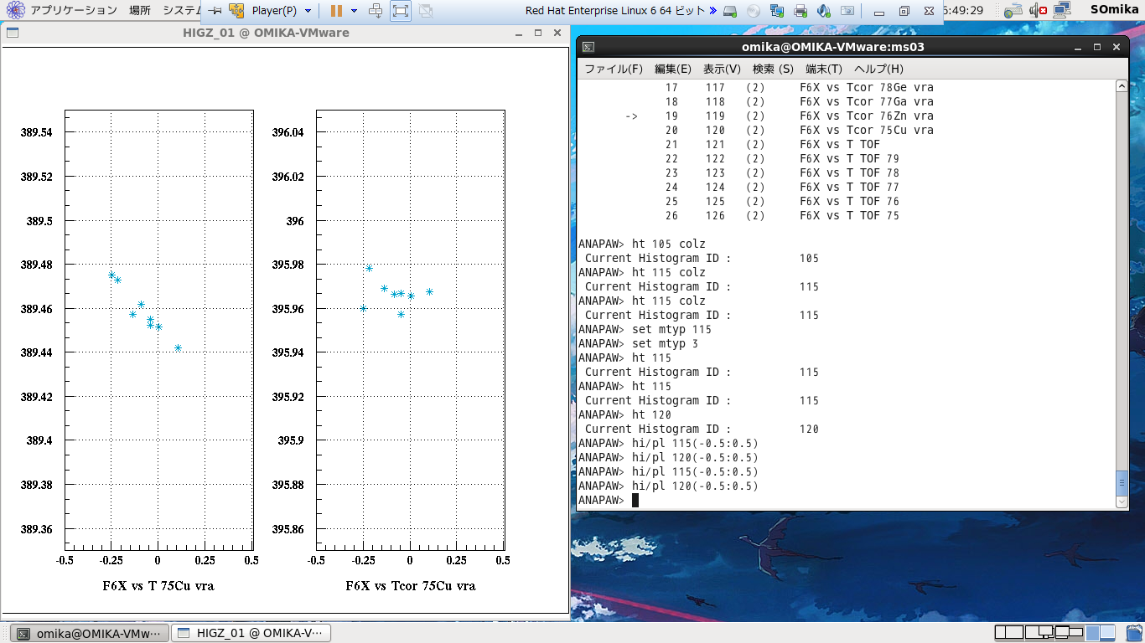
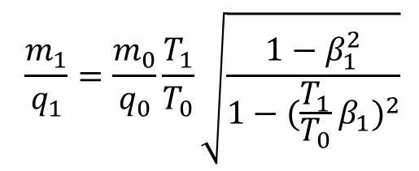
Correction circulation time
$$\frac{m_{1}}{q_{1}}=\frac{m_{0}}{q_{0}}\frac{T_{1}}{T_{0}}\sqrt{\frac{1−β_{1}^{2}}{1−{(\frac{T_{1}}{T_{0}}β_{1})}^{2}}}$$
Count
⁷⁸Ge
Correction circulation time
⁷⁷Ga
Correction
10²
⁷⁶Zn
389.52
Ex)⁷⁵Cu
396.02
⁷⁹As
389.48
395.98
⁷⁵Cu
10
Circulation time [ns]
395.94
389.44
Correction circulation time [ns]
RMS
0.010 [ns]
RMS
0.0057 [ns]
389.40
395.90
389.36
395.86
1
365
370
375
380
385
390
395
-0.5
0
0.5
-0.5
0
0.5
Correction circulation time [ns]
momentum@F6 [%]
momentum@F6 [%]
6/15

Slide 8
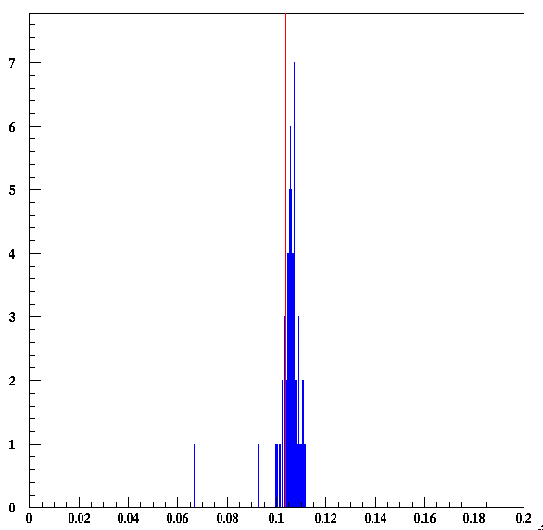
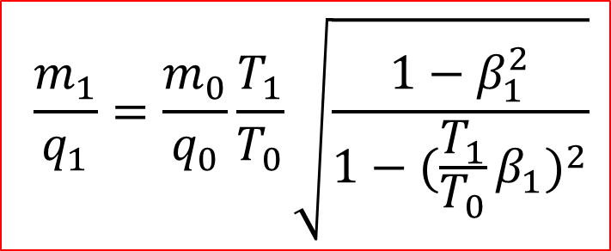
m/q spectrum
AME2012
2.4810389
Count
$$\frac{m_{1}}{q_{1}}=\frac{m_{0}}{q_{0}}\frac{T_{1}}{T_{0}}\sqrt{\frac{1−β_{1}^{2}}{1−{(\frac{T_{1}}{T_{0}}β_{1})}^{2}}}$$
Ex) ⁷⁷Ga
6
4
In this talk, definition ‘Accuracy’ as | (m/q_{exp}-m/q_{AME2012}) / m/q_{AME2012} |
About particles close to the nucleus as a reference,
‘Accuracy’ achieve ～10⁻⁶
2
Preliminary
0
0
0.04
0.08
0.12
0.16
0.2
⁷⁷Ga m/q – 2.48
7/15

Slide 9

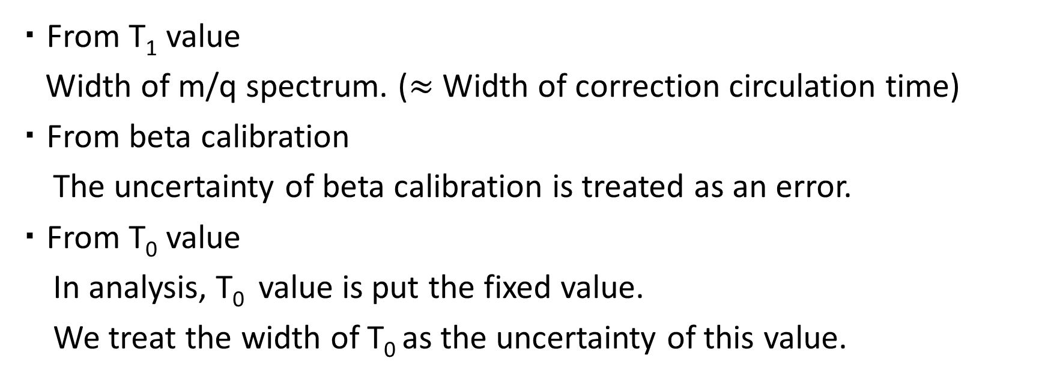
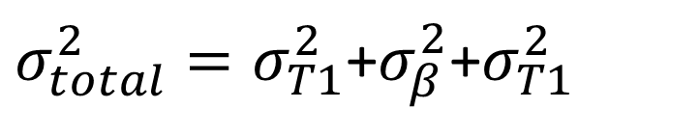
Error estimation
$$\frac{m_{1}}{q_{1}}=\frac{m_{0}}{q_{0}}\frac{T_{1}}{T_{0}}\sqrt{\frac{1−β_{1}^{2}}{1−{(\frac{T_{1}}{T_{0}}β_{1})}^{2}}}$$
・ From T₁ value
Width of m/q spectrum. ($≈$ Width of correction circulation time)
・ From beta calibration
The uncertainty of beta calibration is treated as an error.
・ From T₀ value
In analysis, T₀ value is put the fixed value.
We treat the width of T₀ as the uncertainty of this value.
$σ_{total}^{2}=σ_{T1}^{2}$+$σ_{β}^{2}$+$σ_{T1}^{2}$
8/15

Slide 10

Error from correction T₁
$$\frac{m_{1}}{q_{1}}=\frac{m_{0}}{q_{0}}\frac{T_{1}}{T_{0}}\sqrt{\frac{1−β_{1}^{2}}{1−{(\frac{T_{1}}{T_{0}}β_{1})}^{2}}}$$
Count
Ex) ⁷⁷Ga
6
The width of m/q spectrum is reflected
the width of correction circulation time.
We define σ_{T1} as RMS / m/q_{exp .}
4
2
Preliminary
0
0
0.04
0.08
0.12
0.16
0.2
⁷⁷Ga m/q – 2.48
9/15

Slide 11
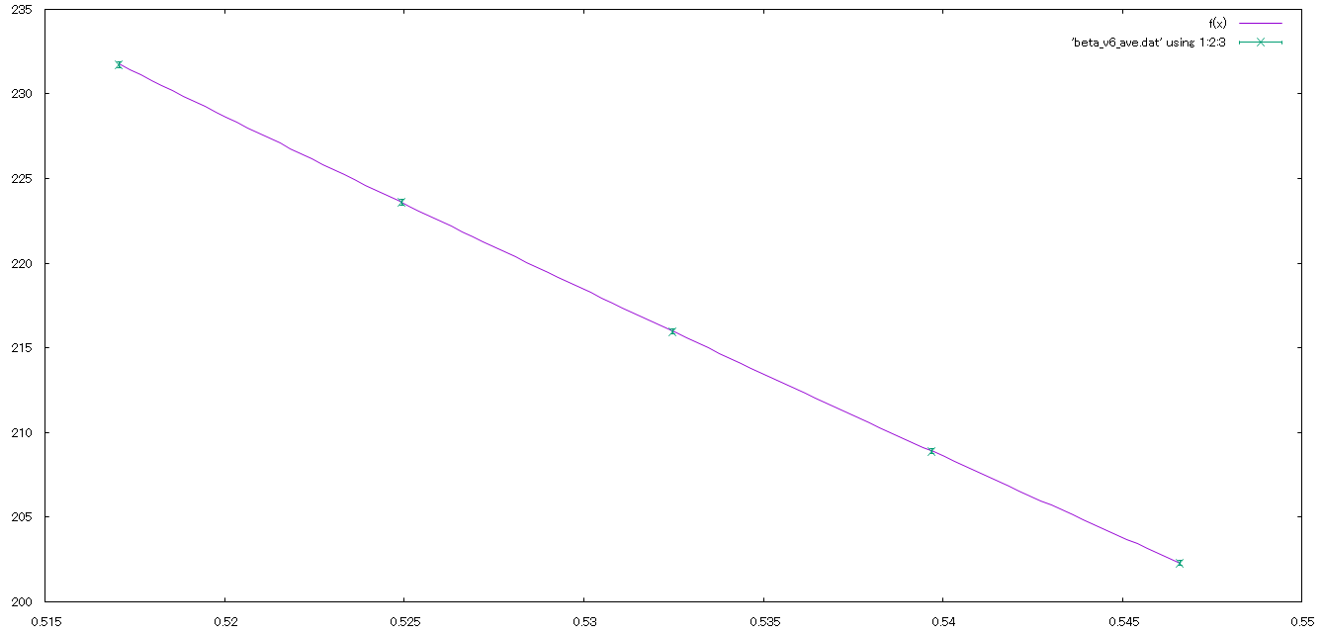

Error from uncertainty of beta
D4
4.8476 Tm
D5
4.8477 Tm
F3
D-H7
4.8467 Tm
Average Brho
4.84934 [Tm]
RMS of Brho
0.00410 [Tm]
D3
4.8575 Tm
We calibrate beta by ToF_{F3->S0} and Brho.
But, Brho value has deviation.
An error from uncertainty of Brho means
an uncertainty beta calibration.
We evaluate this error as how change m₁/q₁
using average Brho or Brho + δBrho.
D-H8
4.8472 Tm
S0
$$\frac{m_{1}}{q_{1}}=\frac{m_{0}}{q_{0}}\frac{T_{1}}{T_{0}}\sqrt{\frac{1−β_{1}^{2}}{1−{(\frac{T_{1}}{T_{0}}β_{1})}^{2}}}$$
10/15

Slide 12
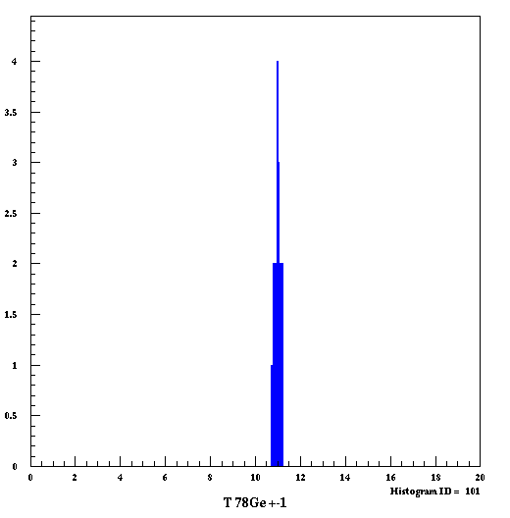
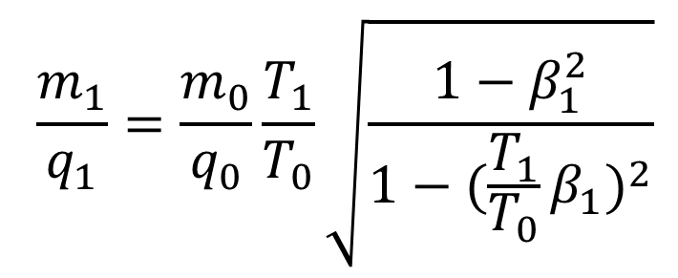
Error from uncertainty of T₀
Count
$$\frac{m_{1}}{q_{1}}=\frac{m_{0}}{q_{0}}\frac{T_{1}}{T_{0}}\sqrt{\frac{1−β_{1}^{2}}{1−{(\frac{T_{1}}{T_{0}}β_{1})}^{2}}}$$
4
3
To calculate m₁/q₁, T₀ is fixed value.
An Error from uncertainty of T₀ is
estimated by changing T₀ value, and
Check how much change m₁/q_{1.}
2
1
Preliminary
0
373.0
373.04
373.08
373.12
373.16
373.2
⁷⁸Ge Circulation time [ns]
11/15

Slide 13
For future experiment
・ Improvement Brho error
→ To calculate beta, measure transport matrix elements and
decide path length by trajectory reconstruction.
(In MS03 experimental setup, we can’t reconstruction)
・ Improvement efficiency
→ In MS03, extraction efficiency is ～0.1% (comparison F3 events).
To increase efficiency, tuning of injection line more optimum.
・Improvement ToF counter
→ S. Suzuki Talk
For improvement above problem,
We are developing the position sensitive MCP + Foil detector.
13/15

Slide 14
Summary
・3rd commissioning experiment has been done
to check the performance of Rare-RI Ring.
・As a reference particle for isochronous field, we used ⁷⁸Ga@175MeV/nucleon.
・The isochronous filed in ring achieve 5.0×10⁻⁶ .
・In particles close to the nucleus as a reference, ‘Accuracy’ achieve ～10⁻⁶.
・Precision is ～10⁻⁵.
14/15

